Slide 1
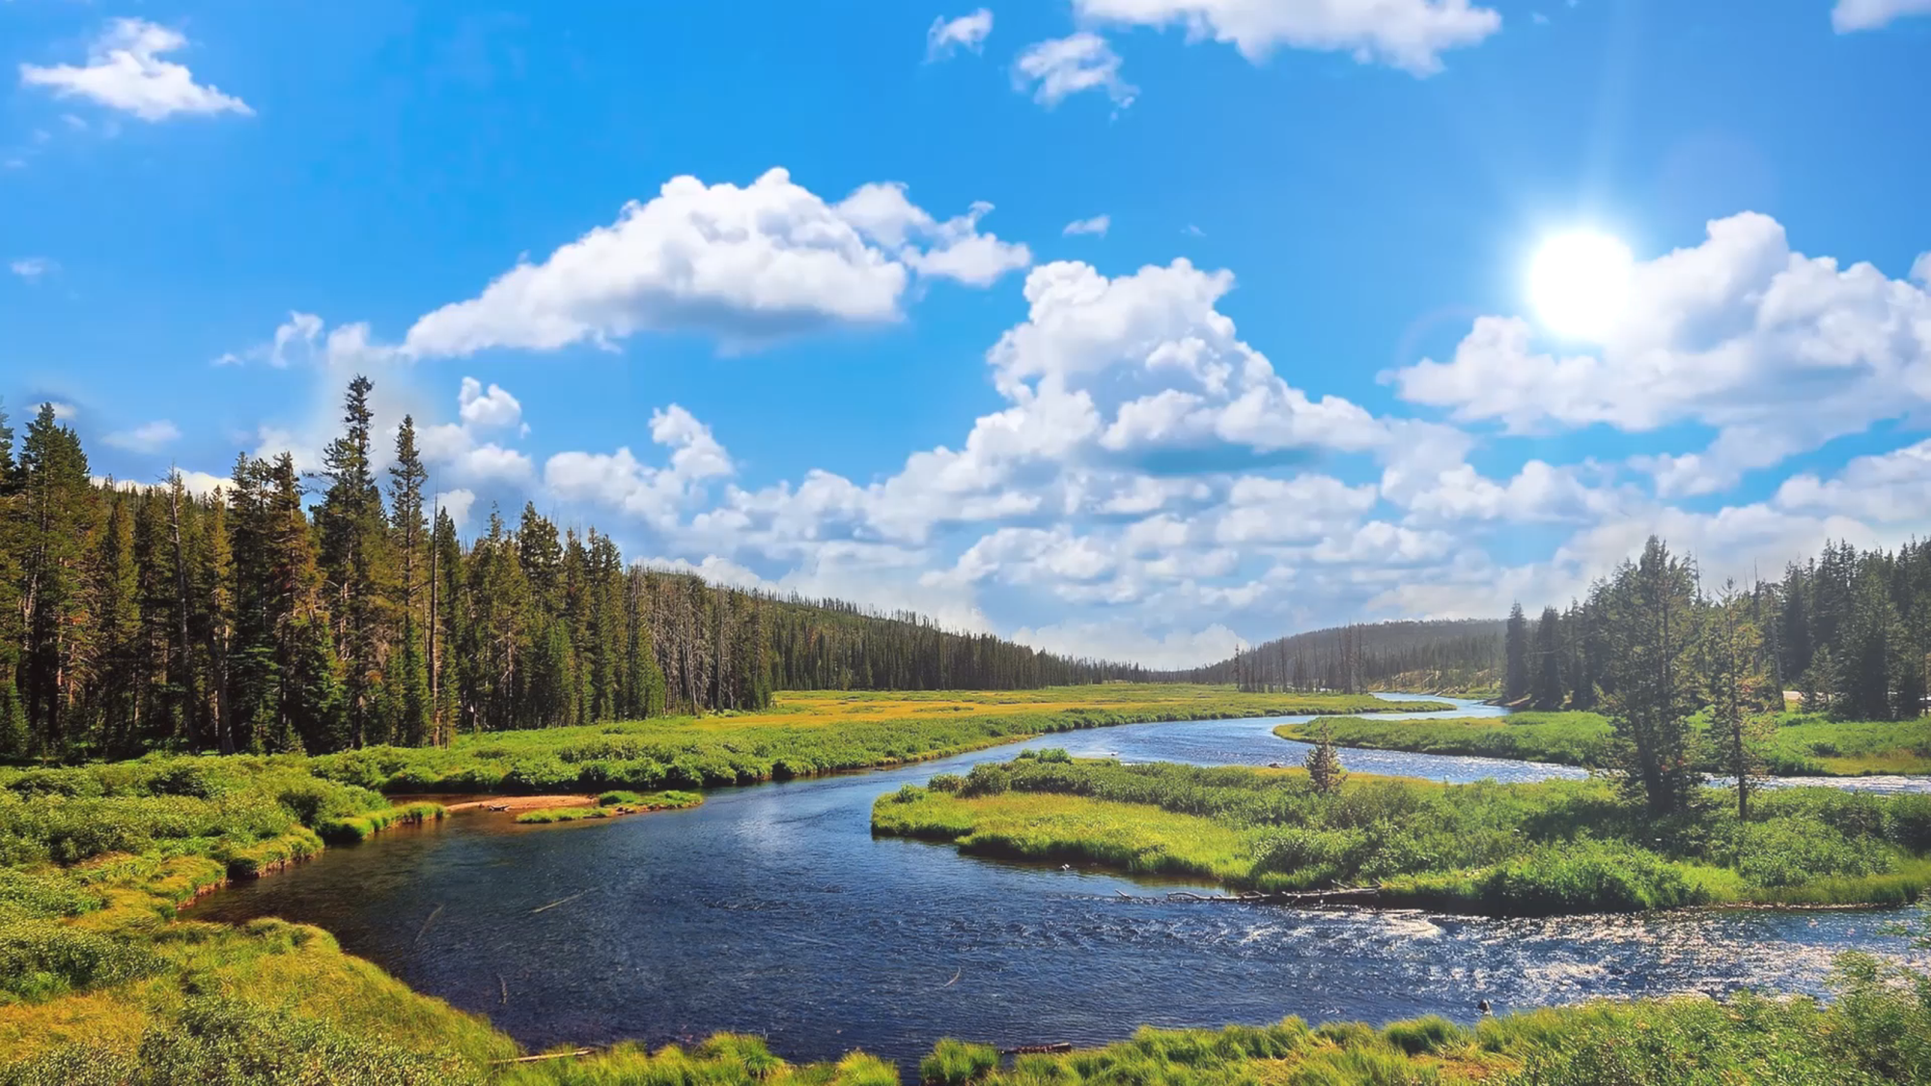
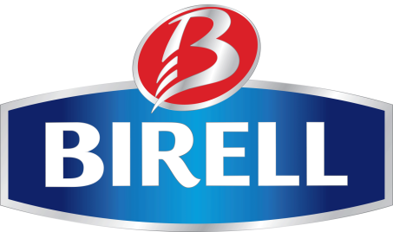
Non-alco beer in Czech Republic:
From negative choice for drivers
to natural non-alcoholic refreshment
Roman Trzaskalik
Plzeňský Prazdroj

Slide 2
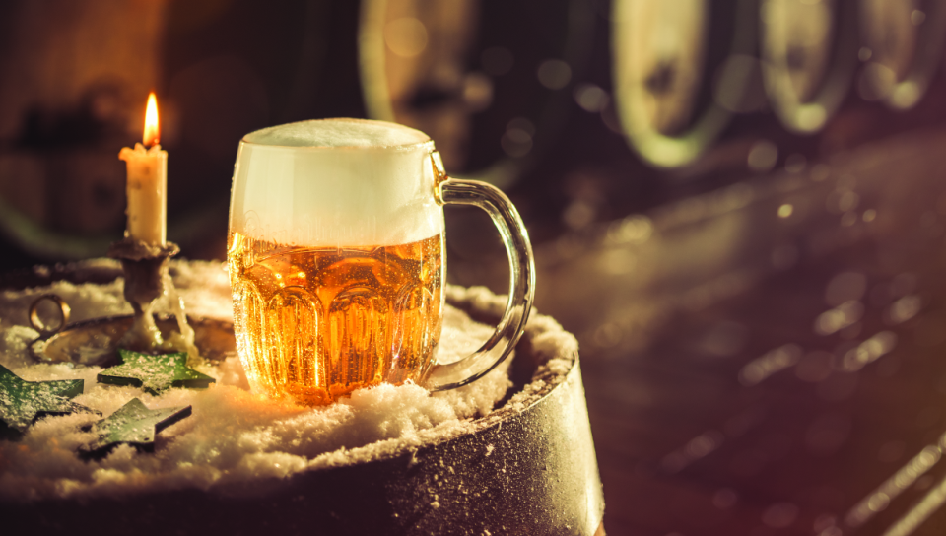
Plzeňský Prazdroj
Gave the world the first golden lager in 1842
Brewing and selling every second beer in Czech Republic
Part of Asahi Breweries Europe Group

Slide 3
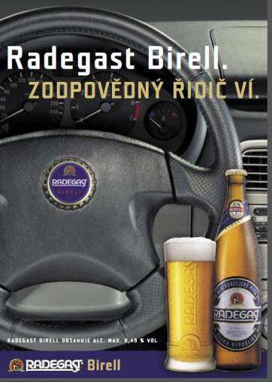
The story begins back in 1992 with Radegast Birell
Unique yeast producing low alcohol
The same fermentation process as in the case of classic Czech lagers
Excellent TASTE = the base of success
Negative choice
- when you can't have a beer
Notes:
87% of consumers considers taste of BIRELL Pale as comparable with regular alcoholic beers.

Slide 4
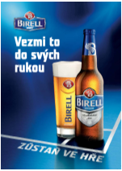
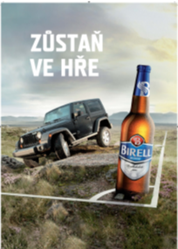
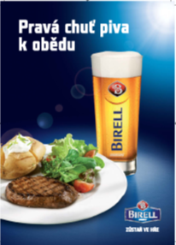
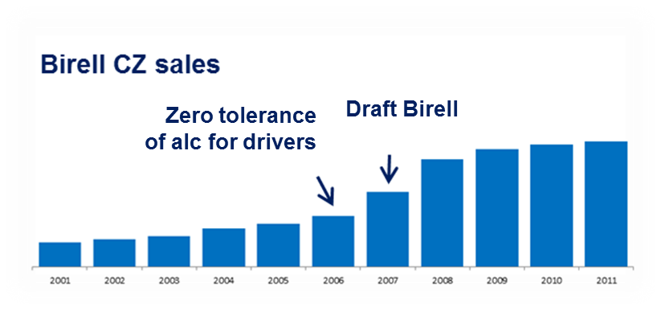
2010 – Birell as a brand = Taste, drivers, meal & on tap
Notes:
87% of consumers considers taste of BIRELL Pale as comparable with regular alcoholic beers.

Slide 5
2011 New vision:
To become non-alco refreshment for adults
Notes:
Be first, do not wait and test everything to perfection…

Slide 6
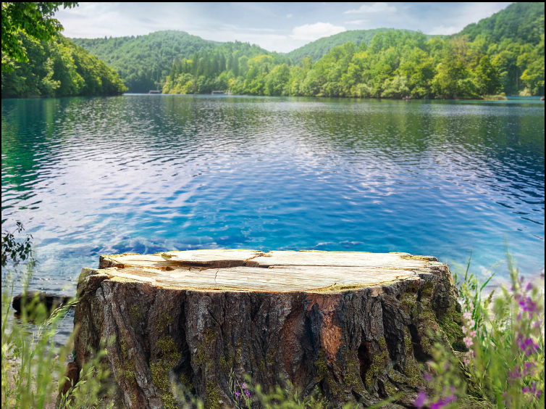
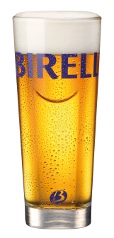
Bridging NAB to soft-drinks step by step:
Targeting new consumers
Penetrating new occasions
Shelving in close to CSD
Addressing soft-drink benefits with better propositions
Great Taste
Naturally brewed
NO preservatives, NO artificial colors or flavorings

Slide 7
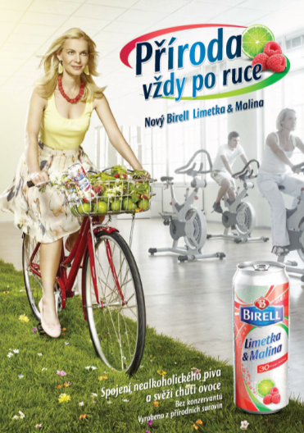
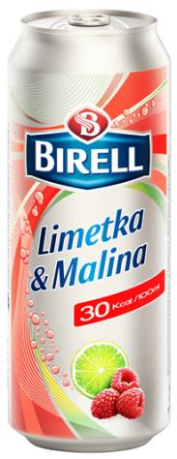
2012: Launch of first non-alco radler in the market
Notes:
We started with non-alco radler as first logical option. Alco radlers become popular in 2011, but non-alco version was not available on the market…and non-alco radler has bigger potential than alcoholic one in our opinion… We are gaining from first-mover advantage until now

Slide 8
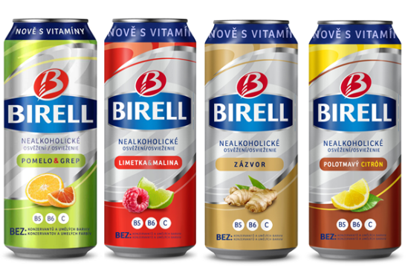
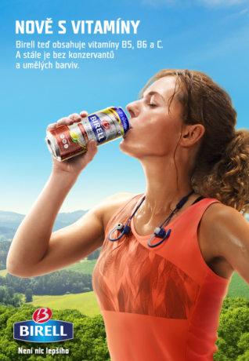
2016: Vitamins for the whole range
Notes:
And in 2016 we introduced first version with BI semi-dark base and also added vitamins as a benefit to whole flavoured range.

Slide 9
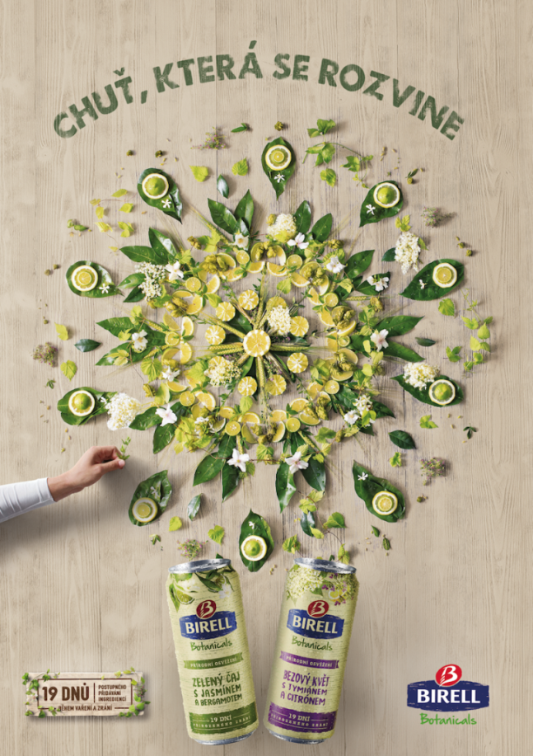
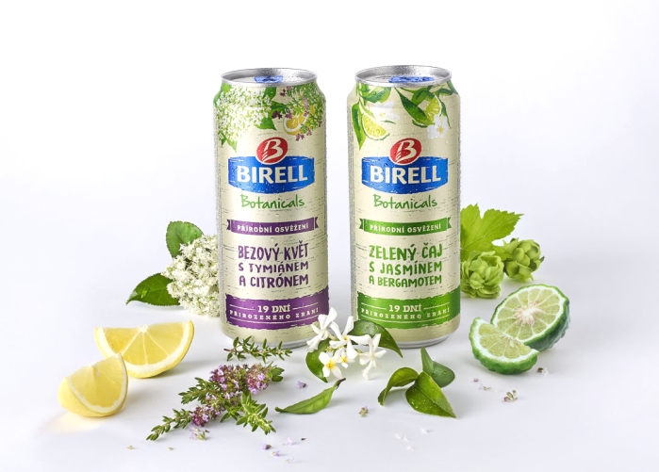
2017: Botanicals – milestone for healthy lifestyle
Gradual dosing of ingredients and 19 days of care during brewing and maturing
Below 5g of sugar for 100ml
Notes:
2017 was the year of big innovations for Birell. We enriched core-beer range with Green Barley variant, offering even more beery taste and also benefit of added green-barley powder. Radler was for the first time in Czech offered on tap (after success in SK) and we brought compLetely new sub-line of product inspired by craft soda - Birell Botanicals. I will explain you difference between radler and Botanicals in a while.
to gradual dosing of ingredients and 19 days of care during brewing and maturing

Slide 10
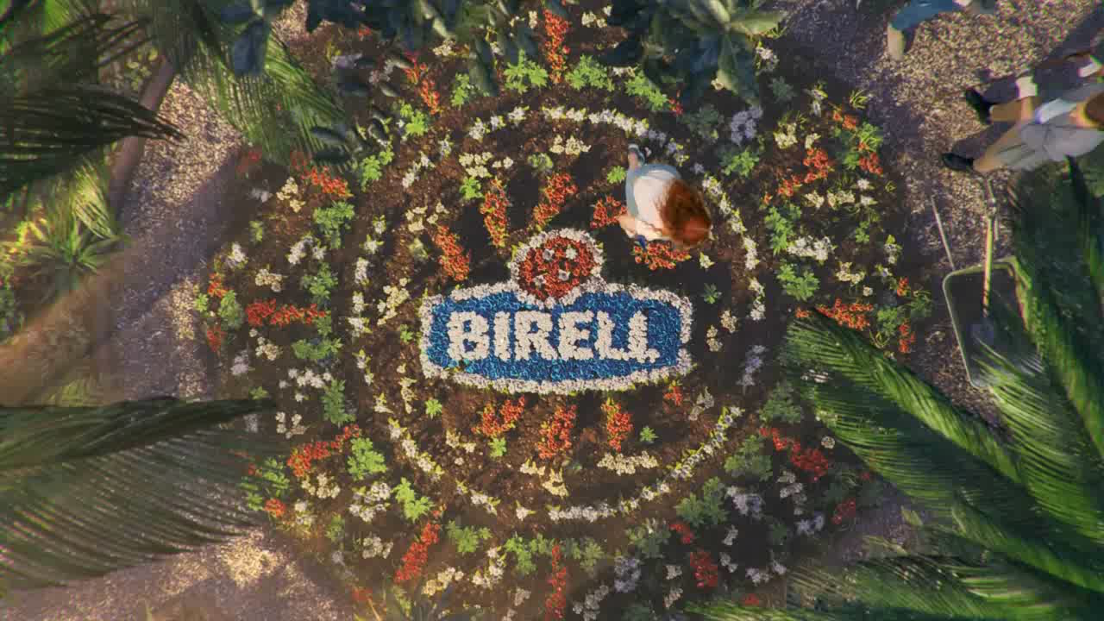

Slide 11
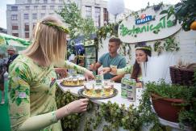
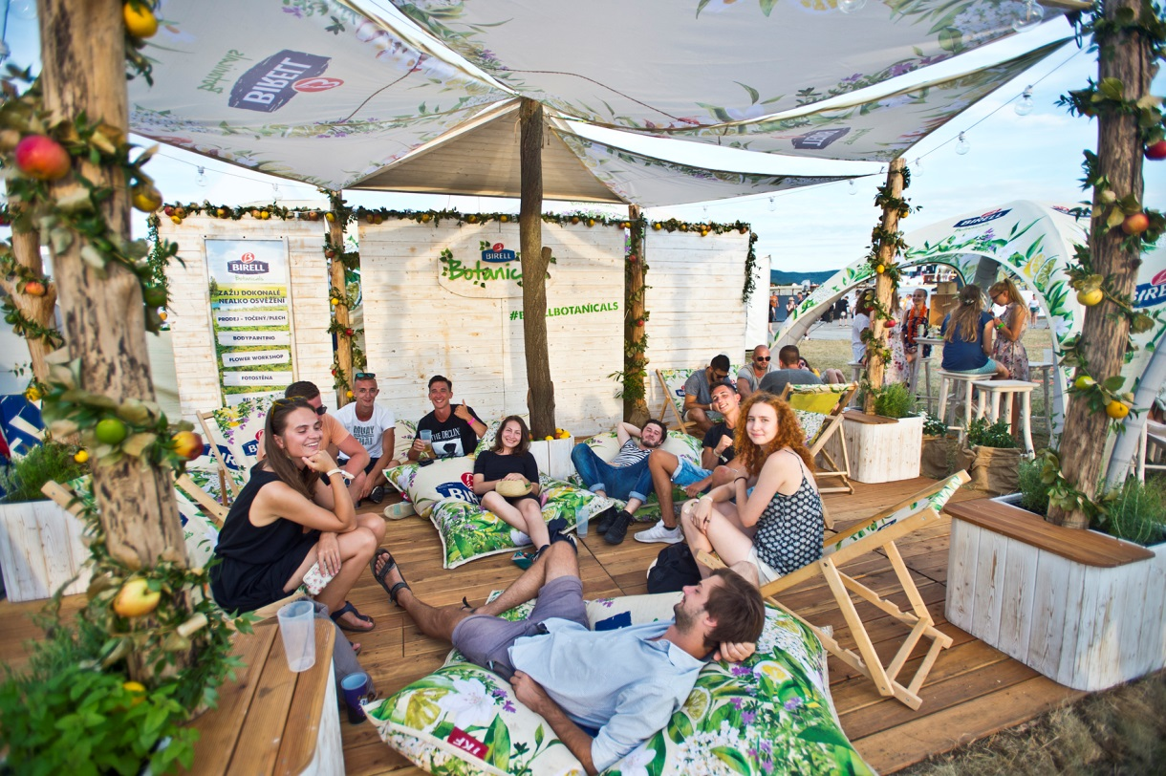
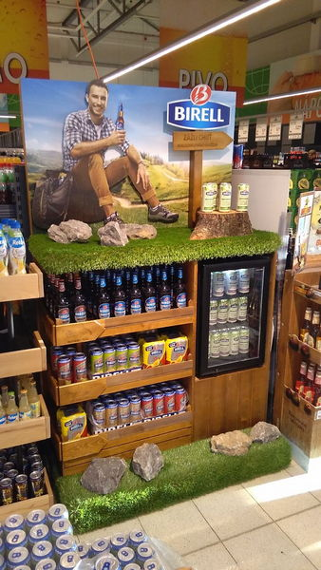
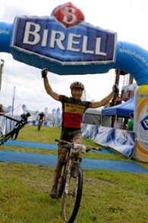
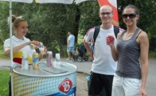
Active life style, Taste of experience & Massive samplings
Notes:
This is already quite far from 2011 communication, right?
Třeba ještě vizuálně doladit..

Slide 12
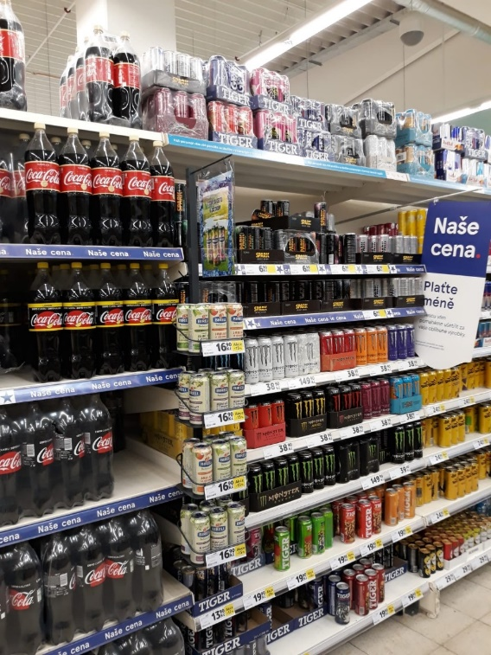
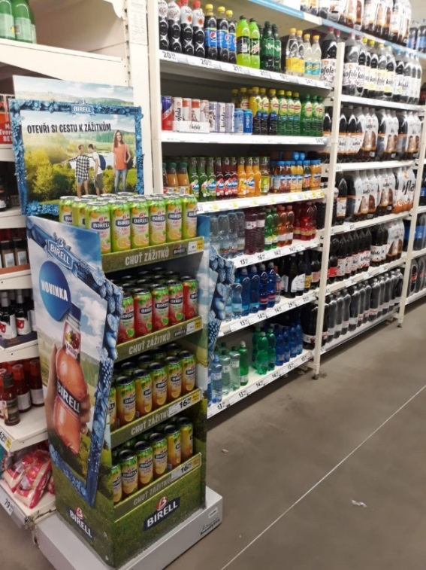
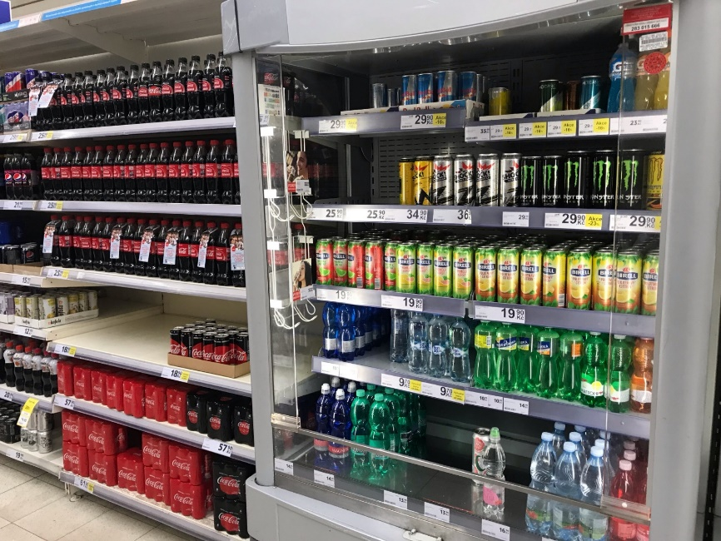
Right placement in non-alco sections

Slide 13
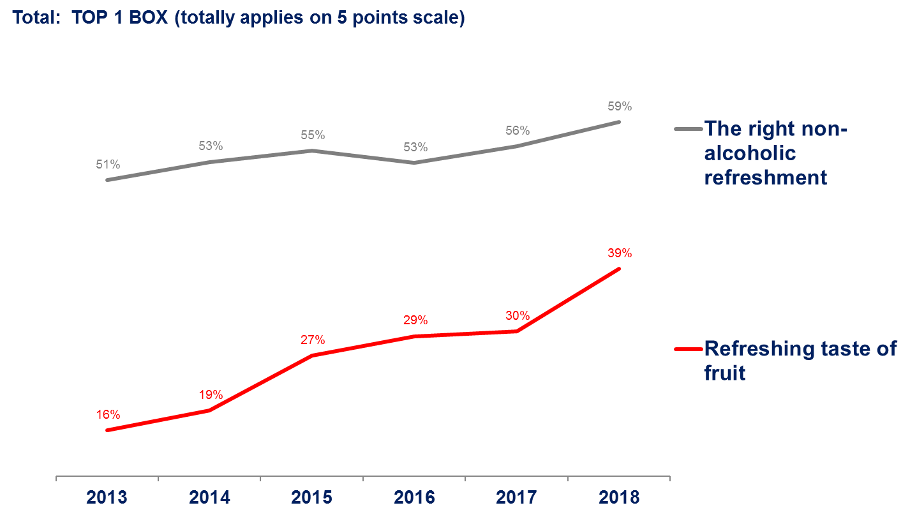
Shift in perception of Birell

Slide 14
Dramatic change of occasion when Birell is consumed

Slide 15
2018 – Non Alco beers have much less Unhealthy perception

Slide 16
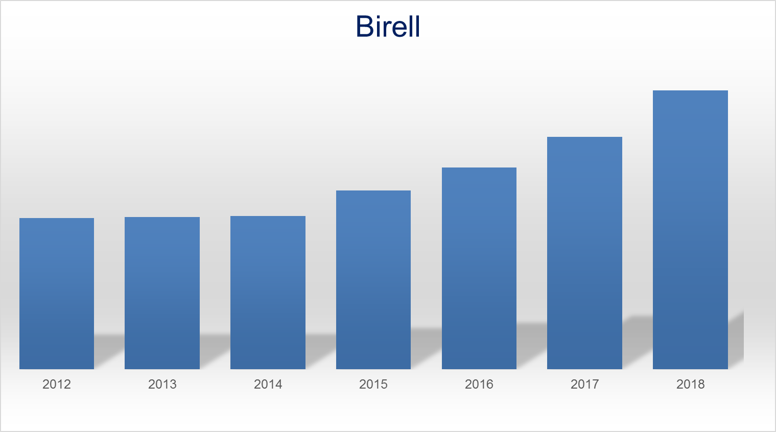
Birell sales
Notes:
Today NAB is over 8% of beer market , still growing strong double digit YoY, where Birell is a synonymum for the category, with 68% share in core, and over 70% share in flavoured

Slide 17
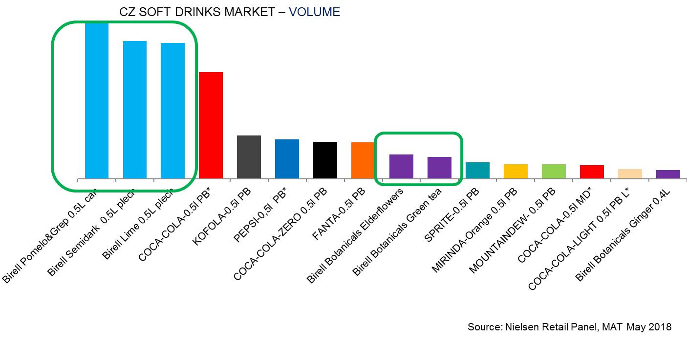
2018: Birell became leader in the soft drink single serve
volume sales in off-trade

Slide 18
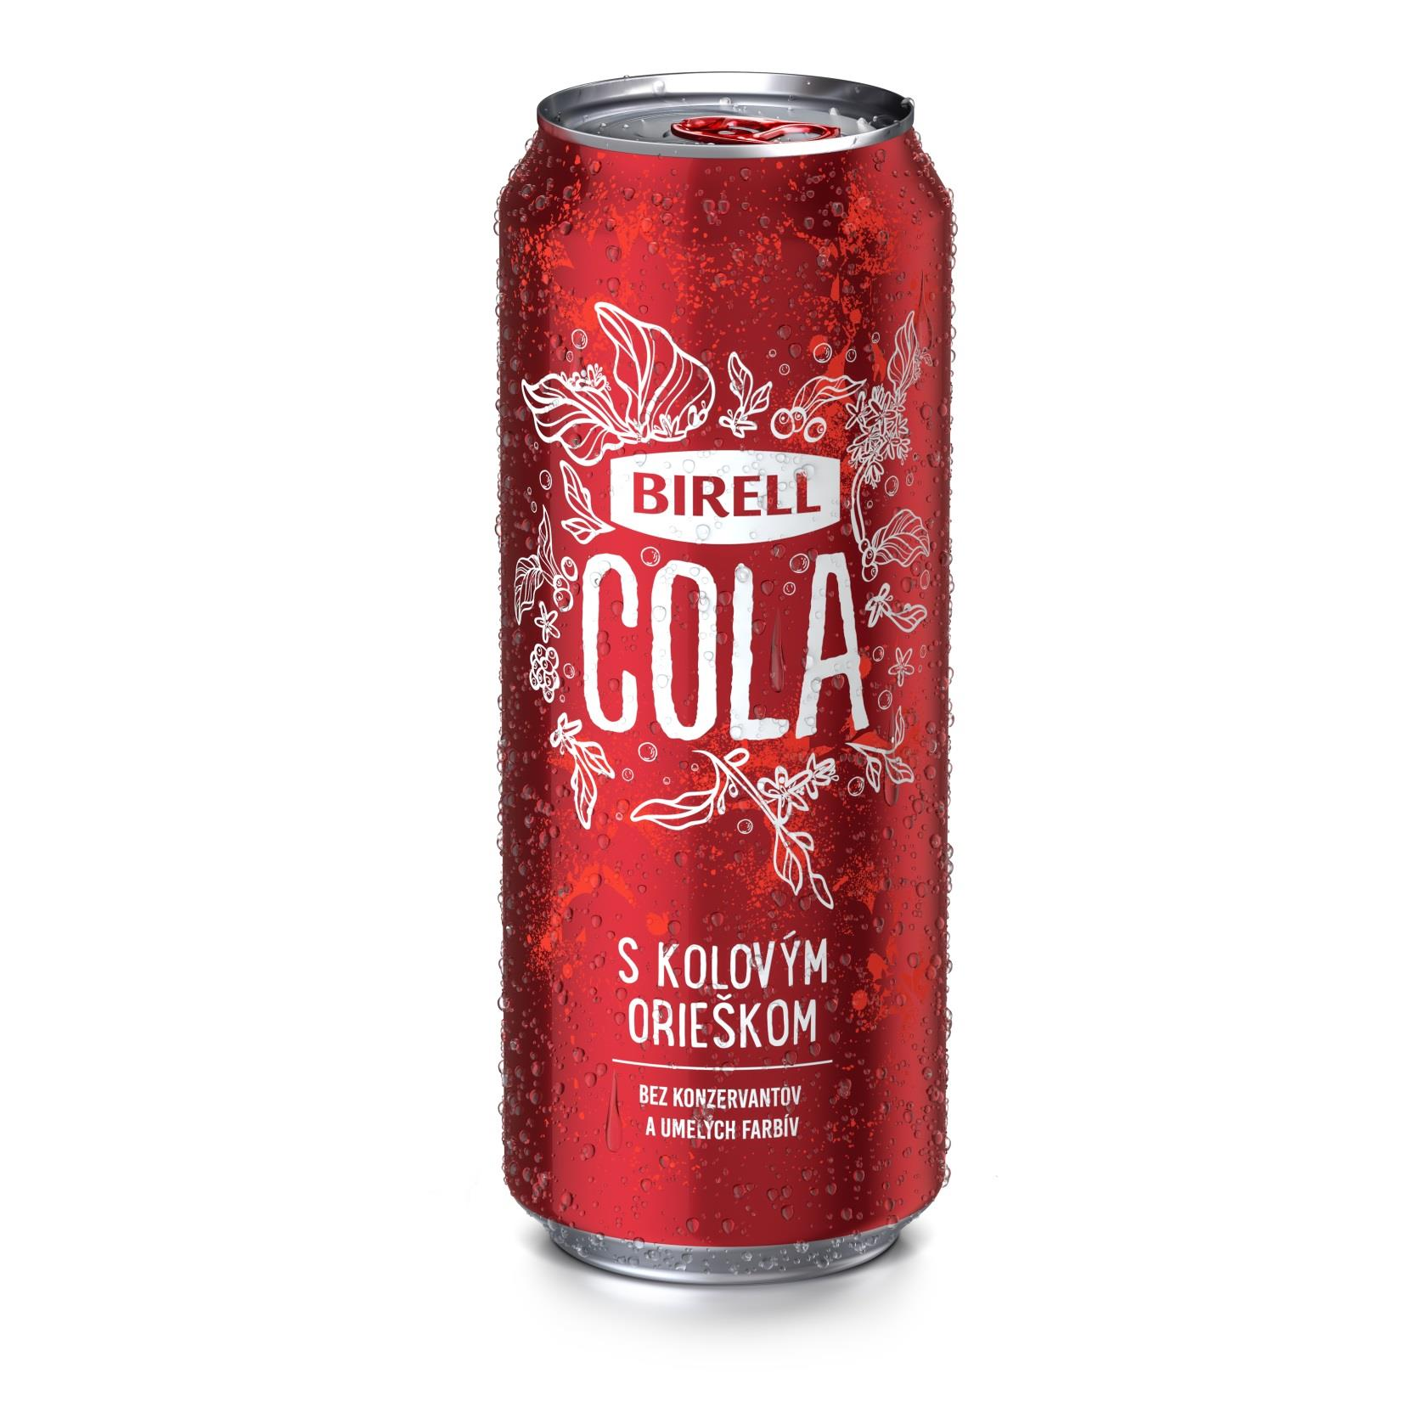

Slide 19
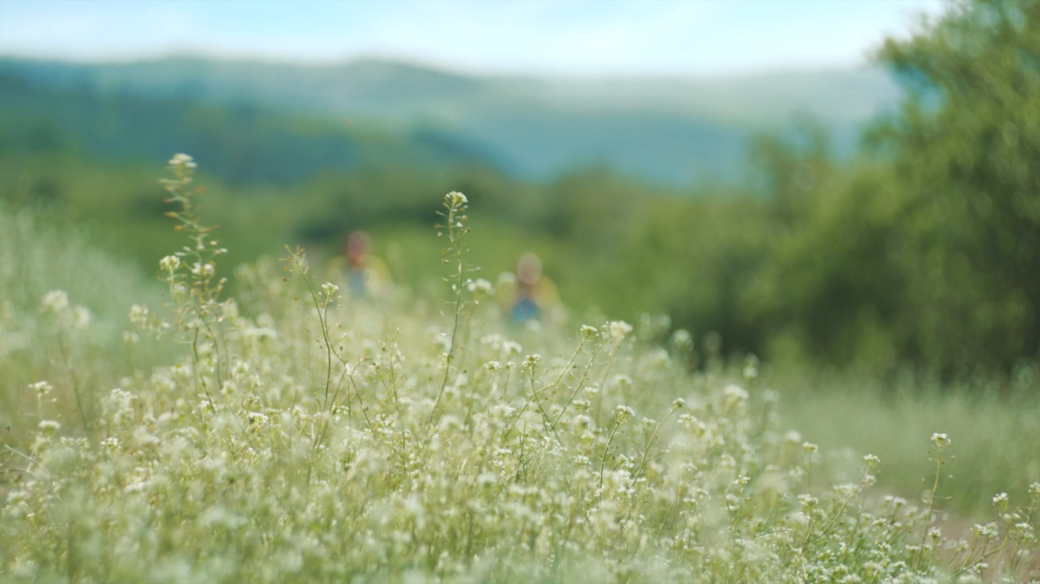
Notes:
So, what do you think? Will it work out?

Slide 20
Non-alco beer can become natural
non-alco refreshment
for adults
Great
taste
is a must
Non-alco beer – natural brewing process,
no nasties
Being bold in innovation
&
activation

