Slide 1
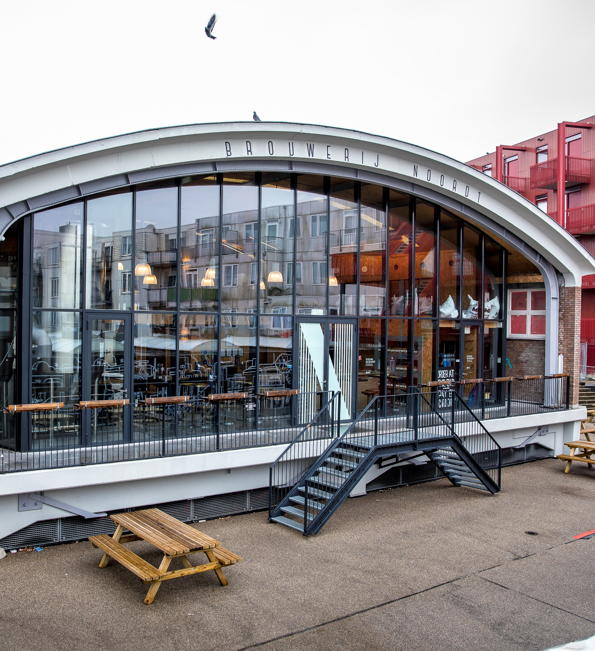
City Brewery &
Brewpub
Peter Rouwen – NOORDT

Slide 2
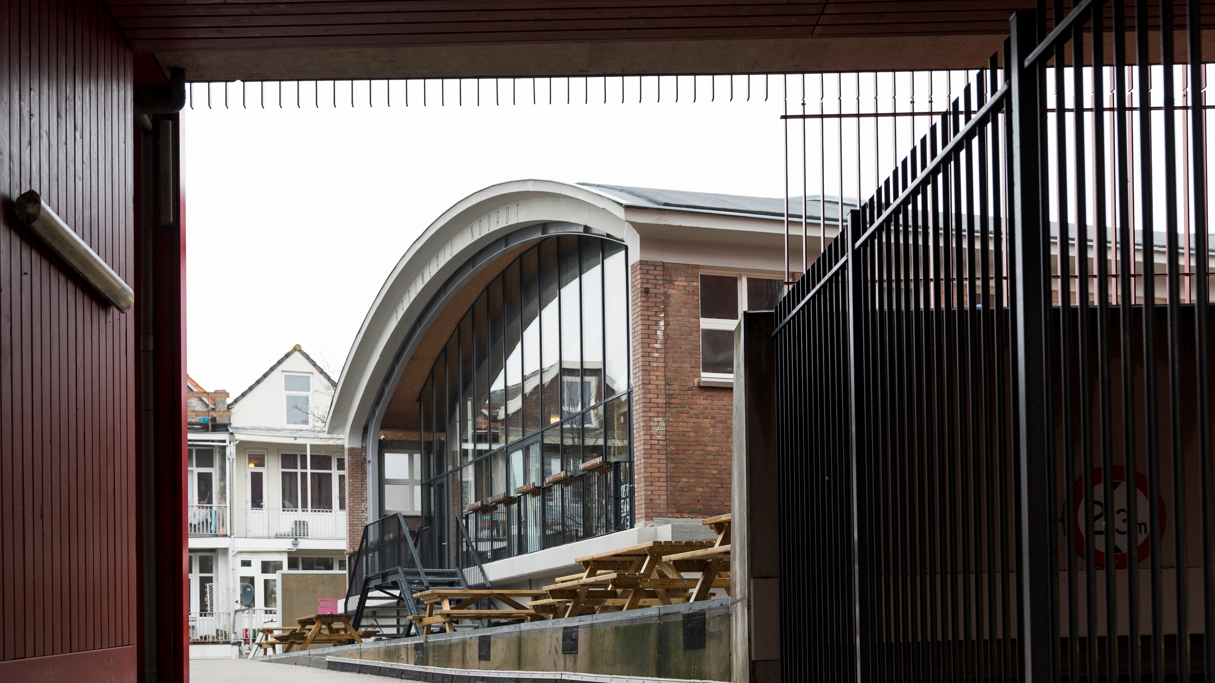
Operating brewery in the heart of Rotterdam

Slide 3
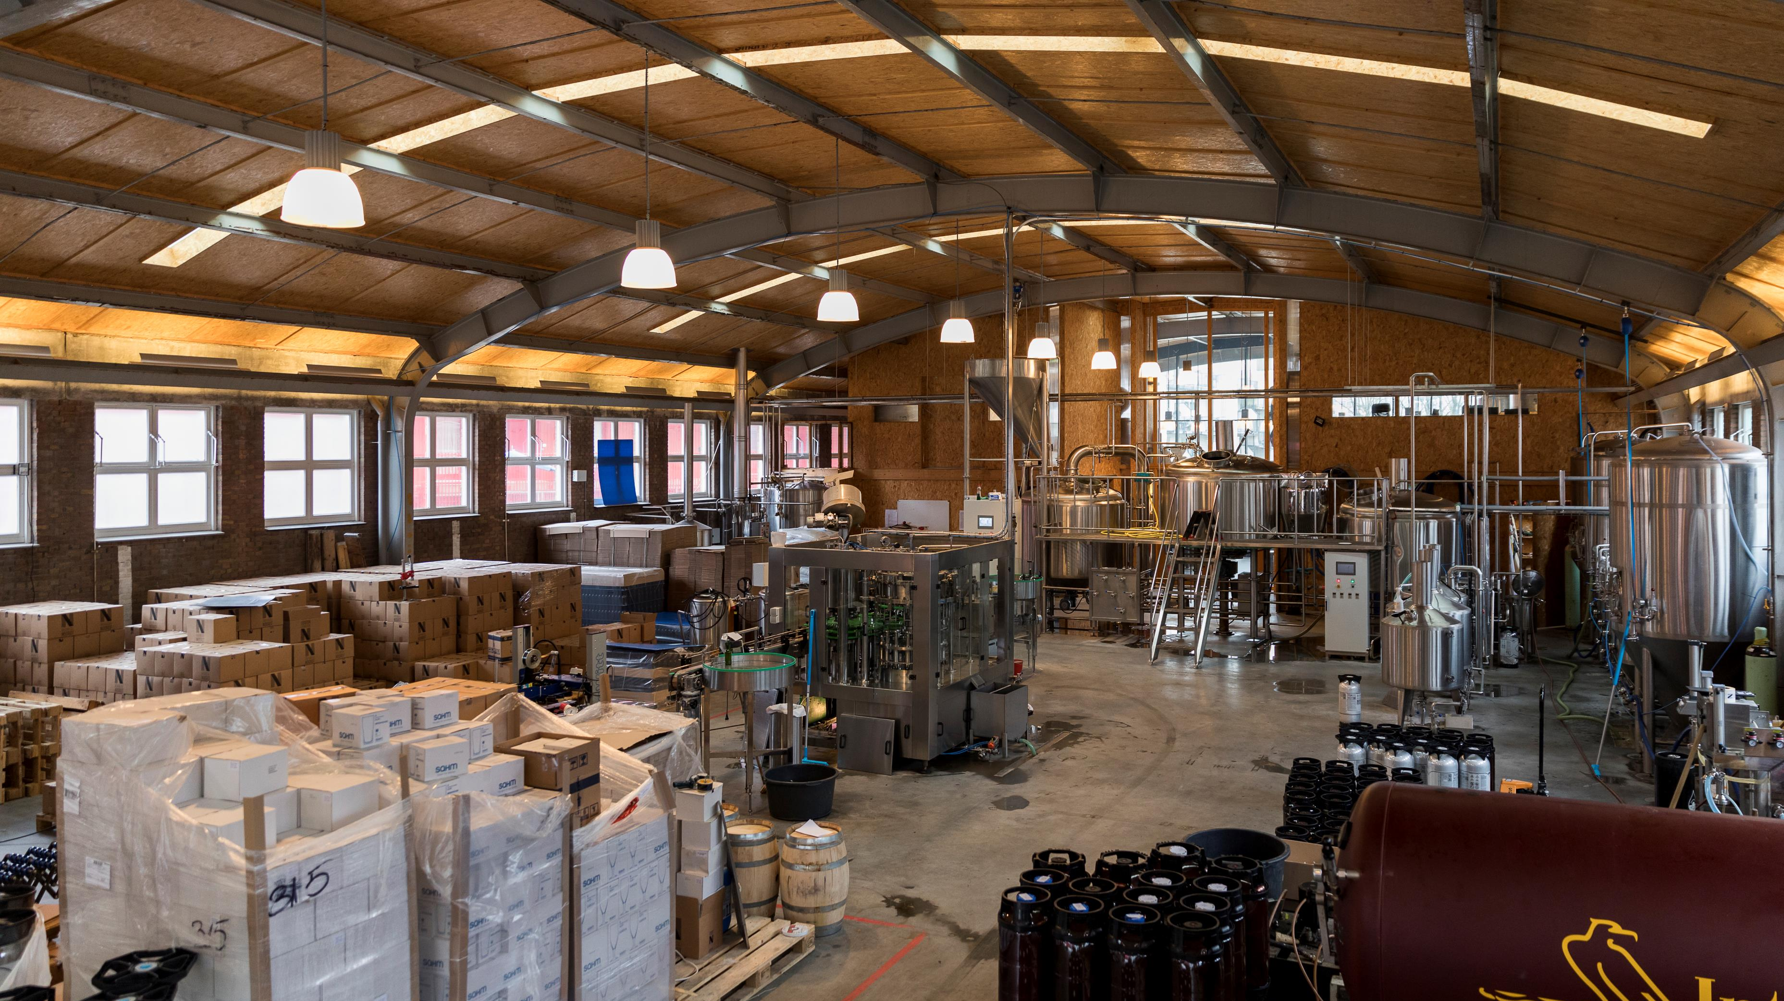
Starting a brewery
Finance
Building
Knowhow
Equipment

Slide 4
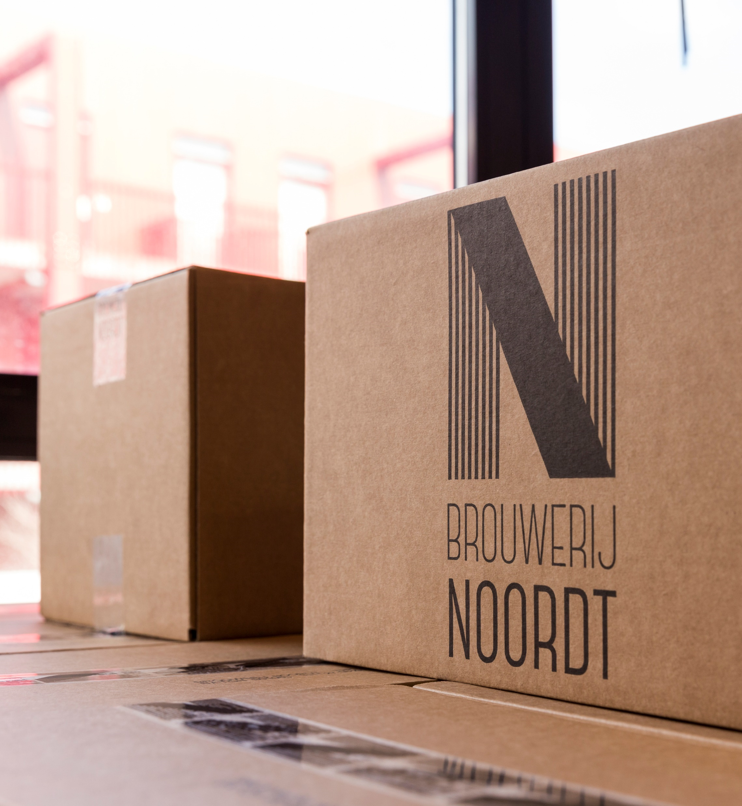
Starting a brewery
Financing
Crowdfunding
Bank
Investors
Private financing

Slide 5
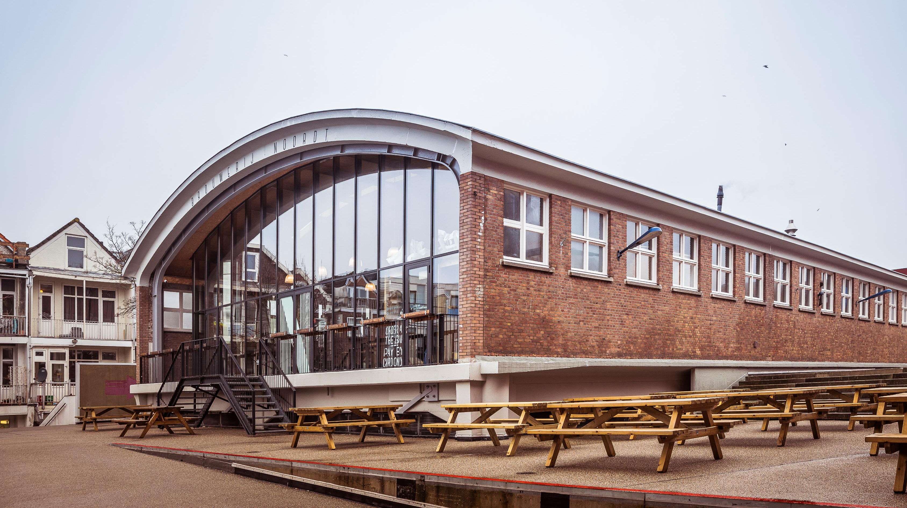
Starting a brewery
Building
Rent / Buy
Permits
Suitability
Infrastructure
Potential

Slide 6
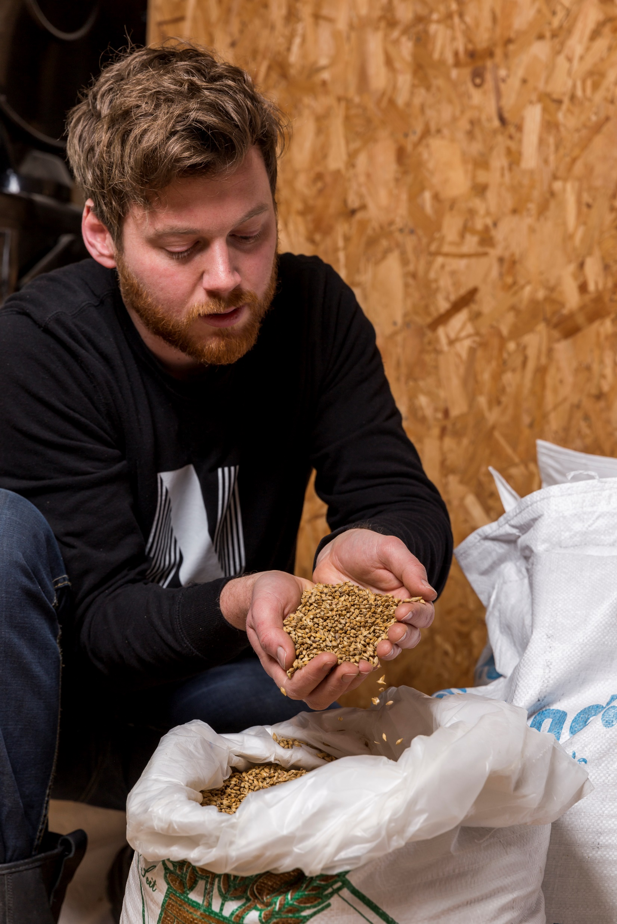
Starting a brewery
Knowhow
Education
Internship

Slide 7
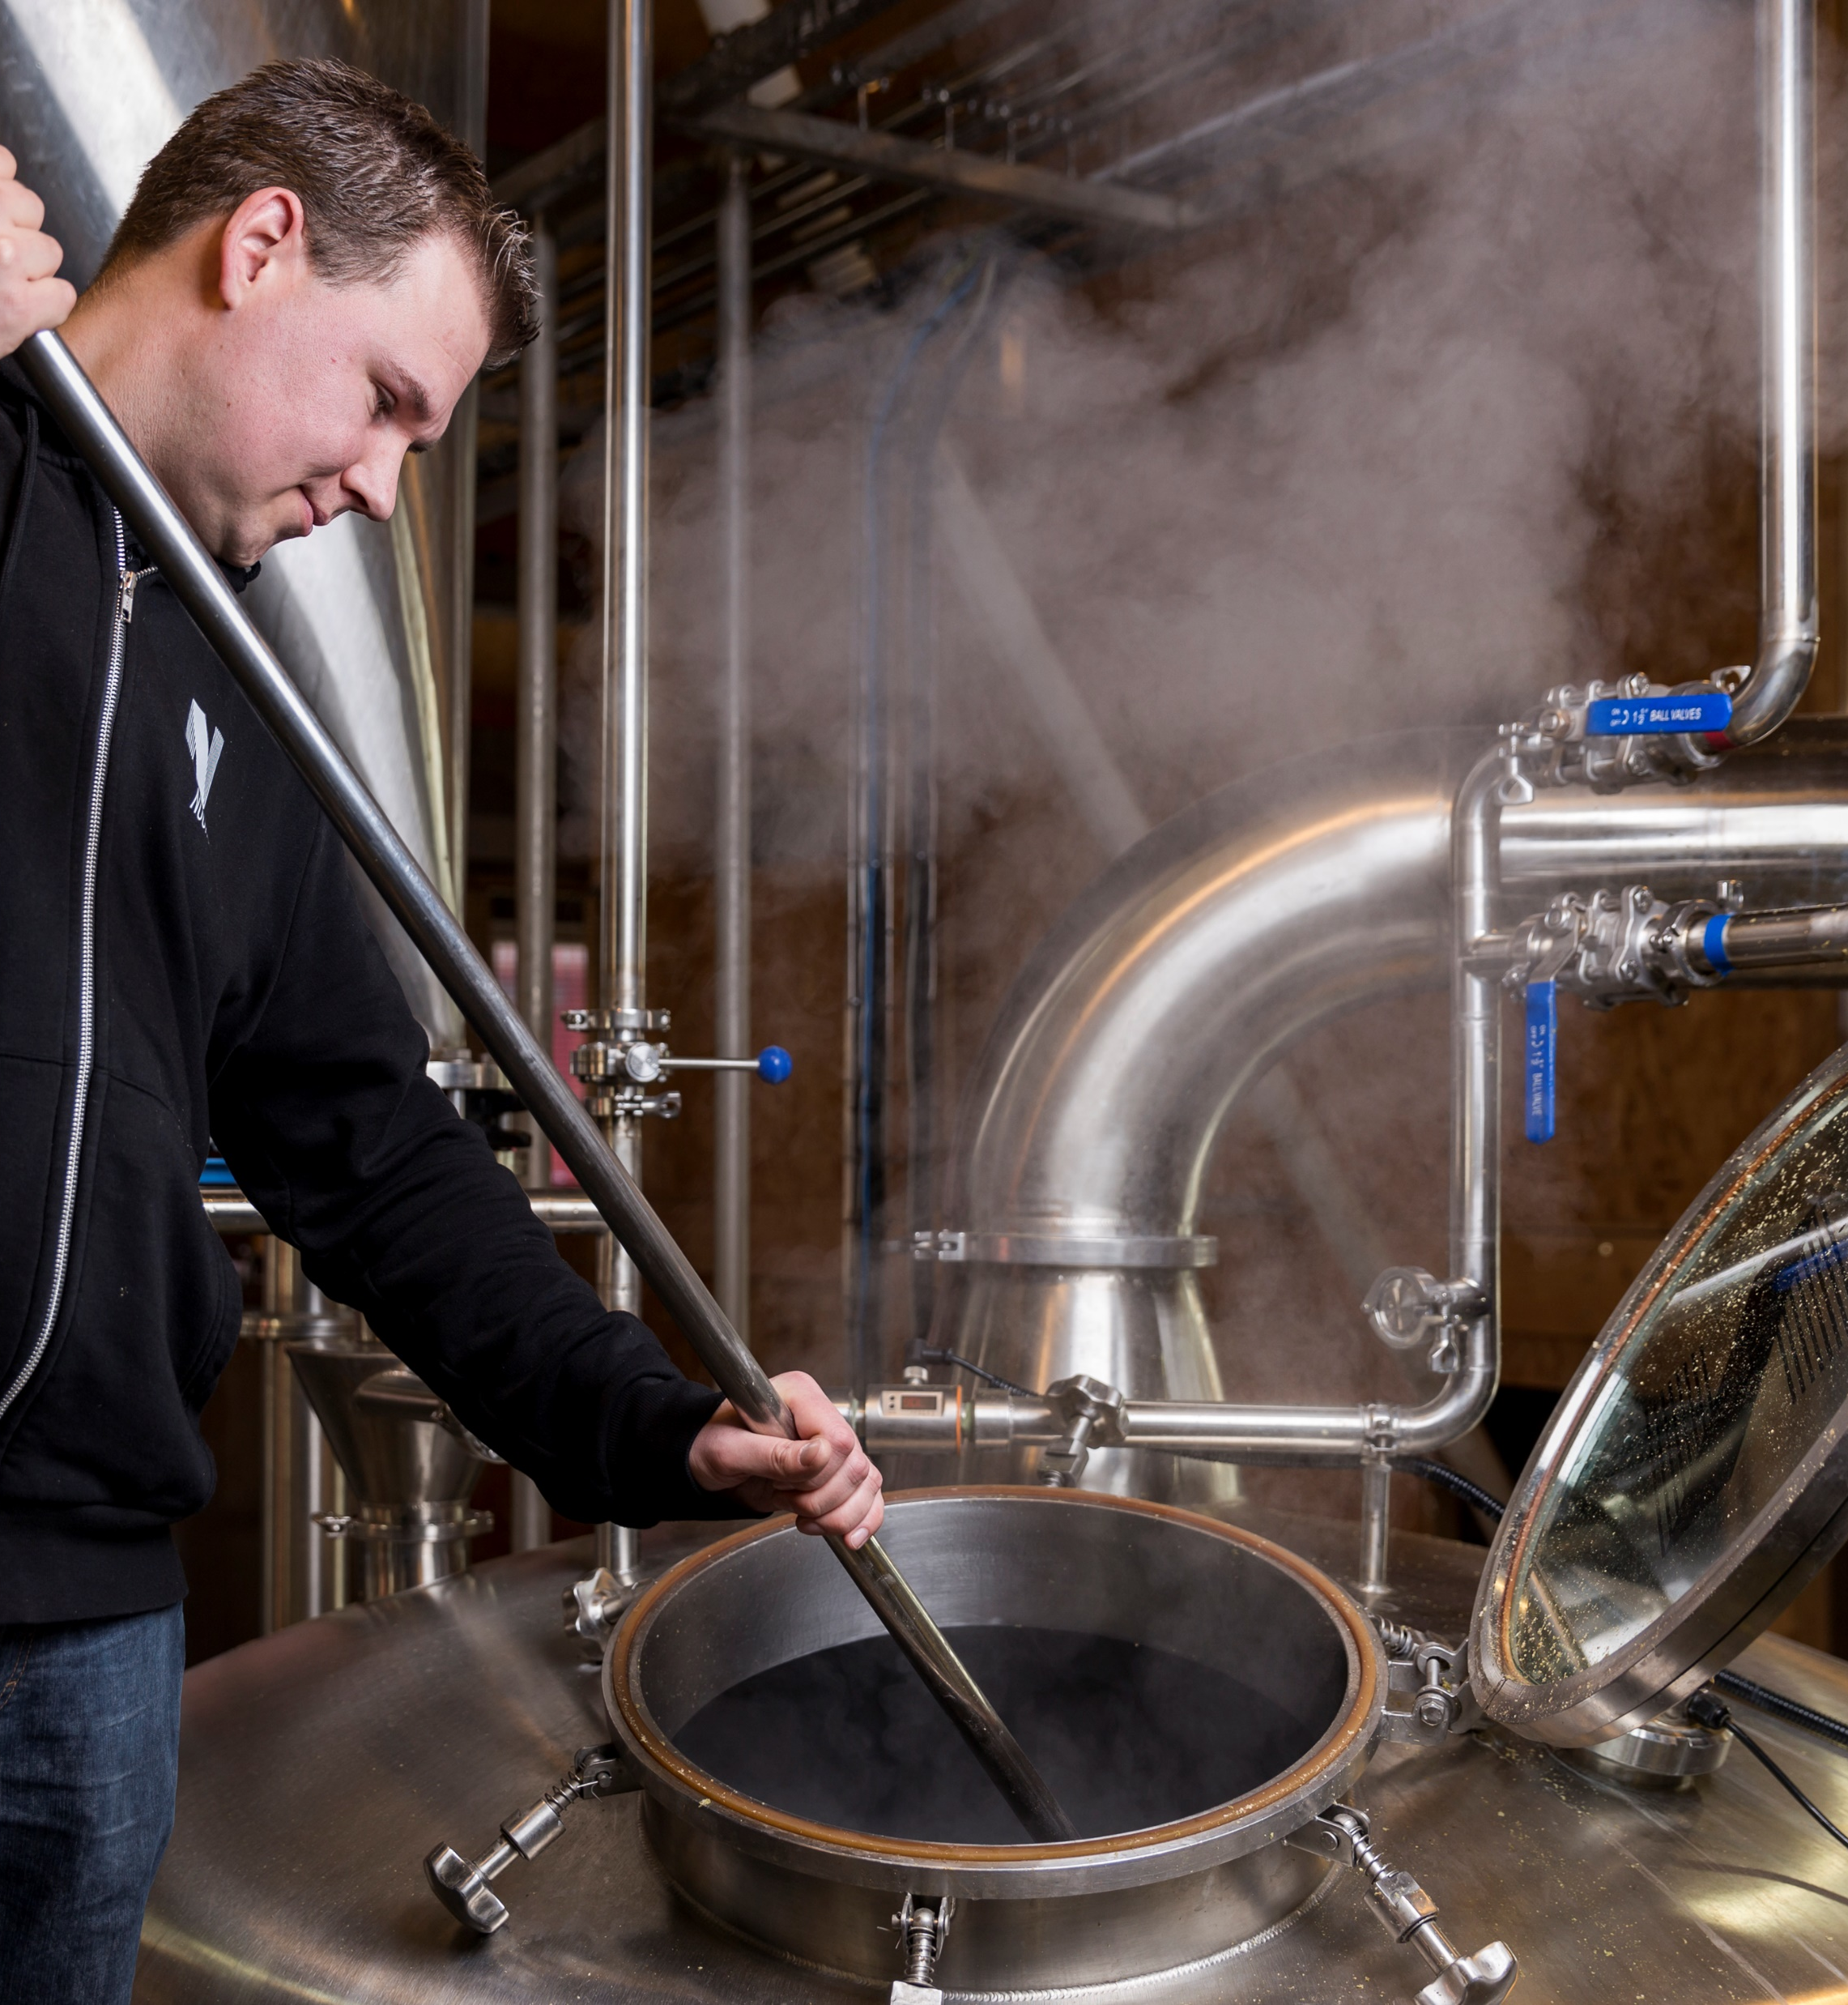
Starting a brewery
Brewing Equipment
Price vs Quality
5 -10 year write-off

Slide 8
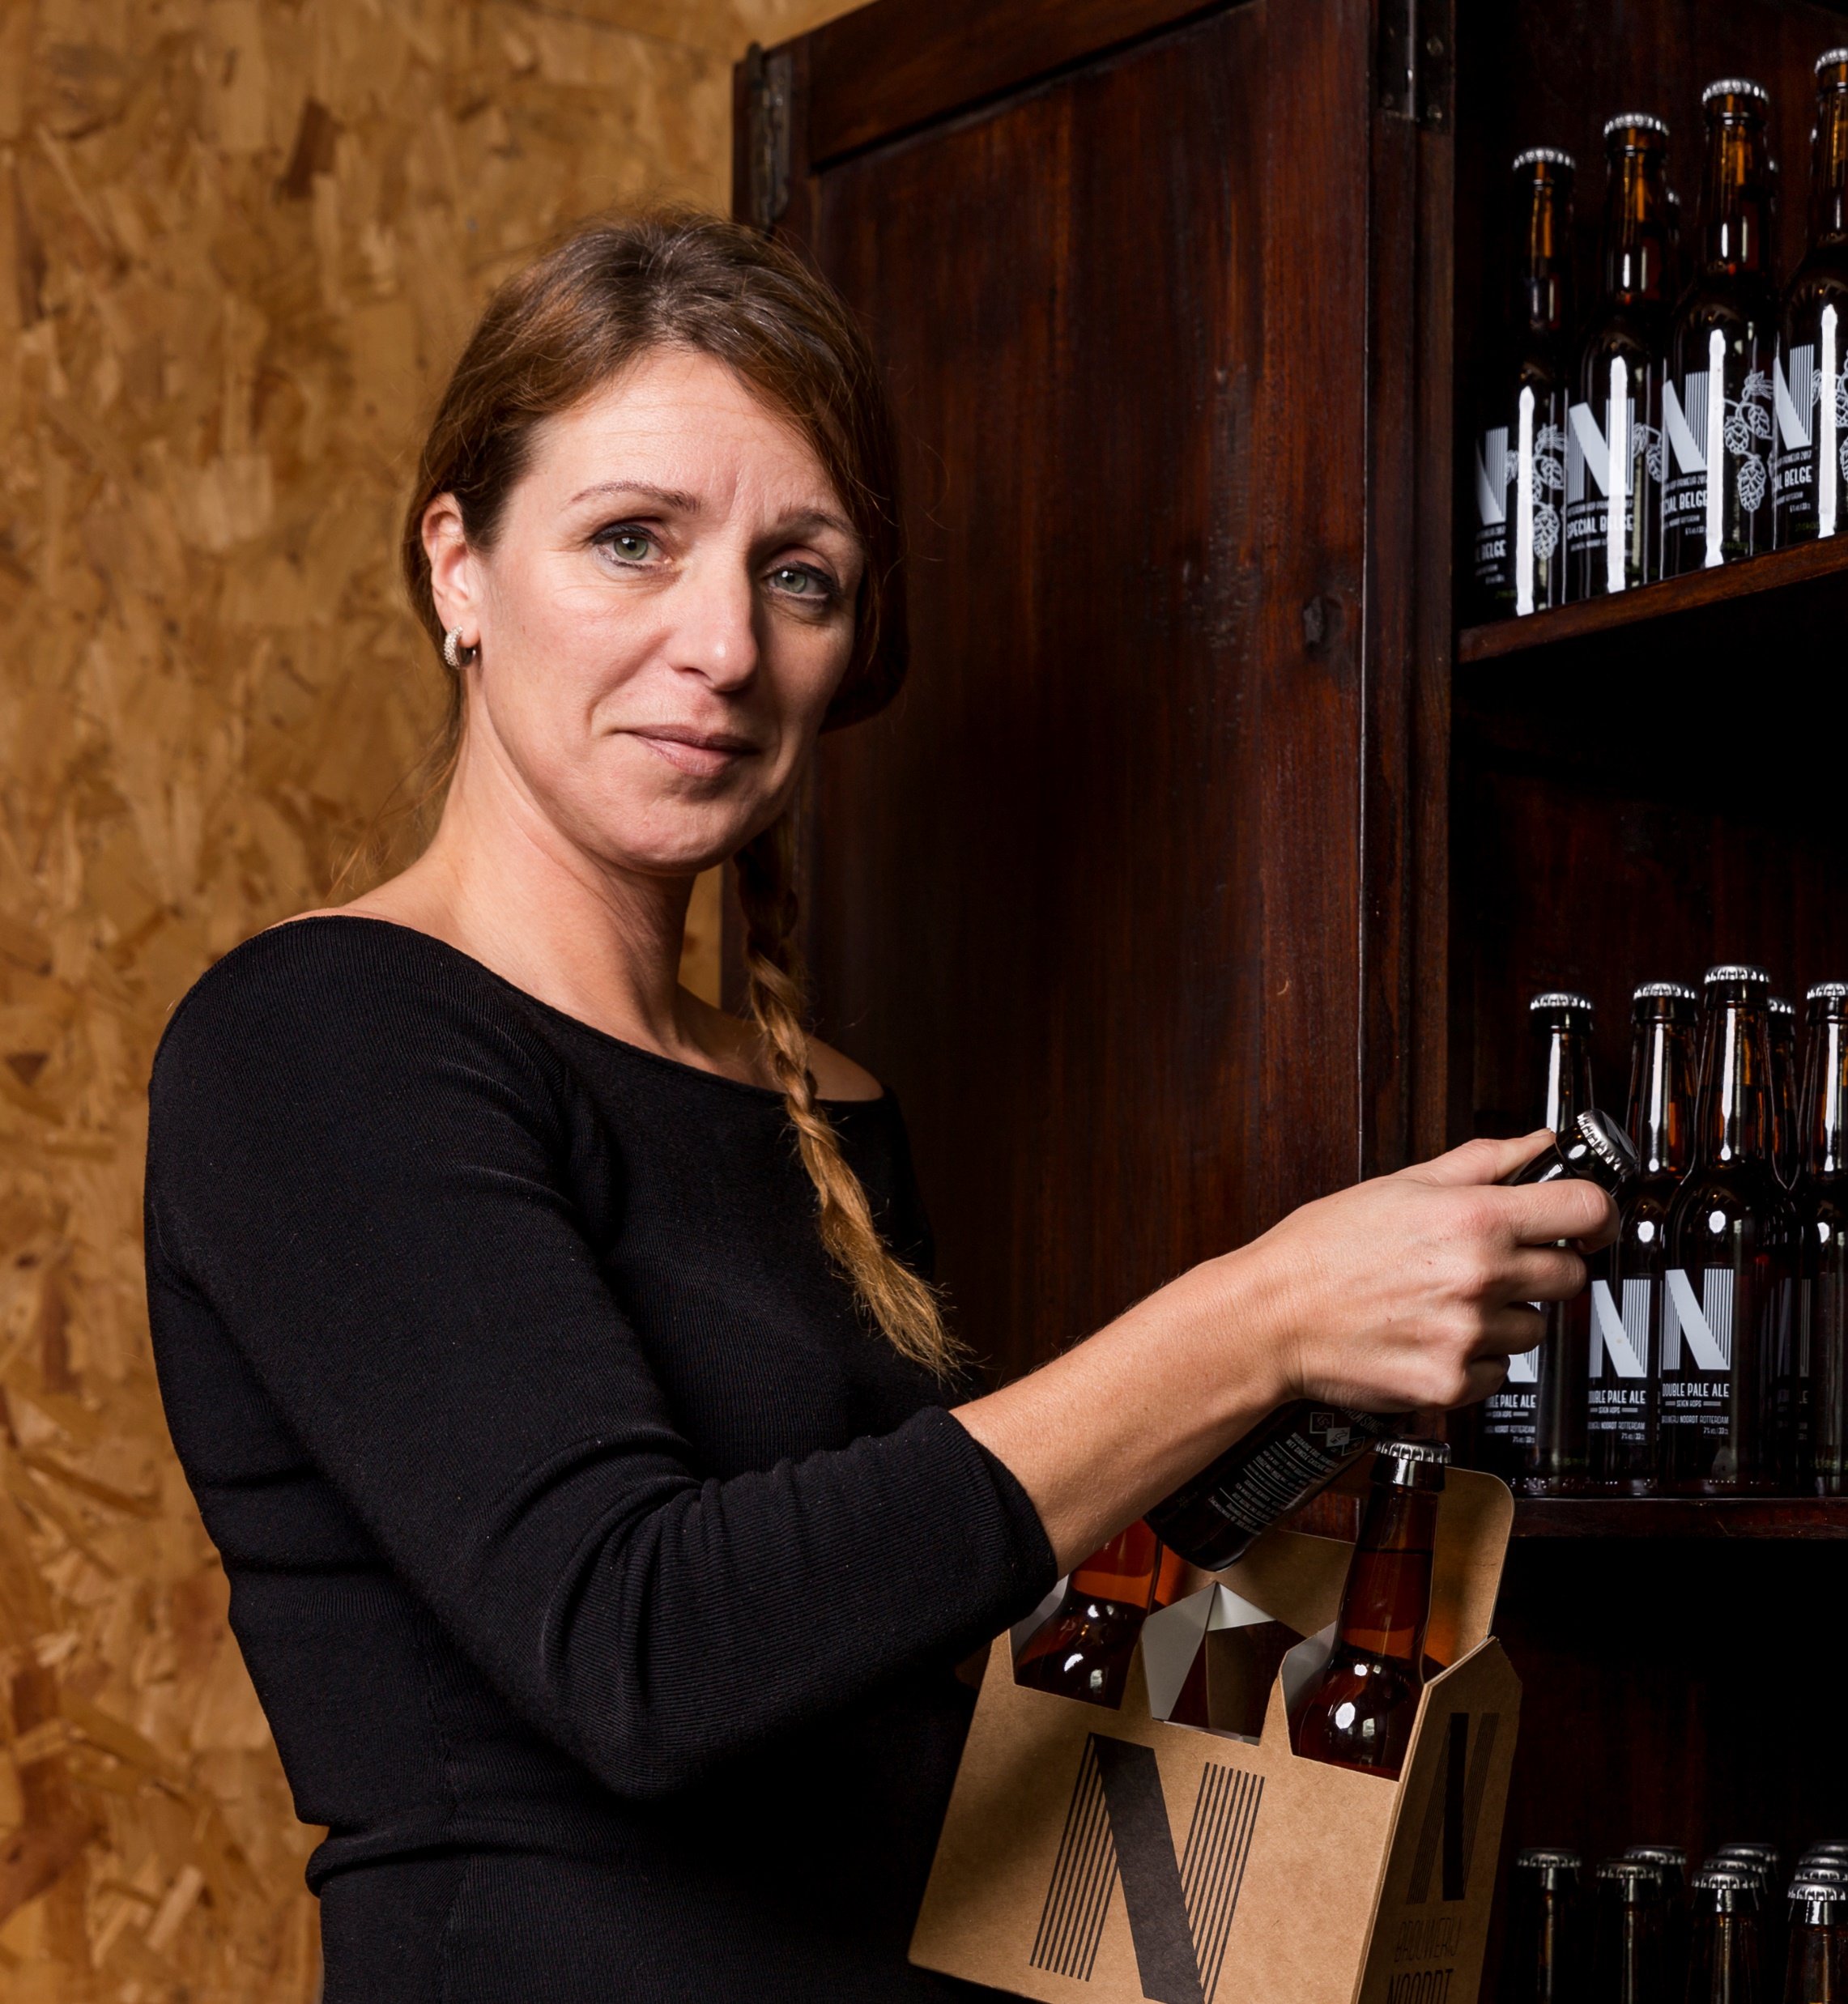
Running a brewery
Office & Administration
Software
Qualified Personnel
Additional equipment

Slide 9
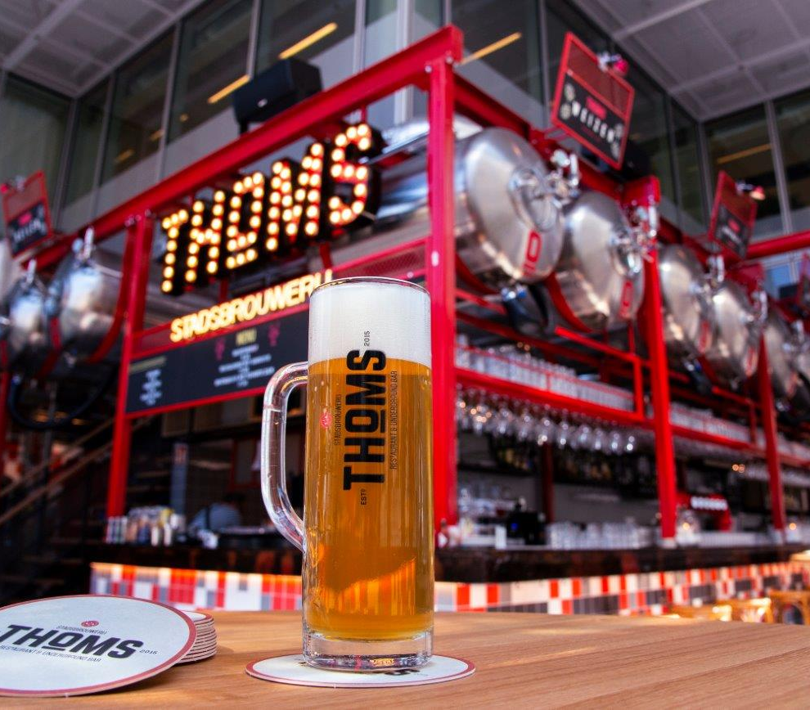
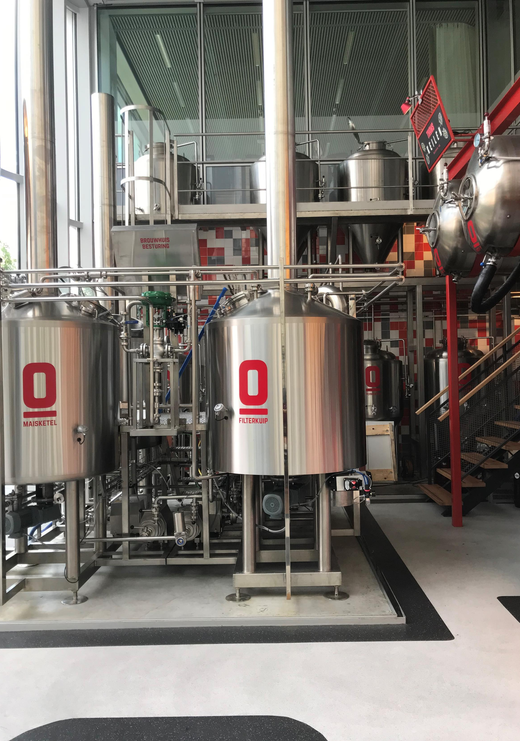
Foto: Entree Magazine

Slide 10
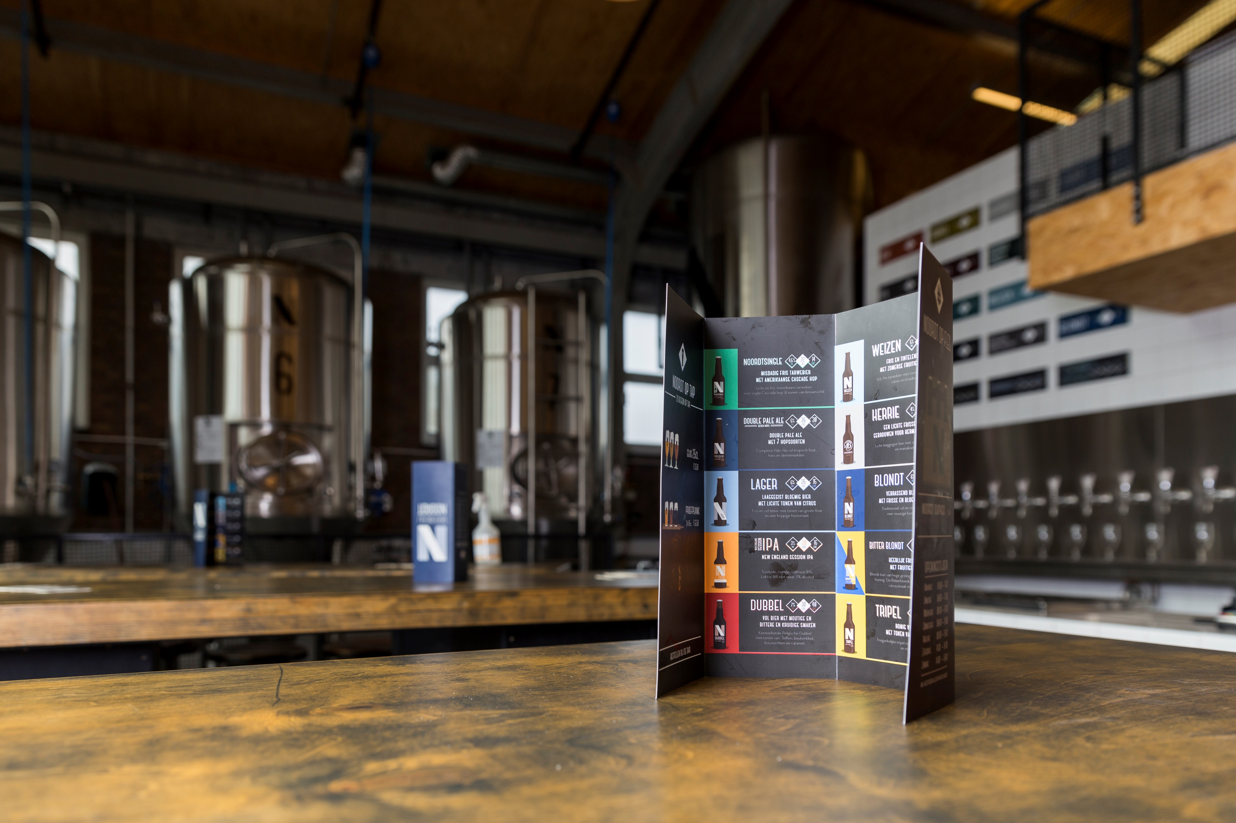

Slide 11
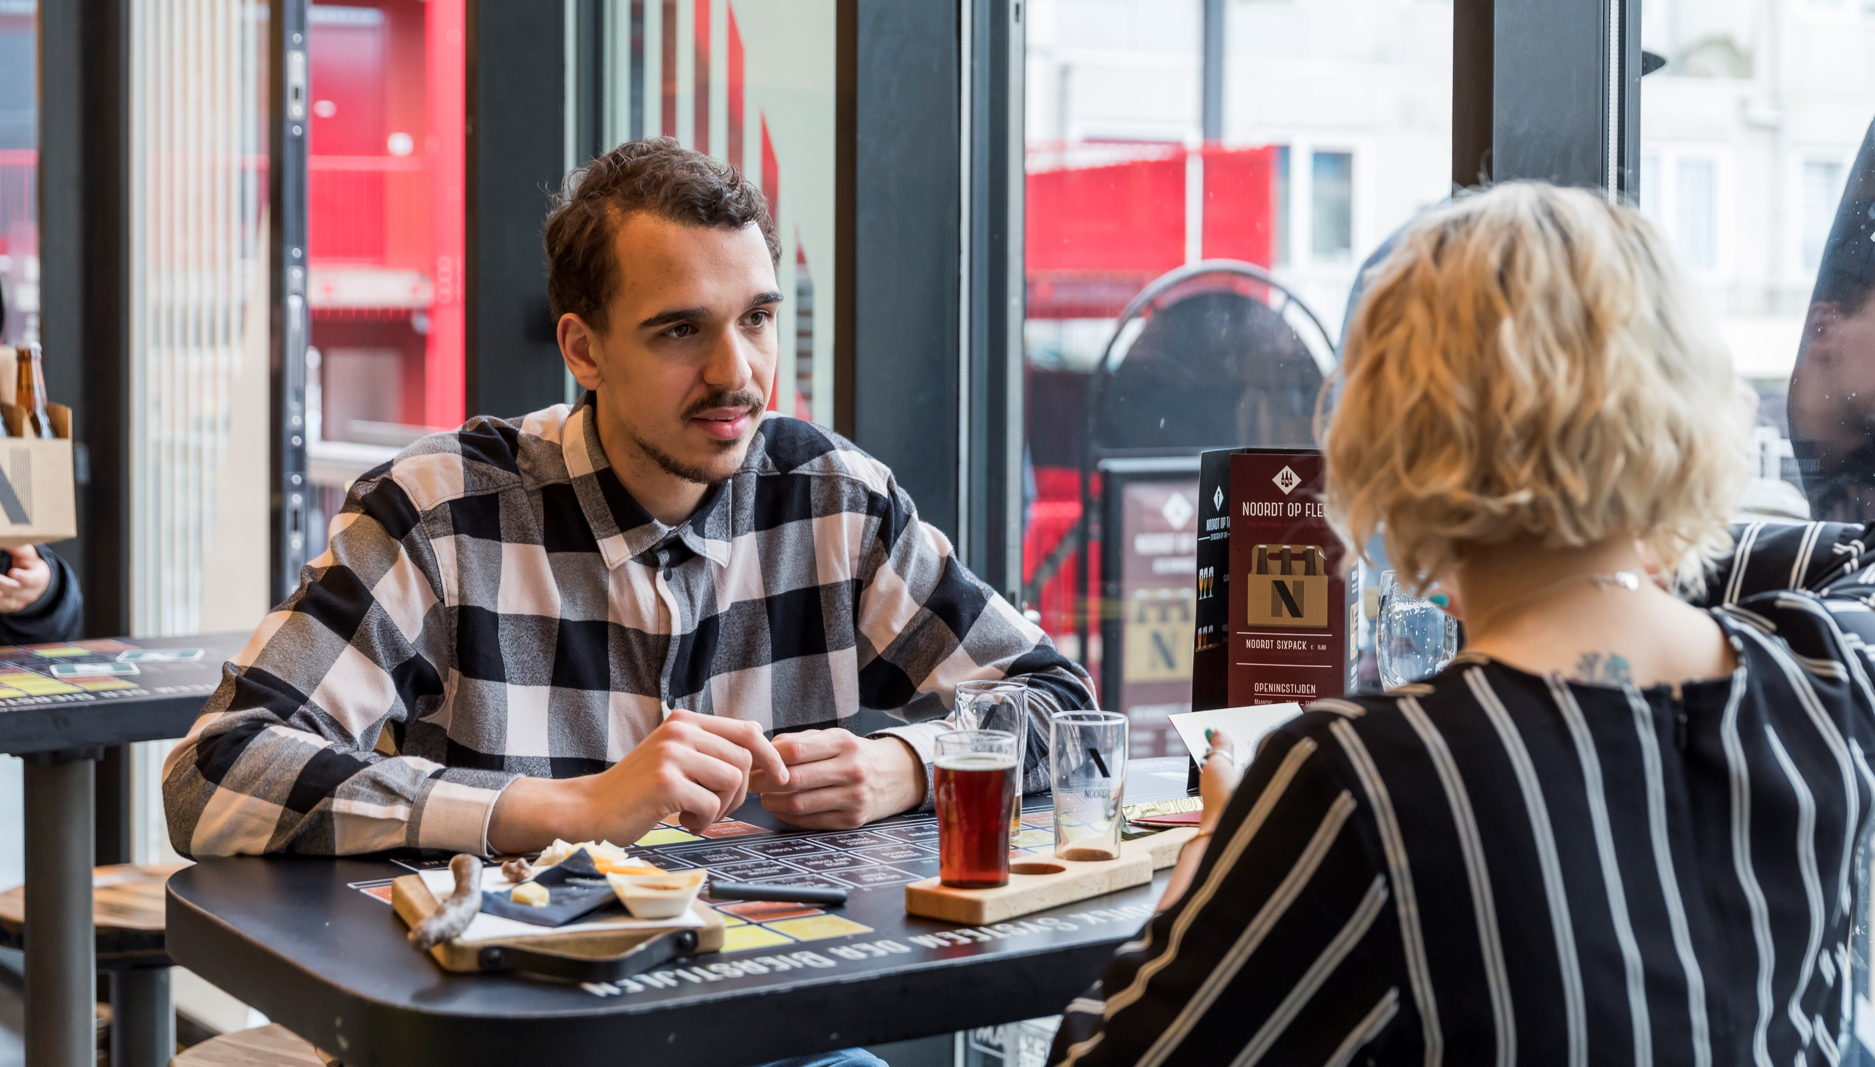
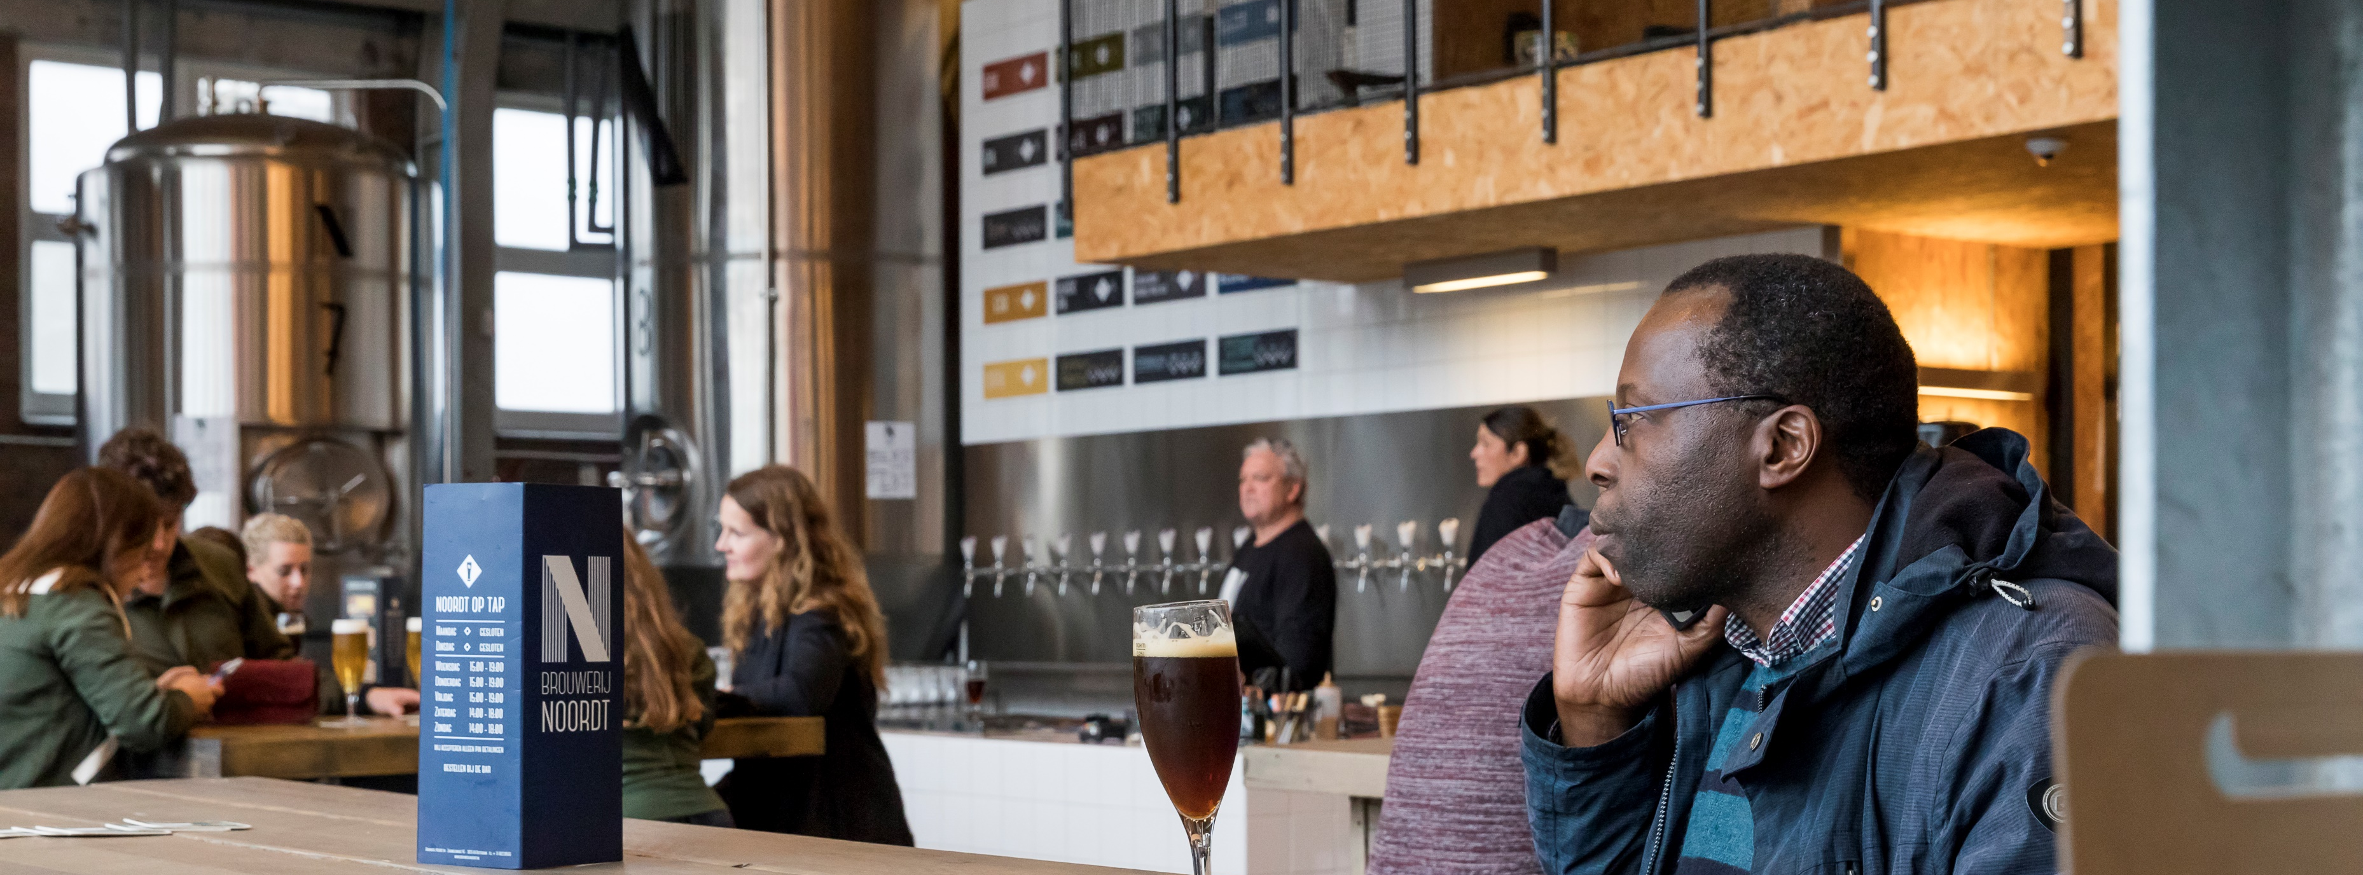
Brewpub vs. Taproom
BP
TR
HIGHER
MORE
ALL
LOWER
NONE
FULL
LOWER
LESS
BEER ONLY
HIGH
NONE
SHORT
Investment
Personnel
Products
Margins
Kitchen
Opening hours

Slide 12
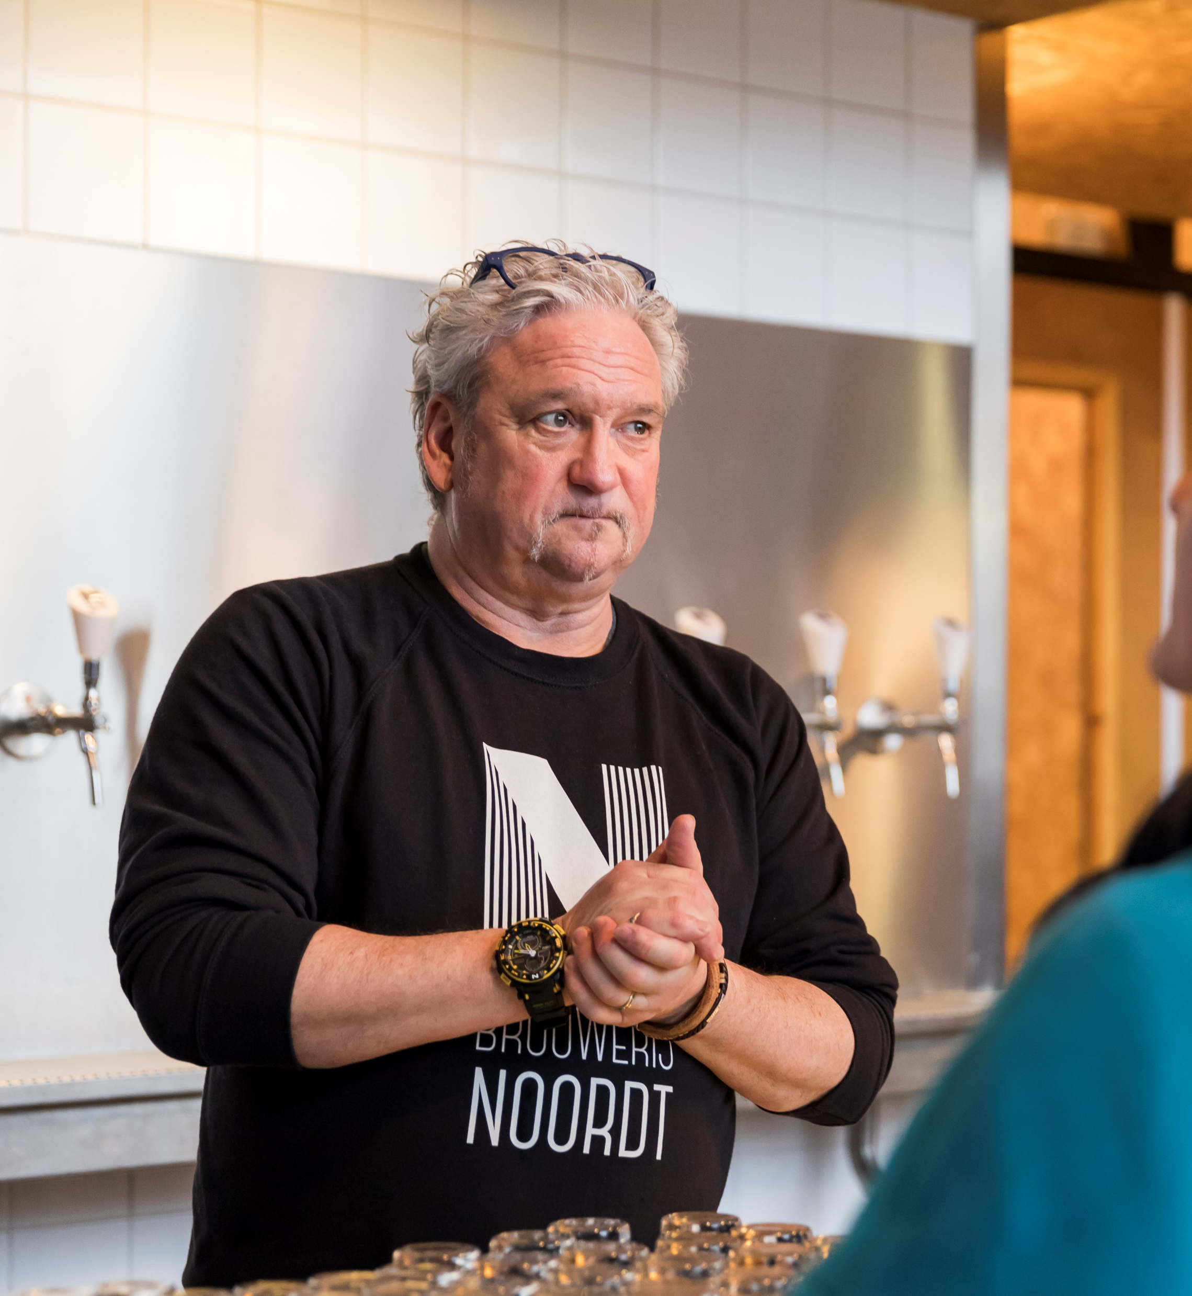
Selling your beer
Networking
Be the strongest in your area
Knowing your audience
Service
Hosting customers

Slide 13
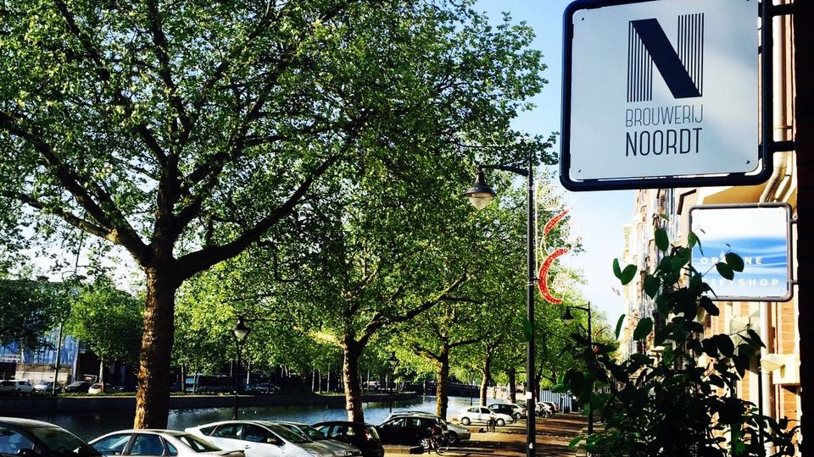
Five key point for staying in business
Strong focus on personnel / Education
Financial focus (software)
Direct communication
Customer support
Family, not a team

Slide 14
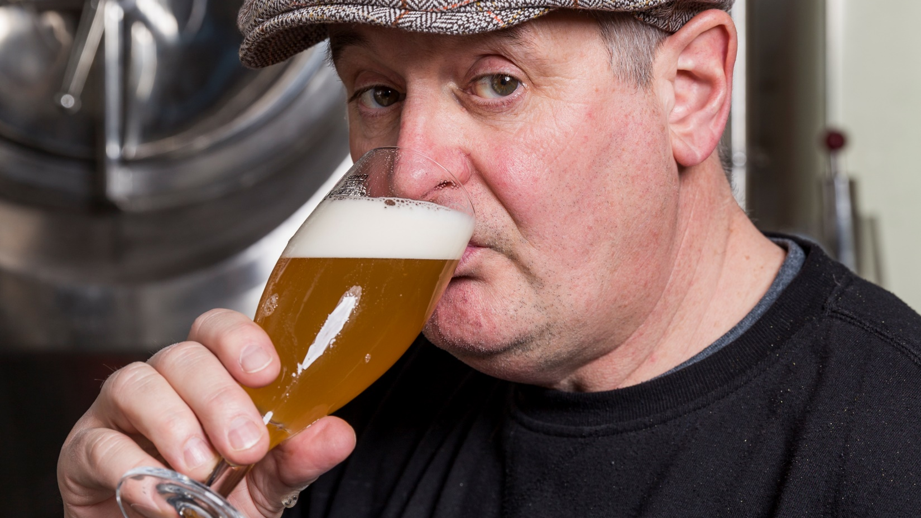
If you won’t improve yourself, you’d better get out of this business

