Slide 1
THE BREWERS OF EUROPE FORUM & EBC CONGRESS
Guerrilla Marketing
Pete Slosberg

Slide 2
How to Get More Than Your Fair Share of Mind Share
(On a limited budget)
‹#›

Slide 3
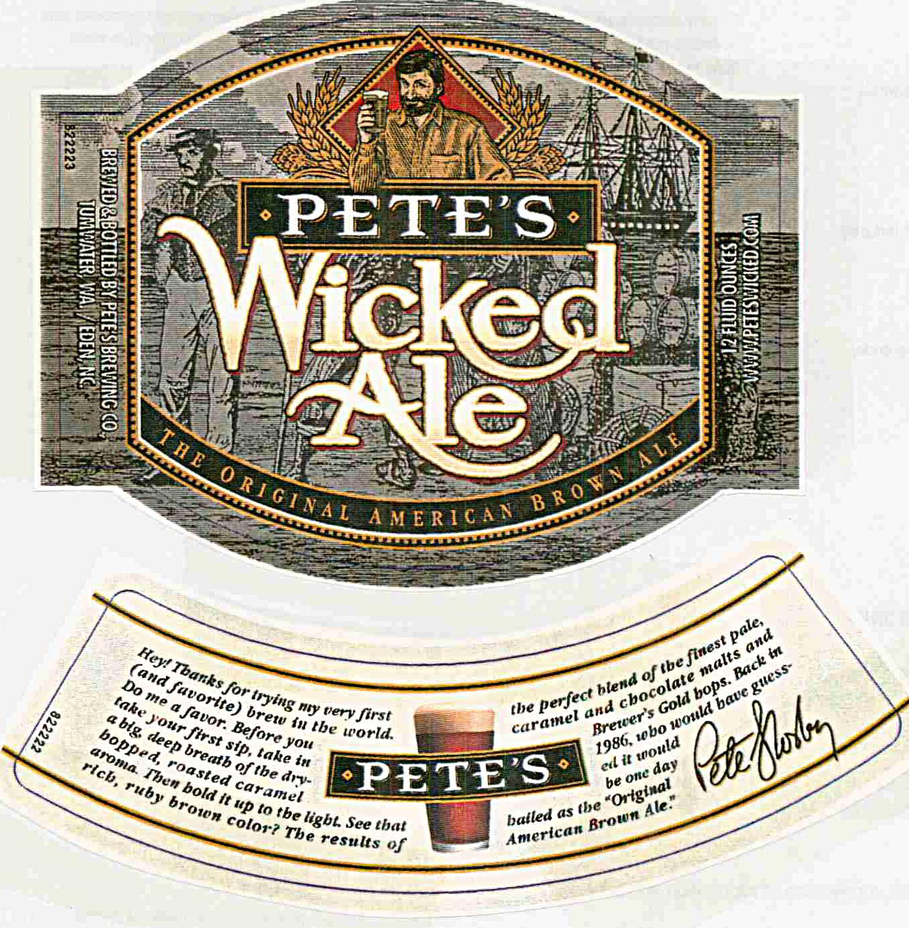

Slide 4
Pete’s Brewing Co accomplishments
Started 1986, public 1995, acquired 1998
Multiple awards, including Gold at GABF
Created a new Beer Style: American Brown Ale
10 Consecutive years over 100% annual growth
Inc. Magazine top 100 3-years in a row
500,000 Hectoliters in 10th year (number 2 behind Sam Adams)
Peak revenue $70M, sold 1 billion bottle equivalents
‹#›

Slide 5
Guerrilla Marketing
Multiply Your Voice
-Create Advocates
-Let Others Amplify your Messages and Benefits
-It starts the snow-ball rolling

Slide 6
Famous Saying
“If you Build it
They will Come”

Slide 7
Starting Concepts
Hone your Elevator Pitch
Put yourself in the Other Person’s Shoes
Learn How to Handle Objections

Slide 8
Is Your Product Great?
‹#›

Slide 9
Why does this Matter?
Just because you think your product is great, doesn't mean others do
Assume every one is a SCEPTIC
Prove and demonstrate why anyone should care
Assume everyone is a 12 year old, keep answers simple and concise
Avoid using too much industry jargon
Become Memorable
‹#›

Slide 10
Who is Your Customer?
‹#›

Slide 11
Who is your Customer?
Your employees
Your wholesaler and distributor principals
Your wholesaler and distributor sales forces
Your retailer principals
Your retailers sales force
Your Suppliers
Press and media
End customer
‹#›

Slide 12
The Holy Trinity of Marketing
Awareness
Trial
Repetition
‹#›

Slide 13
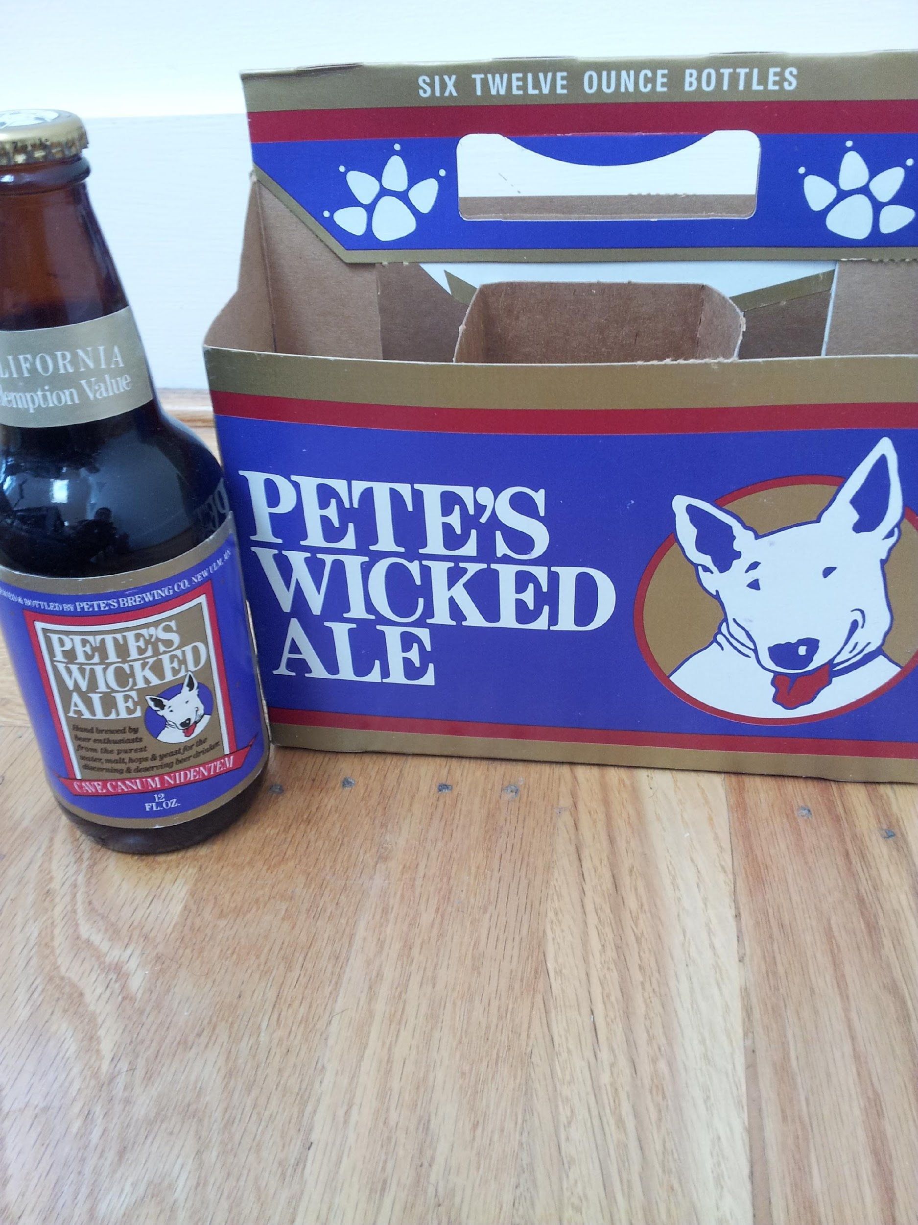
‹#›

Slide 14
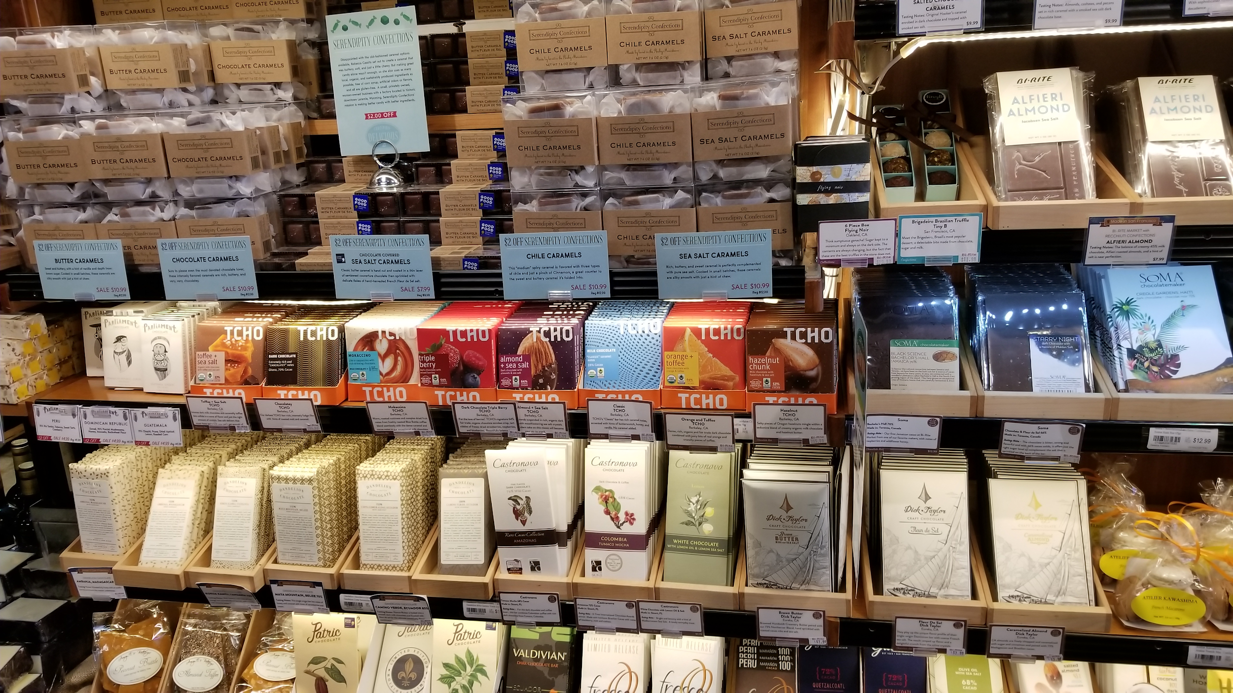

Slide 15
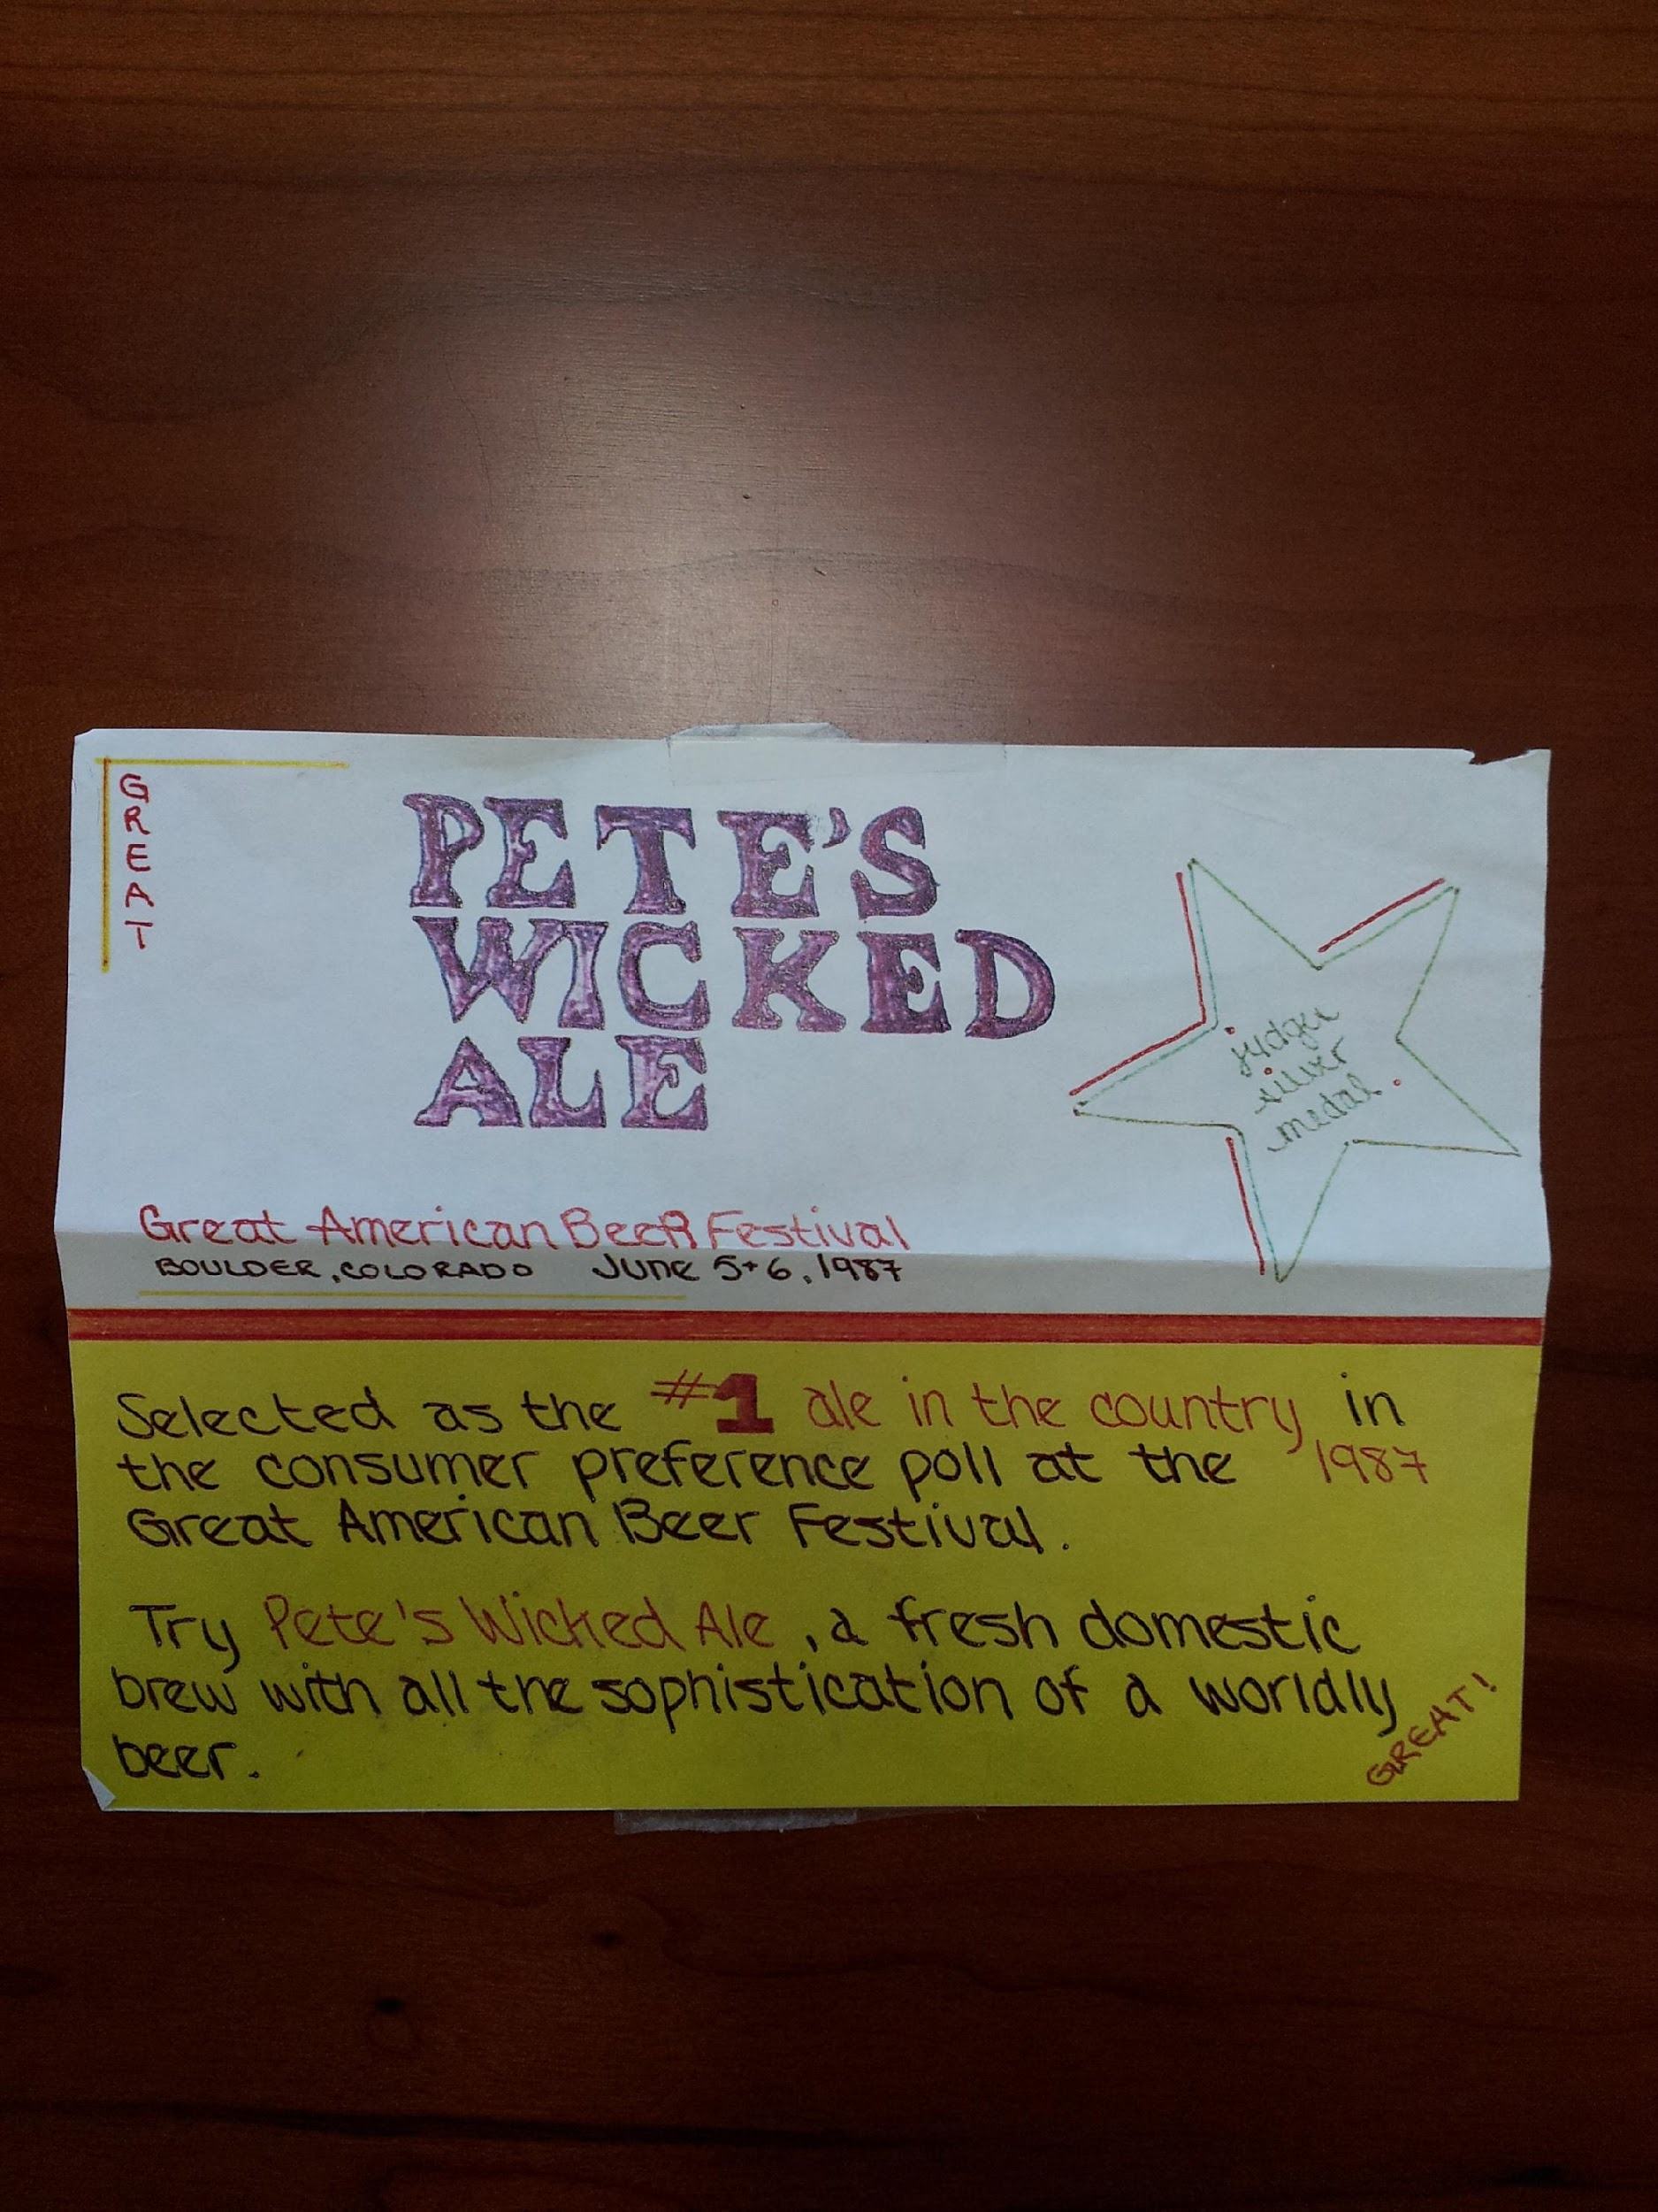
Pete_SCORE_2018
‹#›
Notes:
No money for marketing support so we went downscale to get attention with a “shelf talker”

Slide 16
Pete’s Brewing Company Beer Knowledge Test
Malts - What are the different kinds of Malt and how do you get them? Explain the difference in enzyme activity
Hops – Why are hops used in making beer? Describe the key types of hops and their characteristics
Brewing – Describe the brewing process; the equipment, and the time frame of the activities
Name three kinds of defects in beer and describe their characteristics
Beer Styles – explain the differences between Ales, Lagers, and Beers. Describe PBC beers, including specs, styles and lagers. Describe each style and give some historical. Describe three of your local competitive specialty beers – style and characteristics. Compare and contrast to the closest PBC Beer.
‹#›

Slide 17
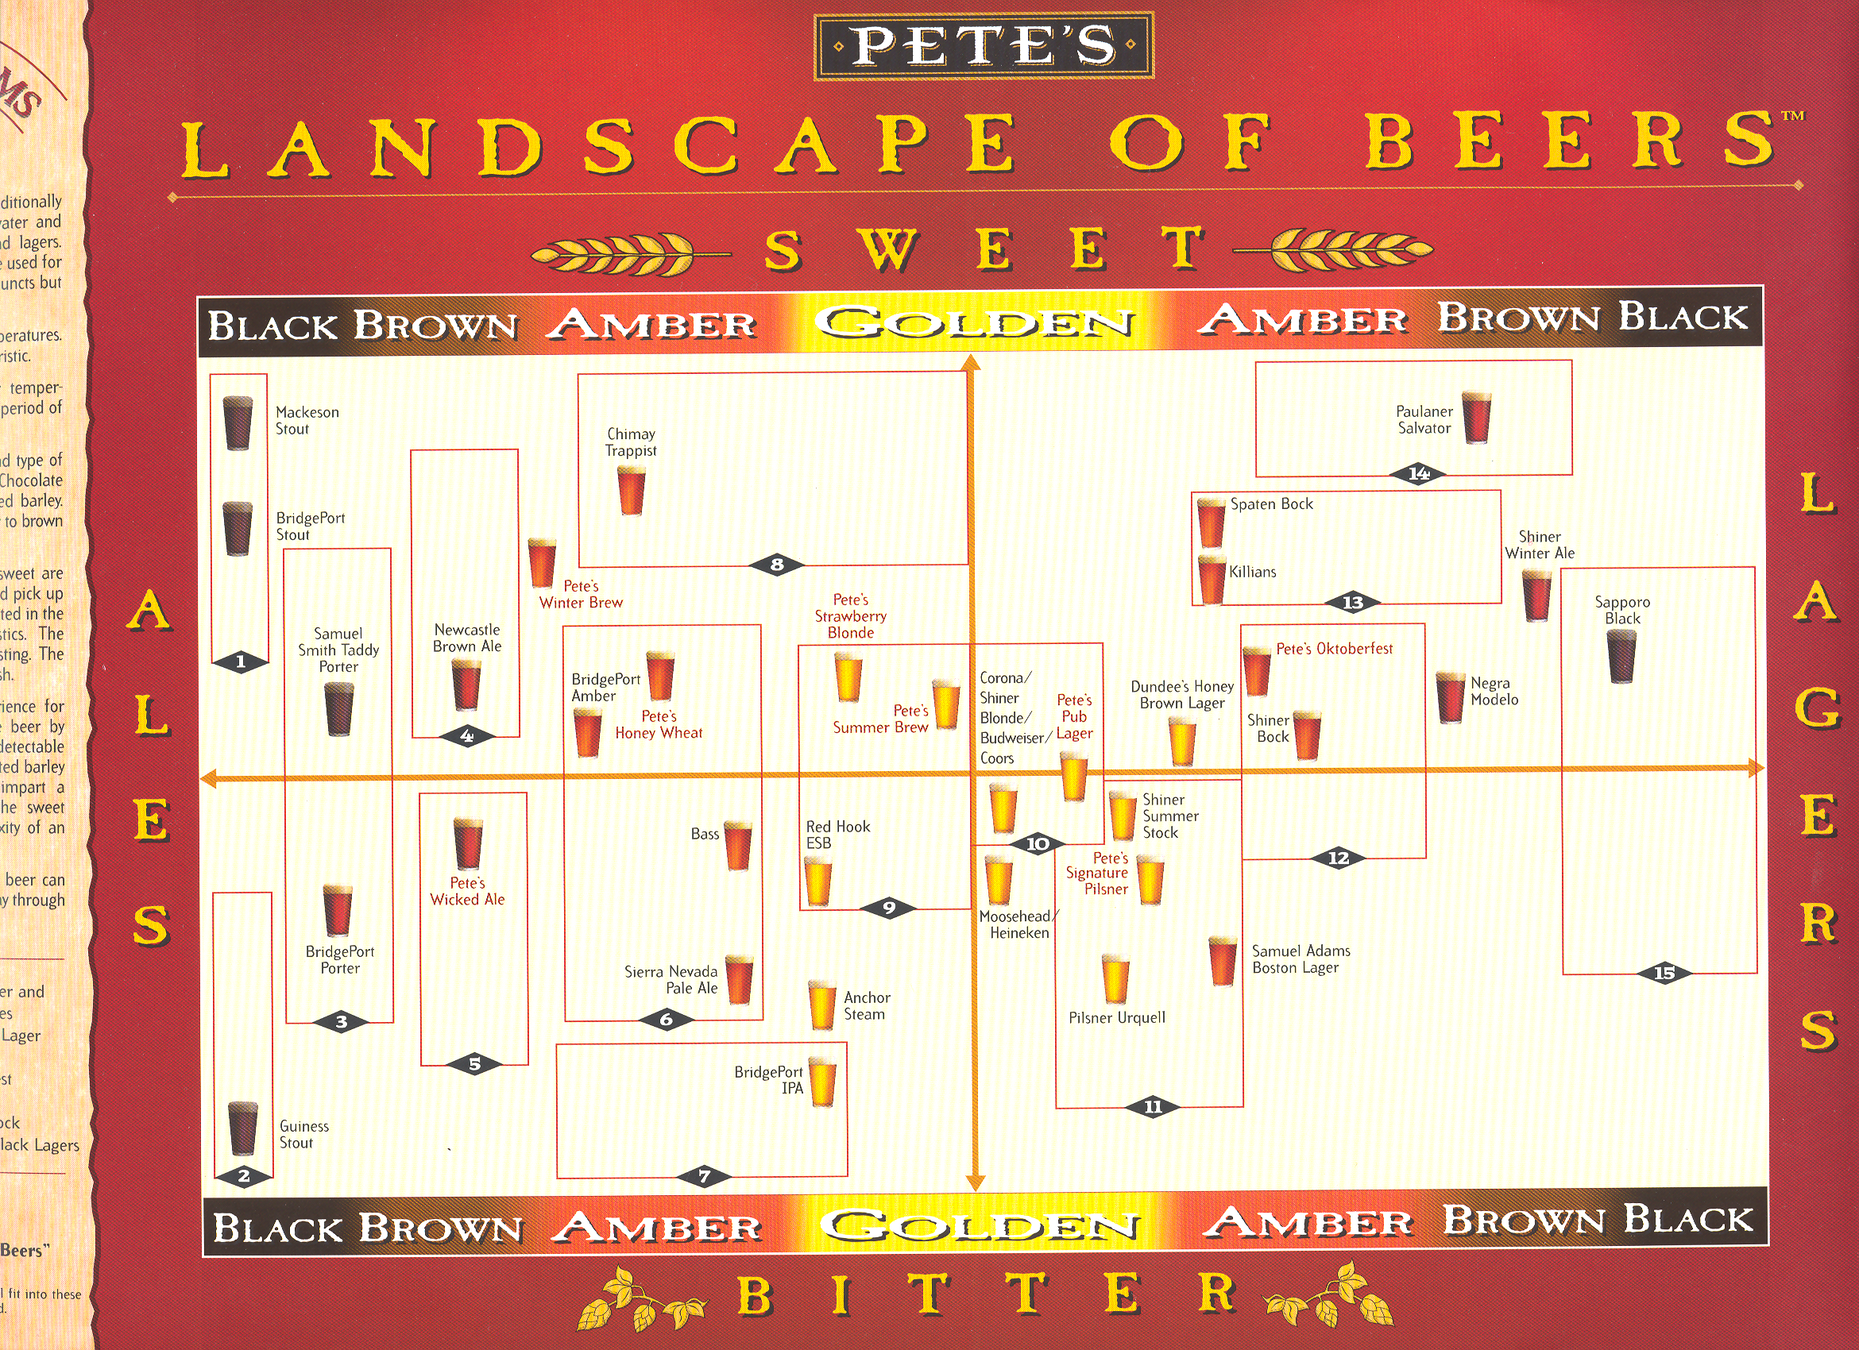
‹#›

Slide 18
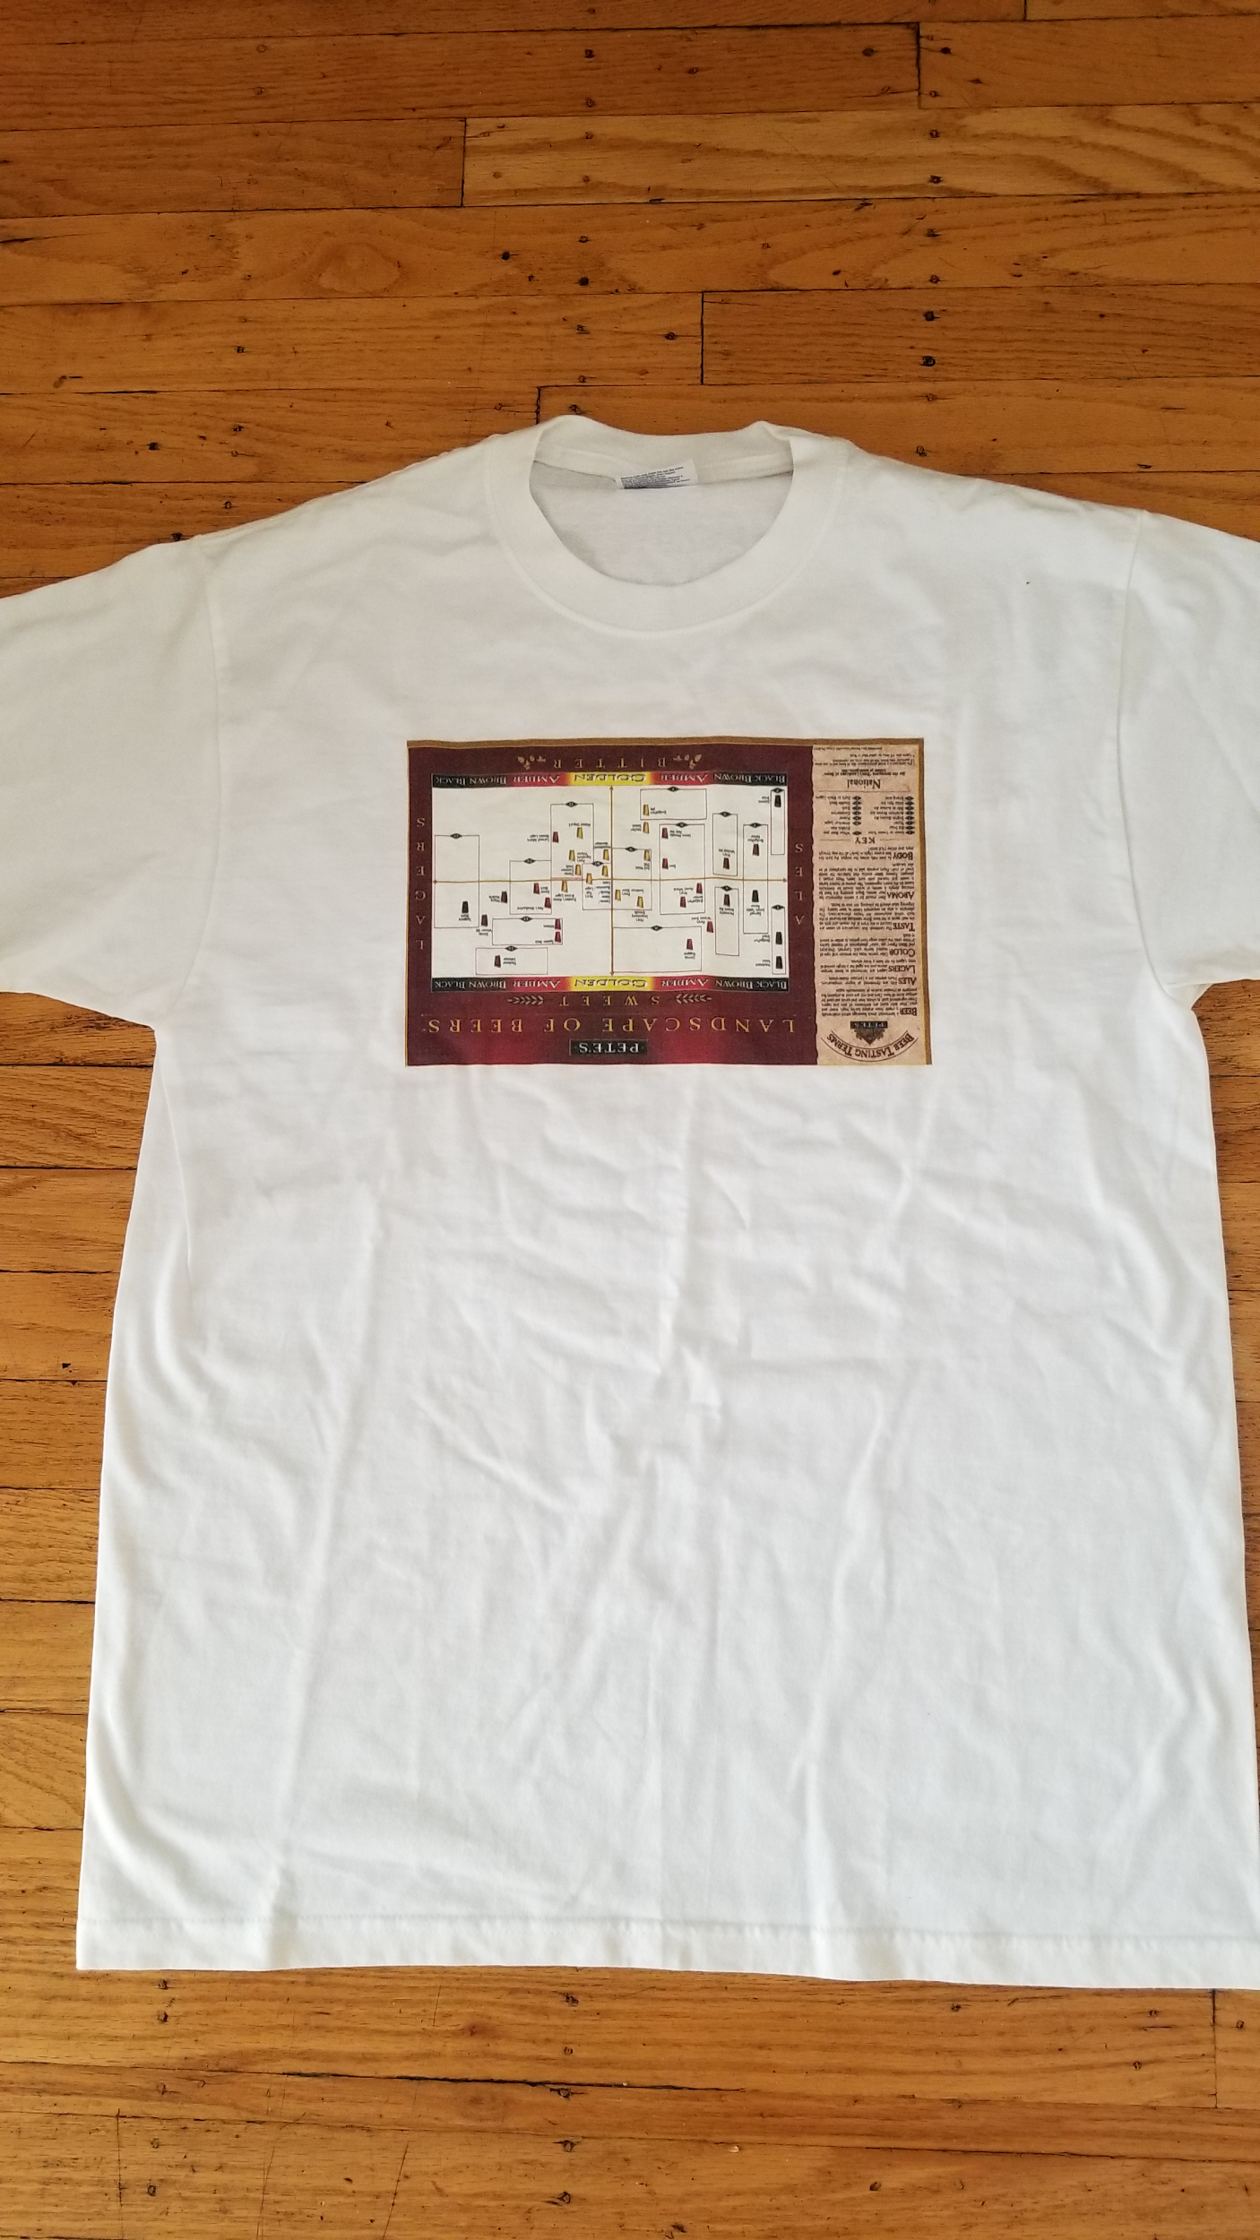

Slide 19
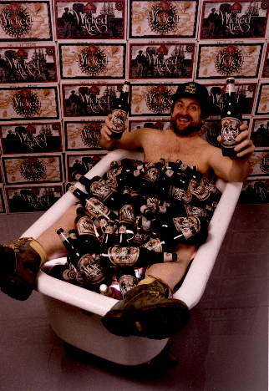
‹#›

Slide 20
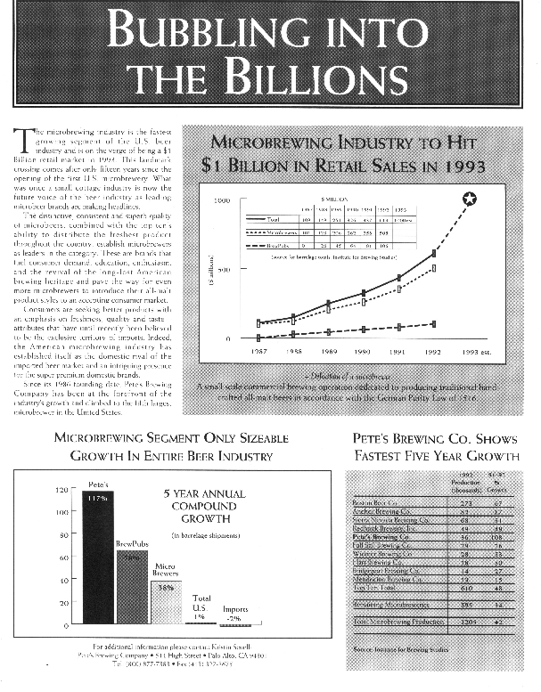
‹#›
Notes:
Created a beer education chart that can make anyone a beer expert in under 10 minutes

Slide 21
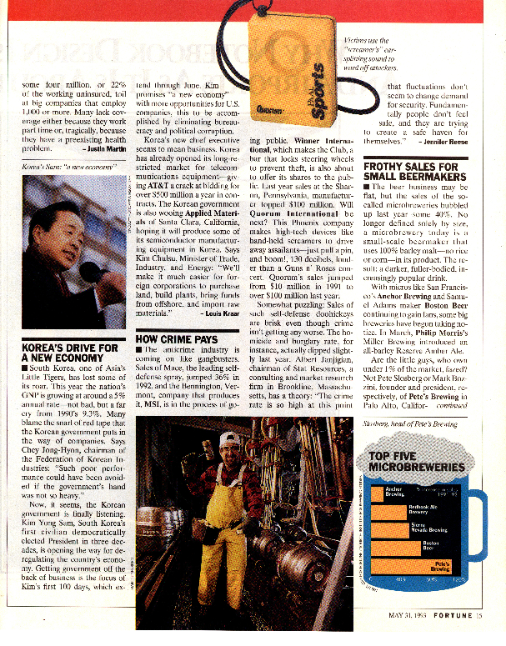
‹#›
Notes:
Putting this picture into a press release got an un-interesting release into 300 newspapers

Slide 22
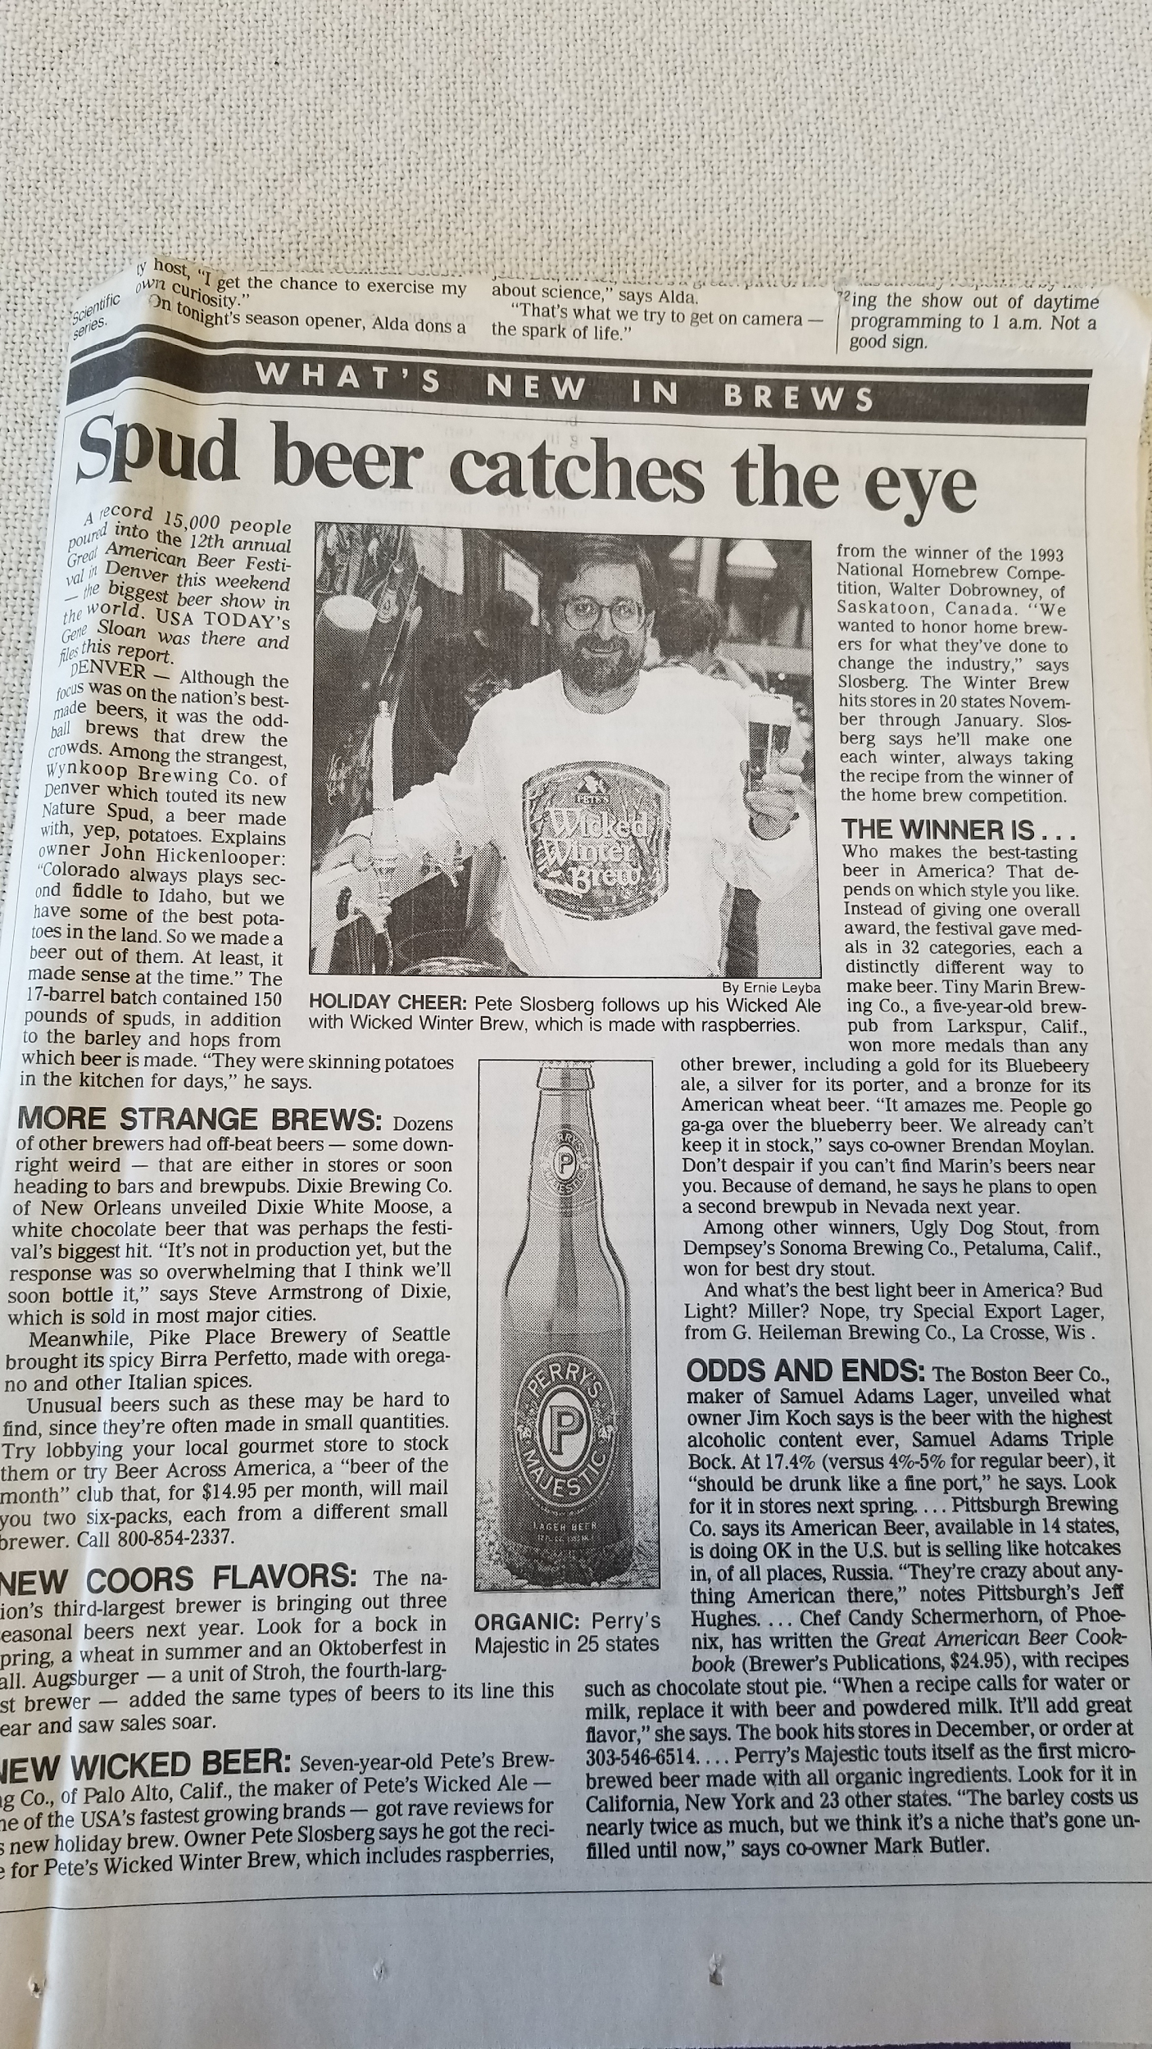
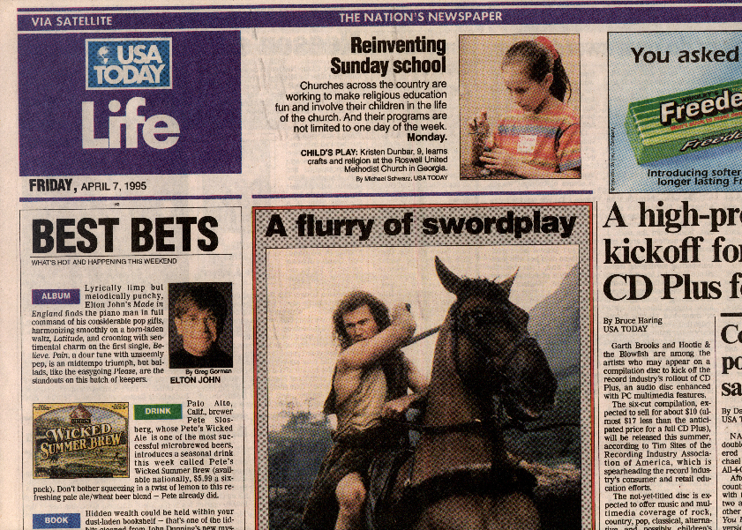

Slide 23
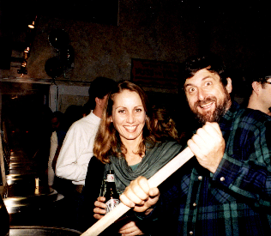
‹#›

Slide 24
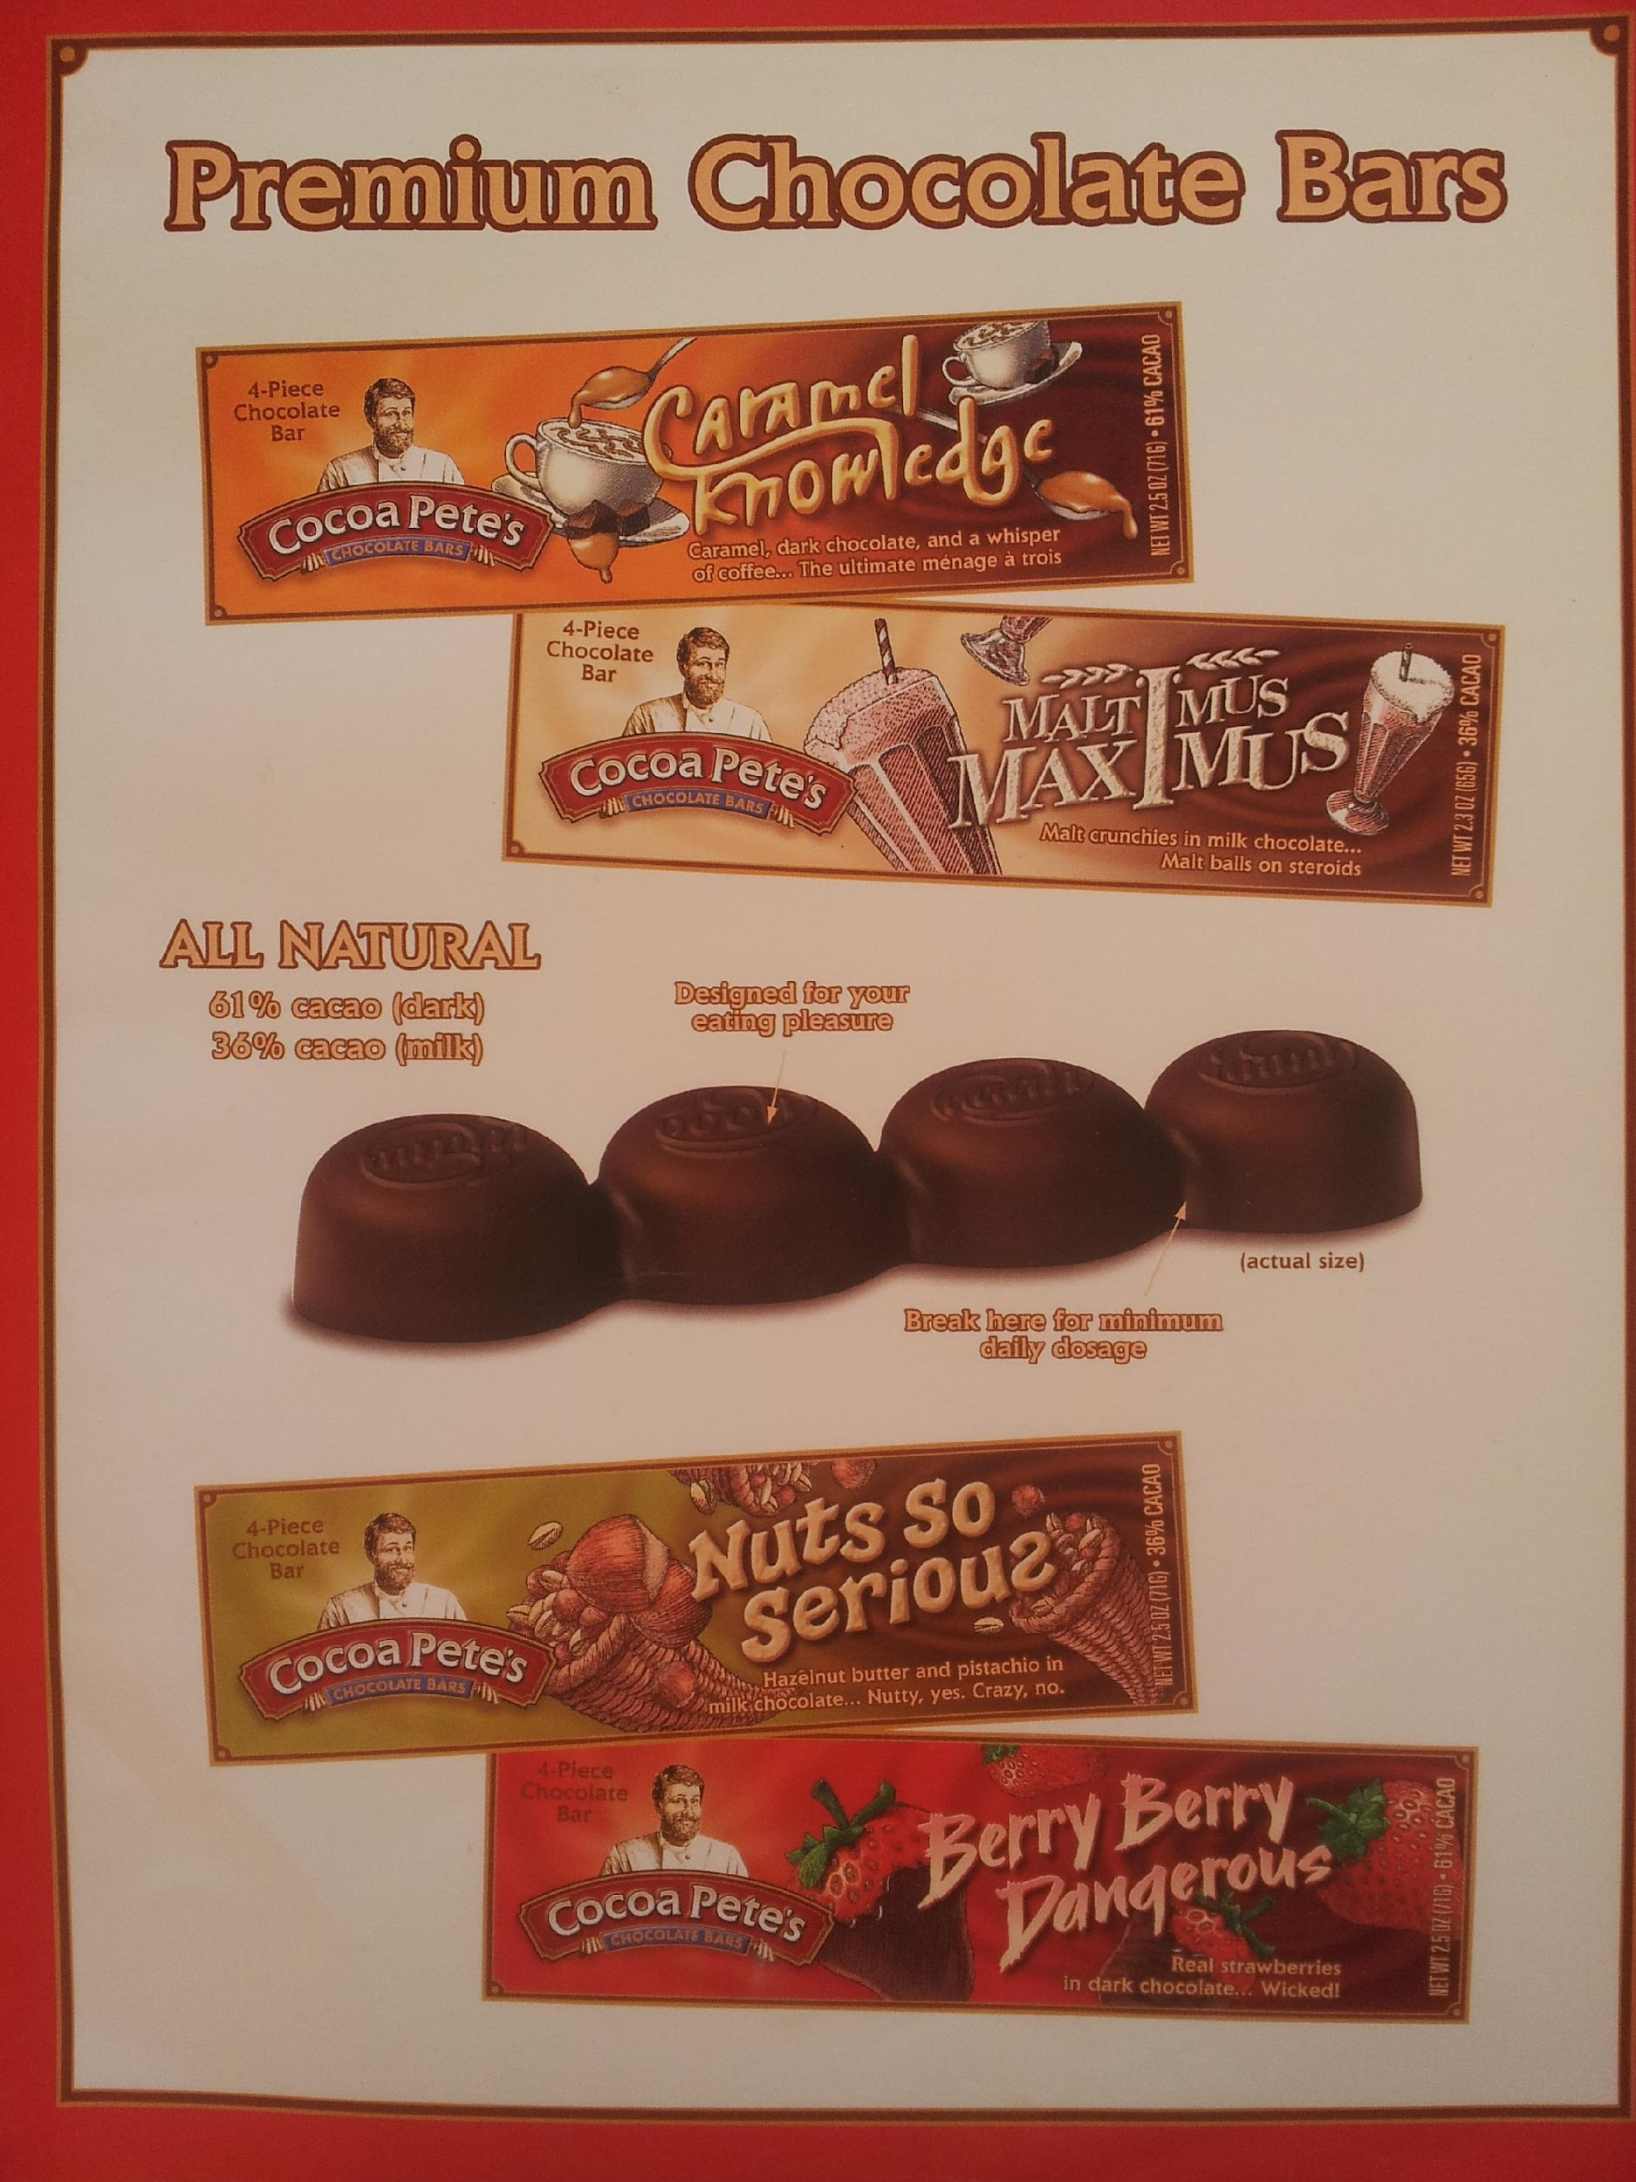
‹#›

Slide 25
Sampling
-Trying is Believing
-Do it with Personality
-We used un-employed Comedians and Actors

Slide 26
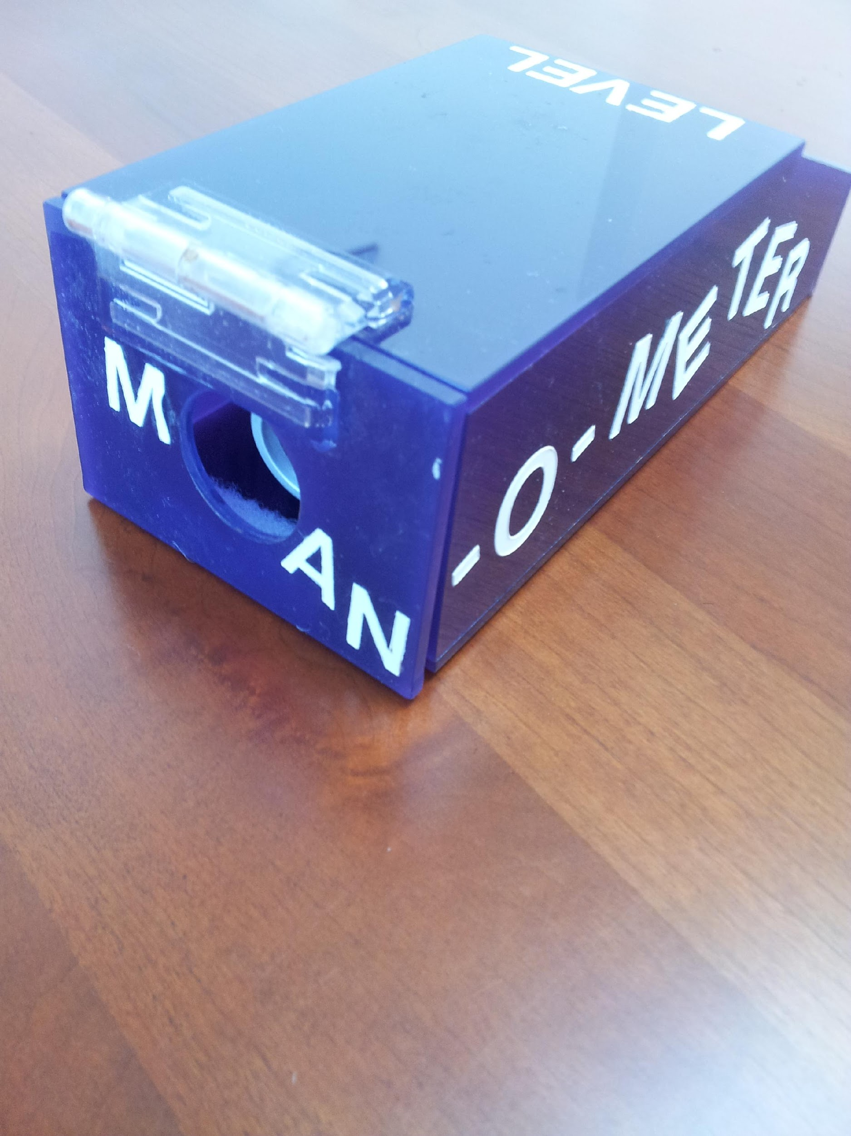
Pete_SCORE_2018
‹#›

Slide 27
