Slide 1
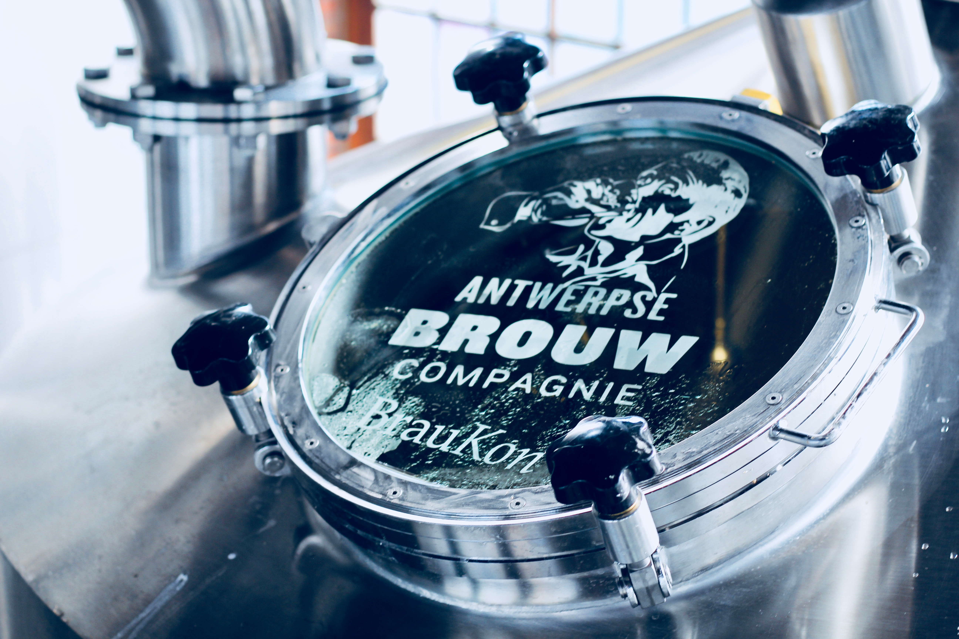
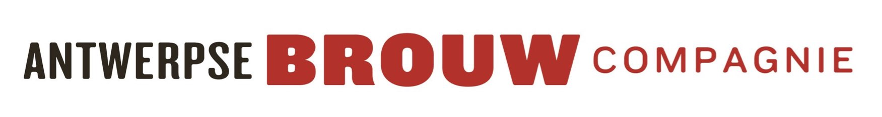
Johan Van Dyck
FOUNDER - OWNER

Slide 2
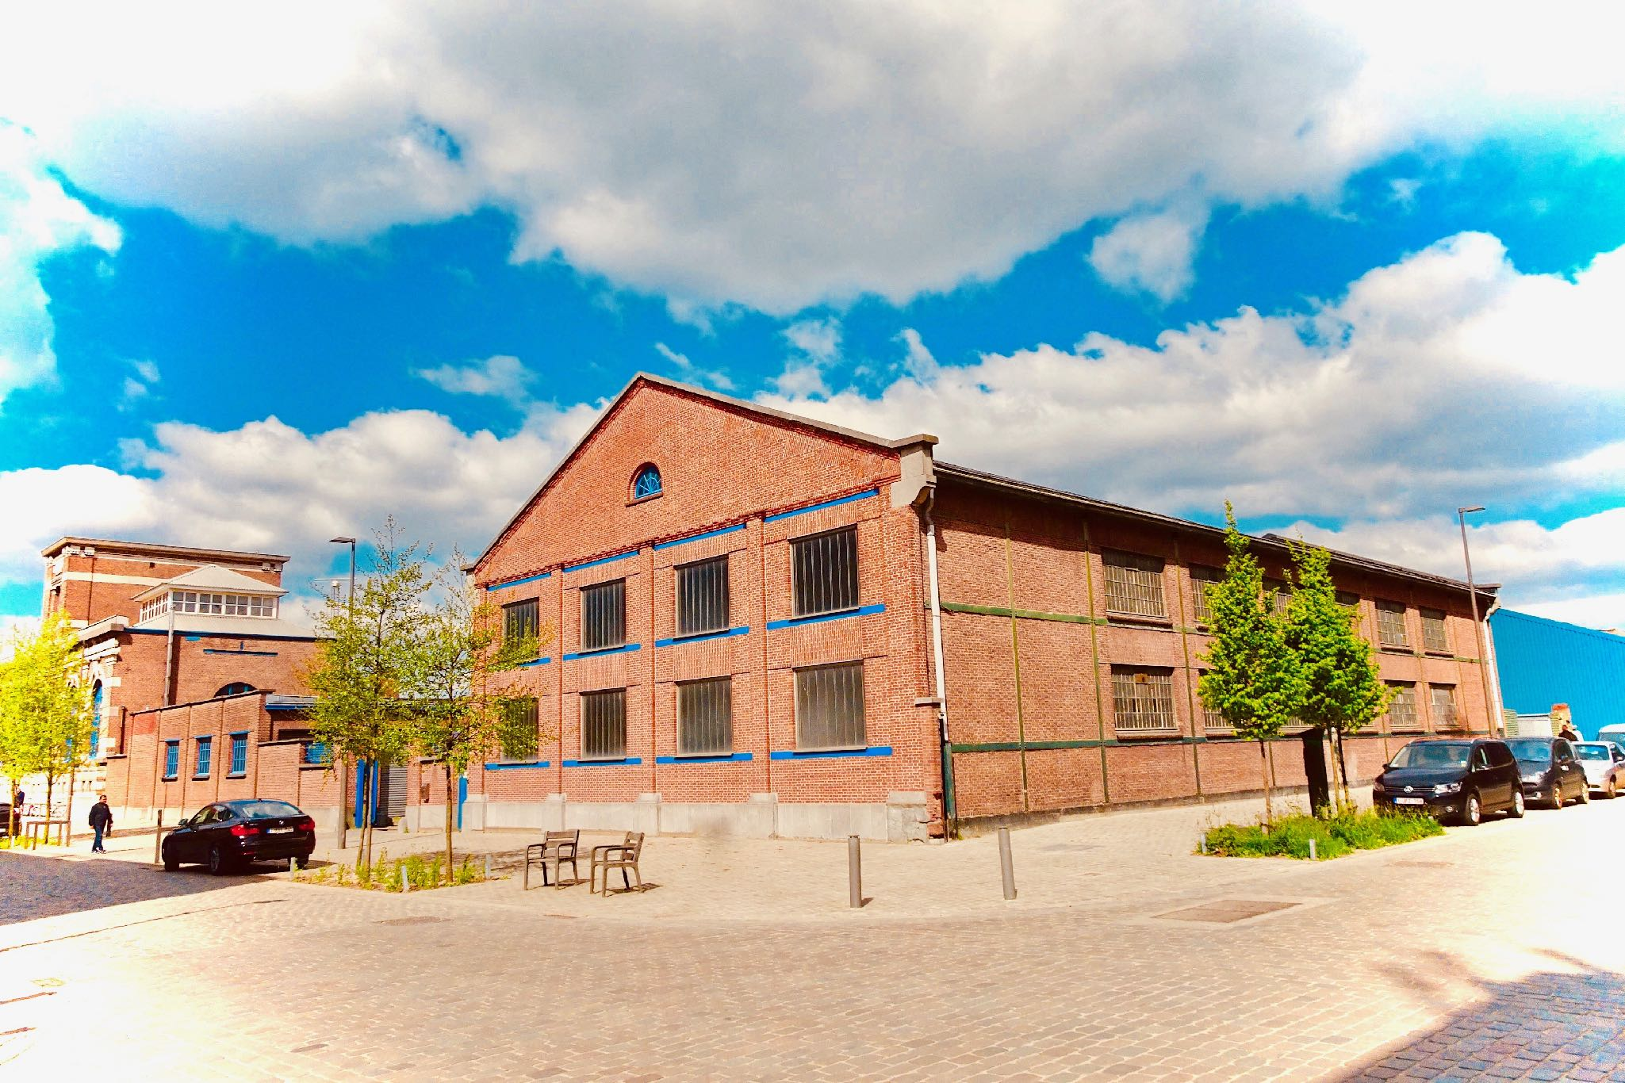
INDEPENDANT LOCAL BREWERY

Slide 3
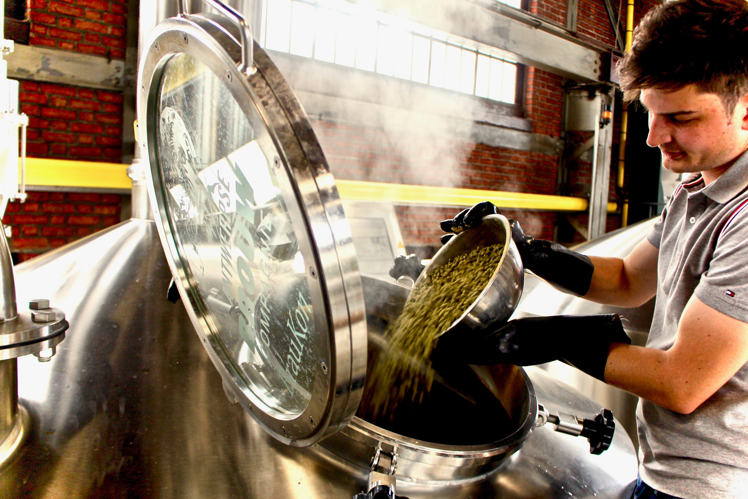

Slide 4
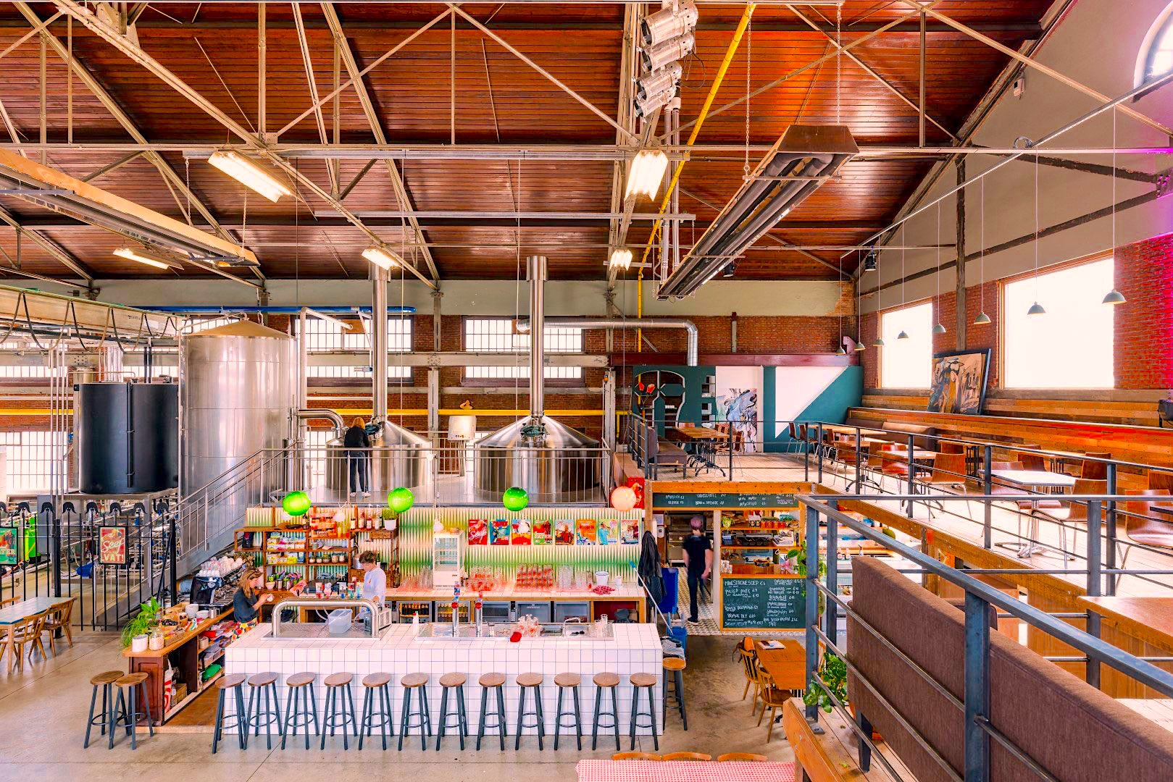

Slide 5
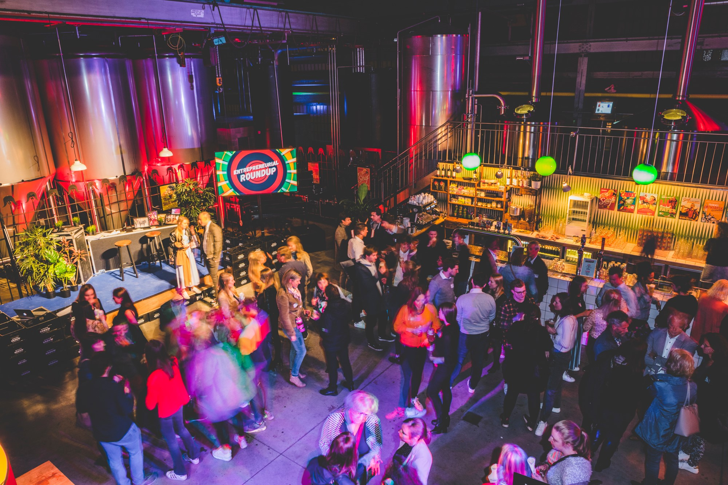
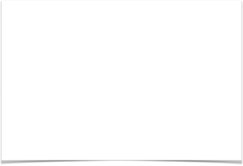
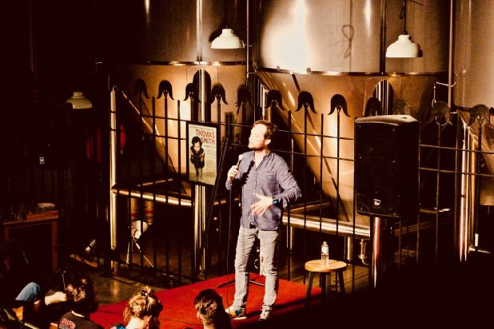
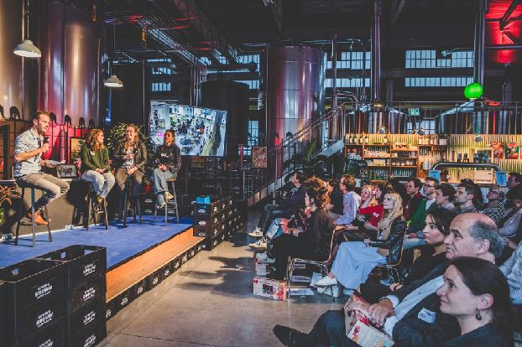
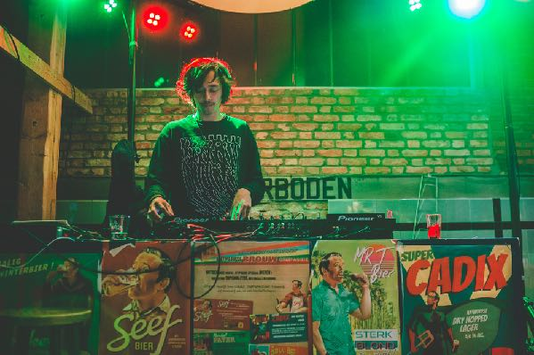

Slide 6
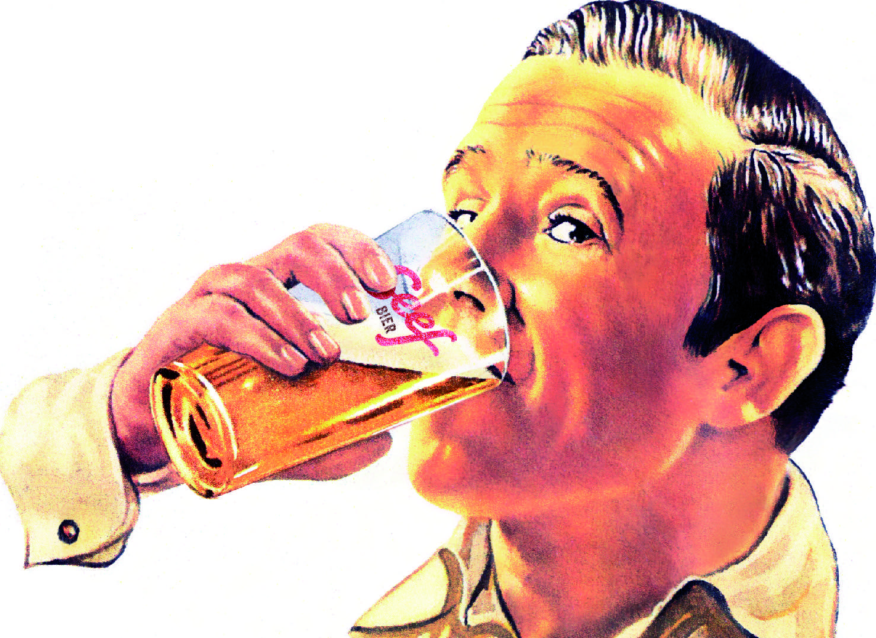
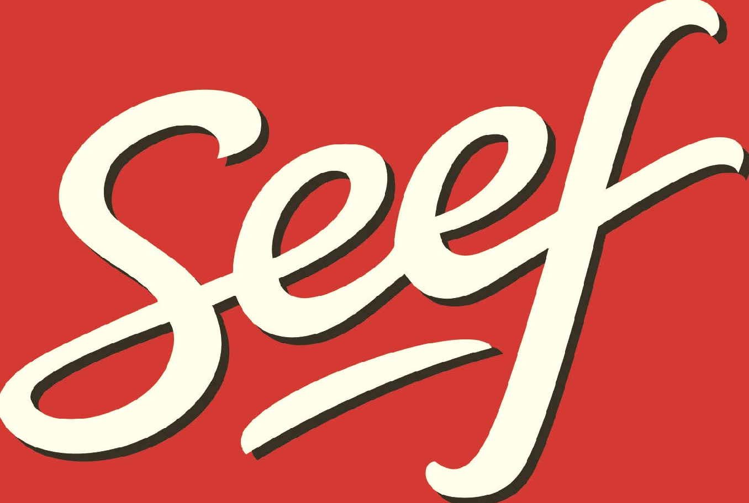

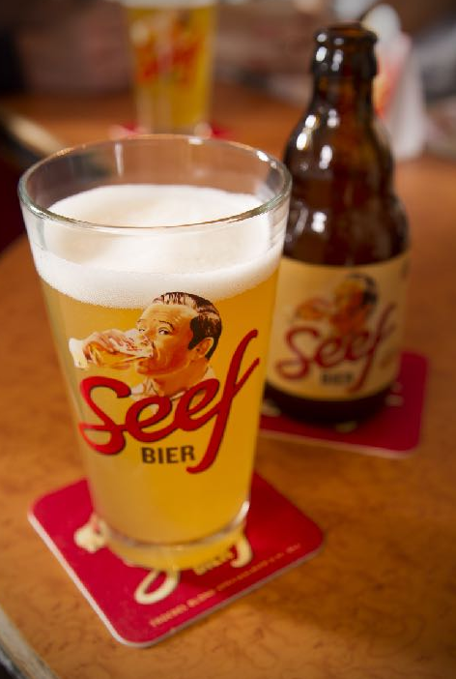
DRINKT
5,6% Alc. Vol / 28 EBU
6X GOLD - WORLD’s BEST !

Slide 7
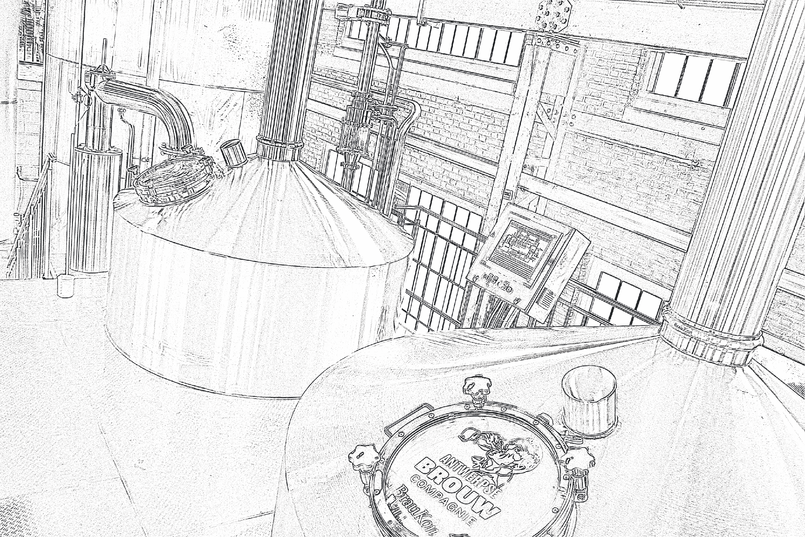
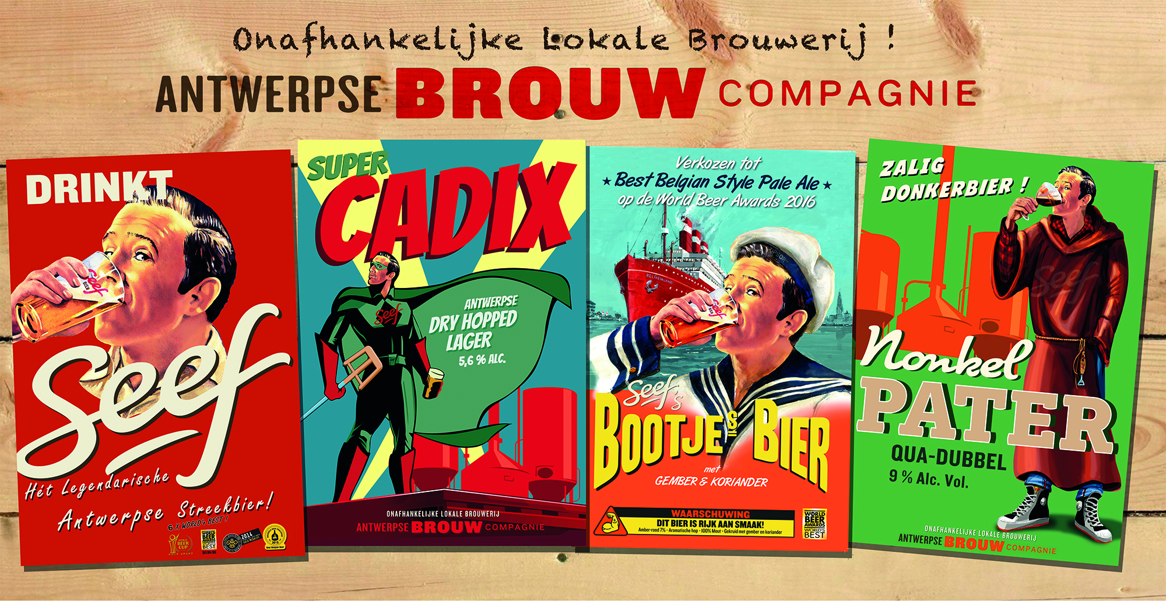
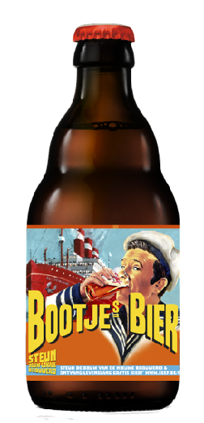
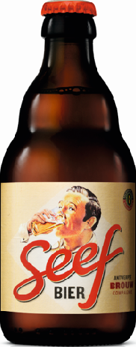
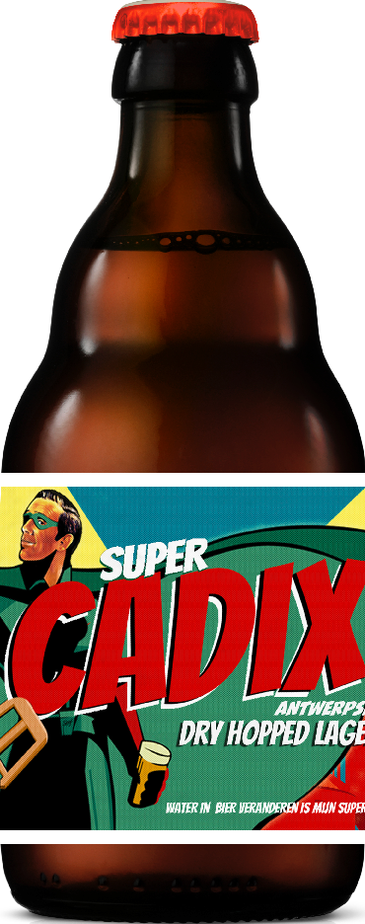
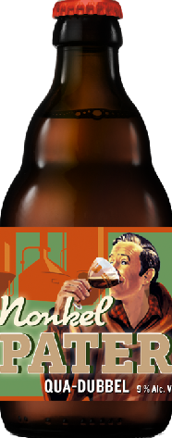

Slide 8
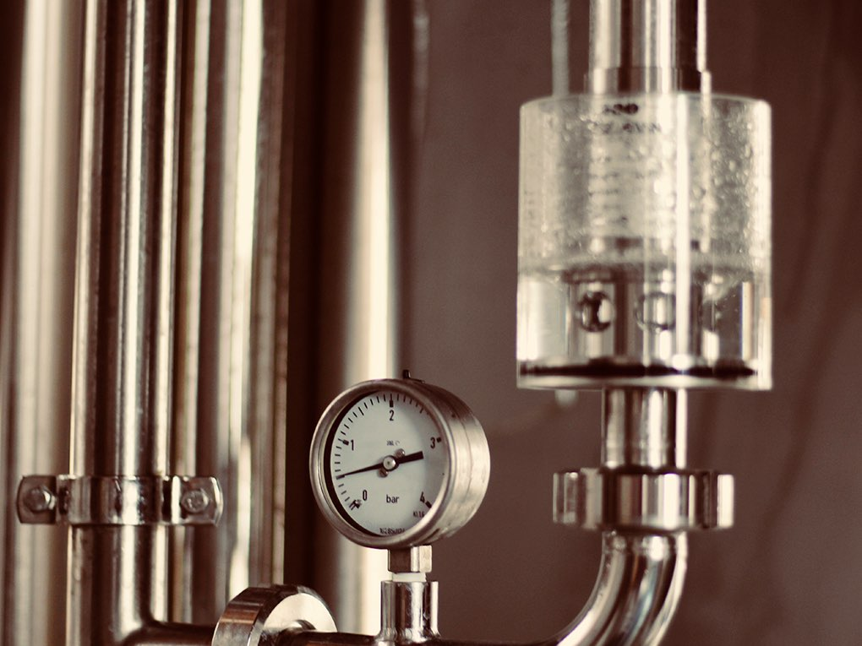
KEY SUCCESFACTORS
..what is succes…?

Slide 9
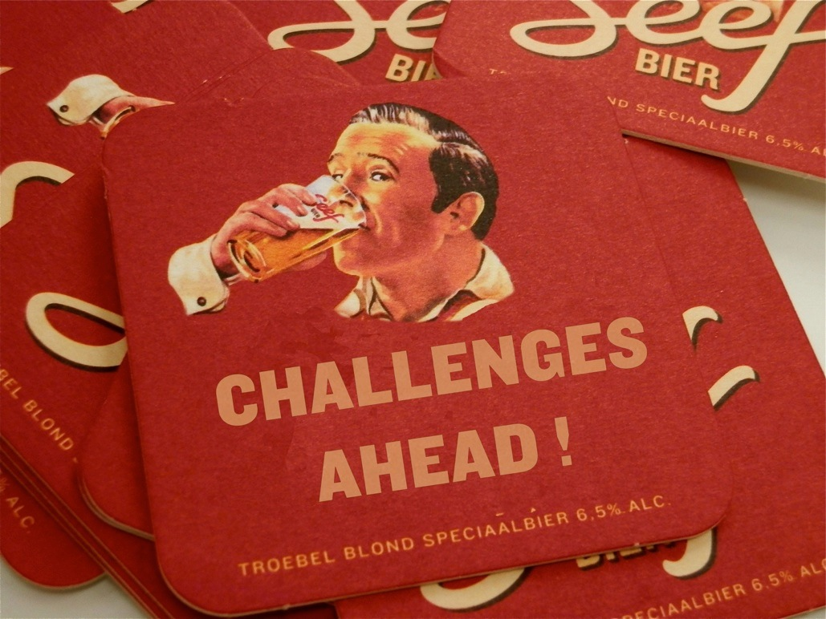
More expensive to brew, more expensive beer
No advertising or marketing budgets
No strong brands
No strong/big sales force
No controle over distribution(channels)

Slide 10
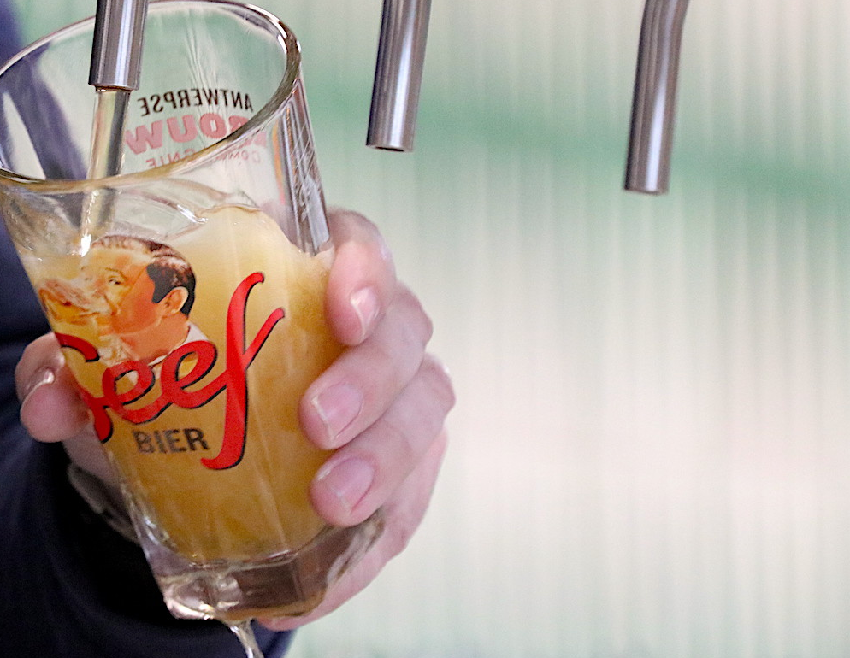
1
TOP QUALITY
..what is succes…?

Slide 11
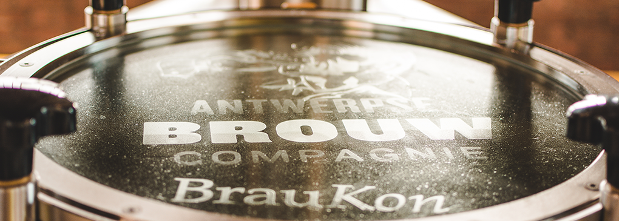
ARTISANAL
≠
AMATEURISH

Slide 12
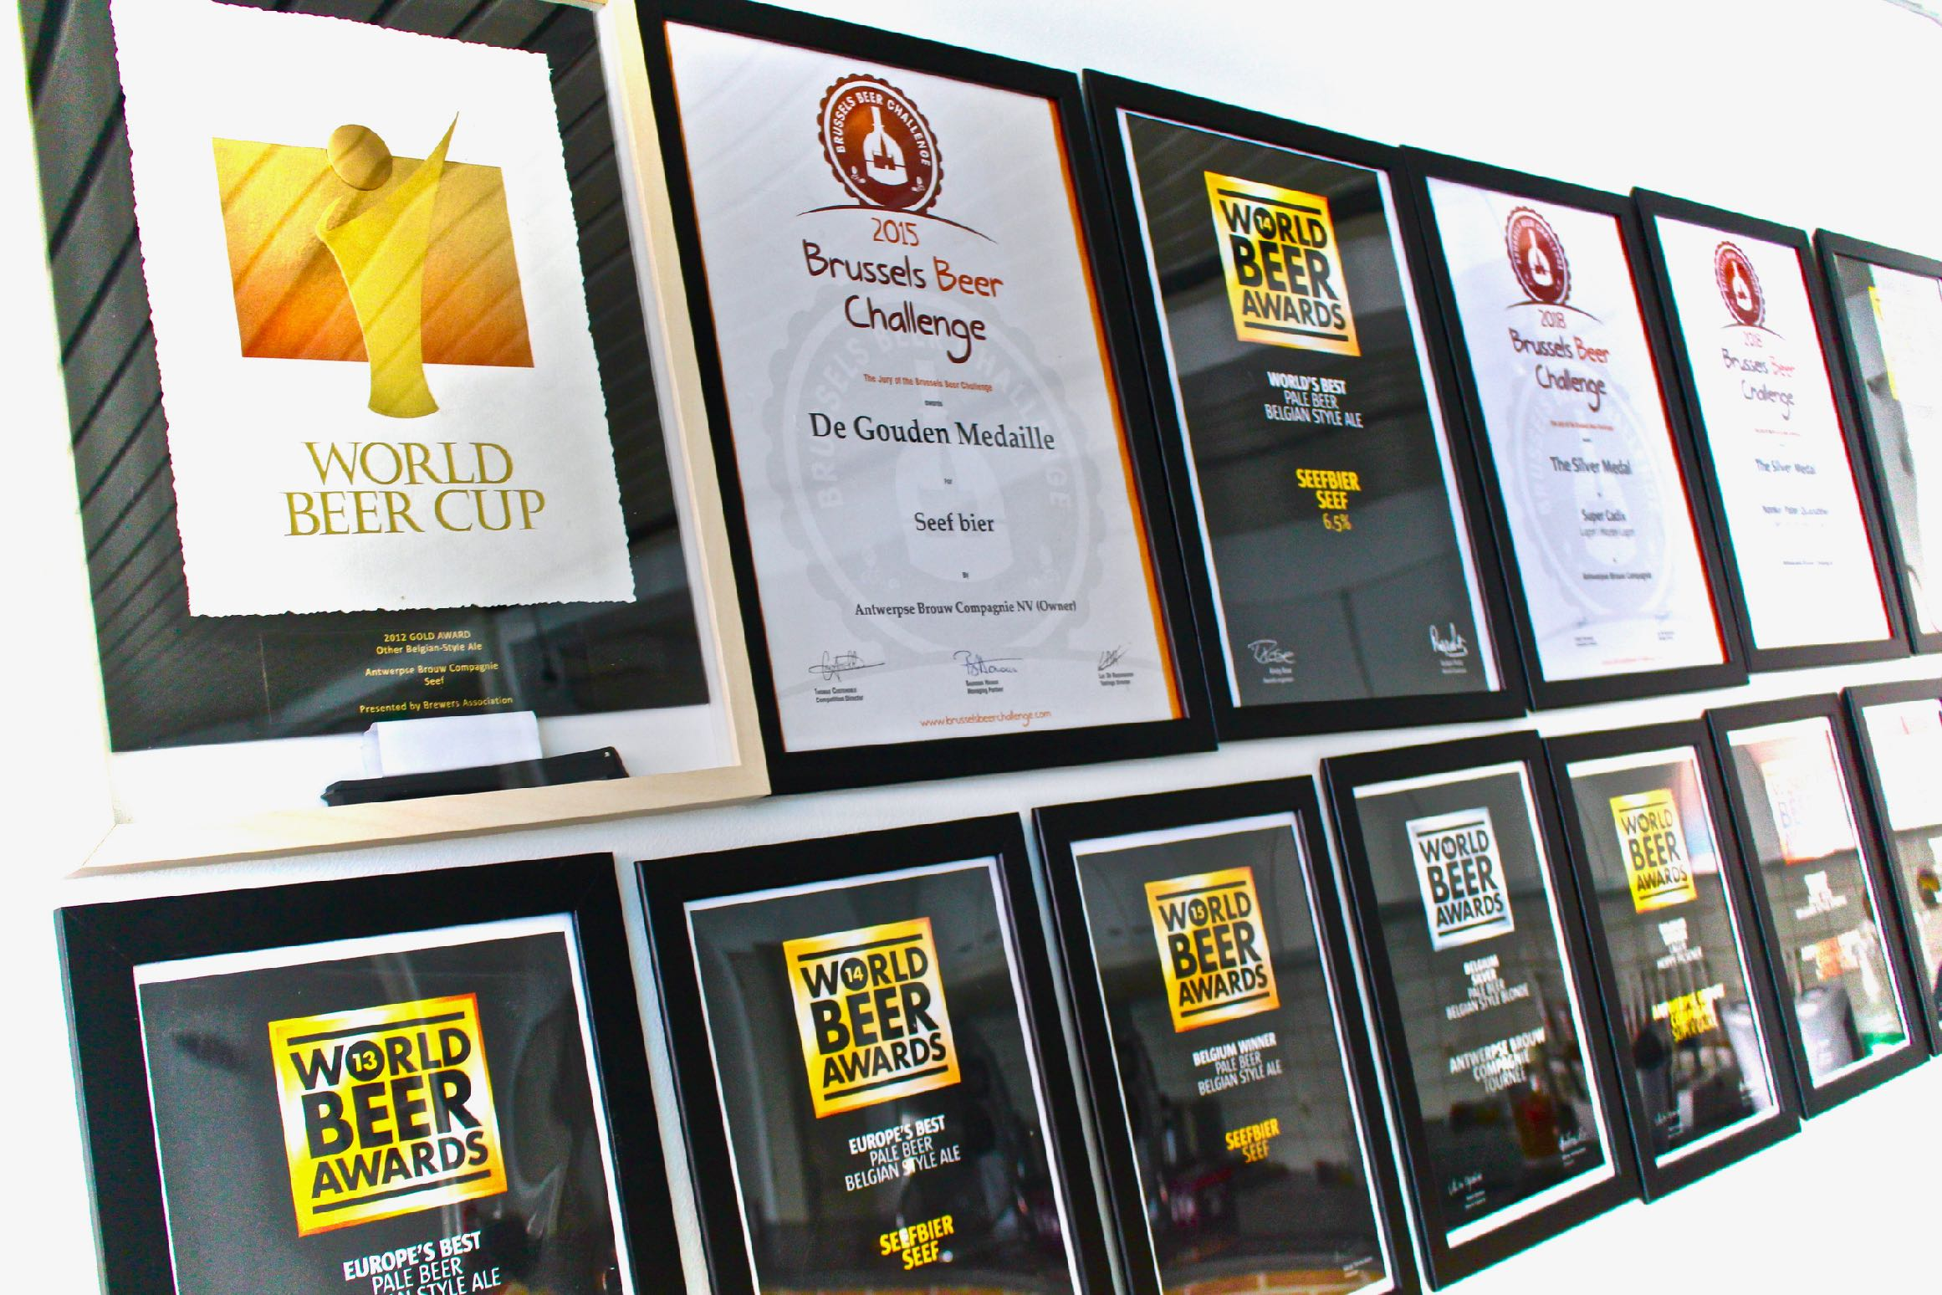
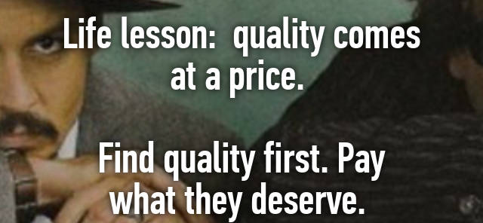
QUALITY = KEY !

Slide 13
INFECTED BATCH ≠ FUNKY WILD SOUR

Slide 14
2
BE UNIQUE !
Will they remember you ?

Slide 15
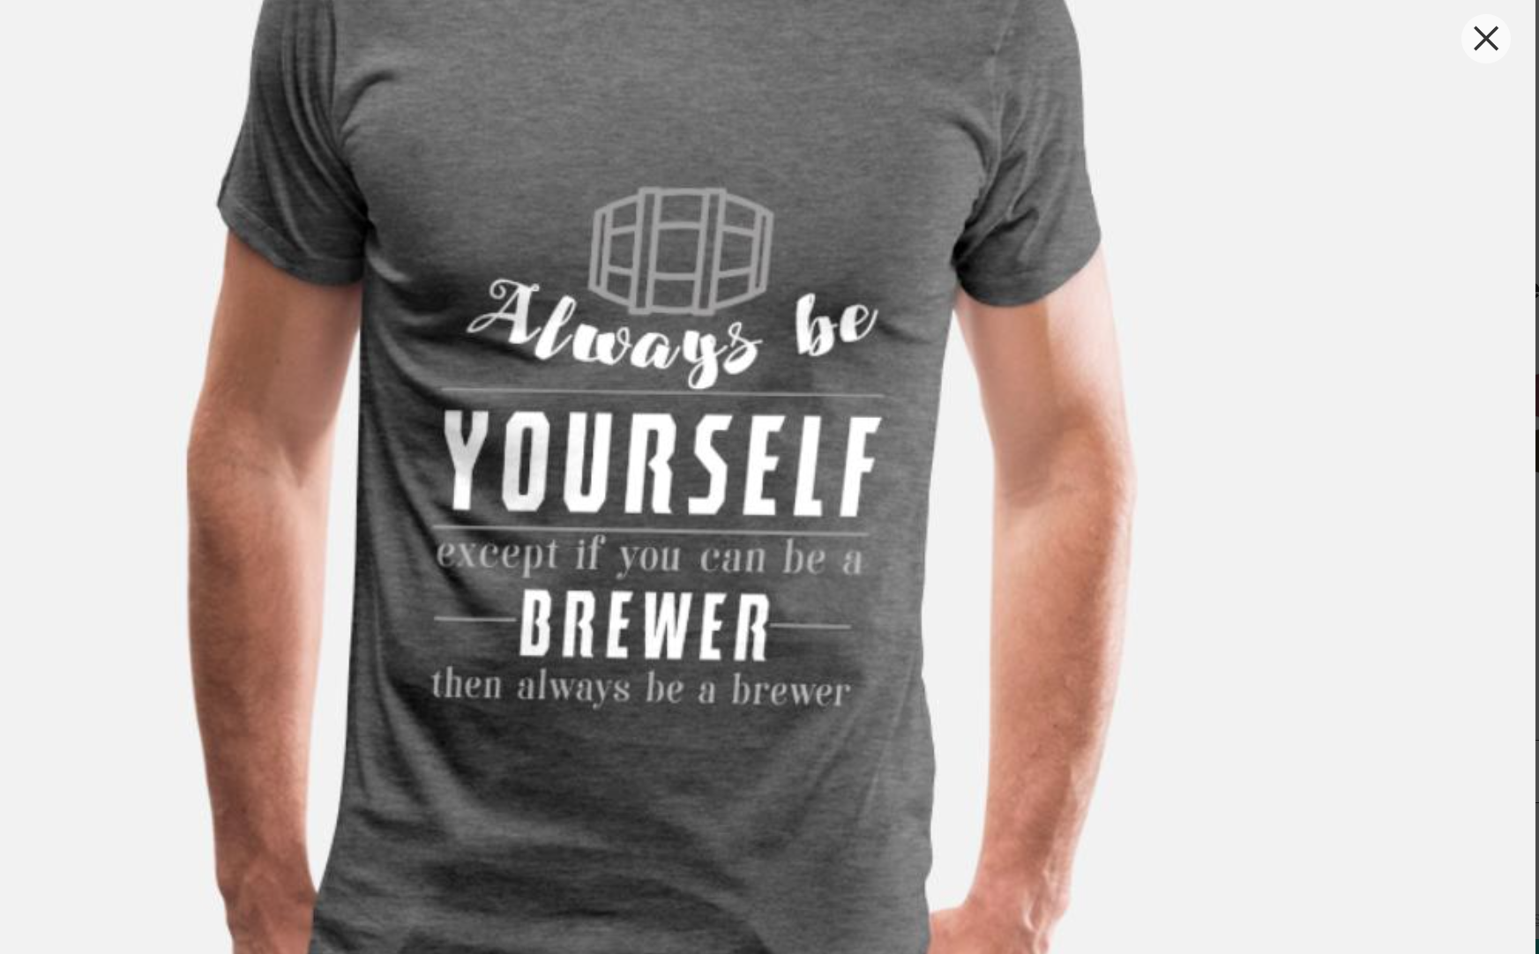
3 BE
AUTHENTIC

Slide 16
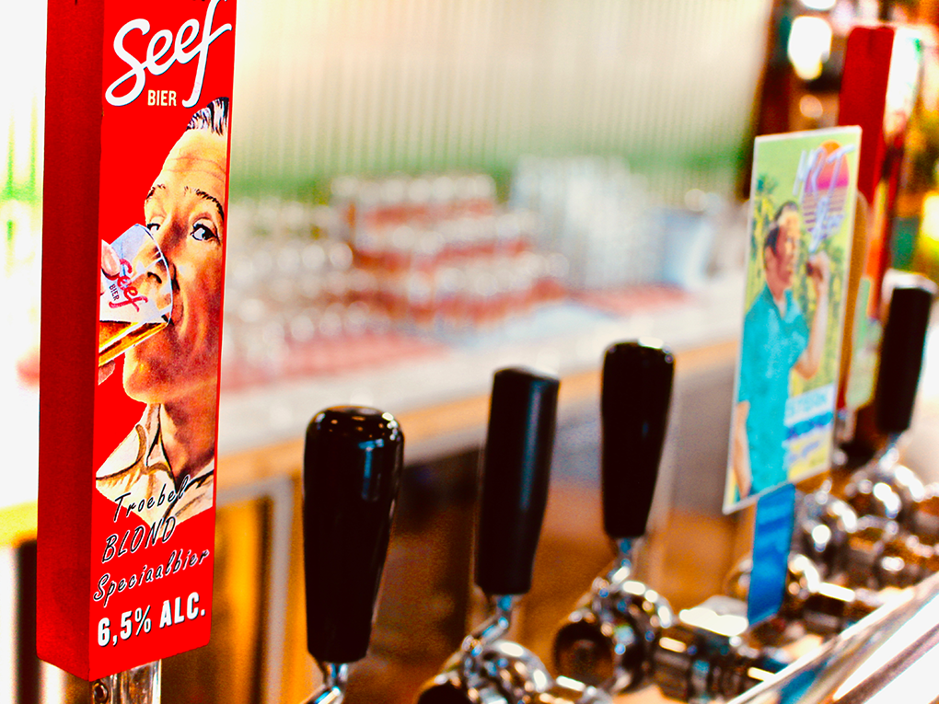
4 LEVERAGE
WEAKNESSES
TO STRENGTHS

Slide 17
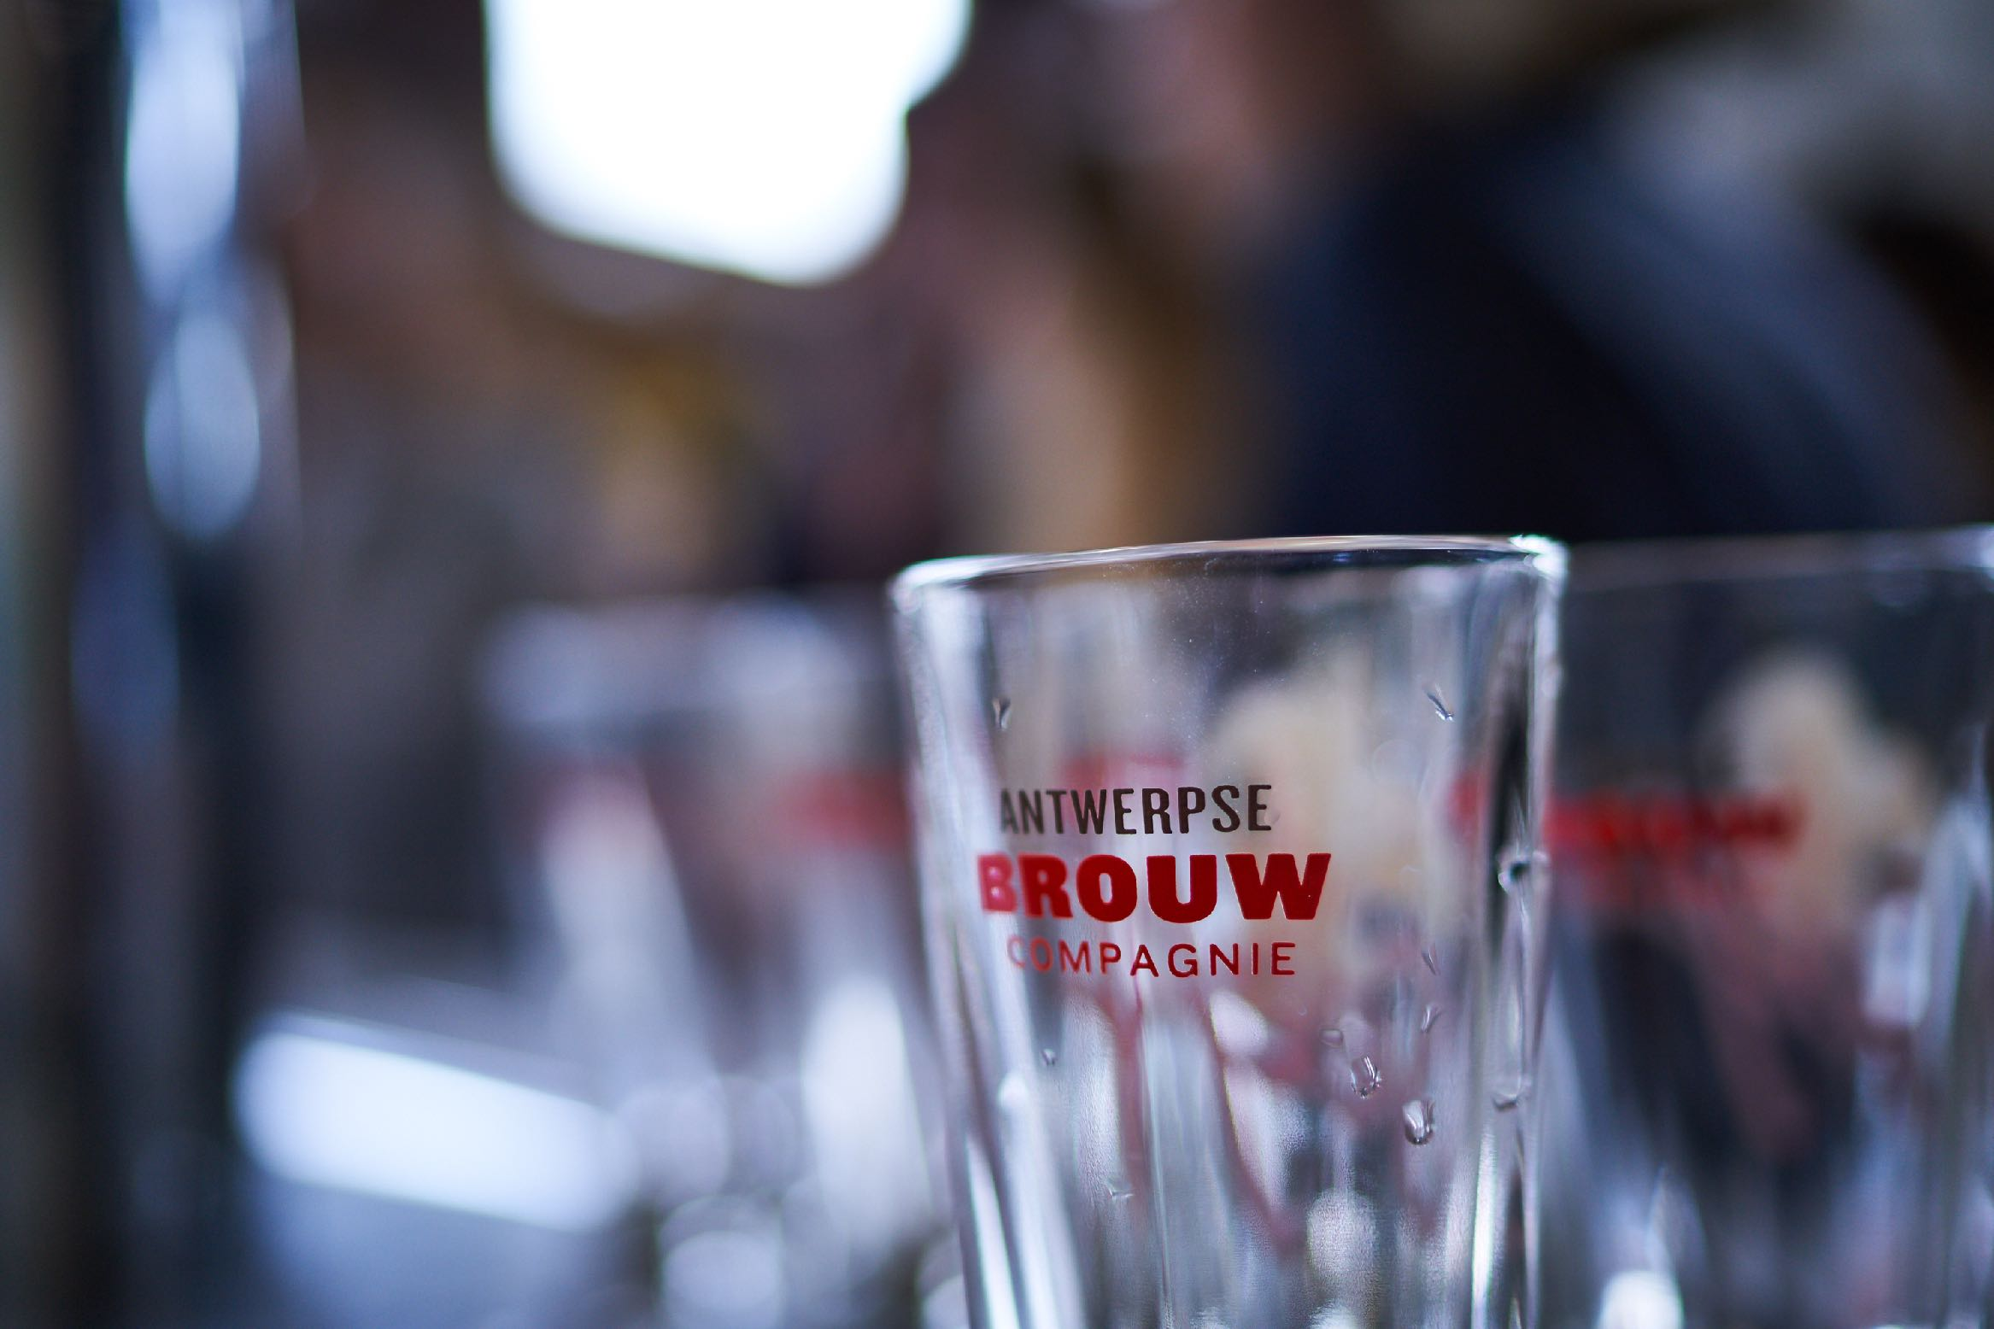
5 KNOW everything,
but know that you don’t .

Slide 18
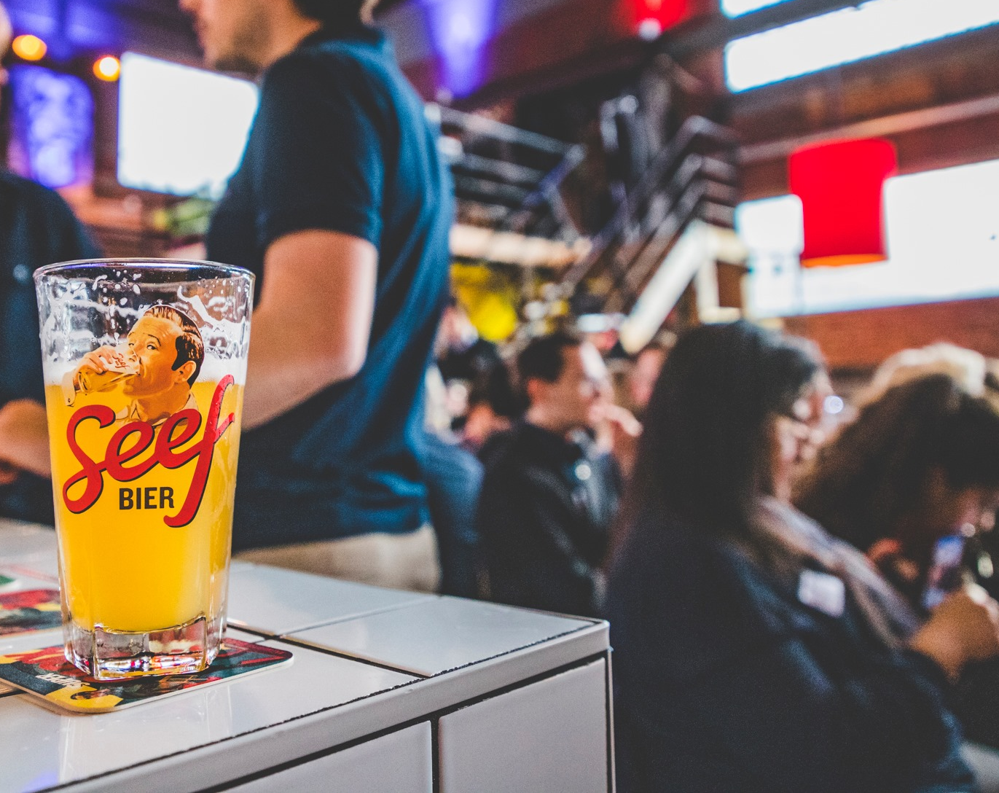

6 Have FUN &
spread your PASSION

Slide 19
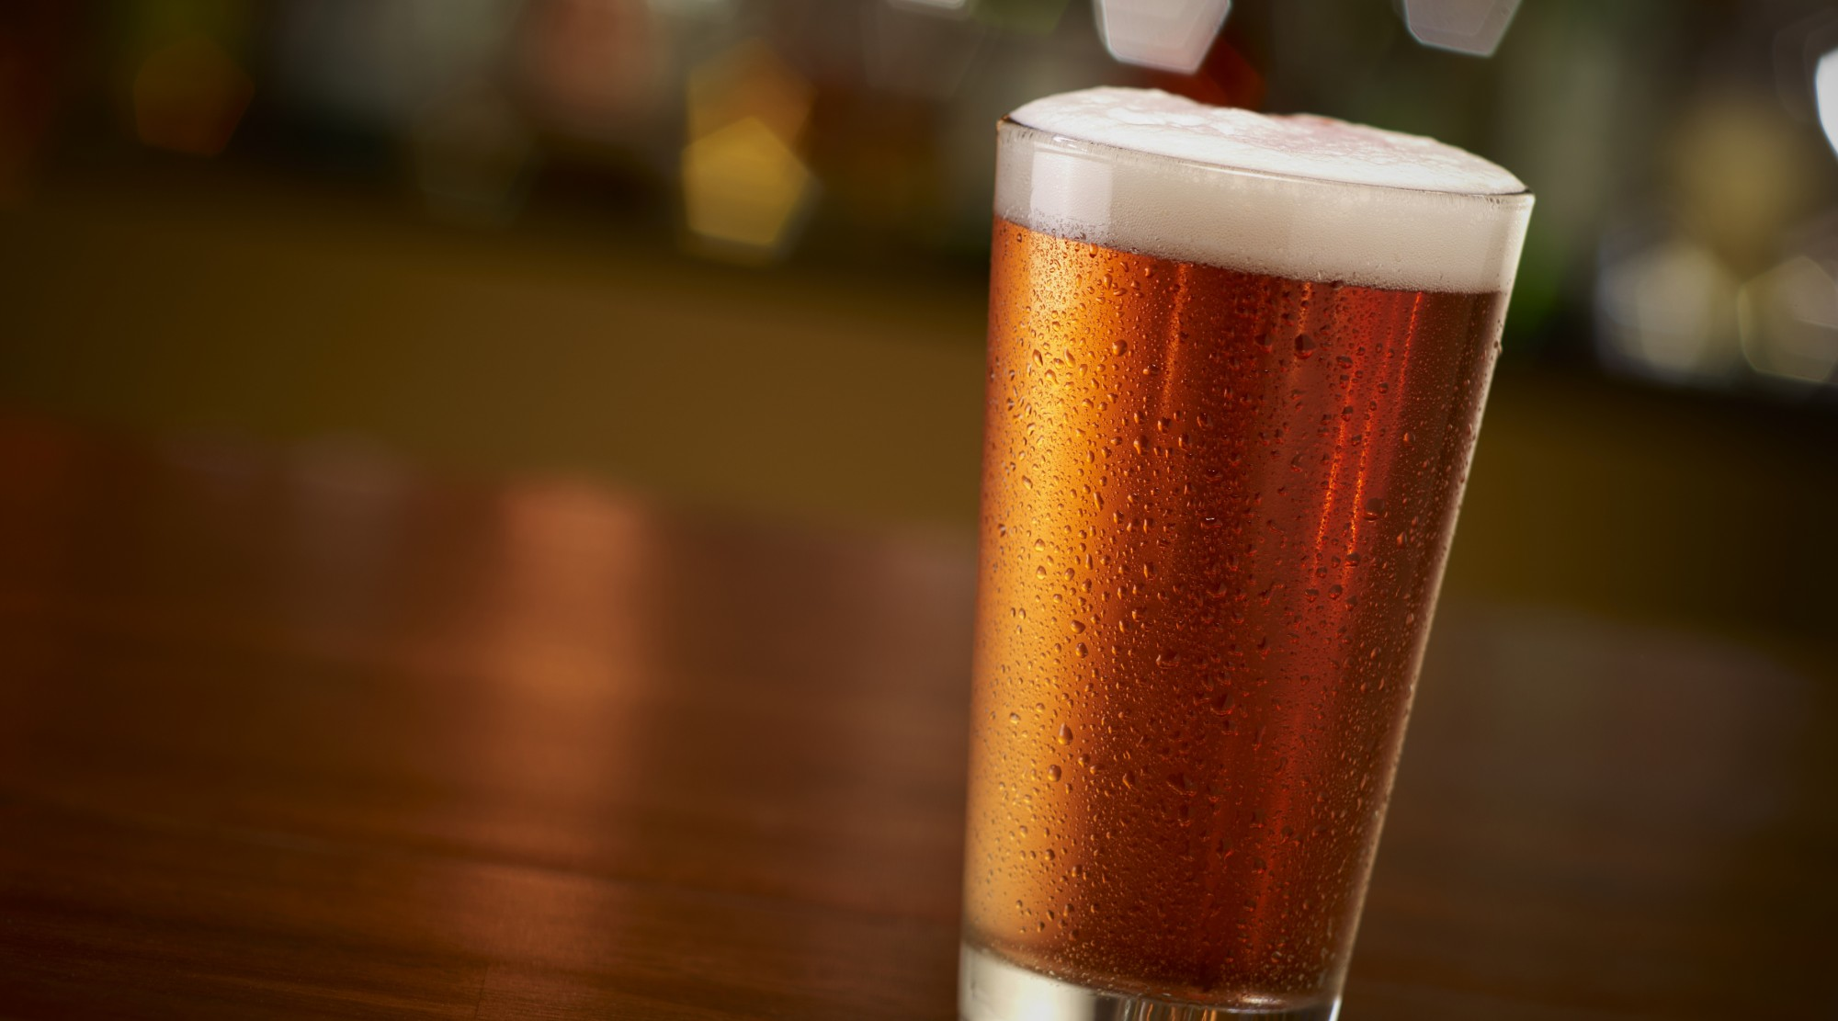

IMPACT
on
BEER MARKET ?

Slide 20
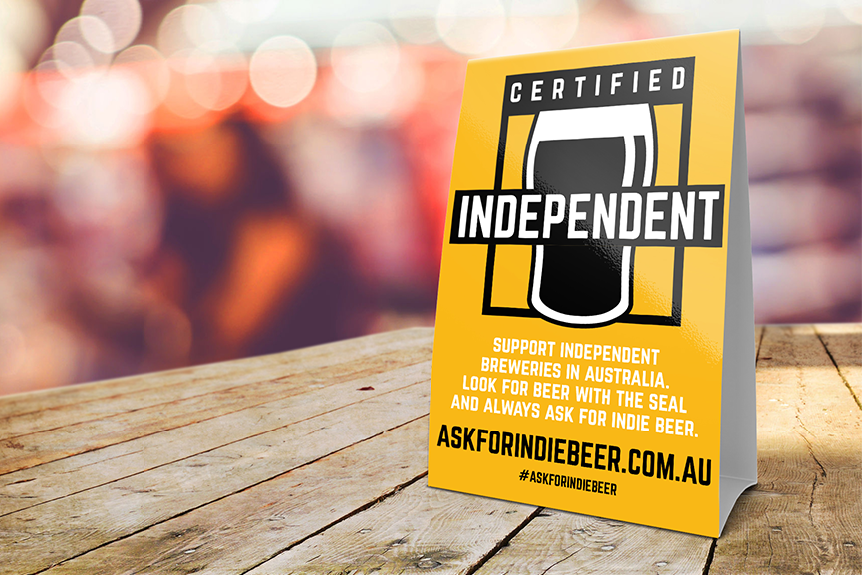
SMALL
vs
BIG

Slide 21
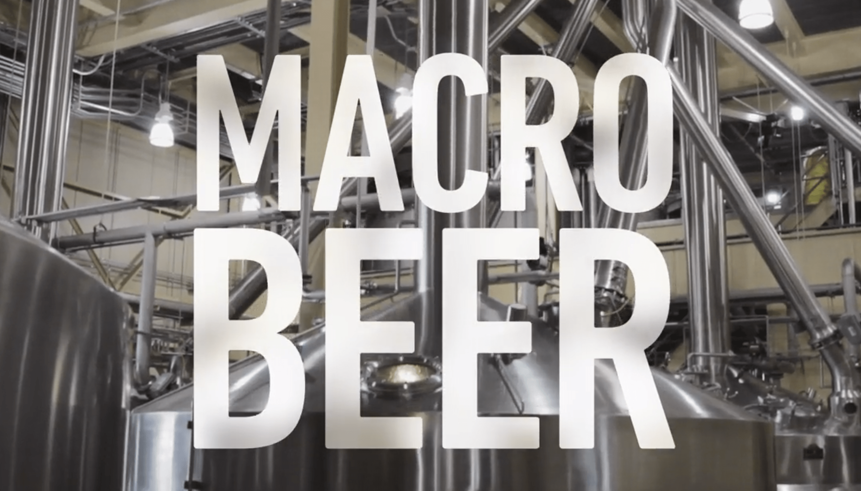

Slide 22

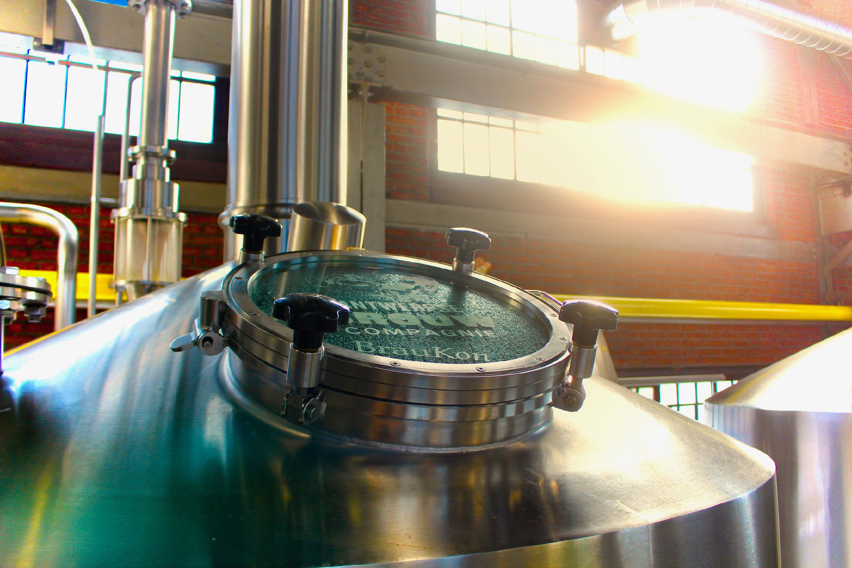

Slide 23
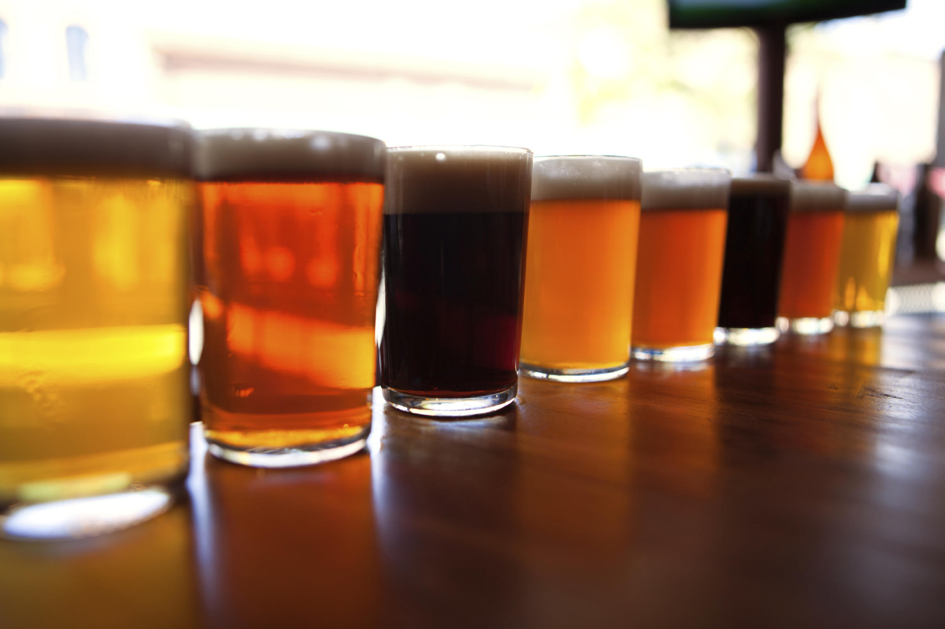
What if you could
outsource your R&D… for free ?

Slide 24
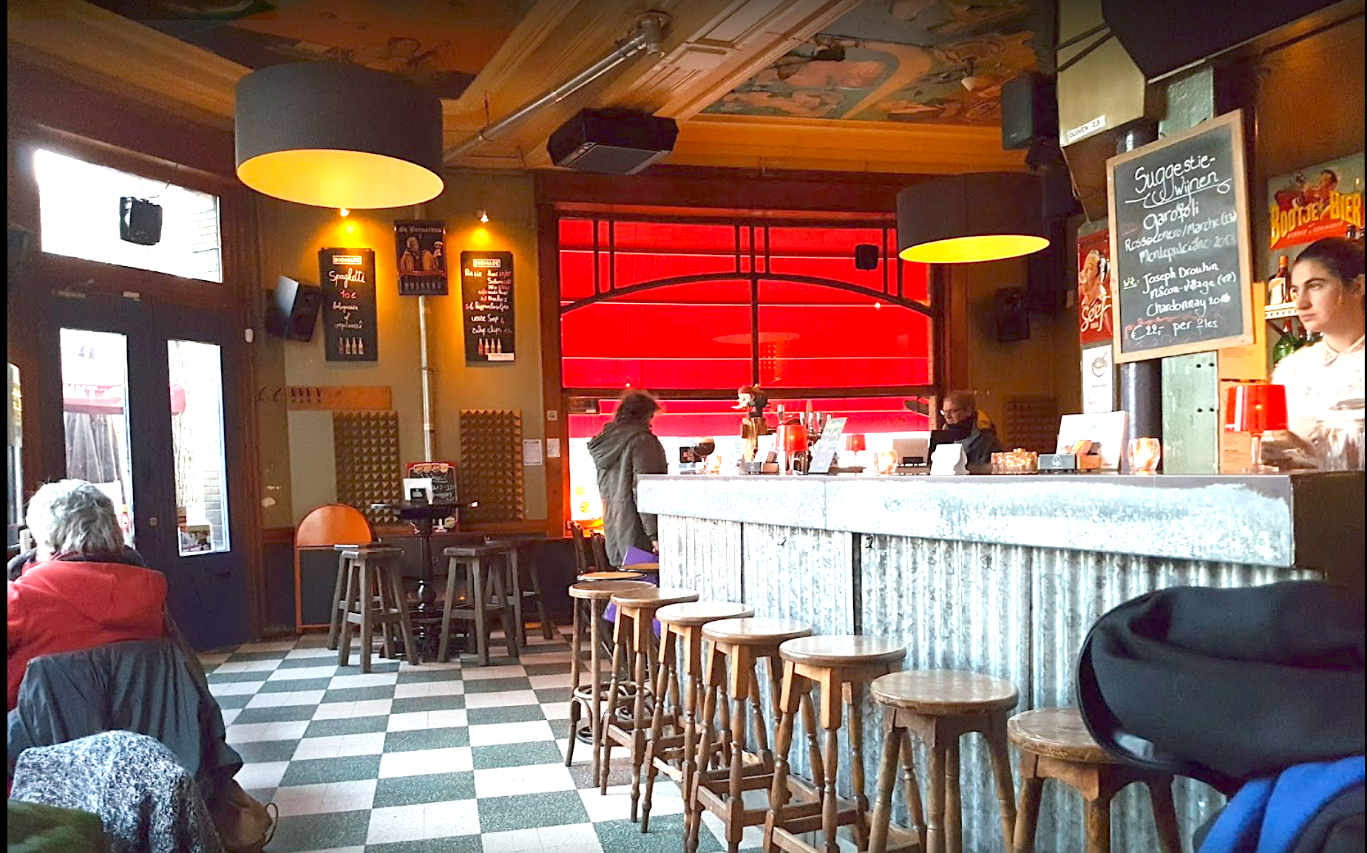
Help your customers differentiate and grow.

Slide 25
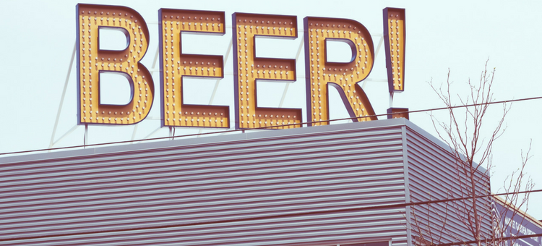
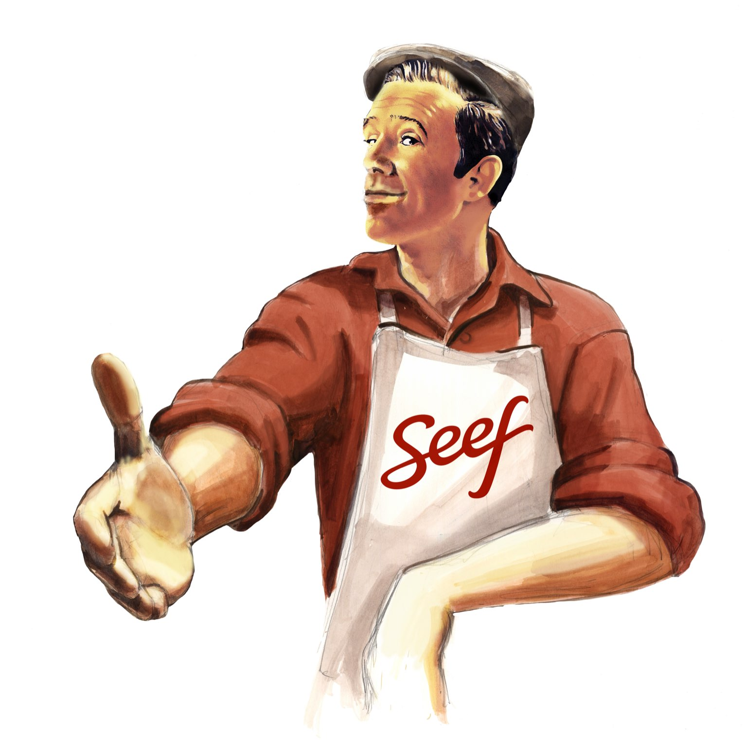
Dynamic market
=
Growth
=
YOUR win

Slide 26
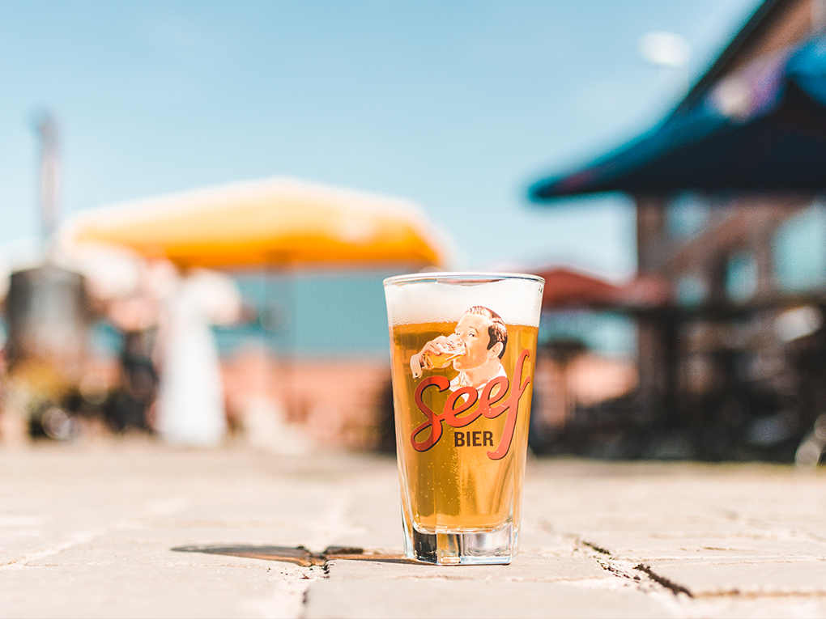
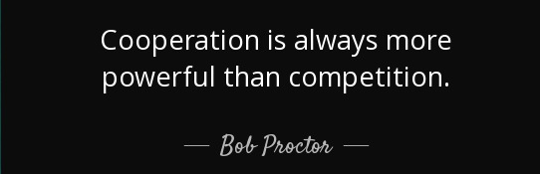

Slide 27
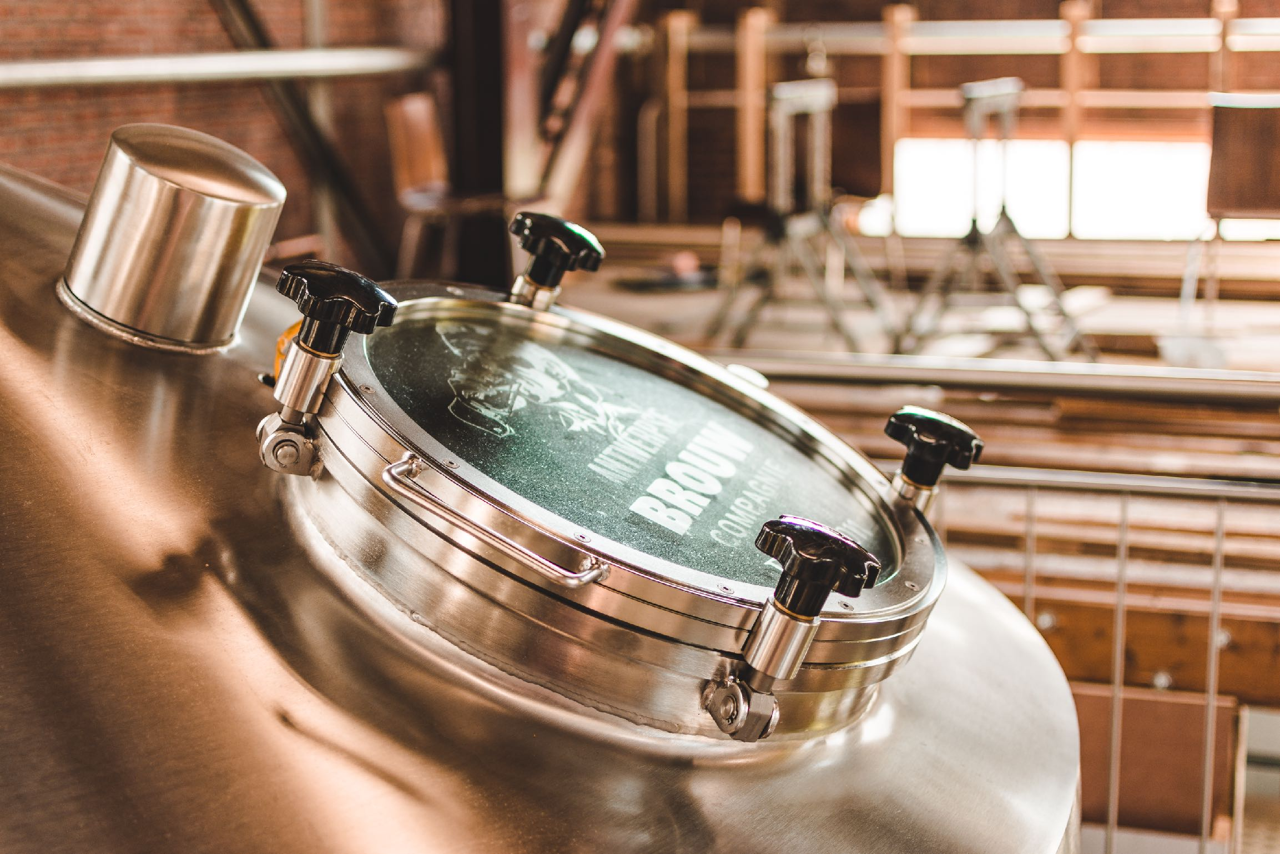
Thank you !
Johan Van Dyck
@seefbier
www.seef.be

