Slide 1


Slide 2

Presentation Meron video

Slide 3

From the romance of the vineyard
Notes:
Explaining today's goals, why are you standing here? What are they going to hear and/or learn from you? From the romance of wines to a clear and bright view on the quality of the wine. Transition to the next slide

Slide 4
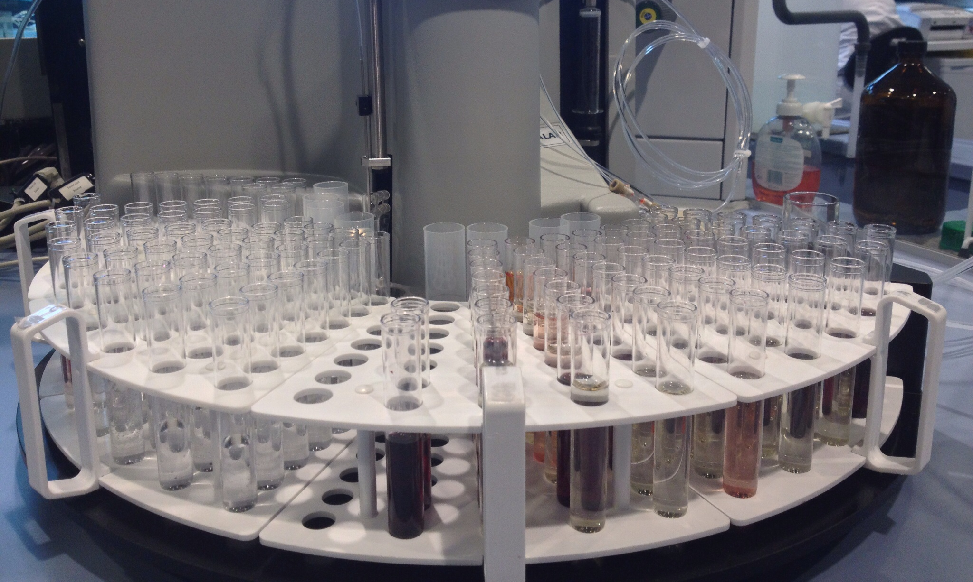
to the technical research of wine behind the scenes

Slide 5
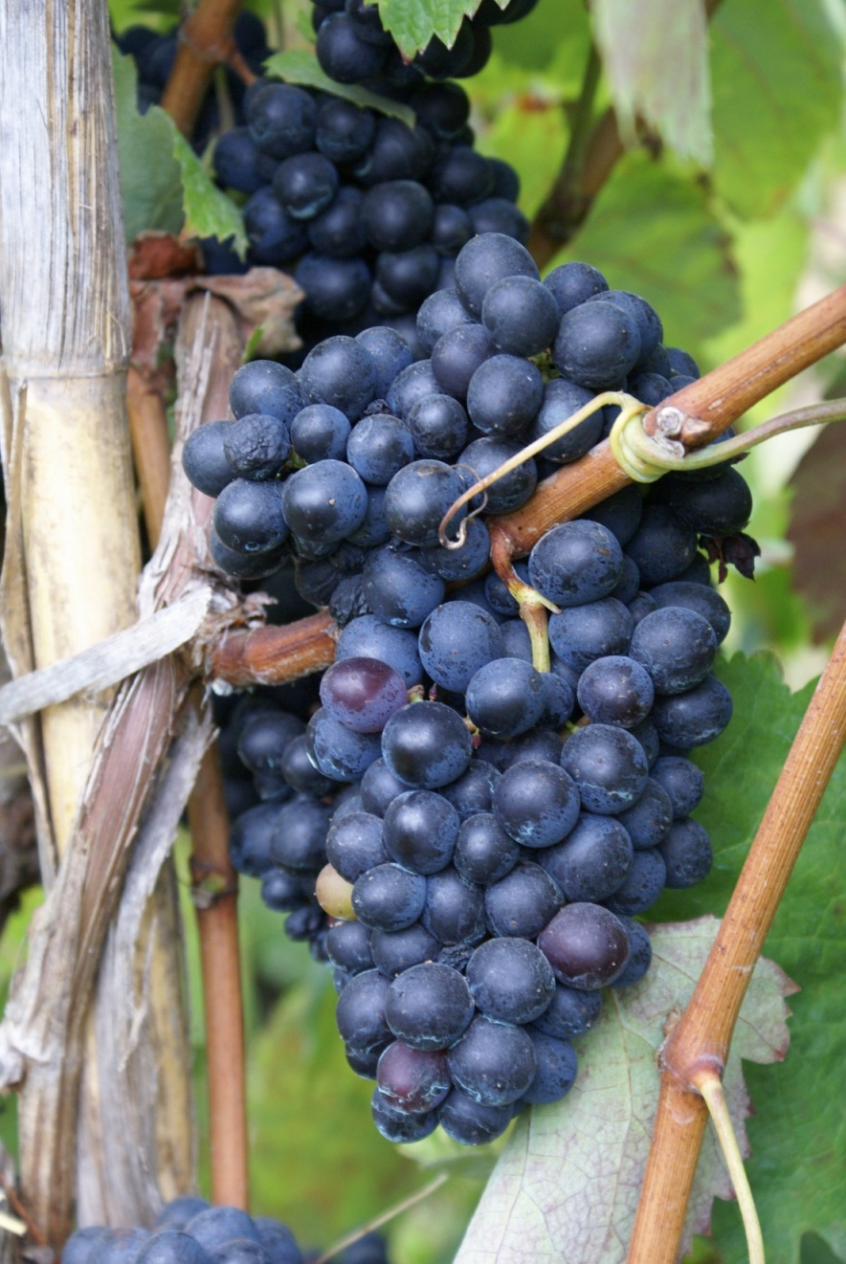
We control the quality assurance of wine starting…………

Slide 6
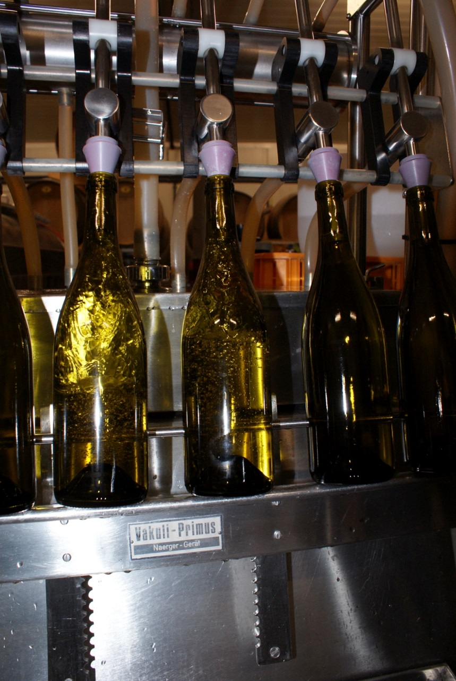
Quality assurance of bottling proces

Slide 7
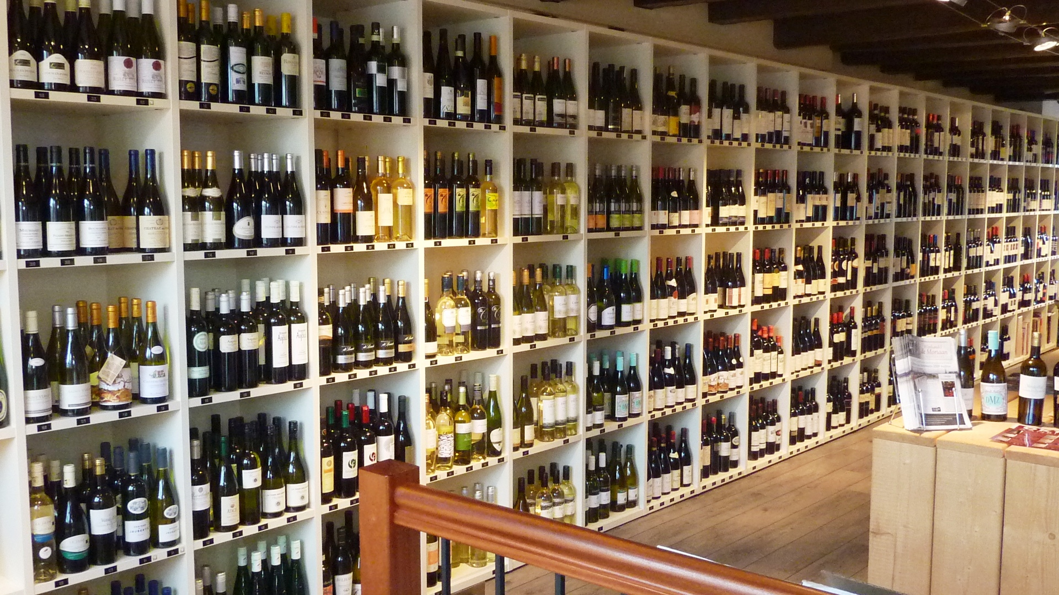
Quality assurance at the stores…

Slide 8
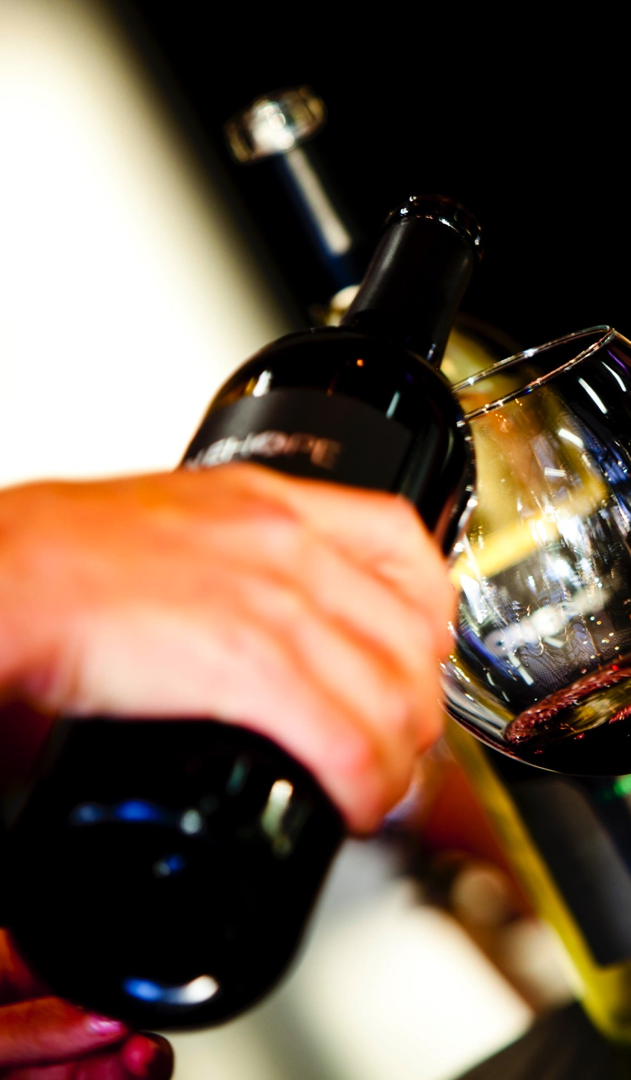
Quality assurance of the wine to the end-consumer……

Slide 9
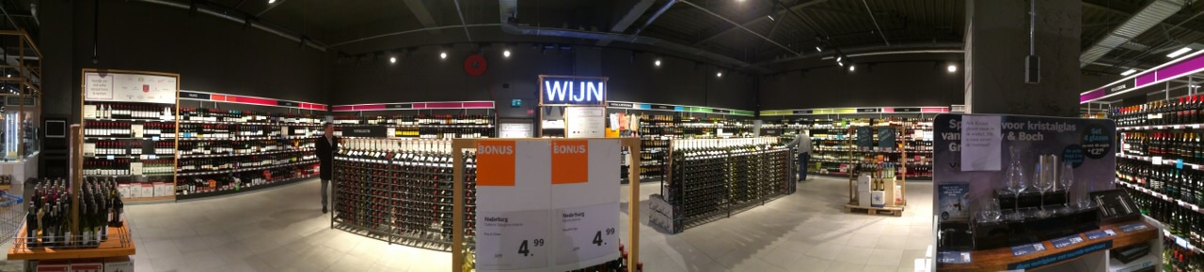
A wine department in a big supermarket

Slide 10
How do you as a consumer come to purchase a selection of wine?

Slide 11
How does the retailer guarantee the wine's authenticity?

Slide 12
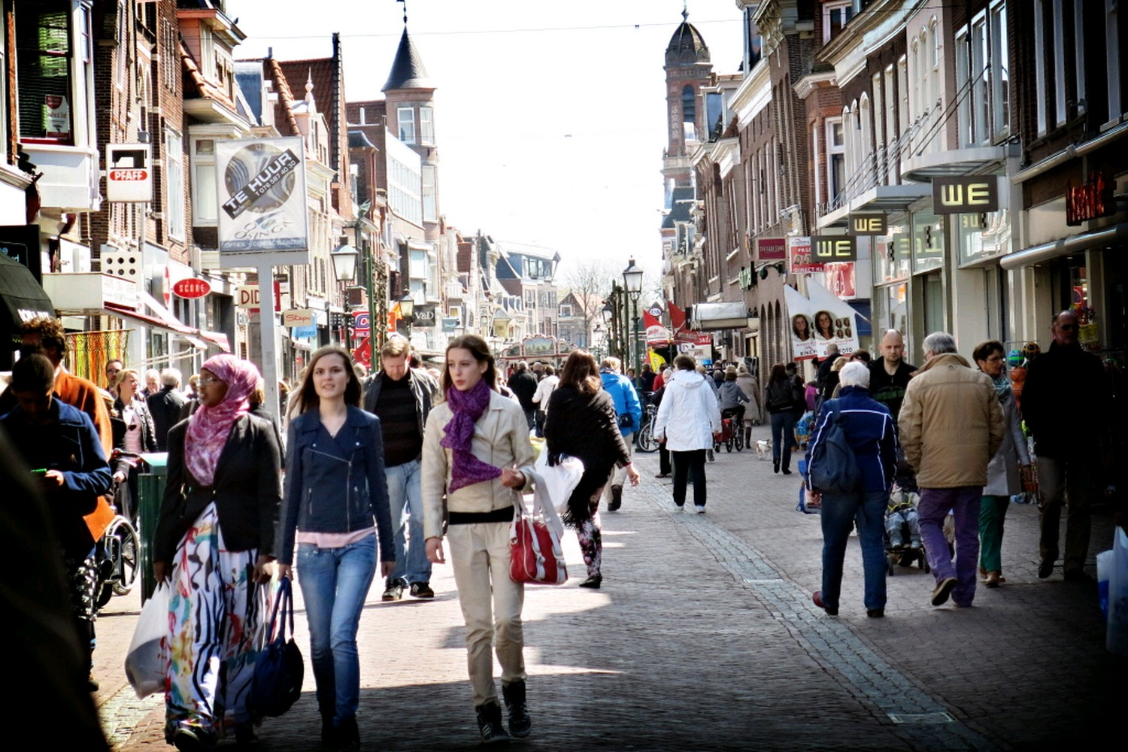
The origin
Everything starts by the consumer
The consumer
Notes:
Telling a short storyline about Meron, how Meron started.

Slide 13
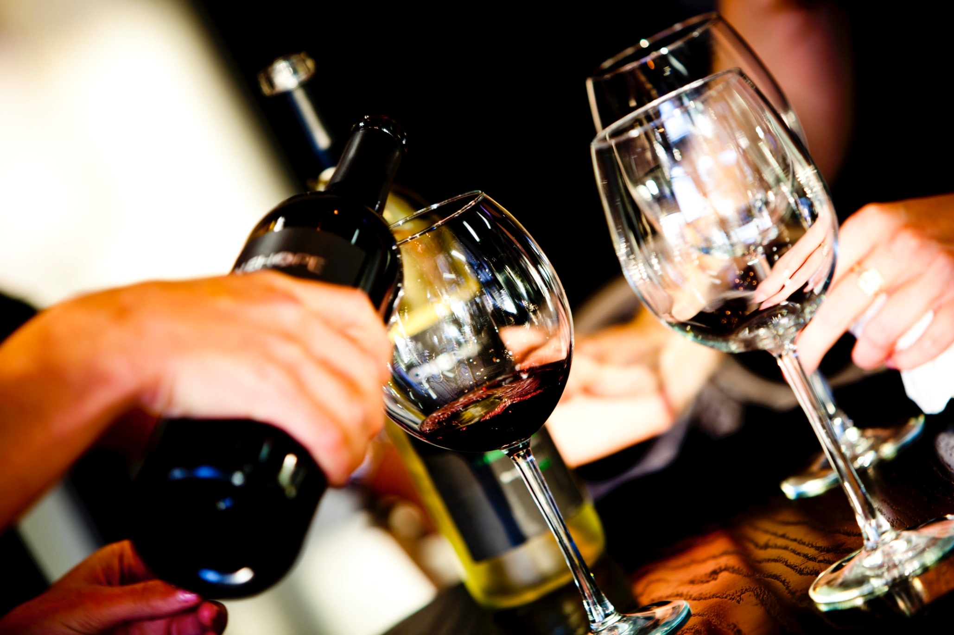
Mission
Securing the quality of wine within the chain of the producer up to the consumer.
Monitoring the authenticity, constancy and quality of the different tilting moments within the supply chain.
Transparency with the aim of optimising the quality curve of wine as much as possible.

Slide 14
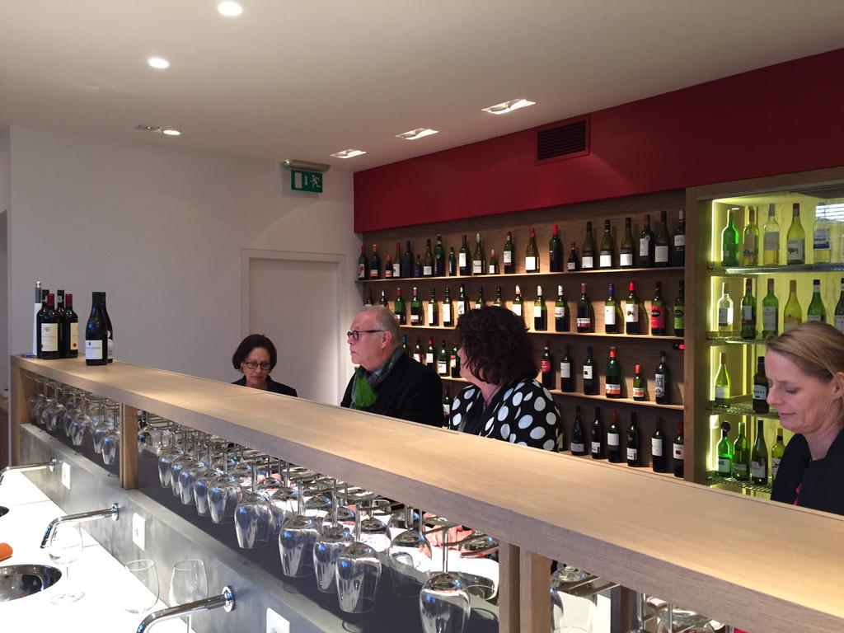
Main activities
Wine research
  chemical/technical flavour
Wine knowledge
  factually/technically founded
Wine advice
  independent

Slide 15
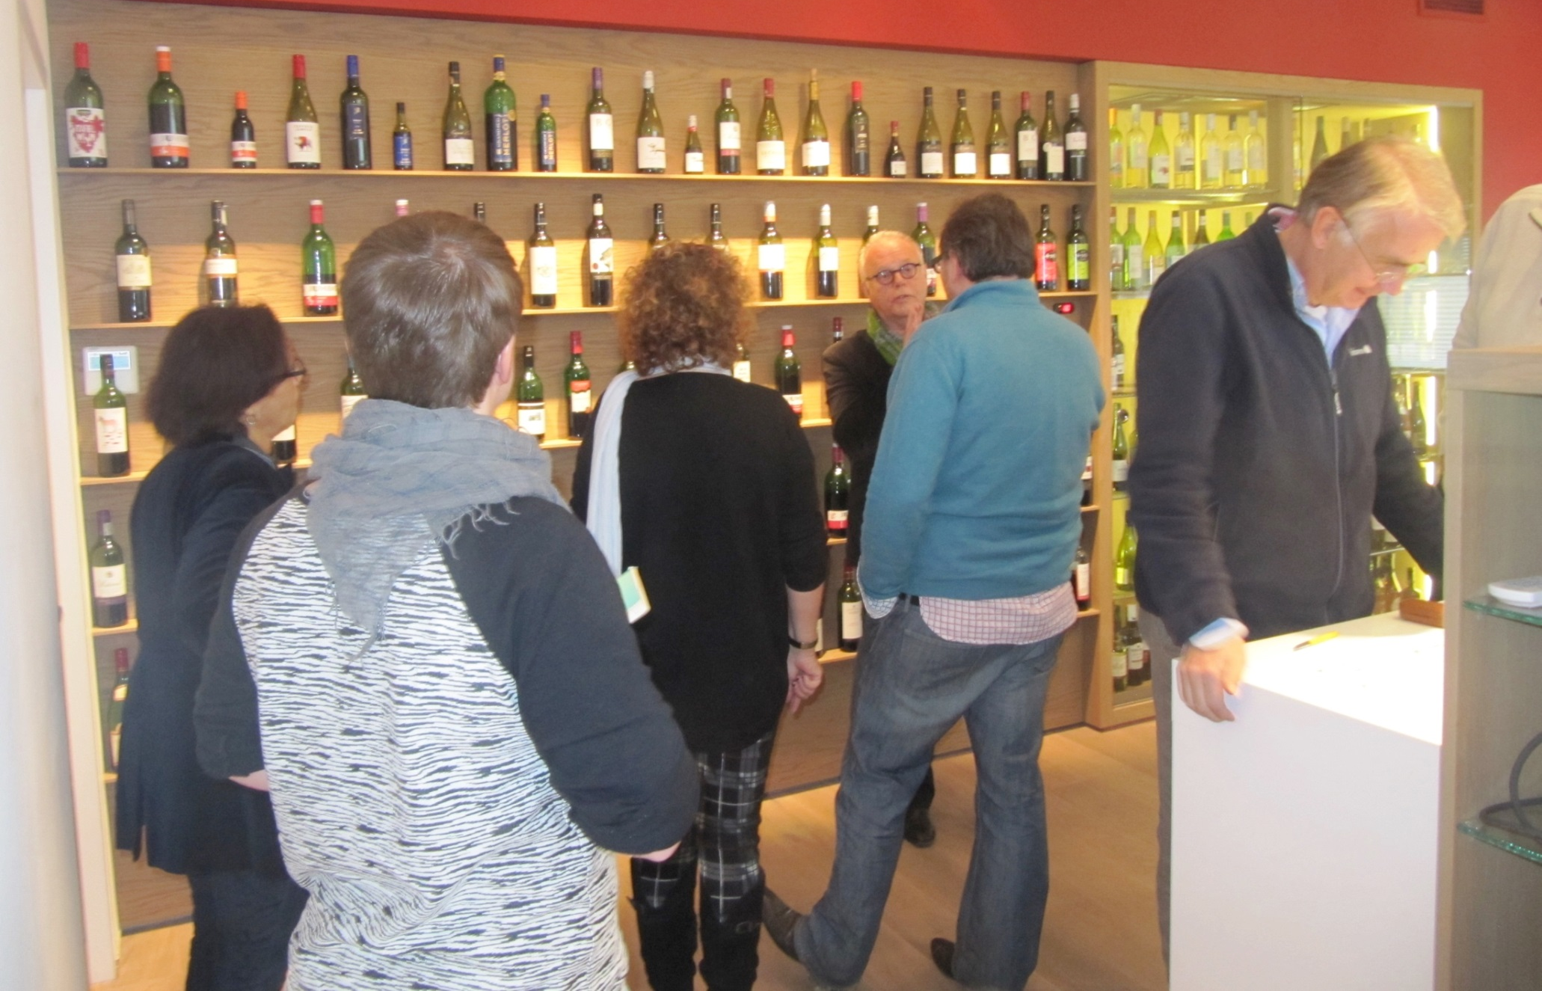
Wine research
How do we guarantee the quality/authenticity?

Slide 16
Basic Standard Analysis Package
sustainability
Free sulfite
Appellation related parameters
Total reducing sugars
Legal standards / target regulation
Total sulfite
Volatile acidity
Turbidity
Total acidity
pH
Stability of protein
Alcohol
Sorbic acid
Milk Caseïn
Egg-white

Slide 17
Procedure Chemical SPEC
Sample
SPEC
Agreed supplier
Agreed producer
Customer agreement
Final SPEC
Brut
Finished

Slide 18
Procedure Chemical SPEC
Supplier
Producer
SPEC
Customer

Slide 19
Monitoring
At the first delivery
For large volumes at every bottling batch
Minimal 2 times a year in stock/store level
When exchange of year new SPEC

Slide 20
Method
Advice approval / disapproval
Organoleptic assessment PTR-MS data
Legal requirements customers own target standards
Research consistency quality
Sustainability

Slide 21
Database chemical measurements
Spacious
320,000
various wines

Slide 22

Database chemical measurements
Spacious
4.2 million
data information

Slide 23
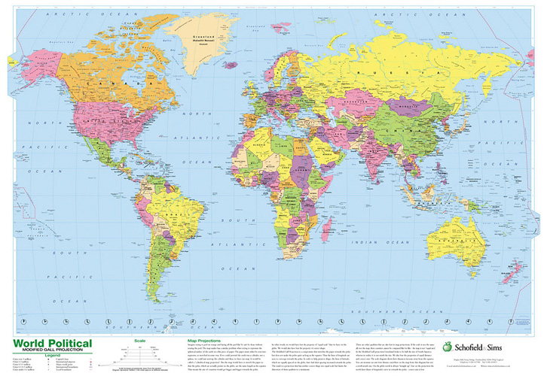
Database chemical measurements
Descend to
Nations
Regions
Areas
grape varieties

Slide 24
Database chemical measurements
Calculation
of
Average amounts

Slide 25
Drafting a substantiated product specification per wine (SPEC)

Slide 26
Client base
Retailers (wholesale distribution)
Importers / producers
Bottling companies
Wholesale Restaurants
Consumers' association Netherlands/Belgium

Slide 27
Meron facts
Largest wine laboratory in the Benelux
Authority in the market
Spacious 6,000 taste provisions
Large amount of 7.500 wine analyses per year
Global accreditation (RvA L 302)
Cooperation with approximately 85% of the Dutch retail market
Growing cooperation with importers / bottlers / producers

Slide 28
Meron facts
Growing market in the UK, Belgium,Germany and other European countries

Slide 29
TRENDS
Relationship between (chemical) wine and health
Establishing limited nutrition guidance for wines
Readable bottling date on the wine
Transparency to the consumer
(Especially in the supermarkets a great desire for shelf management: first in first out!)

Slide 30
TRENDS
Transparency to the consumer

Slide 31
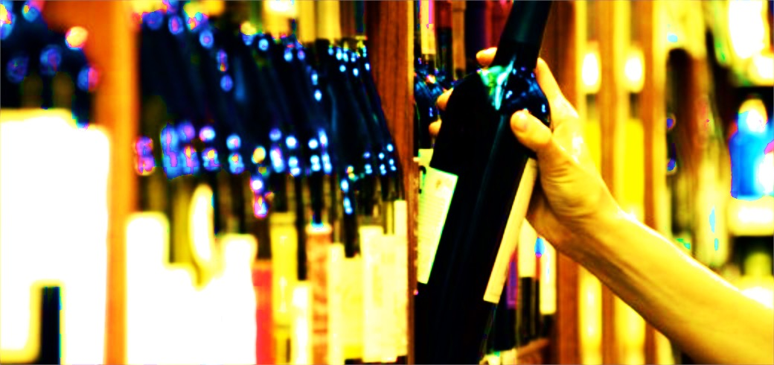
In this market ever greater demands are made on
DISTINGUISHING CAPACITY

Slide 32
Do you want a 48 hours response to the quality assurance of your wine?
Don't hesitate to contact MERON!

Slide 33
taste specification

Slide 34
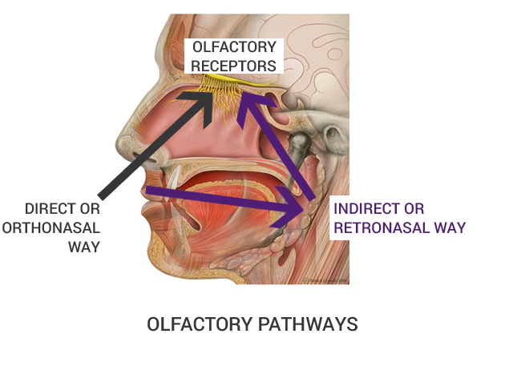
SCENT & AROMA

Slide 35
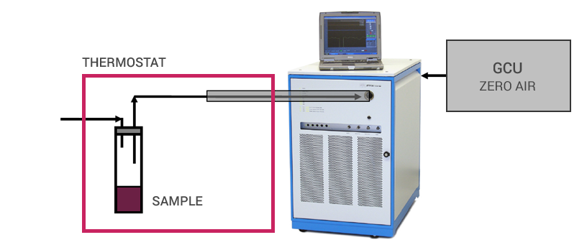
Aroma analysis
With a fast analysis technique which makes use of proton transfer reaction mass spectrometry (PTR-MS) the fragrance and flavour is quantified and qualified.

Slide 36
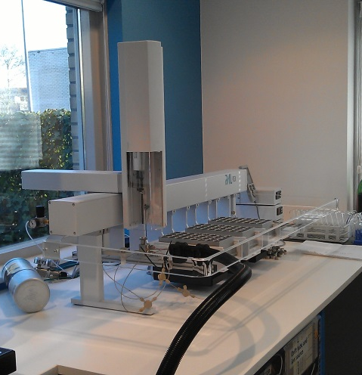
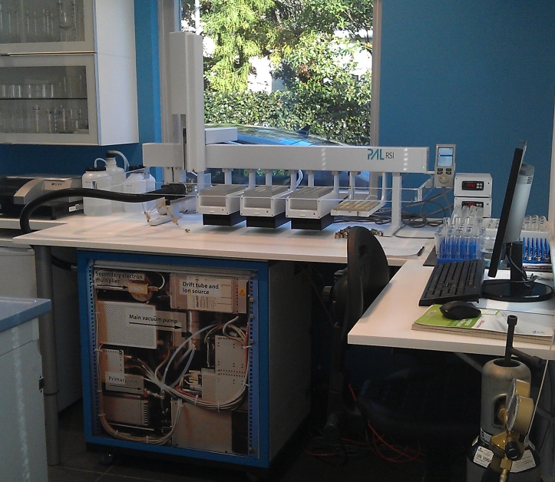
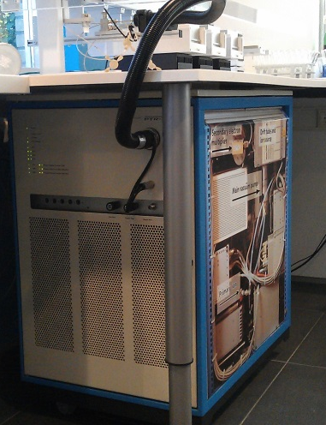
Instrumental setup
Autosampler
PTR-MS

Slide 37
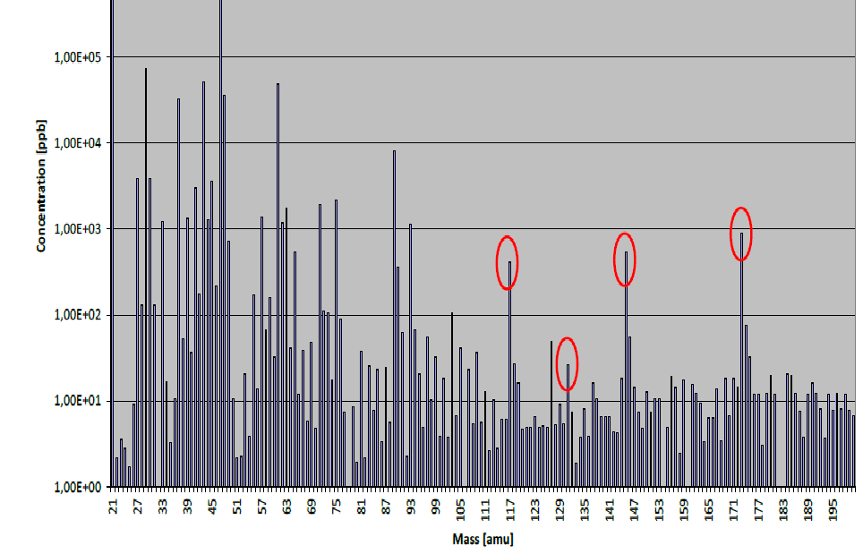
Result
De vluchtige aromacomponenten worden opgezogen en geïoniseerd

Slide 38
Result
The mass numbers are collected and translated into an algorithm with readable aroma data
Mpu | Selected scent | Oav | Scent main group | Scent sub group | Scent/flavour
115 | furan-2-ylmethanethiol | 4.837,65876 | Wood |  | roasted coffee
129 | Sotolon | 2.244,81075 | Caramel |  | caramel fenugreek curry
165 | eugenol | 532,99884 | Spicy |  | sweet spicy
135 | 3-mercaptohexan-1-ol | 463,70248 | Fruity | Berry fruit | blackcurrant
117 | 2-Heptanol | 309,98402 | Fruity | Berry fruit | blackcurrant
59 | propanal | 297,51906 | Earthy |  | earthy alcohol wine whiskey cocoa nutty
91 | 2,3-butanediol | 297.00443 | Caramel |  | creamy | buttery
119 | ethyl-2-hydroxypropanoate | 253,55727 | Fruity | Berry fruit | lactate | raspberry
75 | ethyl formate | 251,55122 | Fruity | Berry fruit | ethereal green alcohol rose brandy
71 | 2-butenal | 250,33397 | Floral |  | floral
93 | 2- (methylthio) -1-ethanol | 157,40271 | Biological |  | meaty
141 | ethyl-2,4-hexadienoate | 111.51401 | Biological |  | warm fruity licorice anise ether
South African Pinotage

Slide 39
Taste specification
The taste specification has 4 different sections:
Tasting notes (human assessment)
Sensory analysis according to WSET guidelines
Purchase quality control
Off notes screener

Slide 40
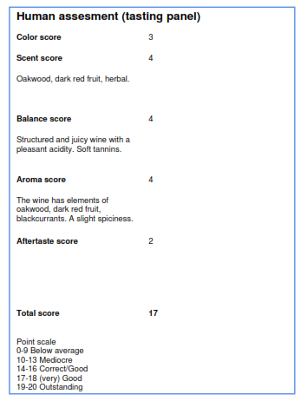
Taste specification
Tasting notes (human assessment)

Slide 41
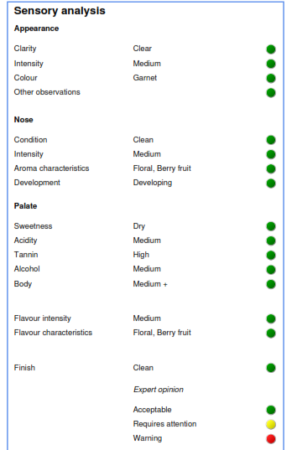
Taste specification
Sensory analysis according to WSET guidelines

Slide 42
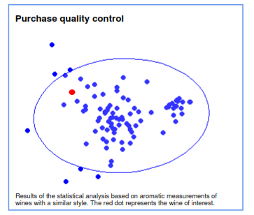
Taste specification
Purchase quality control

Slide 43
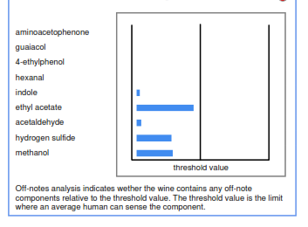
Taste specification
Off notes screener

Slide 44
Purchase control
Quality control from blending to consuming
Meron
Importers or suppliers
Retailers or HORECA industry
Wine producers
Bottling companies
Wine A
Wine A’’
Wine A = Wine A’’ ???

Slide 45
Tender request form
a helpful tool to use when applying for tenders for wine

Slide 46
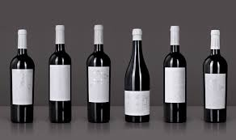
Tender request
Step 1
Tender request for a Verdejo from Rueda, RSP: € 3,99

Slide 47
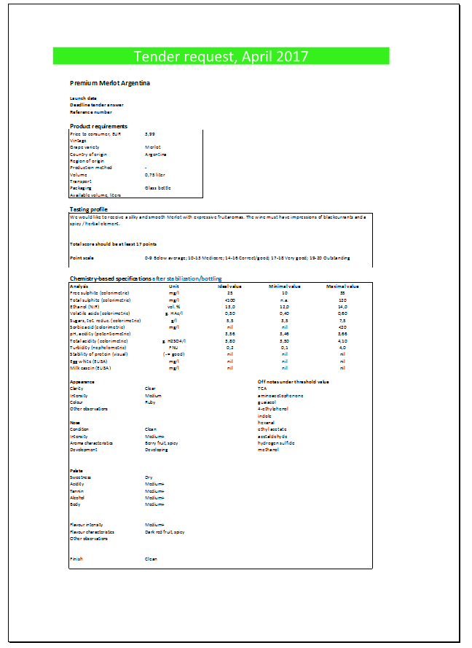
Tender request
Step 1
Tender request for a Verdejo from Rueda, RSP: € 3,99
Development Archetype
Selection of the
“Top 3”
Step 2

Slide 48
your partner in QUALITY MANAGEMENT

