Slide 1


Improving quality of booming French craft scene through training and support
Florian Antoine – Craft Brewers Support Manager

Slide 2

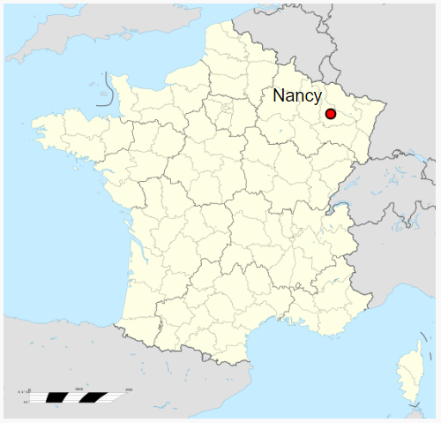
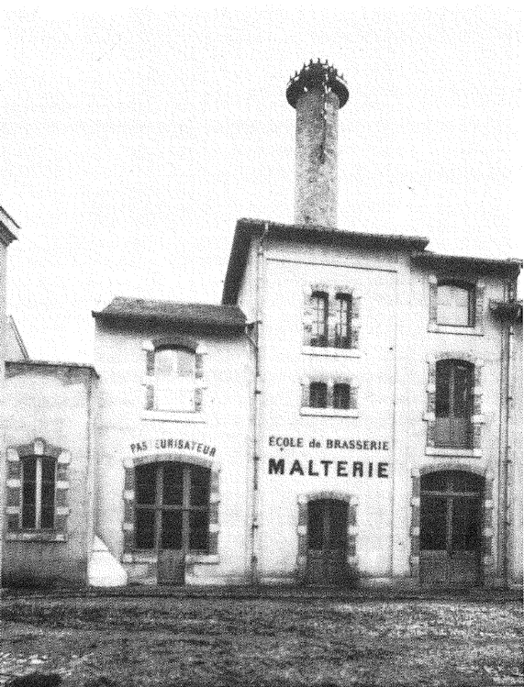

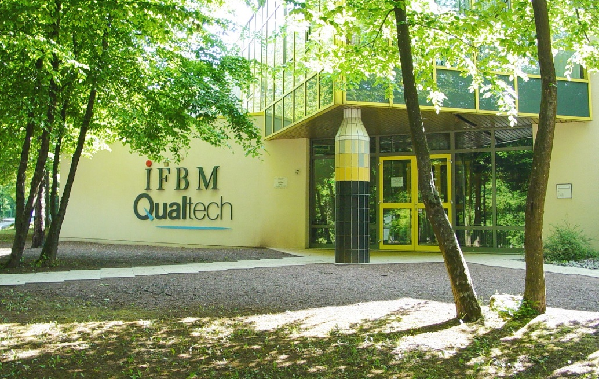
IFBM : French Institute of Brewing and Malting
Who we are
  Once a Brewing and Malting School in Nancy, France (late 19th c.)
  IFBM founded in 1962 as a non-profit organisation
  Food analysis services since 1992
Notes:
Nancy : Lorraine, Brewer’s expo, French Brewery Museum
ecosystem

Slide 3
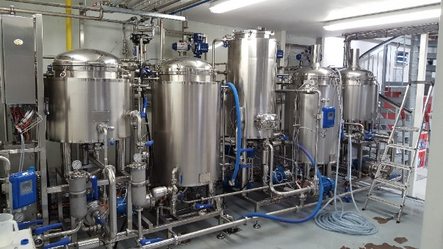

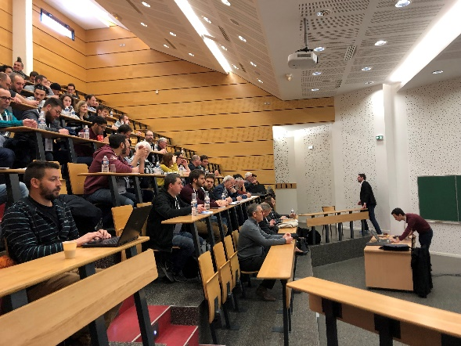
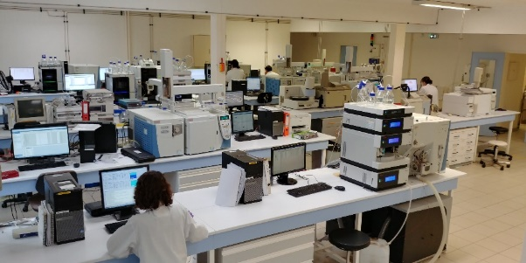
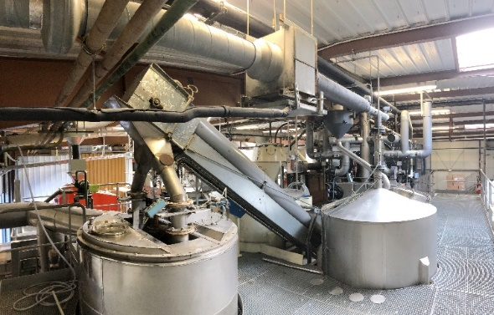
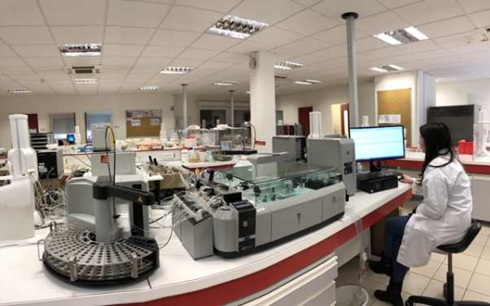
IFBM : French Institute of Brewing and Malting
What we do
  R&D
    Gushing, Sulphites, Contaminants and more
    New recipes (soft, beers and SCOBY)
    On-site trials for new ingredients or auxiliary aids
    Qualifying barley varieties for brewing
    Qualifying phytosanitary products
  Malting and brewing activities
    Home to new entrepreneurs
  Training
    Maltsters, brewers, on-site, off-site and overseas
  Analysis on barley, malt and beer
  Consulting
Notes:
Team of doctors : important topics for the sector
gypsies
Plant : breweries, malthouses
Beverages

Slide 4
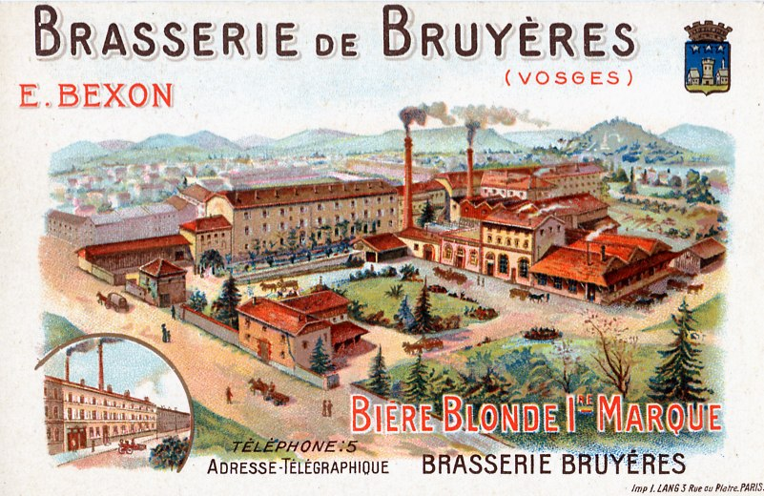
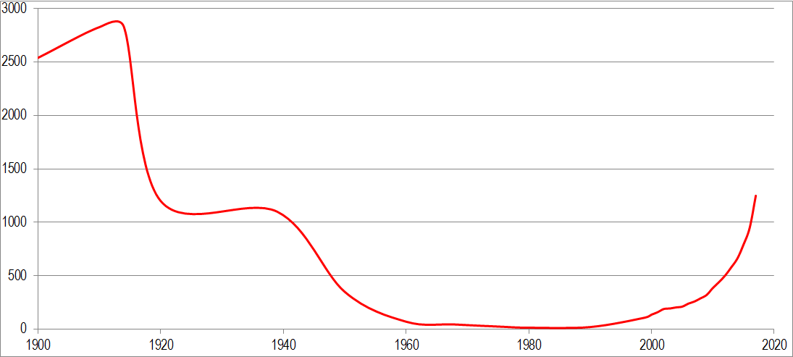
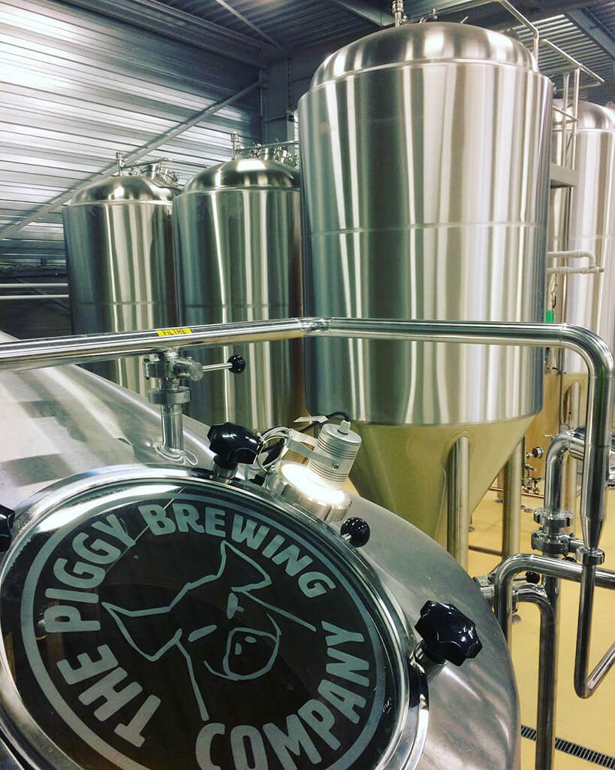
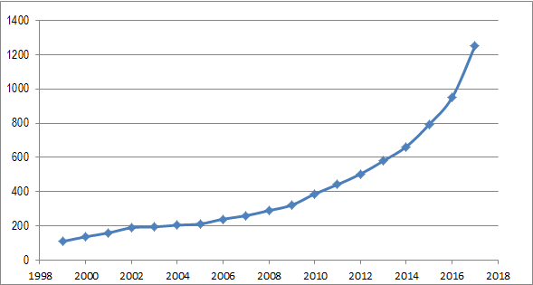
Breweries in France through the last 100 years
1600 breweries in 2018
Number of breweries in France
Year
Notes:
Context : Where is the French brewing sector at?
Brasserie de Bruyères (Vosges/Vogesen) : 1840 -1955
About 30 breweries in the 80s
About 1600 breweries currently

Slide 5
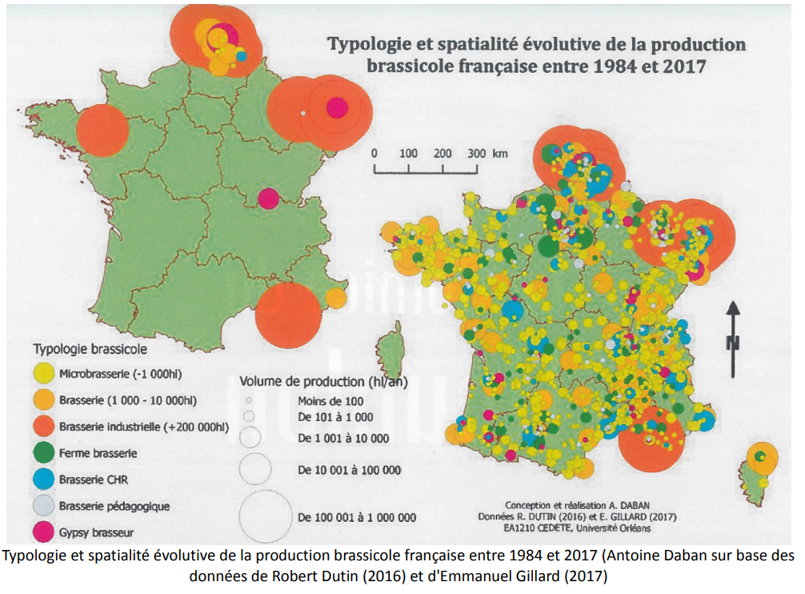
French breweries : what kind of profiles?
A few major breweries : Kronenbourg, Heineken, Champigneulles…
About 1600 craft breweries
What is a “craft brewery” in France?
Legally microbreweries produce less than 200,000hL annually
“Craft” refers to “artisan” : specific regulation
85% less than 5 yo
96% volume produced by 15 biggest brewery
4,2% growth in 2018 (+1.8% on-trade, +5% off-trade)
97% of breweries with less than 10 employees → Data source: Brasseurs de France
Notes:
Definition based on excise tax
3.75€/hl/abv for crafts
7.49€/hl/abv for bigger breweries
NO Data to know whether brewers are alone or just two in their brewery → this creates quite precarious situations where production and sales are by far the most important (Quality Managements can be often forgotten)

Slide 6

Regulatory instances: their role
France's General Directorate for Fair Trading, Consumer Affairs and Fraud Control
2017-2018 Control mainly over <1000hl breweries
Some issues regarding legislation, explained by “youth”
Is that all as an explanation?
Notes:
Prod control (good practises, recipes, cleaning, HACCP traceability)
Labelling
Analysis (Alcohol, sulphites)
Problems with hygiene, traceability, information to consumer

Slide 7
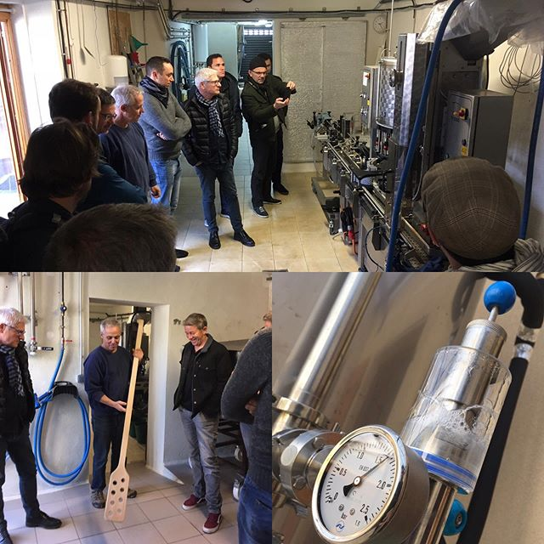
Our role as a training and support centre
Since 2002, more than 750 craft brewing trainees at IFBM
Many different people many different paths
  Level up in Science
Different goals and philosophies
  Give common recommendations
2 main targets :
  Empirical → based on science
  Make them realise they produce food to be sold
Notes:
A LOT of different profiles for trainees
Graduates, high school diploma, no diploma. Many different work experiences
Some ppl have a lot to catch on, not all engineers, food experts. Need to level up in Chemistry, Microbiology, Food science, HACCP
For some of professionals : those elements have almost become instinctive → not the case for some ppl
Not the same goals, different budgets, different philosophies
People with quality management/science background or previous experience in great industry obviously tend to be more sensible to quality management, whereas some see brewing as their art, this is how I do, it just works.

Slide 8

Our role as a training and support centre
A help for all those profiles
For beginners: the keys to open a brewing facility
  Science
  Practical details: equipment, business aspects…
For advanced brewers and brewing workers:
  Specific topics
  Long-time support
Notes:
Longer programs : 3 days to 2 weeks + practical training
Specific : follow up on former trainees or newcomers, haccp, hygiene, yeast management, water profiles, non alcoholic bev…

Slide 9
Thank you for your attention
Florian Antoine – Craft Brewers Support Manager

