Slide 1
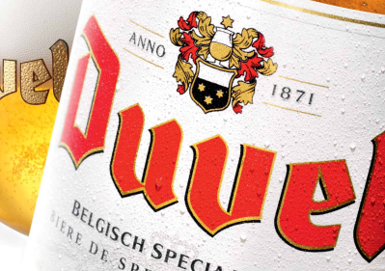
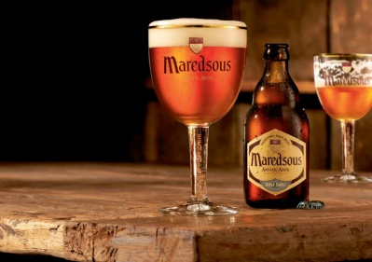
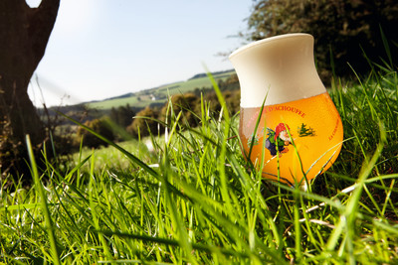
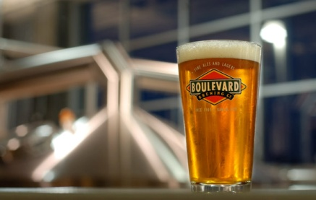
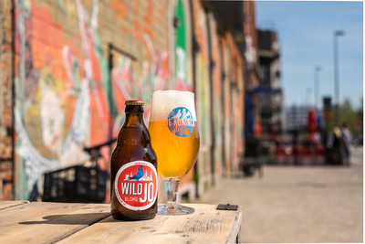

Tradition and innovation: the key to successful quality management

Slide 2
Volume growth
ES
JARR
Birrificio del
Ducato
Firestone walker
Brouwerij ‘t IJ
Boulevard
De Koninck
Liefmans
USA
Ommegang
UK
China
Achouffe
Vedett

Slide 3
Tradition and innovation: the key to successful quality management
Maintaining and increasing quality level by focusing on two topics:
tradition
innovation

Slide 4

Tradition and innovation: the key to successful quality management

Slide 5
Tradition and innovation: the key to successful quality management
Tradition is the building block of the success reached and is important in order to maintain the existing quality level.
Tradition also includes respecting values which are important for the company.

Slide 6
Tradition and innovation: the key to successful quality management
Tradition and acquisitions
We are a Family of Breweries, not a Group nor a Holding
Brewery remains in operation.
Founders are still active and sharing their passion and knowledge.
The location gives authenticity and origin to the beer and brands.

Slide 7
Respecting tradition in production, some examples
Top cropping

Slide 8
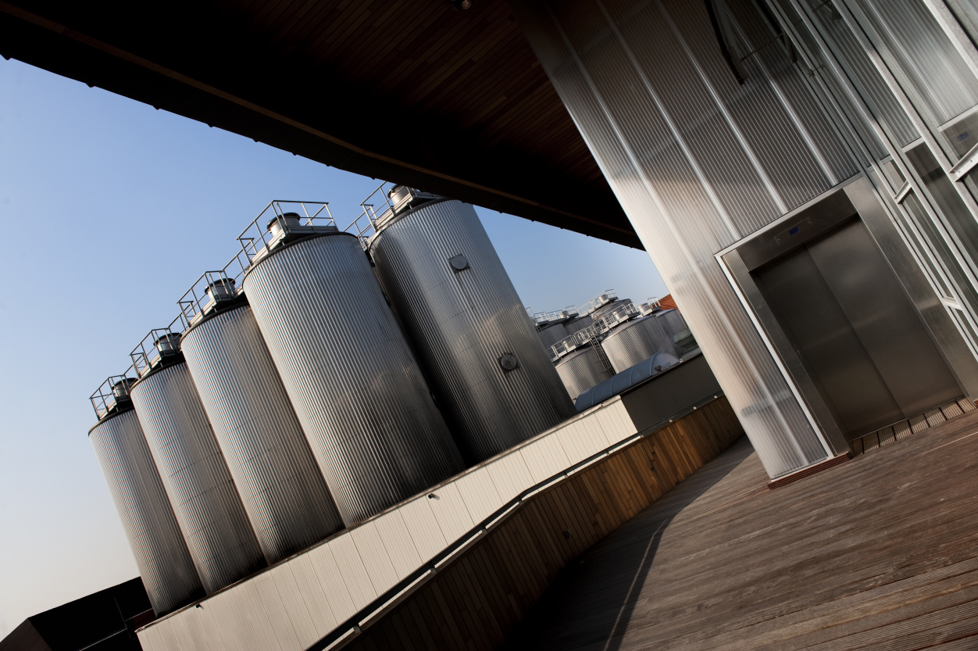
Respecting tradition in production, some examples
Long lagering times, centrifuges and no use of kieselguhr

Slide 9
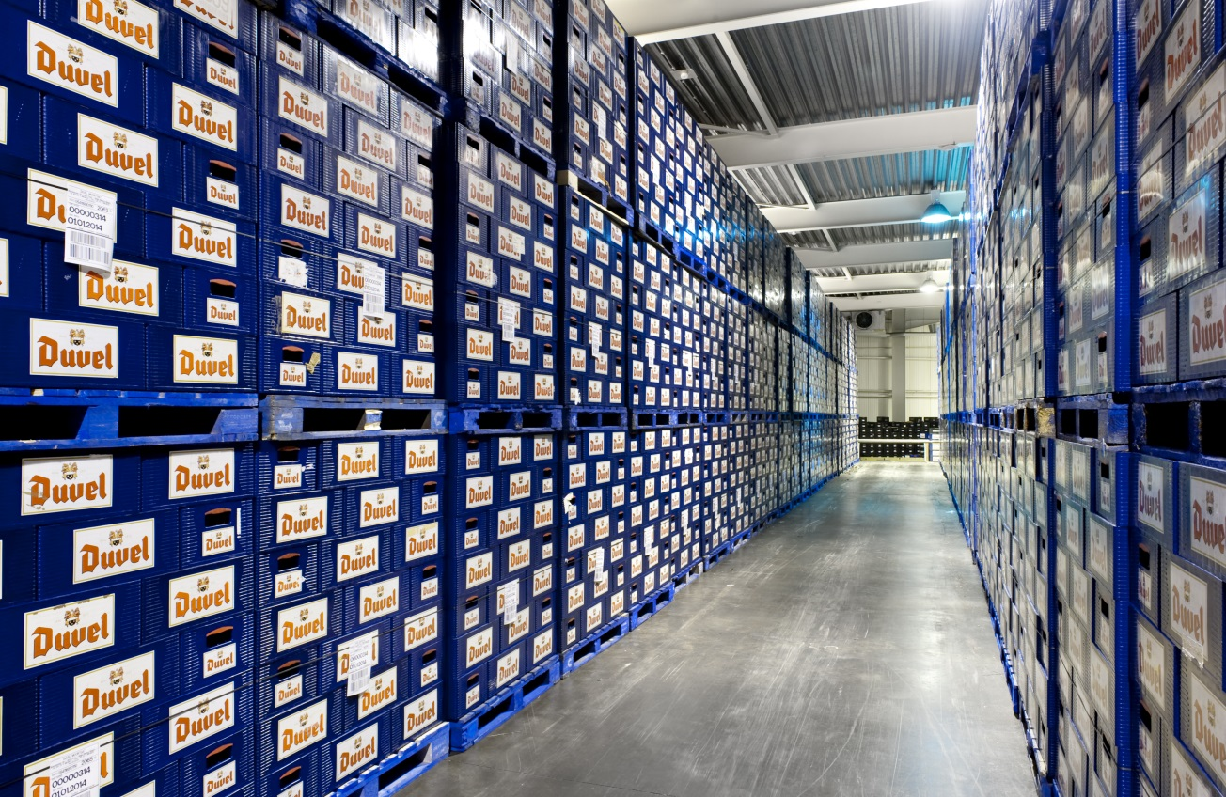
Respecting tradition in production, some examples
Cold storage after bottle fermentation

Slide 10
Tradition and innovation: the key to successful quality management
Every step in the process of your beer is important to reach the quality level.
The pitfall of salami slicing.
Always return to original specifications after a temporary adjustment.
Notes:
Every step in the process of your beer is important to reach the quality level at the end. This doesn’t mean you cannot review certain steps, you just have to keep in mind which parameters are key to your end quality.
It’s possible you are forced, because of capacity reasons, to deviate from the existing quality norm and you adjust the norm for a limited period. You find out that the quality of the end product is still at a good level. Even with this knowledge, it’s important to go back to the old quality standards

Slide 11
Tradition and innovation: the key to successful quality management
Innovation is the tool to implement new techniques in order to achieve a higher quality level.

Slide 12
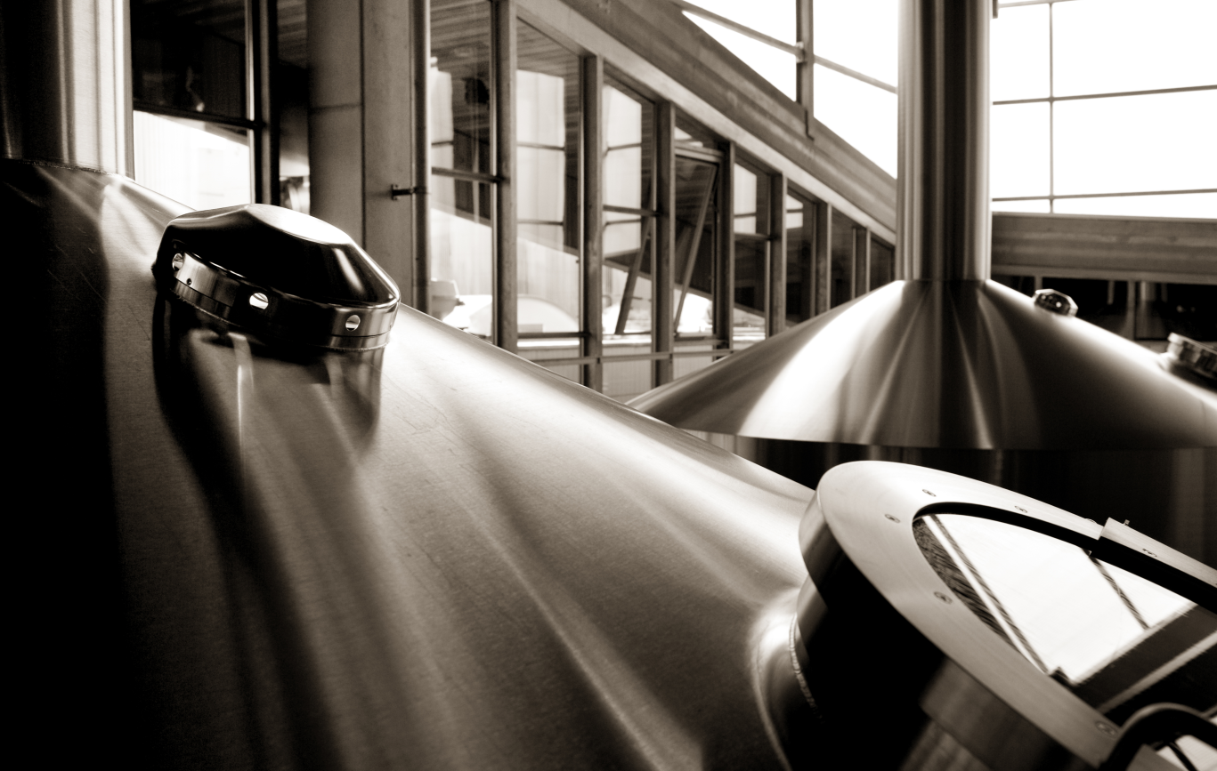
Innovation in production, some examples
Reduced heat load

Slide 13
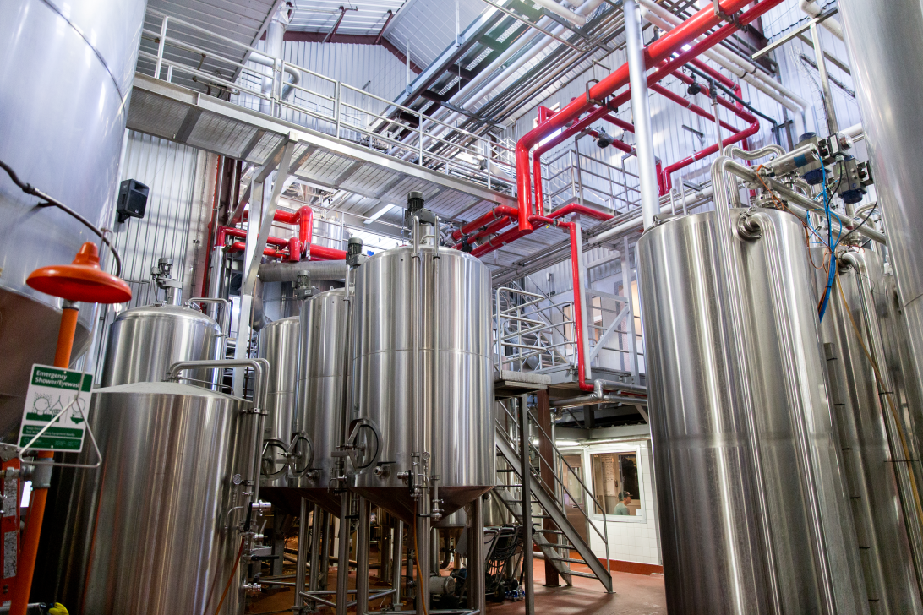
Innovation in production, some examples
In house engineering of propagation plant and yeast dosing before filler

Slide 14
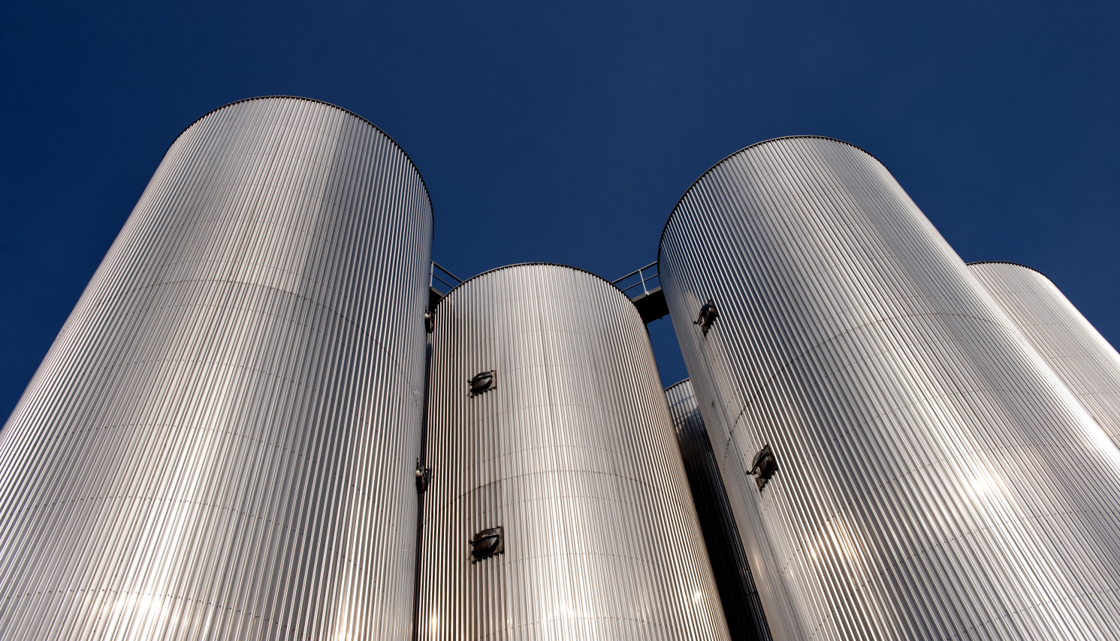
Innovation in production, some examples
ΔT regulation of beers in fermentation

Slide 15
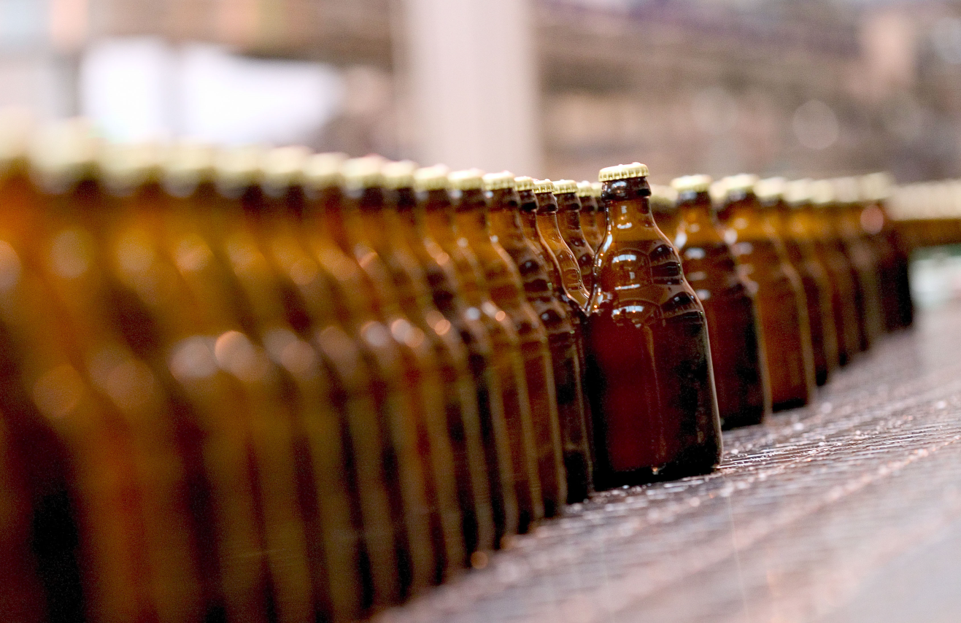
Innovation in production, some examples
Bottling plant
Warm filling
FBI
Time based QC

Slide 16

Innovation in production, some examples
Pilot Brewery

Slide 17
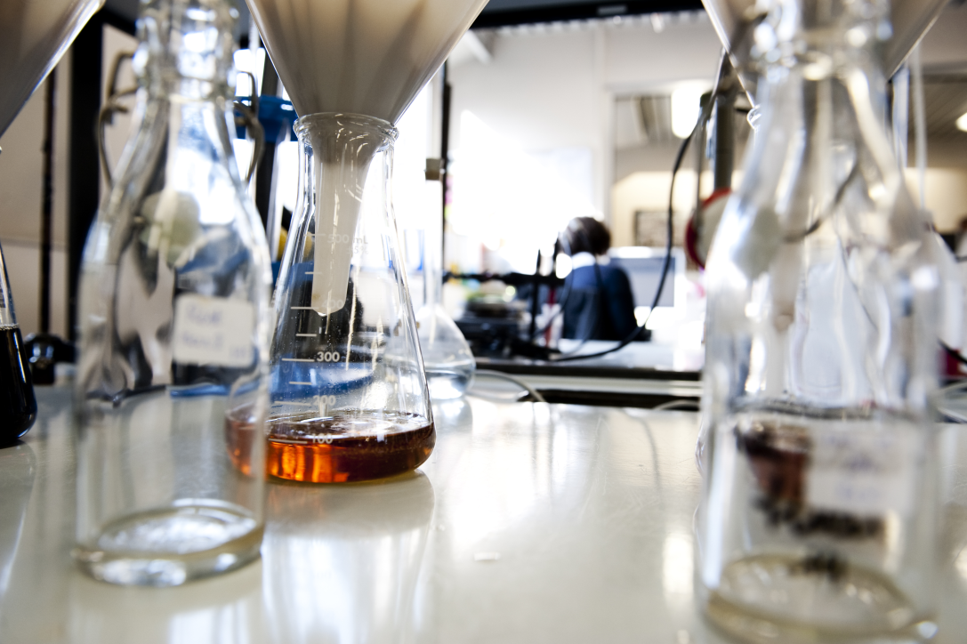
Innovation and research
Innovation means investing in research, to find out the fundamental science behind a particular topic.
Notes:
Not all research is directly leading to practical applications.

Slide 18
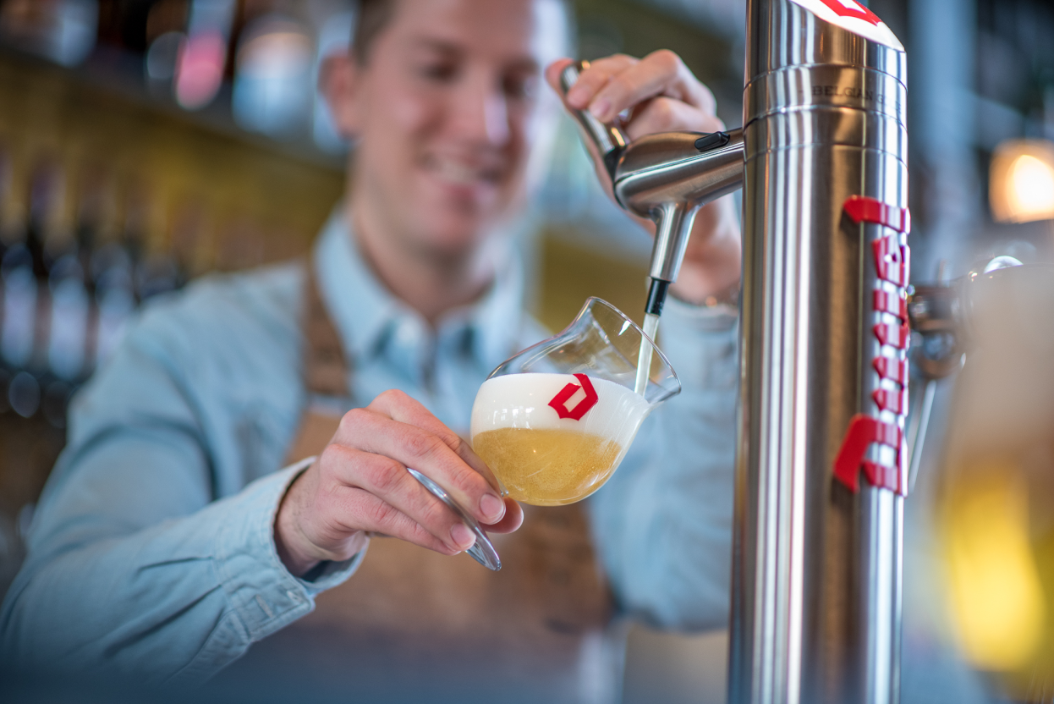
Tradition and innovation
Duvel On Tap

Slide 19
Thank you for your attention!
Beer before glory
We monitor quality every day, quantity once a month
We can take decisions at the coffee machine
Let the beer do the talking
We innovate out of passion or with a purpose, never only for shelf space
Our brewery sites should be beautiful places, fun environment
We know our colleagues by name (and often their families)

