Slide 1
From founder to family brewery
June 2019

Slide 2
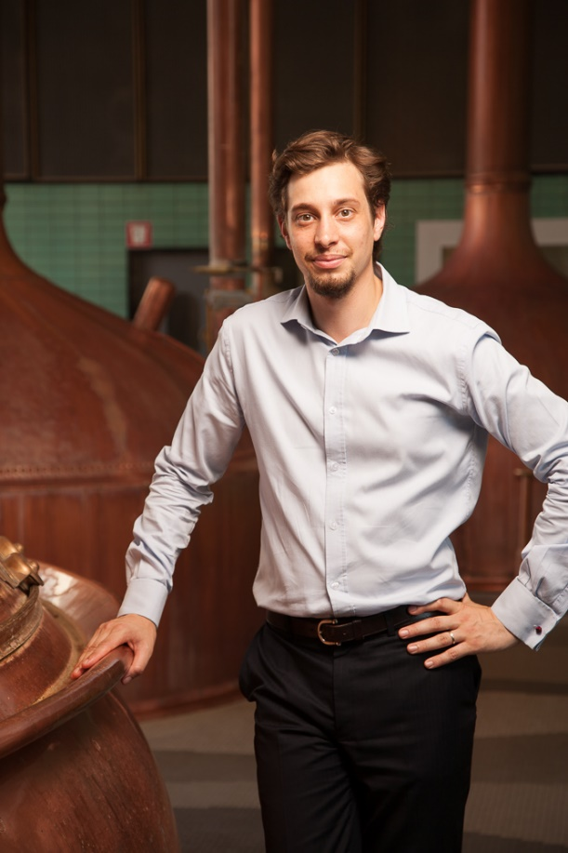
Edouard HAAG
General Manager, Brasserie Meteor (Alsace, France)
8th generation brewer

Slide 3
Agenda
1) Quick overview of Meteor, the oldest brewery in France
2) Our shift into the world of craft
3) Conclusion : why it works

Slide 4
A few words about our long history

Slide 5
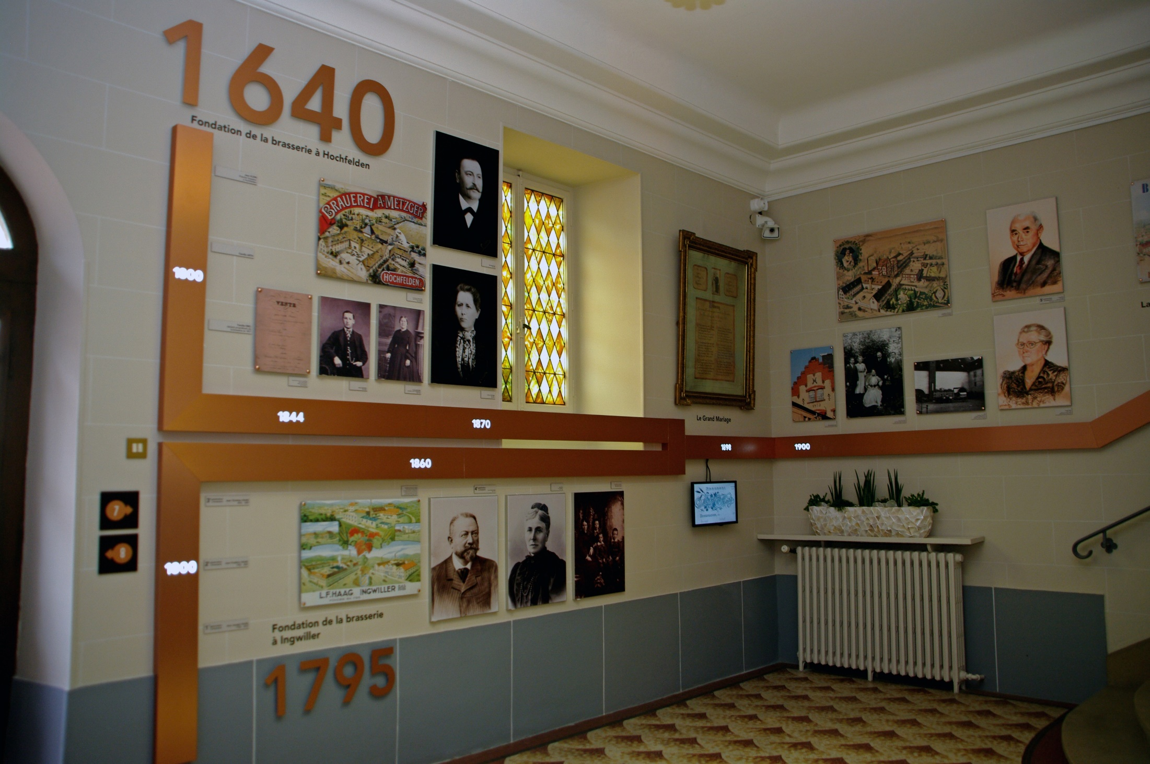
Meteor : our history

Slide 6
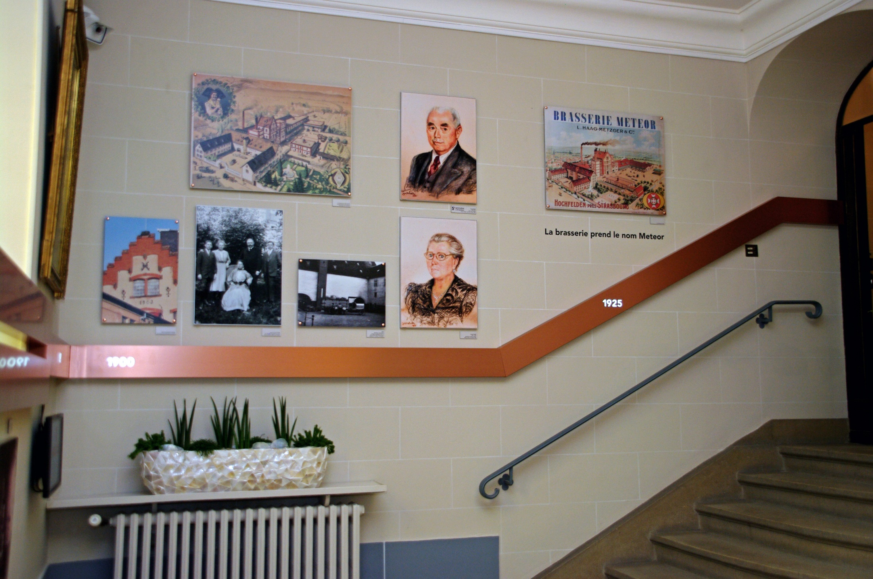

Slide 7
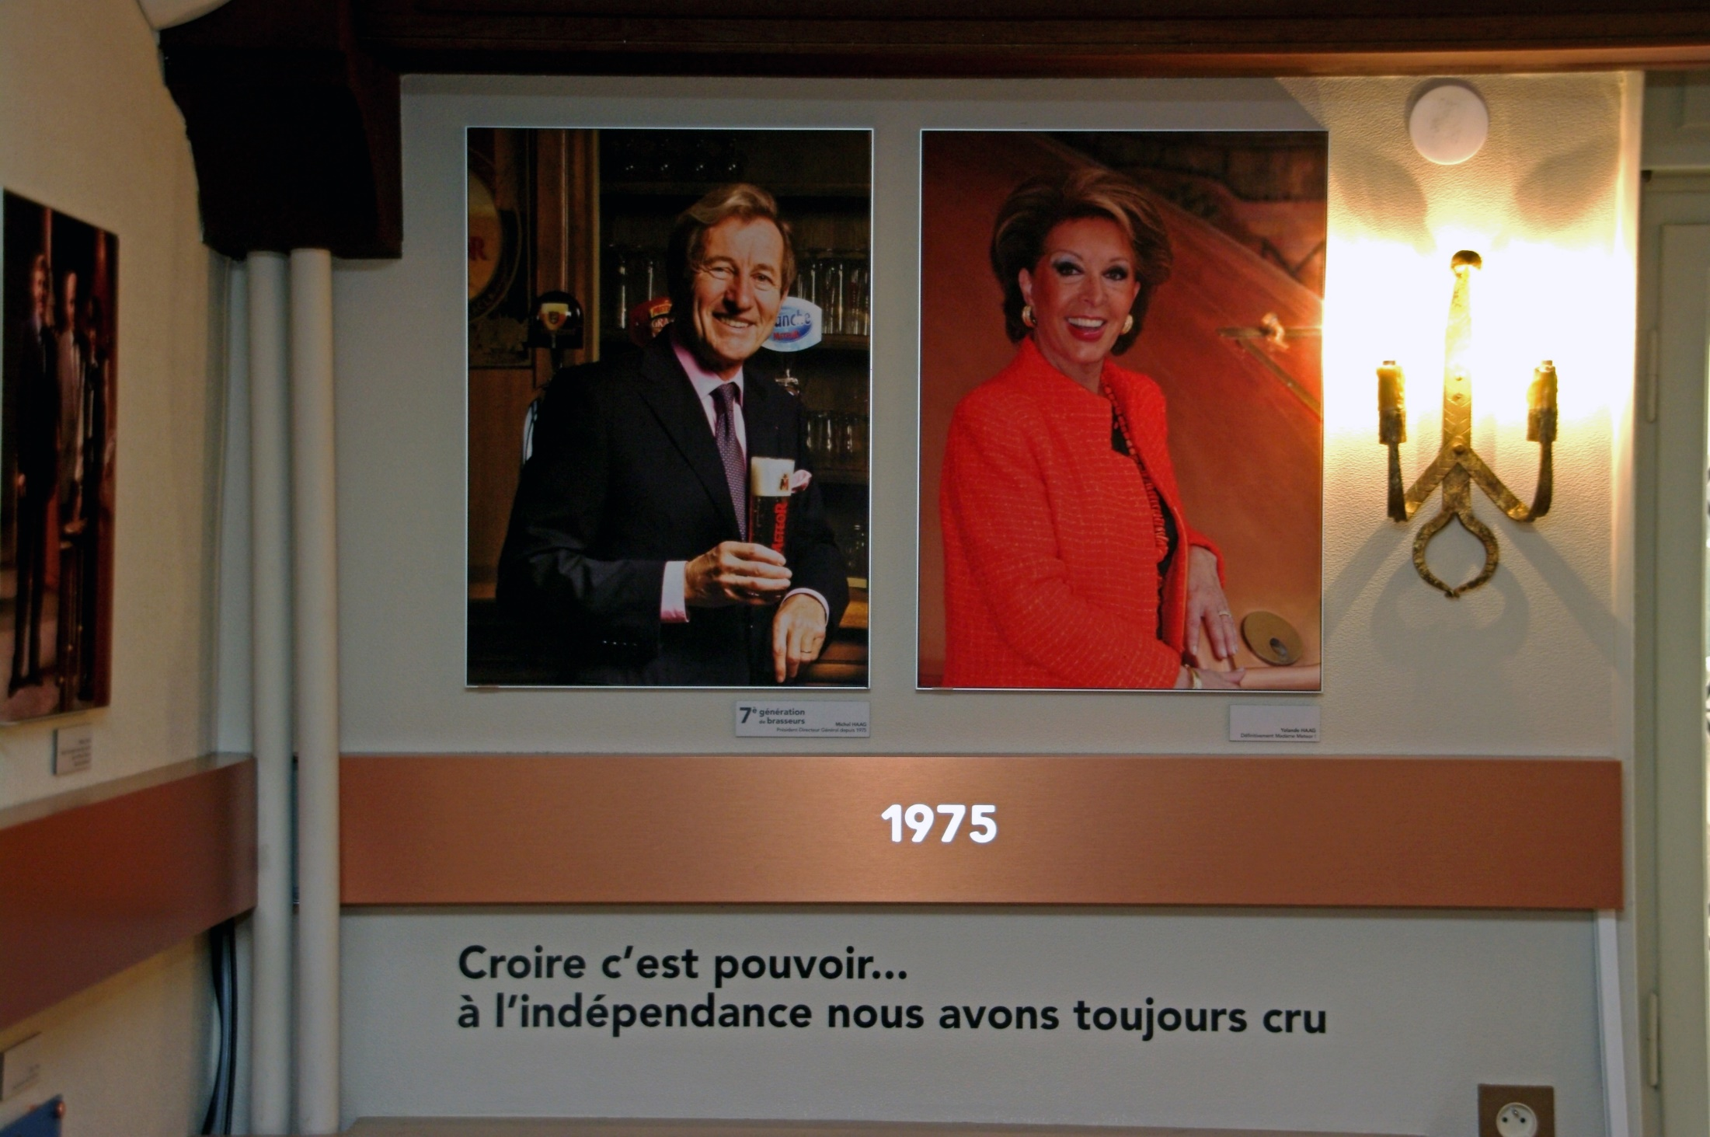

Slide 8
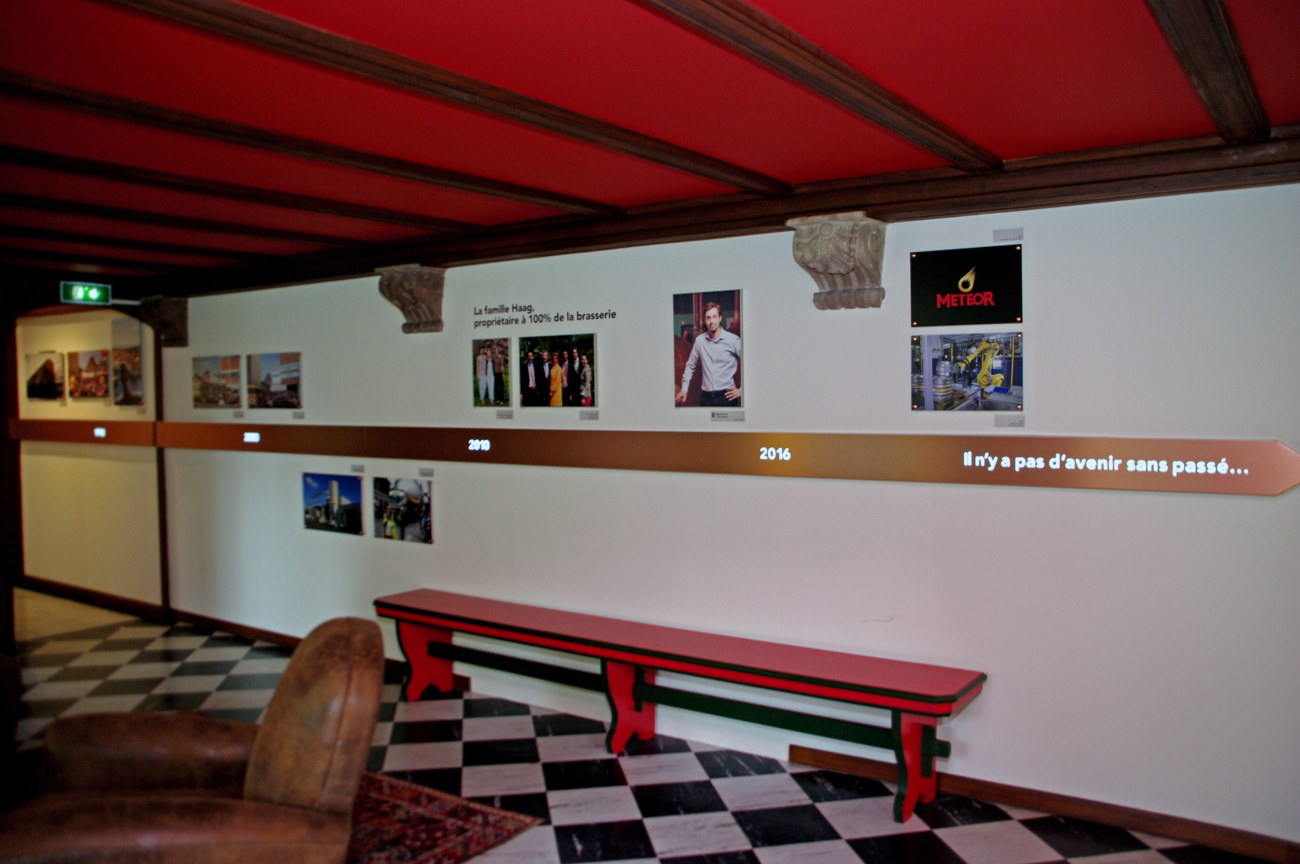

Slide 9
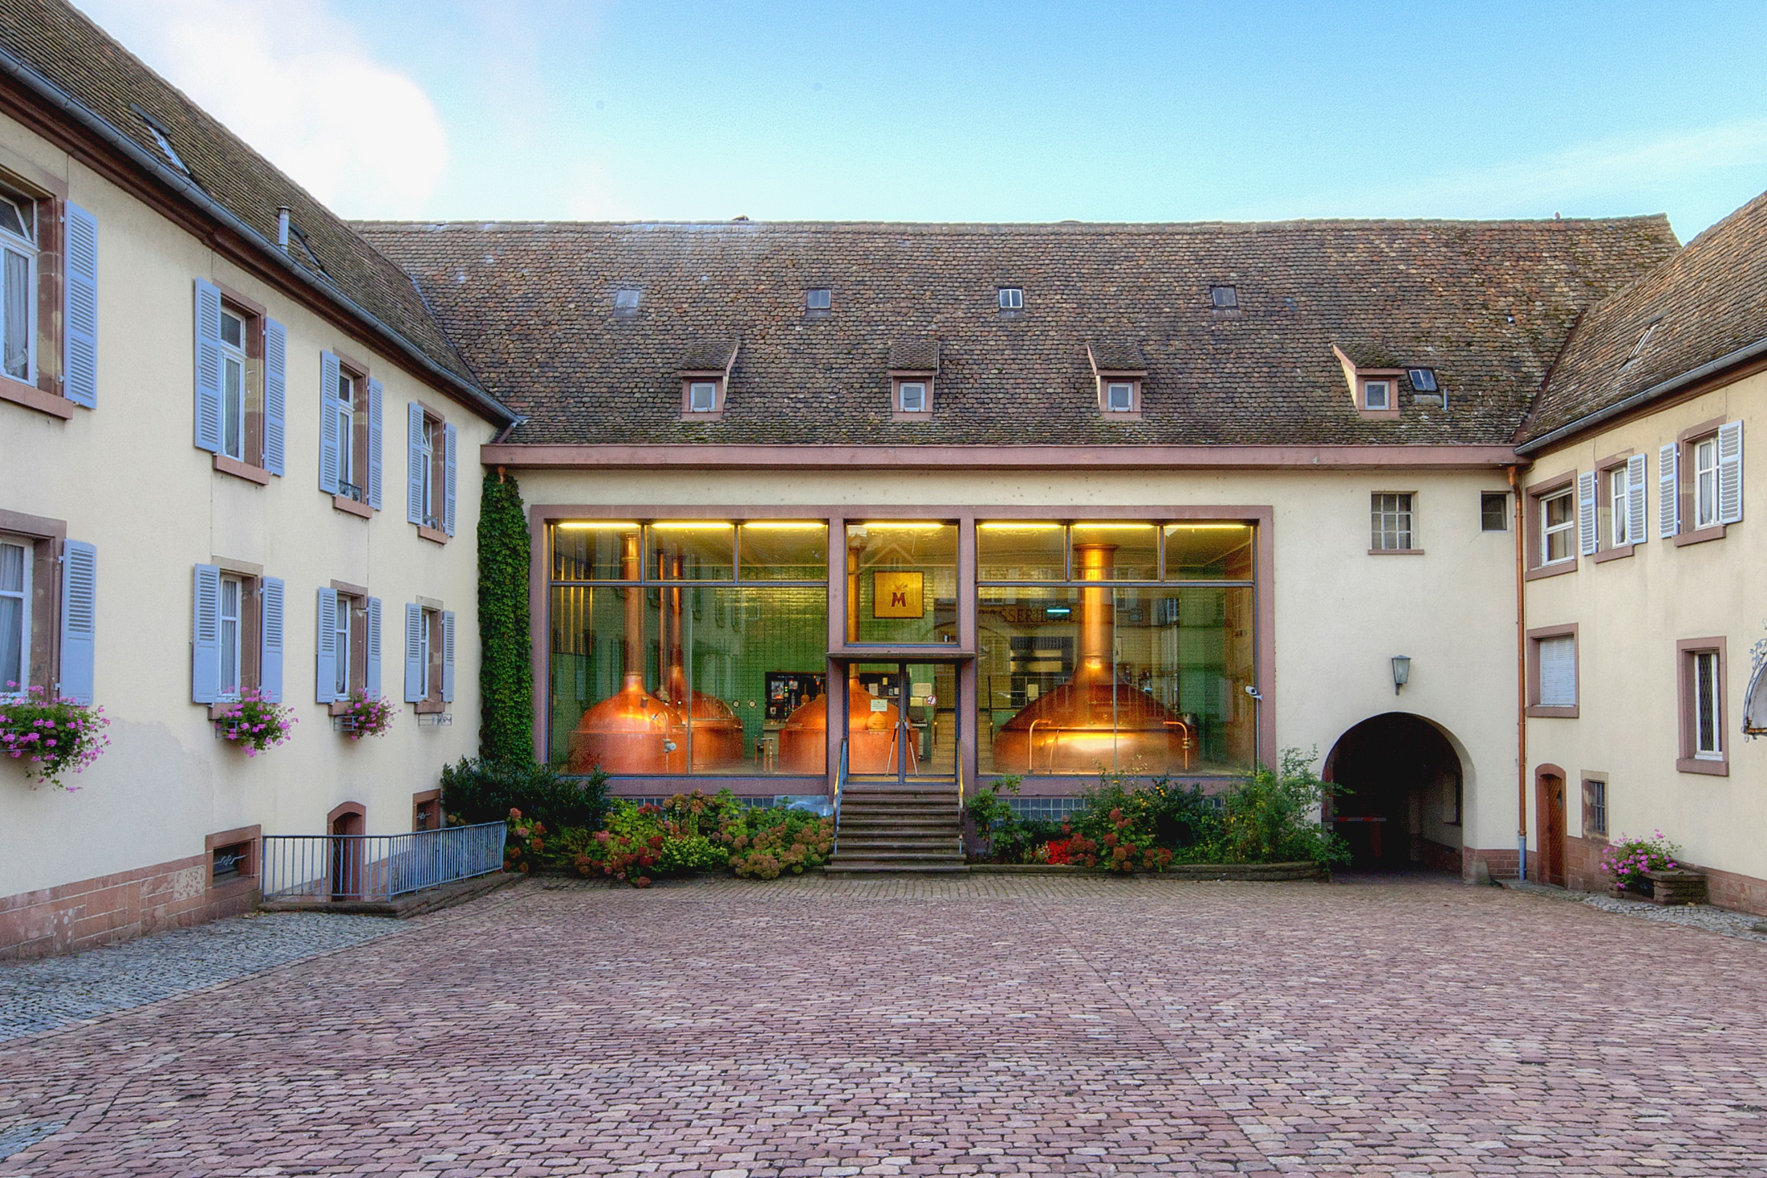

Slide 10
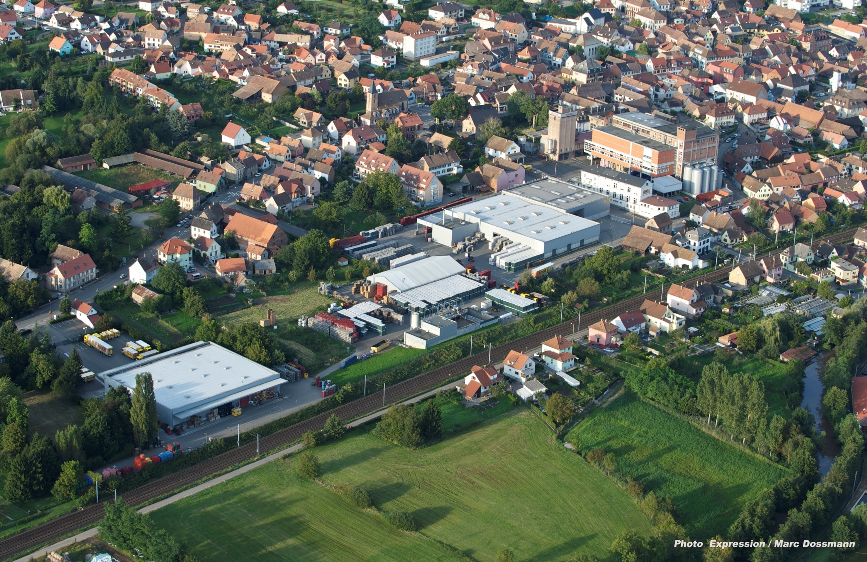

Slide 11
Meteor in a few figures
200 employees
60 M€ revenues / year
500 000 HL of beer / year
+ 9.5% growth 2018/2017
100% of the shares belong to the HAAG Family

Slide 12
Meteor in a few figures
Local versus national growth 2018/2017
Local vs national sales 2018
+ 5 %
+ 14 %

Slide 13
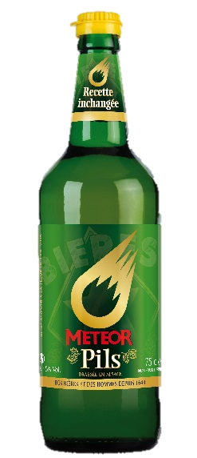
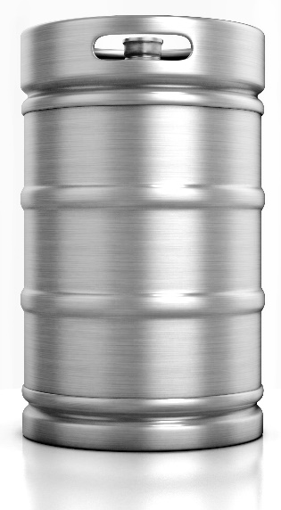
Meteor in a few figures
Bottles versus Kegs 2018
French beer market : 25% Kegs / 75% Bottles

Slide 14

What is at stake…
As an old brewery, we had a traditional range of products, though of excellent quality, but a little boring.
Moreover, we had to face very hard competition.
So we had to make a choice between three options :
To die slowly
To go downmarket
To go upmarket
Our challenge : to move upmarket

Slide 15
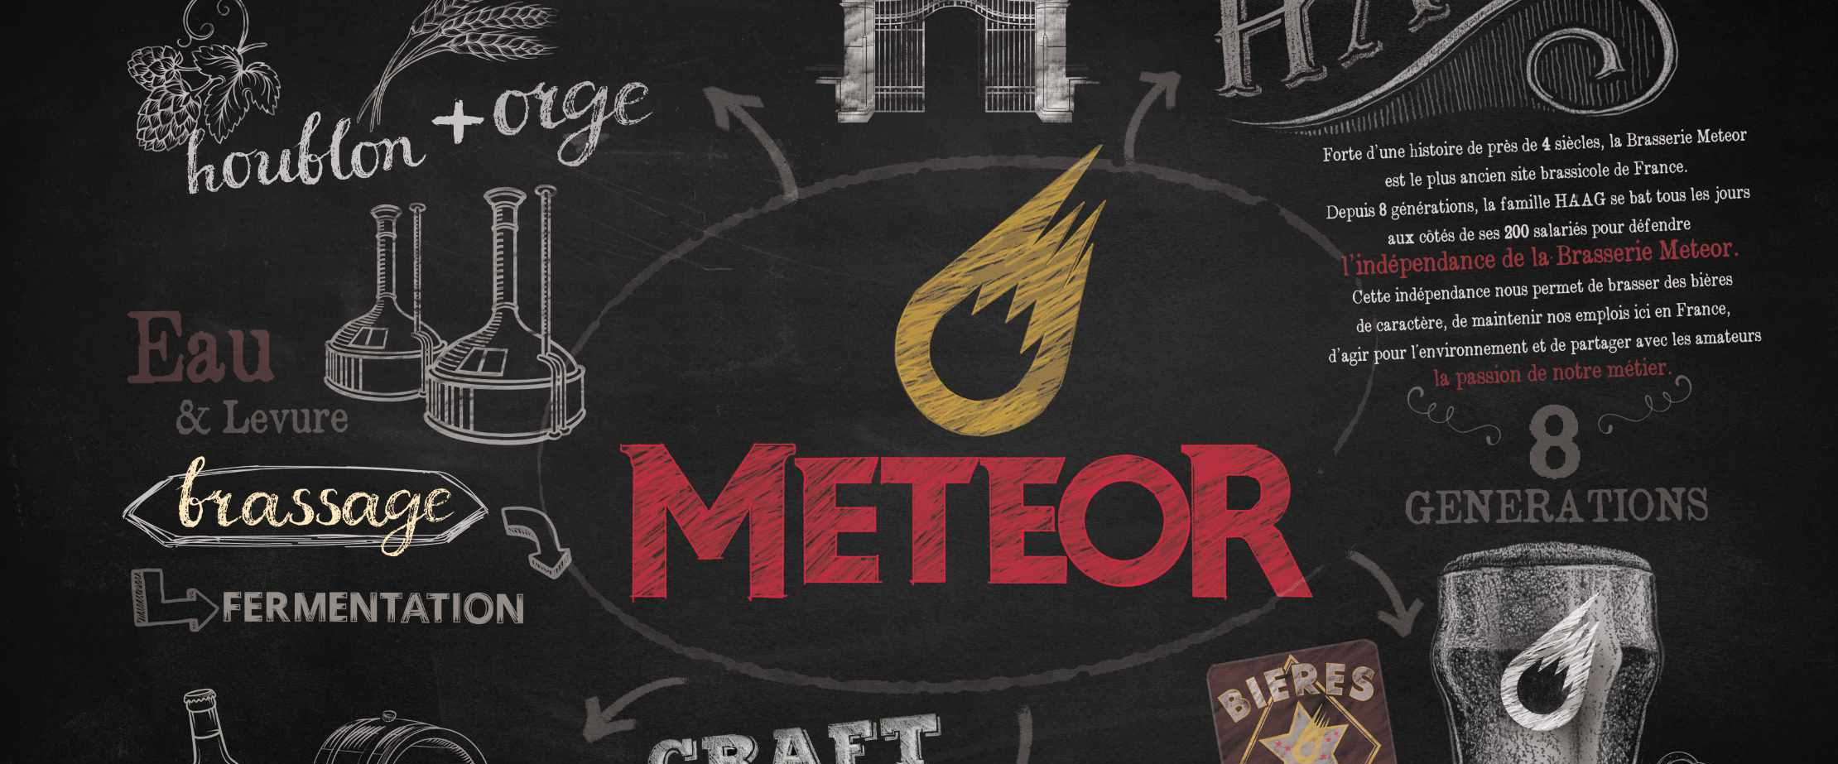
Part II
Meteor into the modern
world of craft

Slide 16
The process….
The Meteor brewery’s reaction to the changing market :
Misunderstanding
During a long time…
Big doubts
One day
New certainty
During a few months
Master plan
Already several years… but never ending
Implementation
Happy customers, Happy Employees, Happy Boss (and happy bankers…)

Slide 17
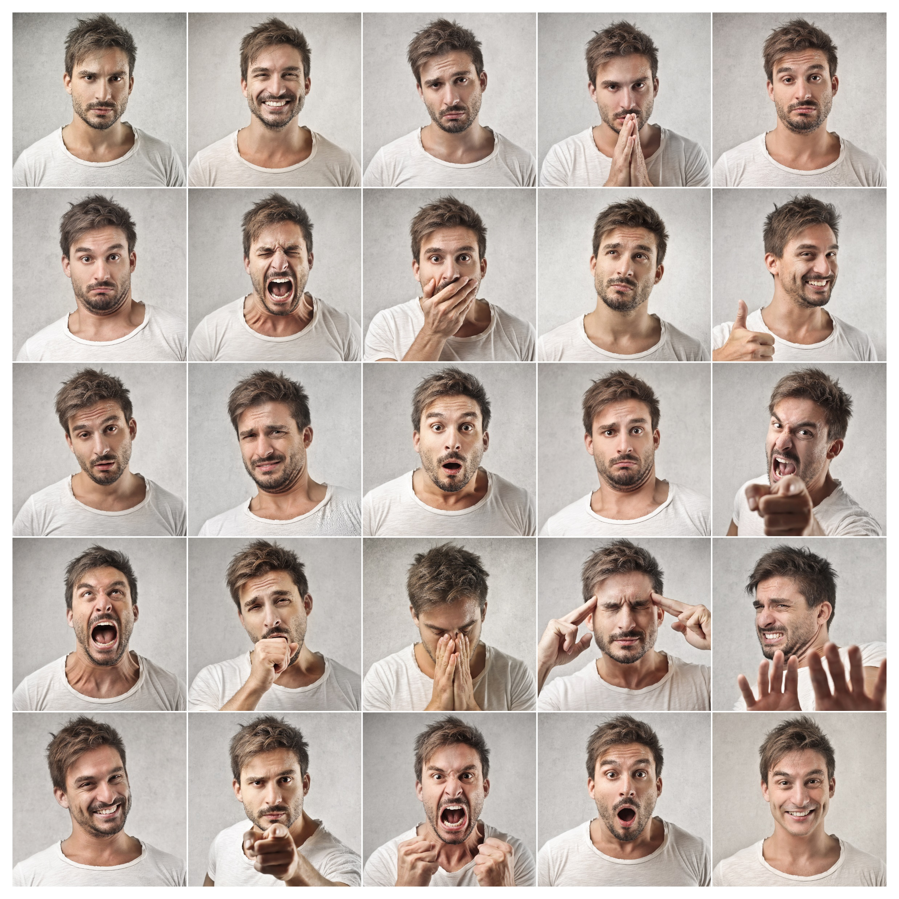

Step 1 : a lack of understanding
Why do people want something else than the best french pilsner ever?
Why do people pay twice the price for a beer of irregular taste?
Who are all these micro-brewers? What motivates them?

Slide 18
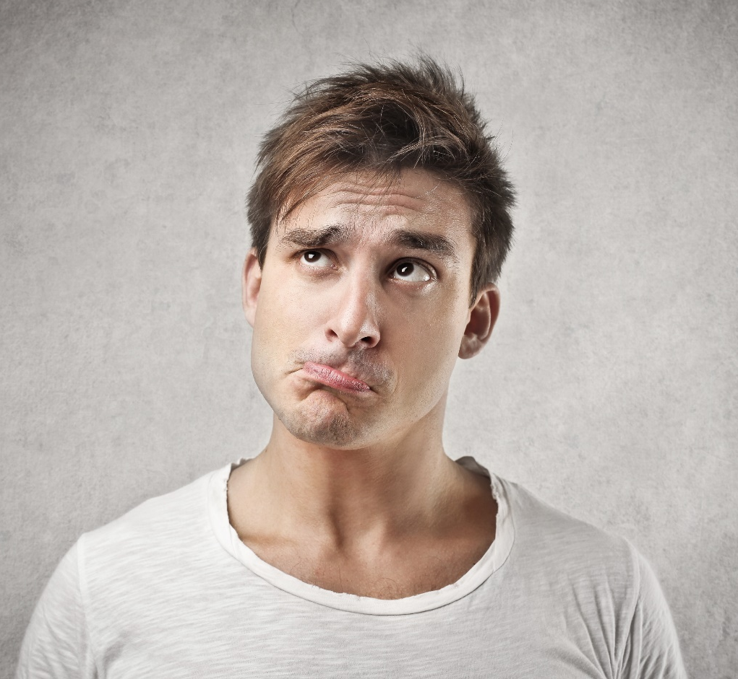
Step 2 : the big doubts
Is our brand still ok?
Should we create a new brand?
Do we have the capacity to create lots of new beers?
Can we get the interest of the people out of our local region?
Etc..

Slide 19
Step 3 : new certainty
We are exactly what the people expect from a brewery like ours
…but…
We don’t know it…
…and neither do they

Slide 20
Step 4 : master plan
Marketing & sales :
  New logo and corporate identity
  Social networks & events
  Limited edition brews & lots of innovation
  The Villa Meteor
  Train the sales reps
Production :
  R&D team
  R&D equipments
  Shorten the innovation cycles

Slide 21


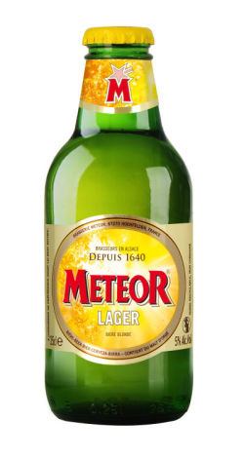
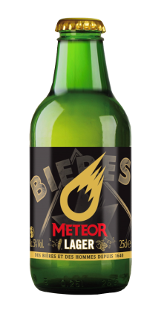
Step 5 : implementation / new identity

Slide 22
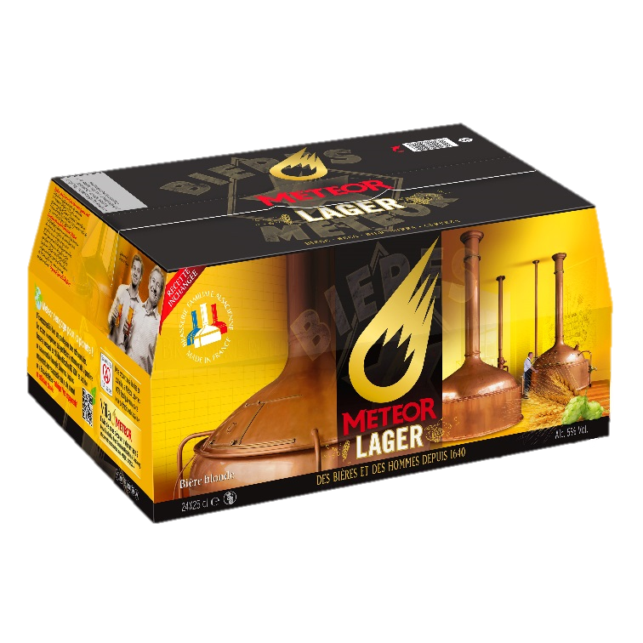
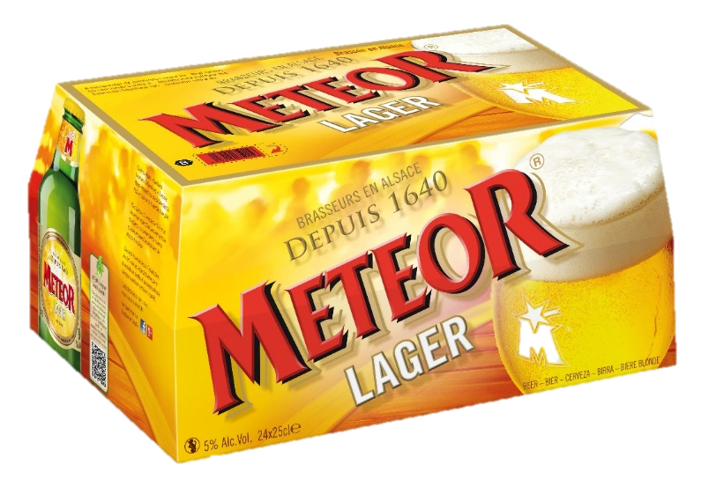
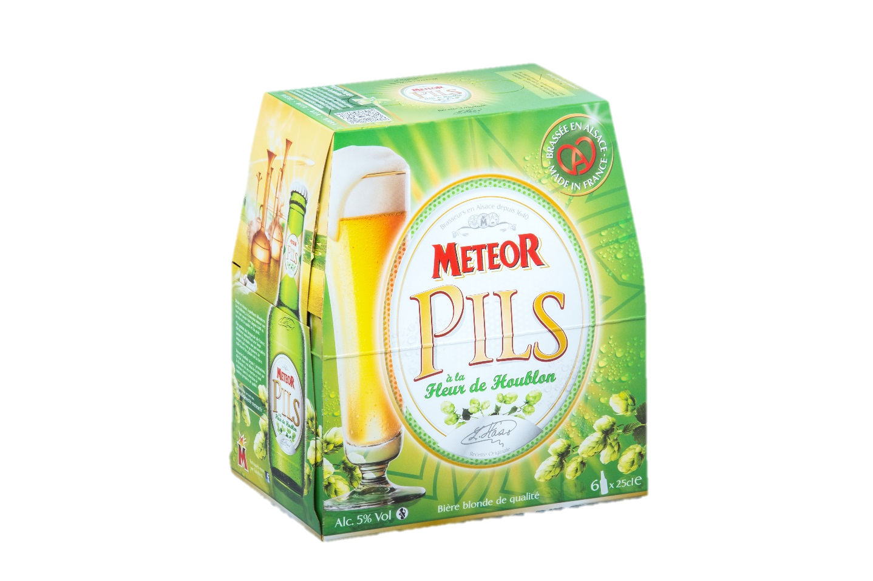
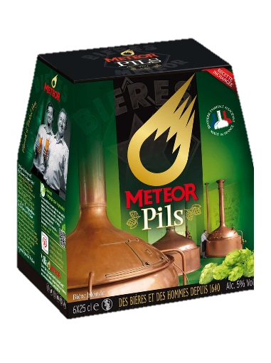
Step 5 : implementation / new identity

Slide 23
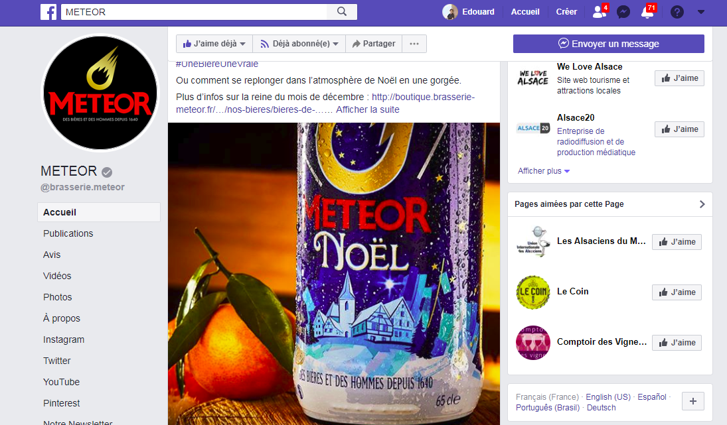
Step 5 : implementation / focus on social networks

Slide 24


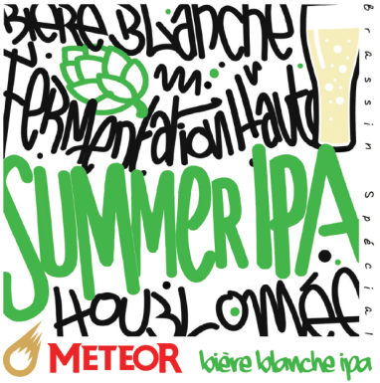

Step 5 : implementation / Innovation
3 Limited edition brews / year : lean startup applied to a brewery

Slide 25
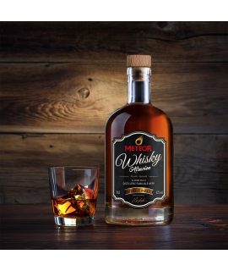
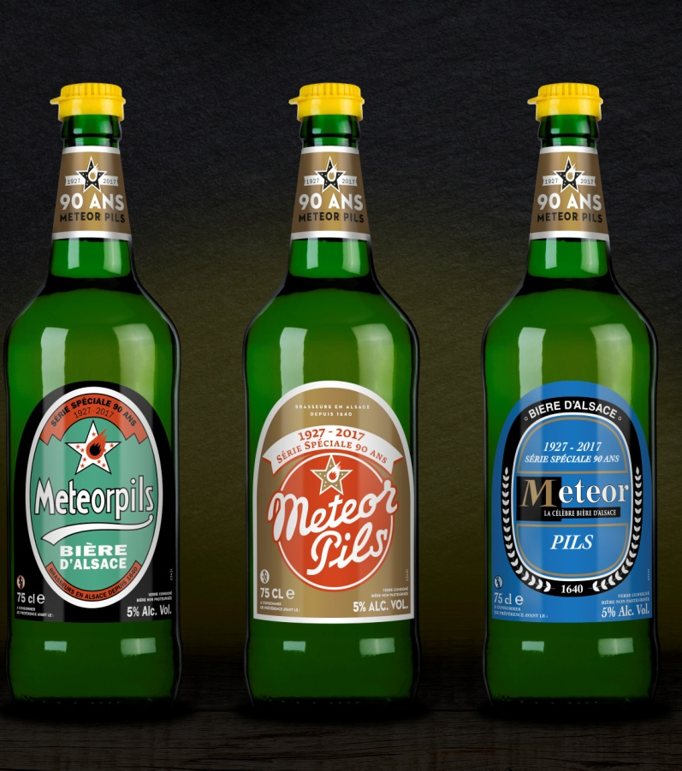

Step 5 : implementation / Innovation

Slide 26
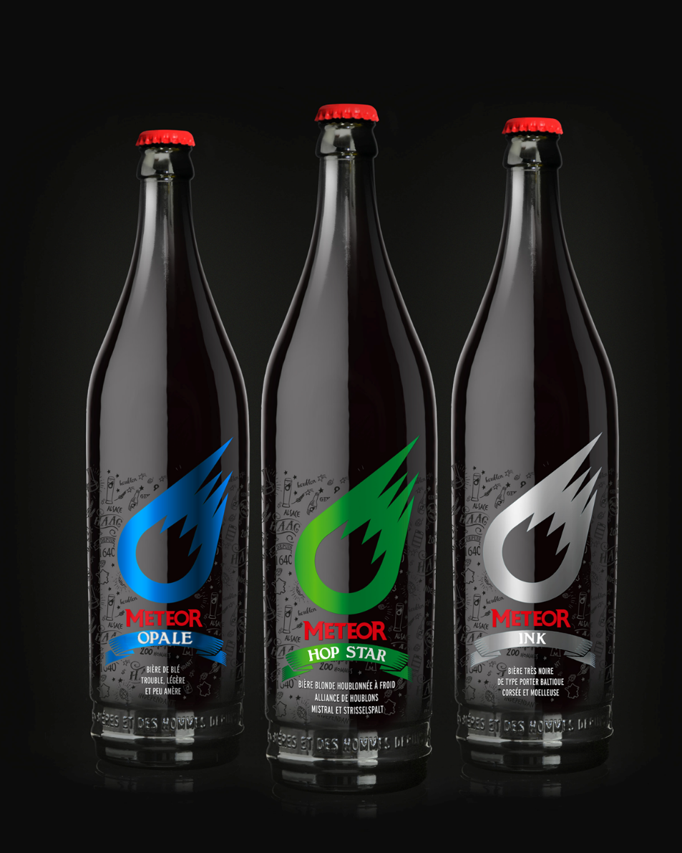
Step 5 : implementation / Innovation

Slide 27
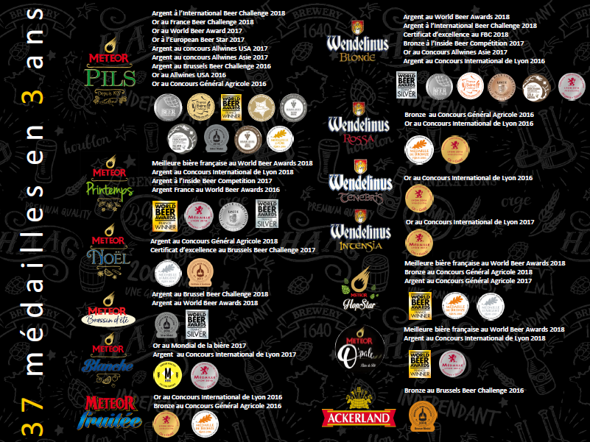
Step 5 : implementation / Innovation

Slide 28
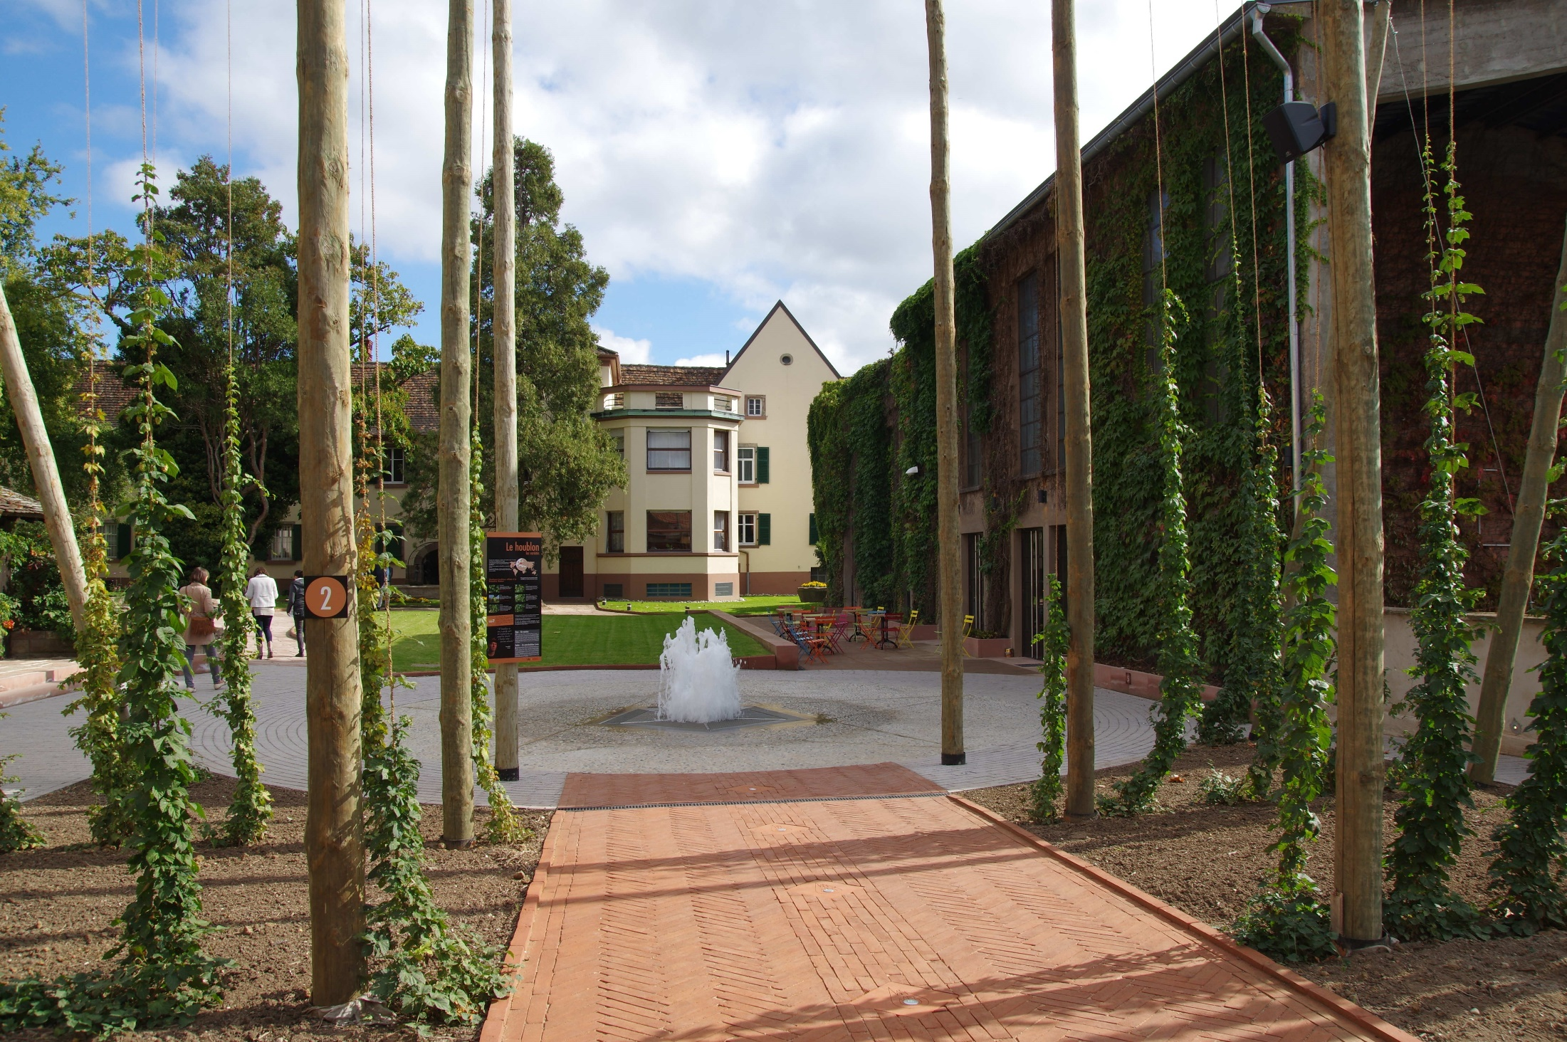
Step 5 : implementation / Villa Meteor

Slide 29
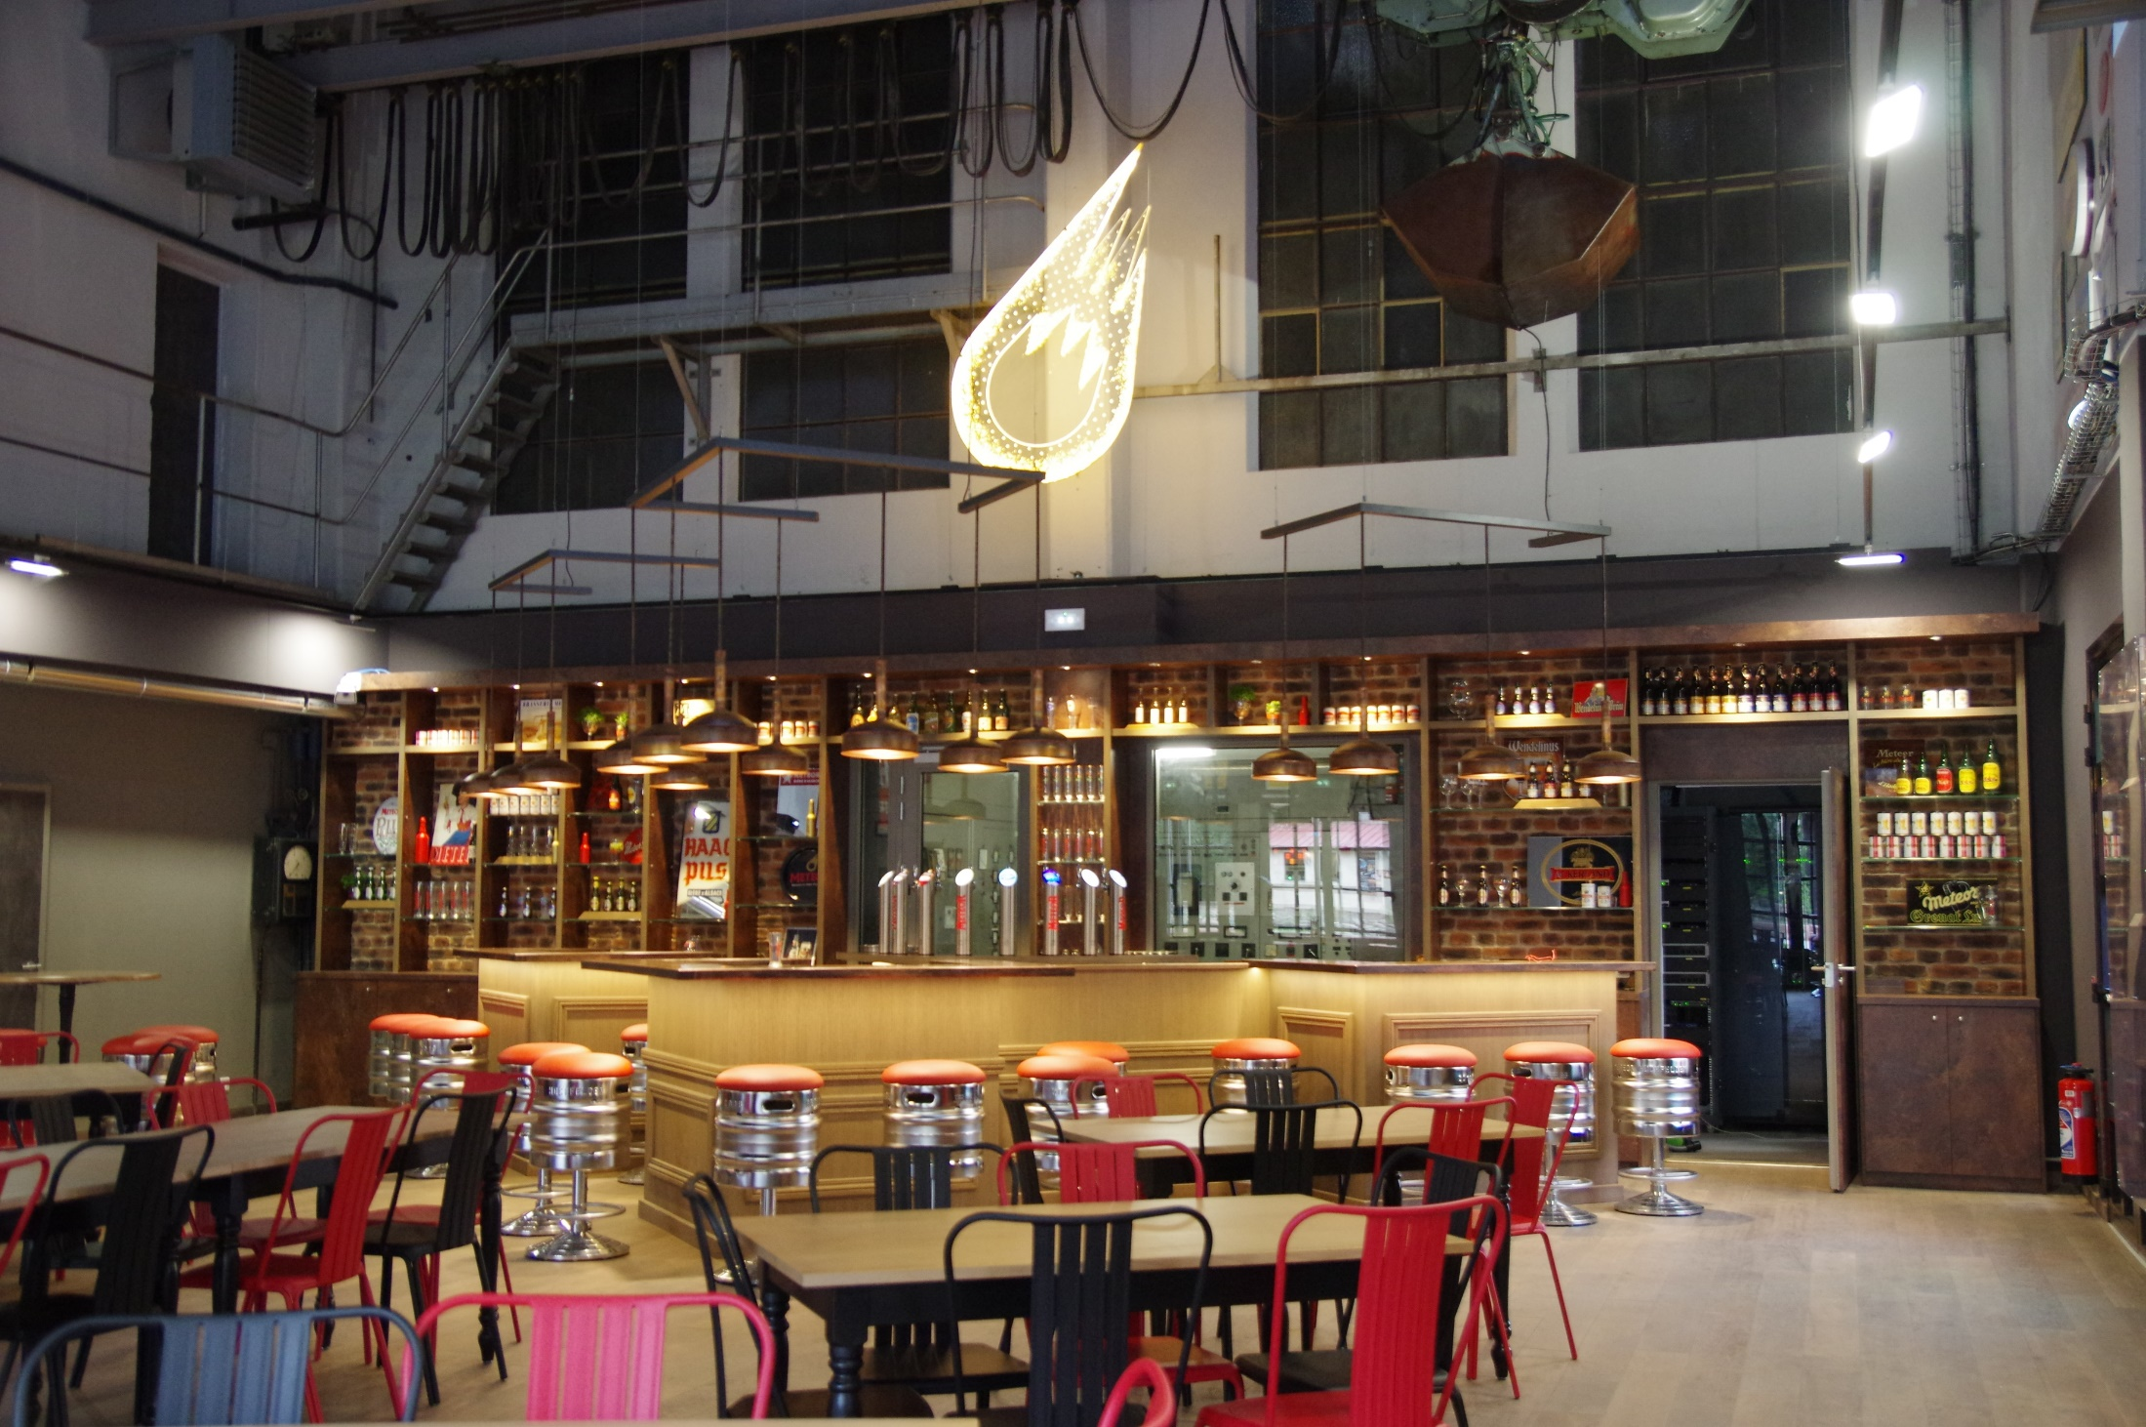
Step 5 : implementation / Villa Meteor

Slide 30
Conclusion : why it works
Quality of the staff :
  involved
  eager to change
Quality of the beers
  we never compromise (…and often delay our launching dates….)
Quality of the communication :
  Authentic
  Transparent
  Explain our values

Slide 31
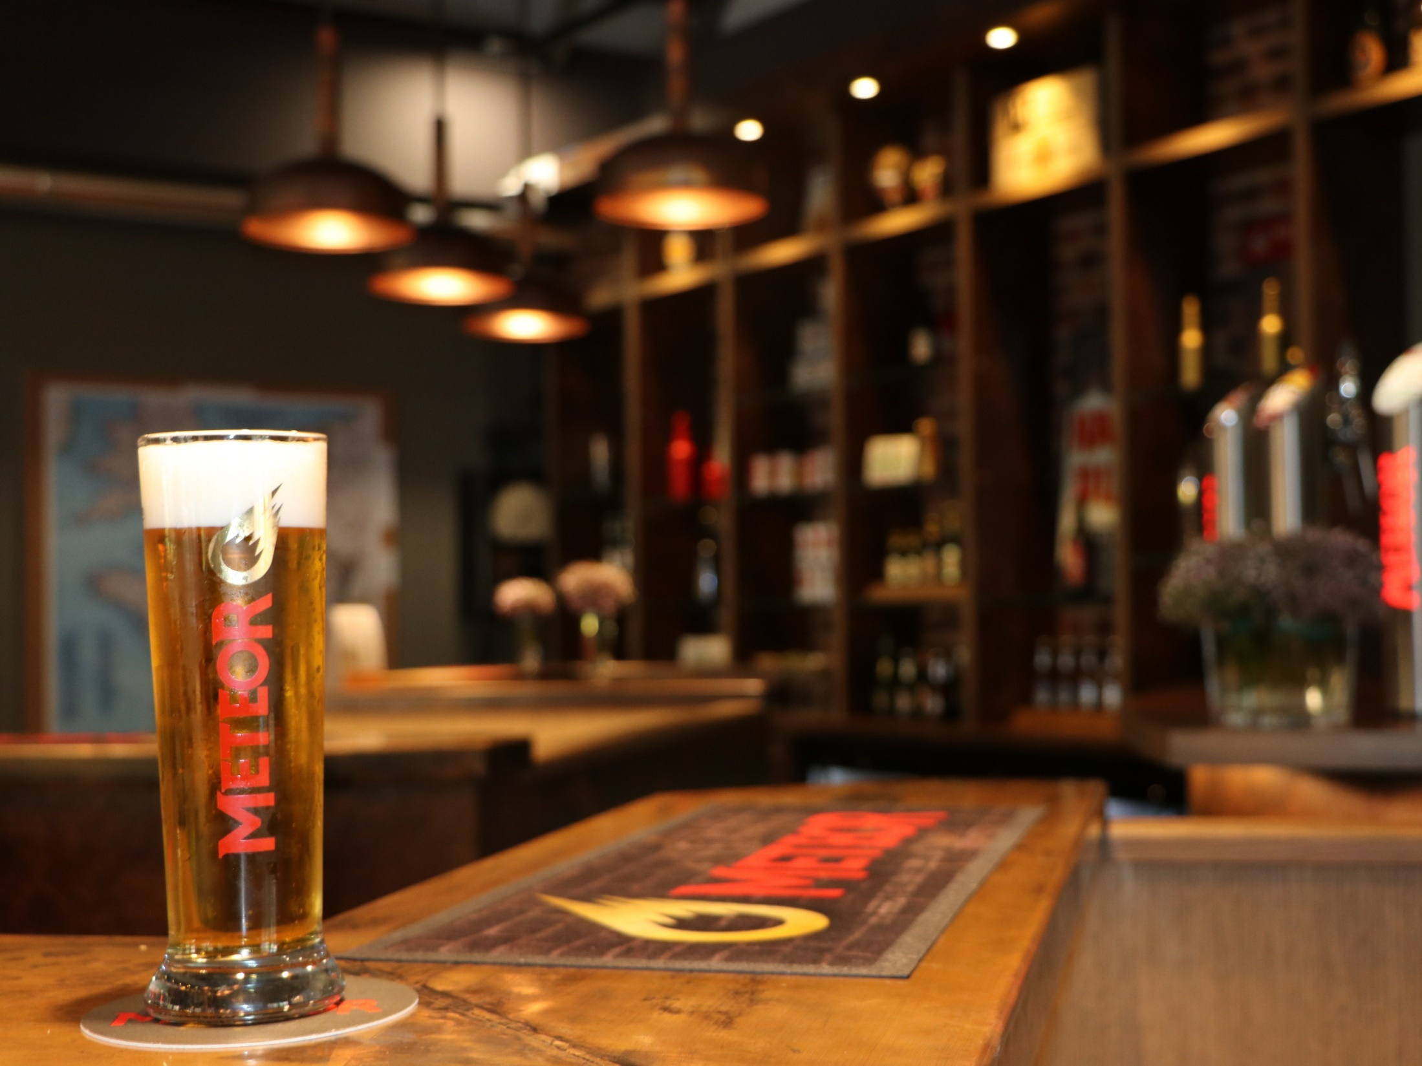
Thank you

