Slide 2
Brewers of Europe Forum
New Retail
Marc Scholten
June 4th 2019

Slide 3
3 questions to start

Slide 4
Did you buy ‘something’ online in the last year?

Slide 5
Did you buy specialty/craft beer in the last year?

Slide 6
Did you ever buy specialty/craft beer ONLINE?

Slide 7
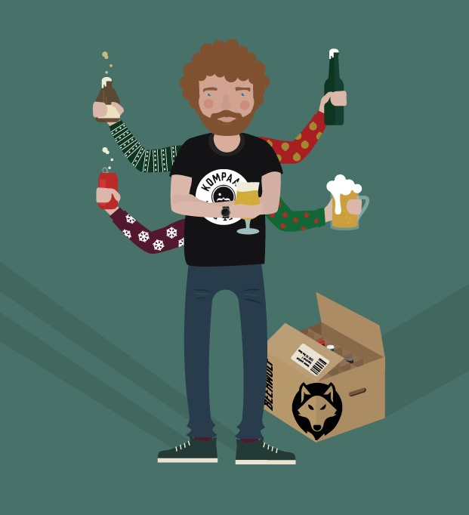
A short intro

Slide 9
BEER
=
HOT

Slide 10
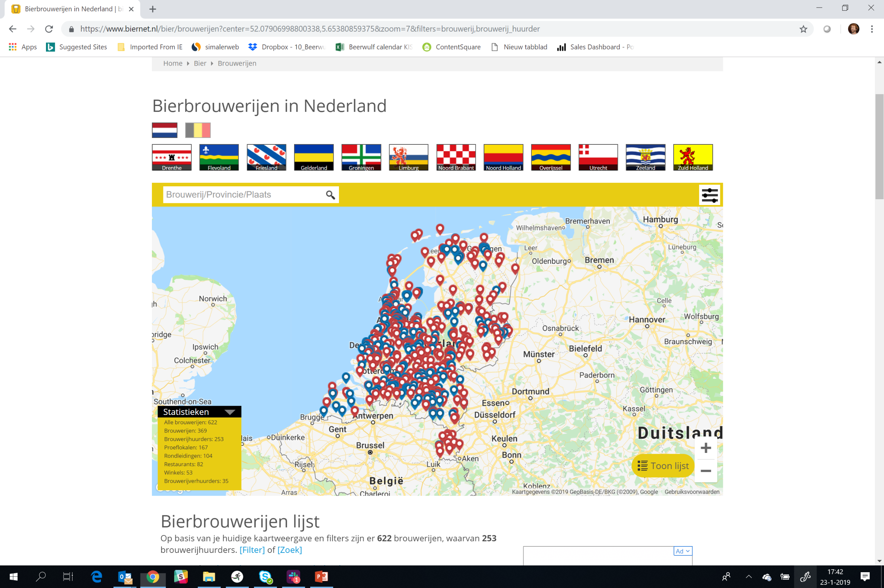

Slide 11
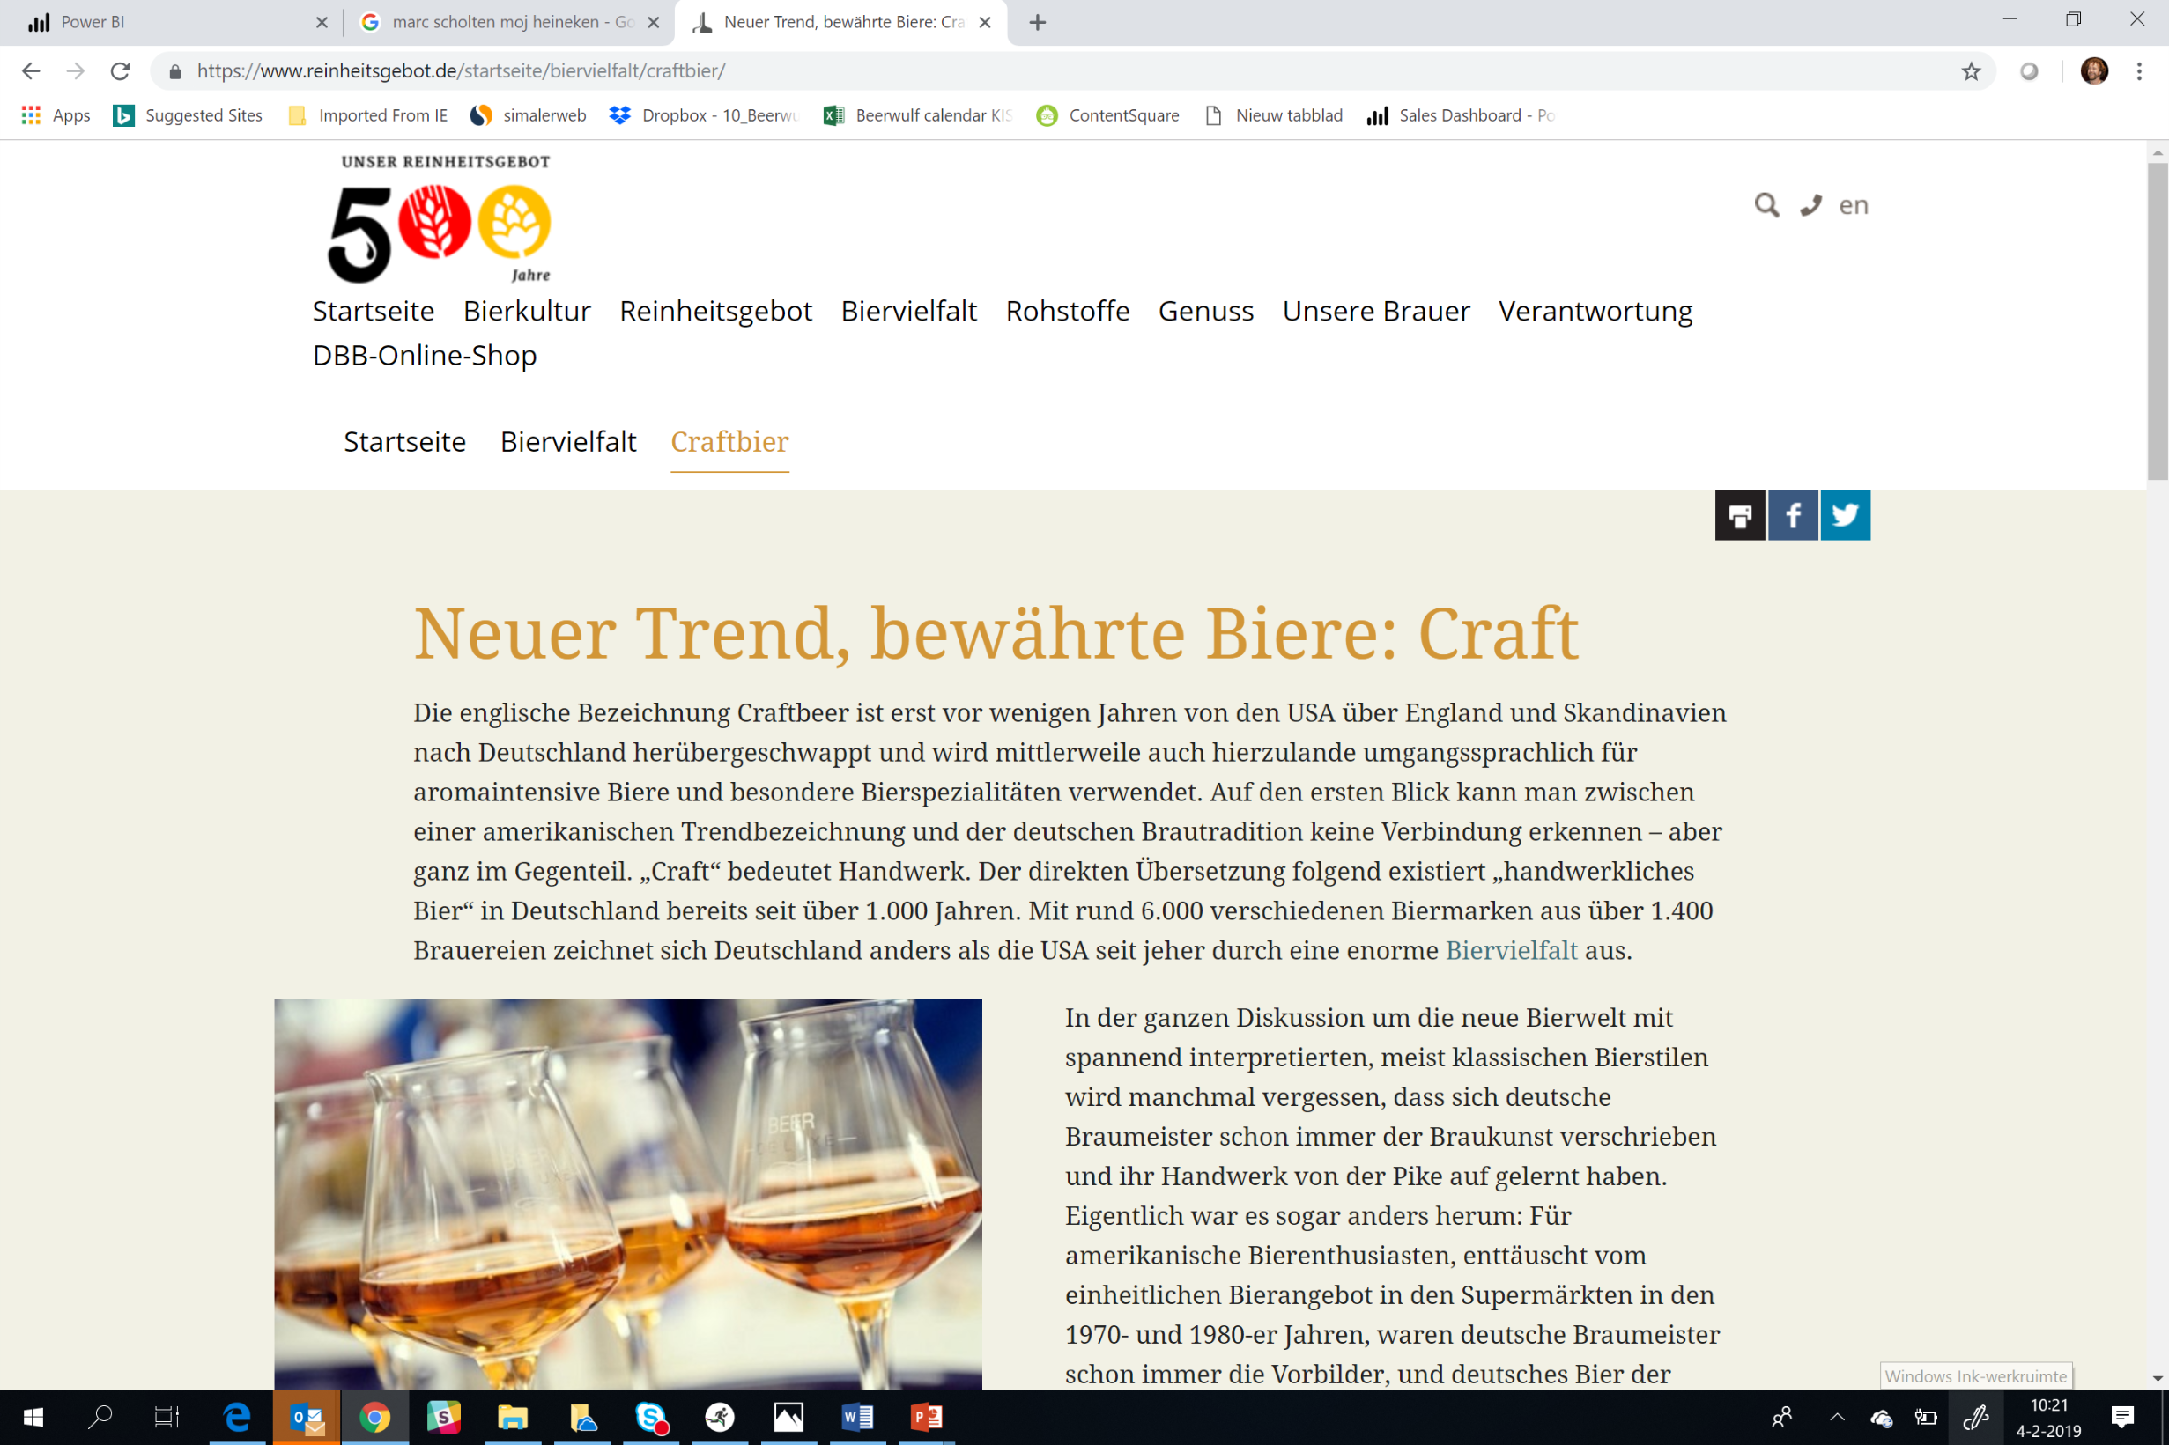

Slide 12
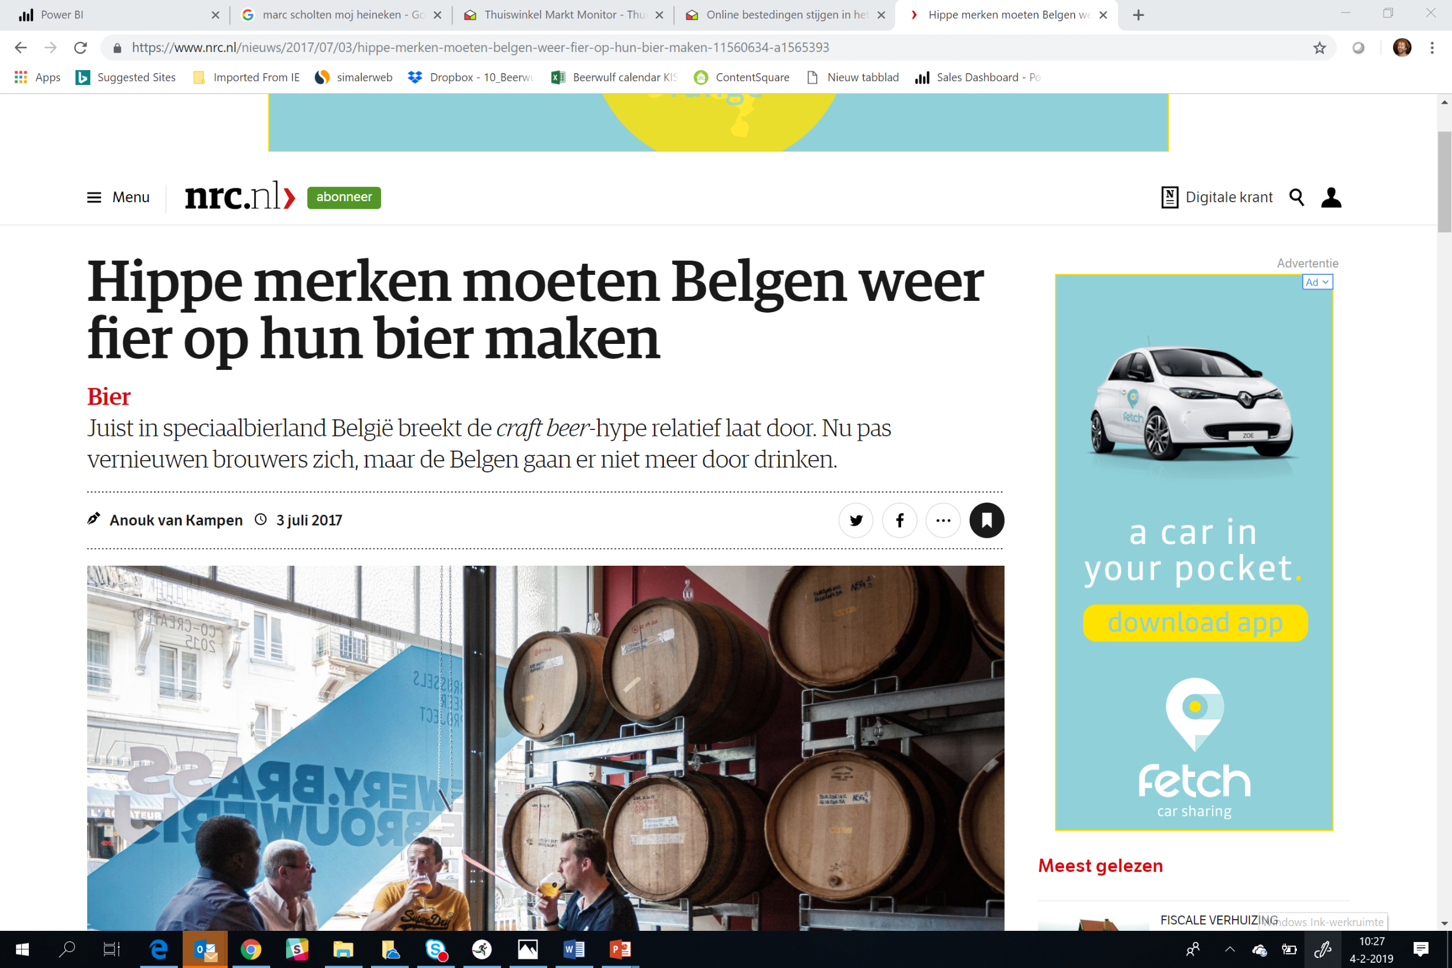

Slide 13
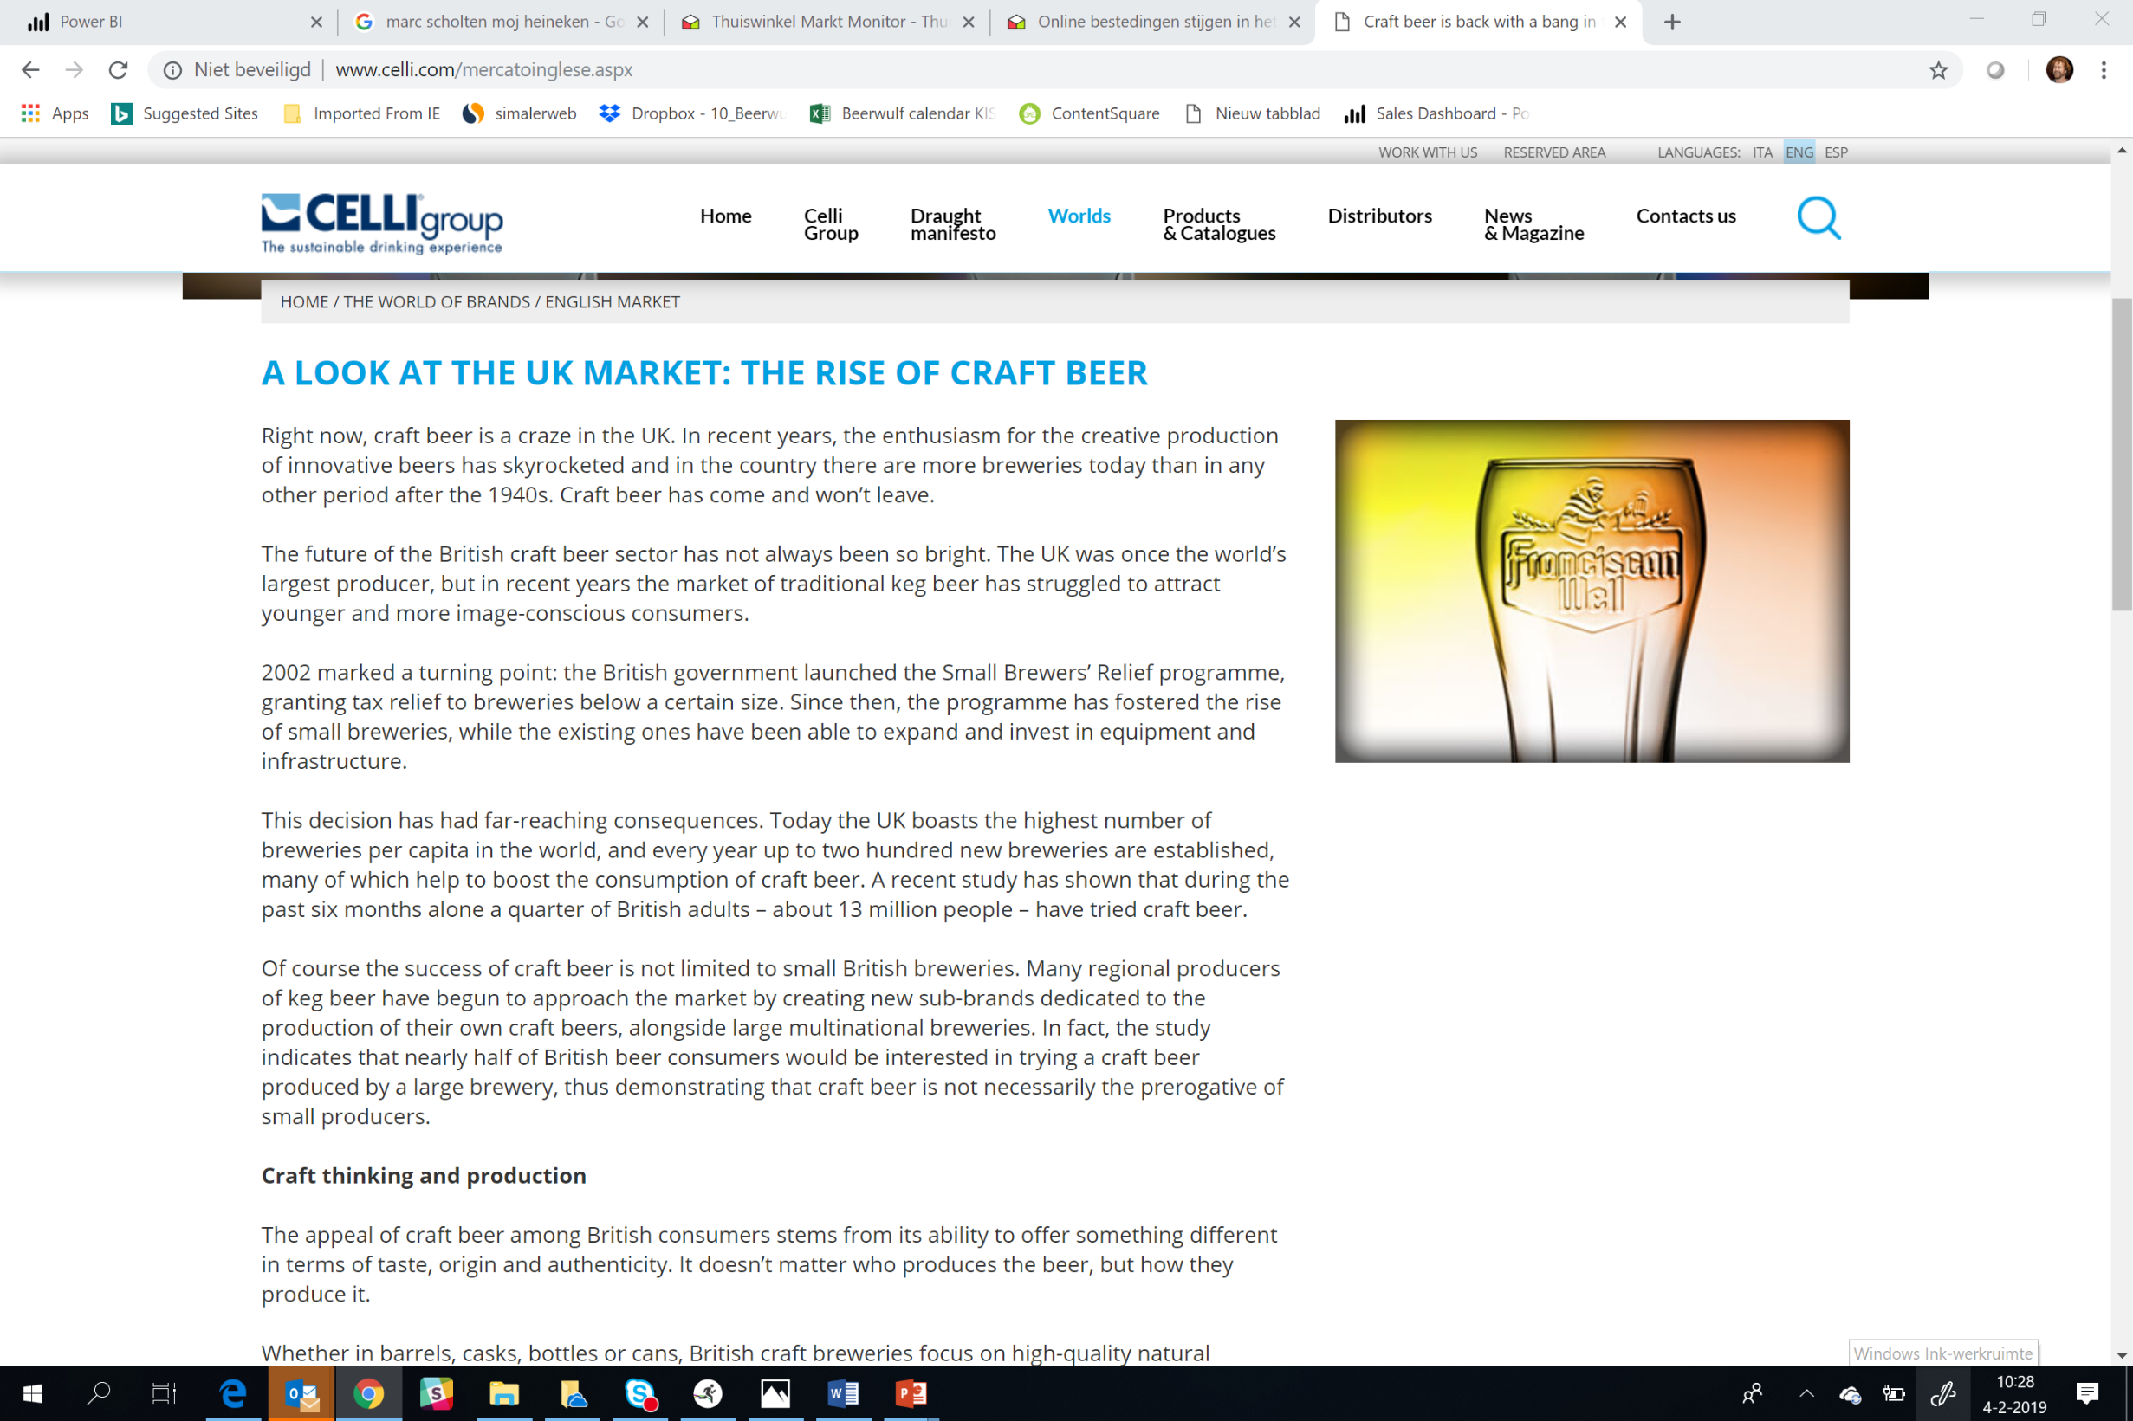

Slide 14
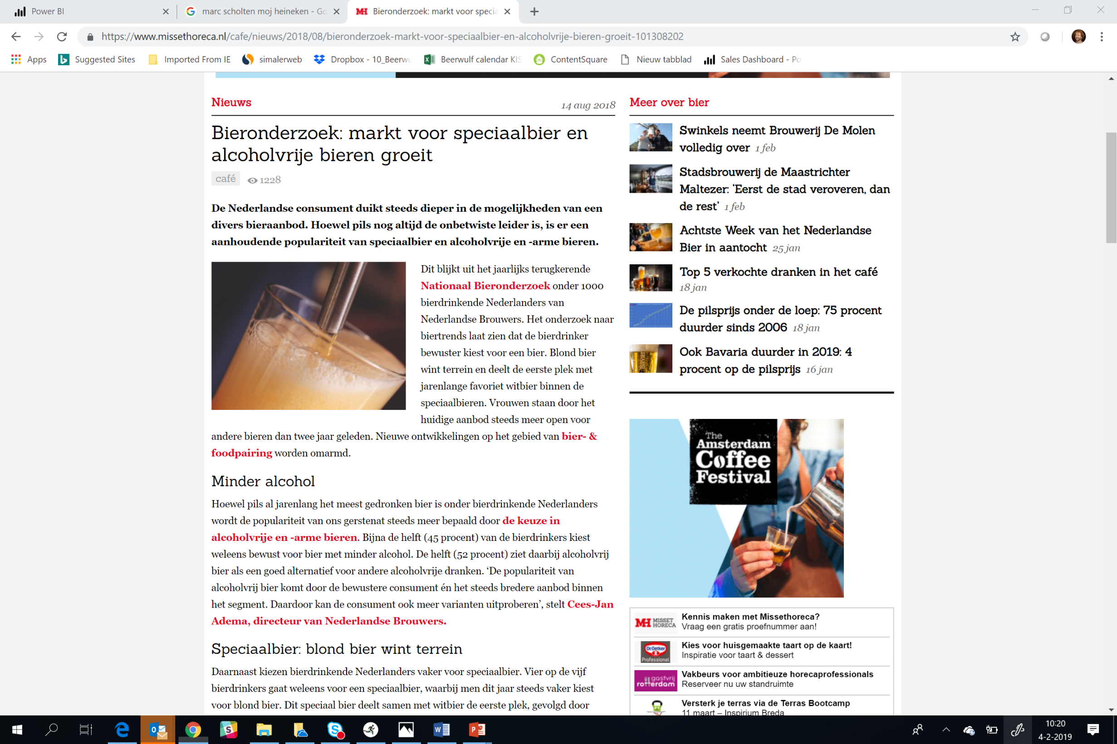

Slide 15
CRAFT BEER
=
RELATIVELY SMALL

Slide 16
AND ECOM % RATE ALSO…

Slide 18
BEHAVOURIAL CHANGE
IS NEEDED

Slide 19
WE STARTED IN JUNE 2016

Slide 20
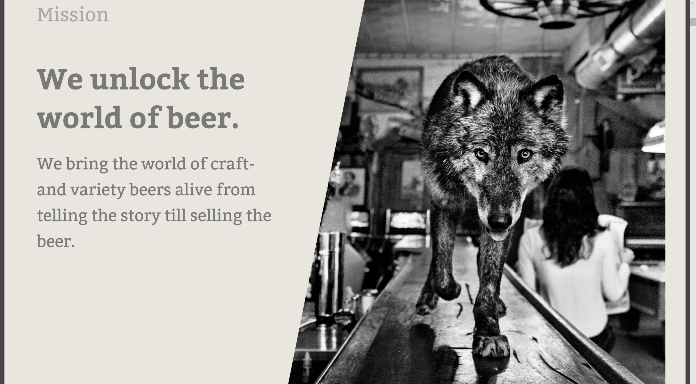
Make craft- and specialty beer easy accessibele for everyone.

Slide 21
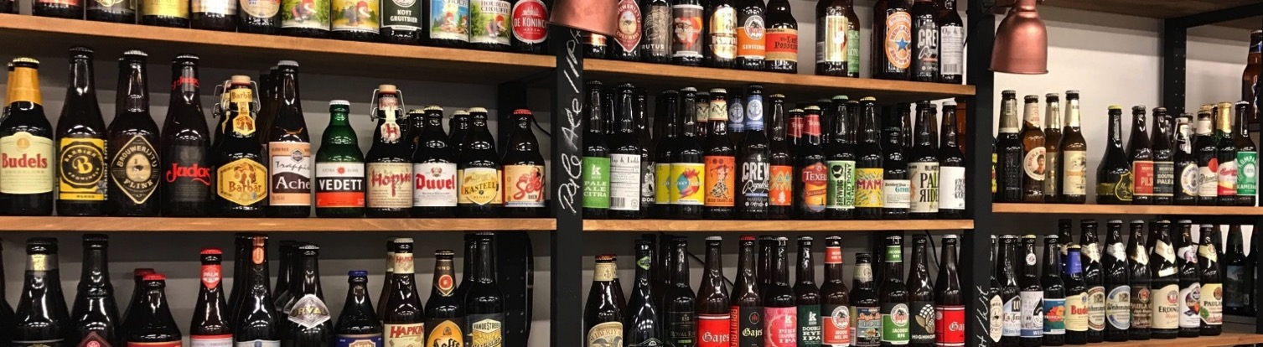
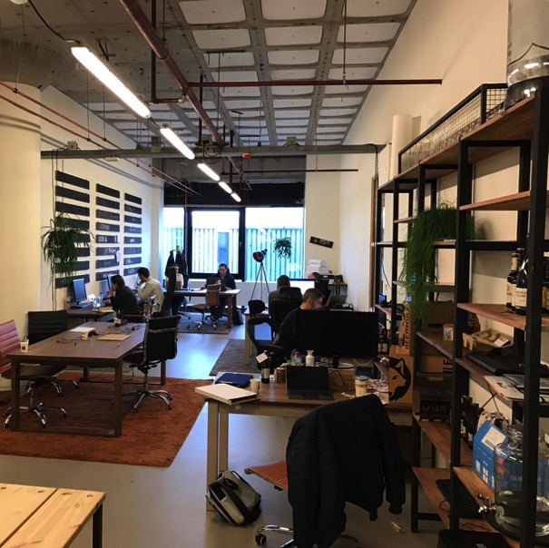
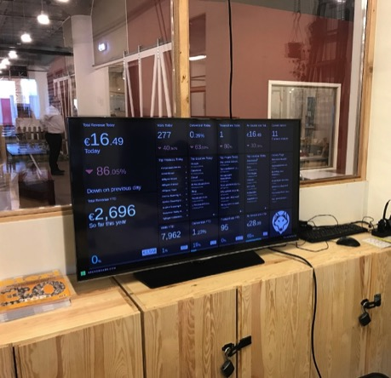
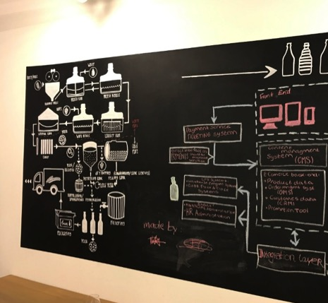

BUILD THE COMPANY IN B.AMSTERDAM
Notes:
Moved to our own office @ B. Amsterdam.

Slide 22
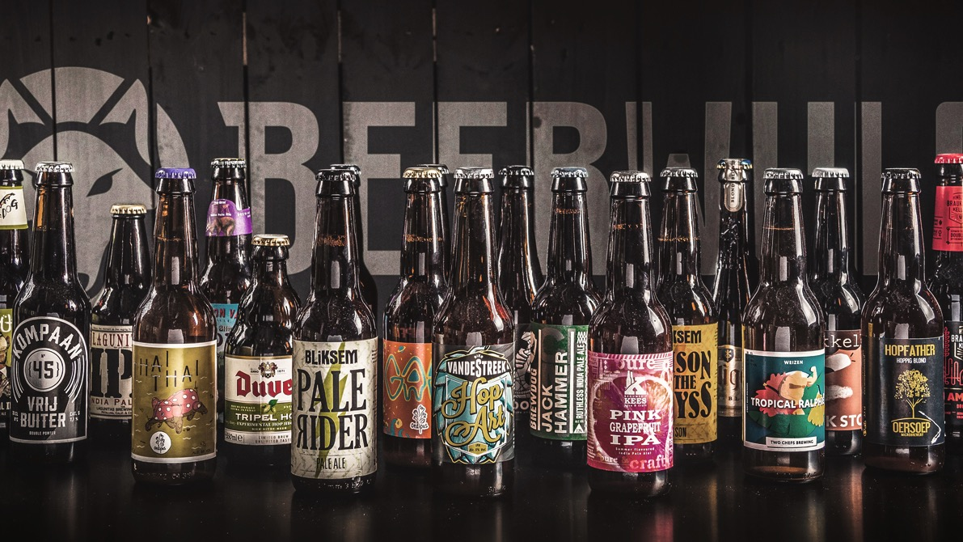


BUILD THE LEADING ONLINE BEER STORE OF EUROPE
Brewing & Bottling
Inbound logistics
Warehousing
Pick & Pack
Outbound Logistics
Last mile delivery
Best assortment
We give you access to the best beer assortment at any time of the year, curated by our independent beer hunters
Best beer User Experience (UX)
We help you navigate through the world of beers, from inspiration till delivery and bring you in direct contact with the brewers
Best service
We make home-delivered C&V beers easily affordable and available for everyone

Slide 23
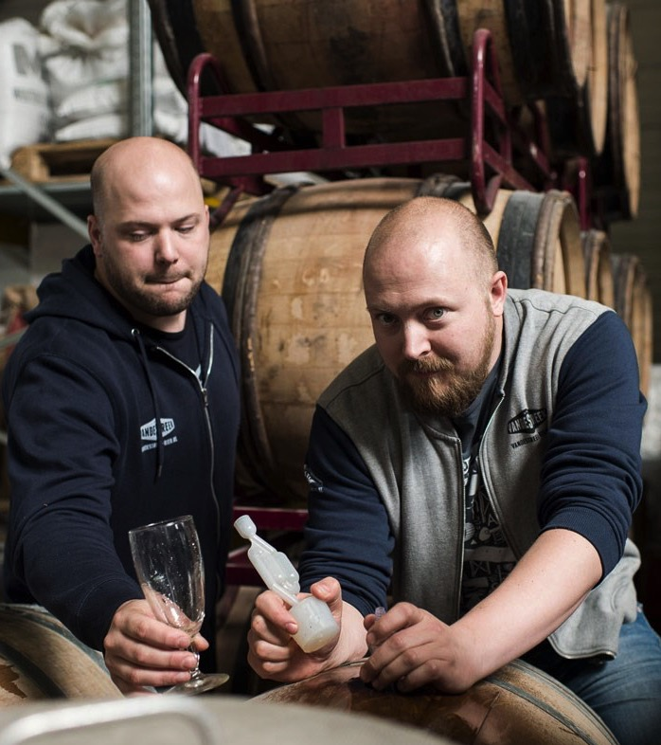
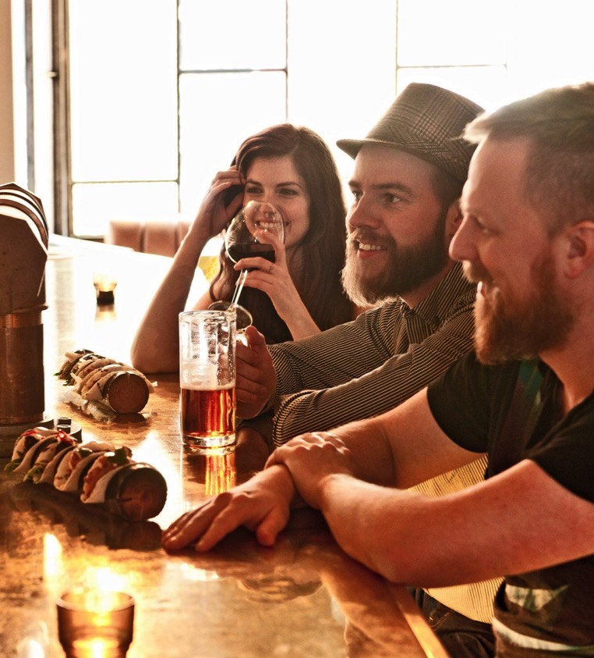
CONSUMER & BEER & BREWER CENTRIC PLATFORM

Slide 24
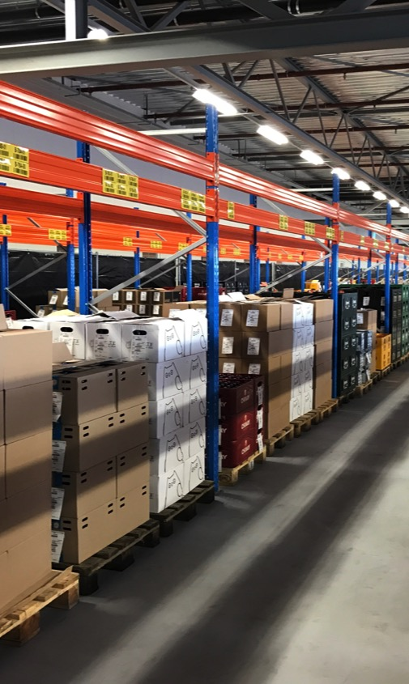
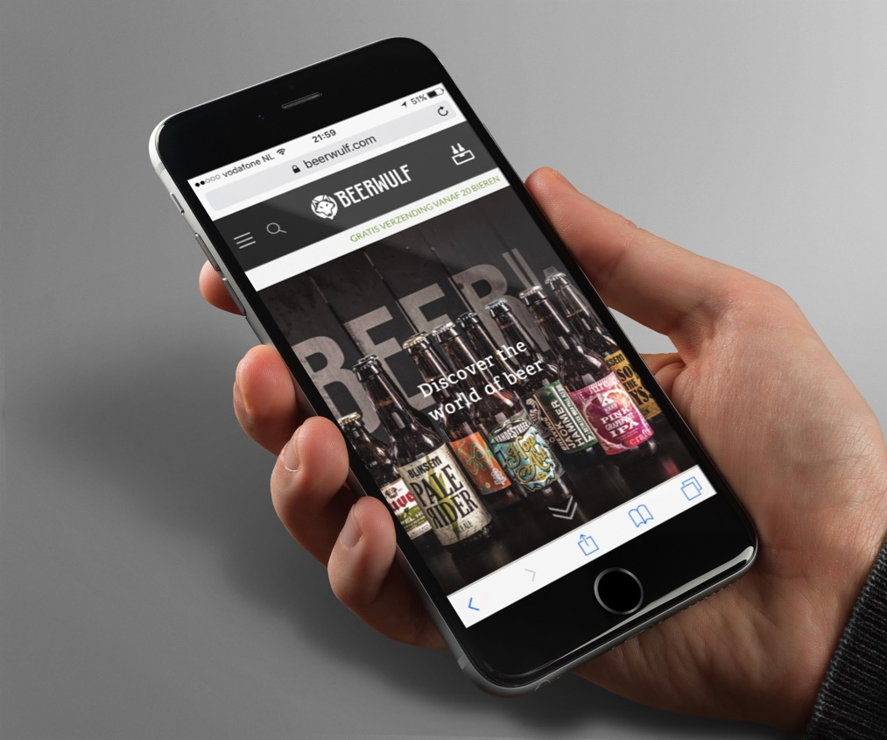

BUILD THE MVP: ASSORTMENT, LOGISTICS, WEBSITE AND BRAND
Notes:
Developed the brand

Slide 25
GO LIVE MARCH 2nd 2017

Slide 26

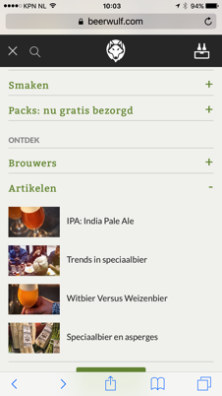
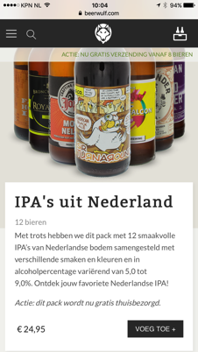
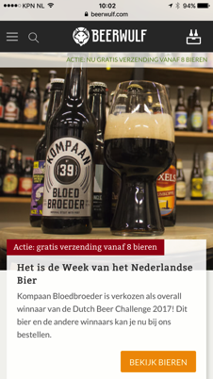
Make it work: Continuous UX improvements

Slide 27
Data over opinions

Slide 28
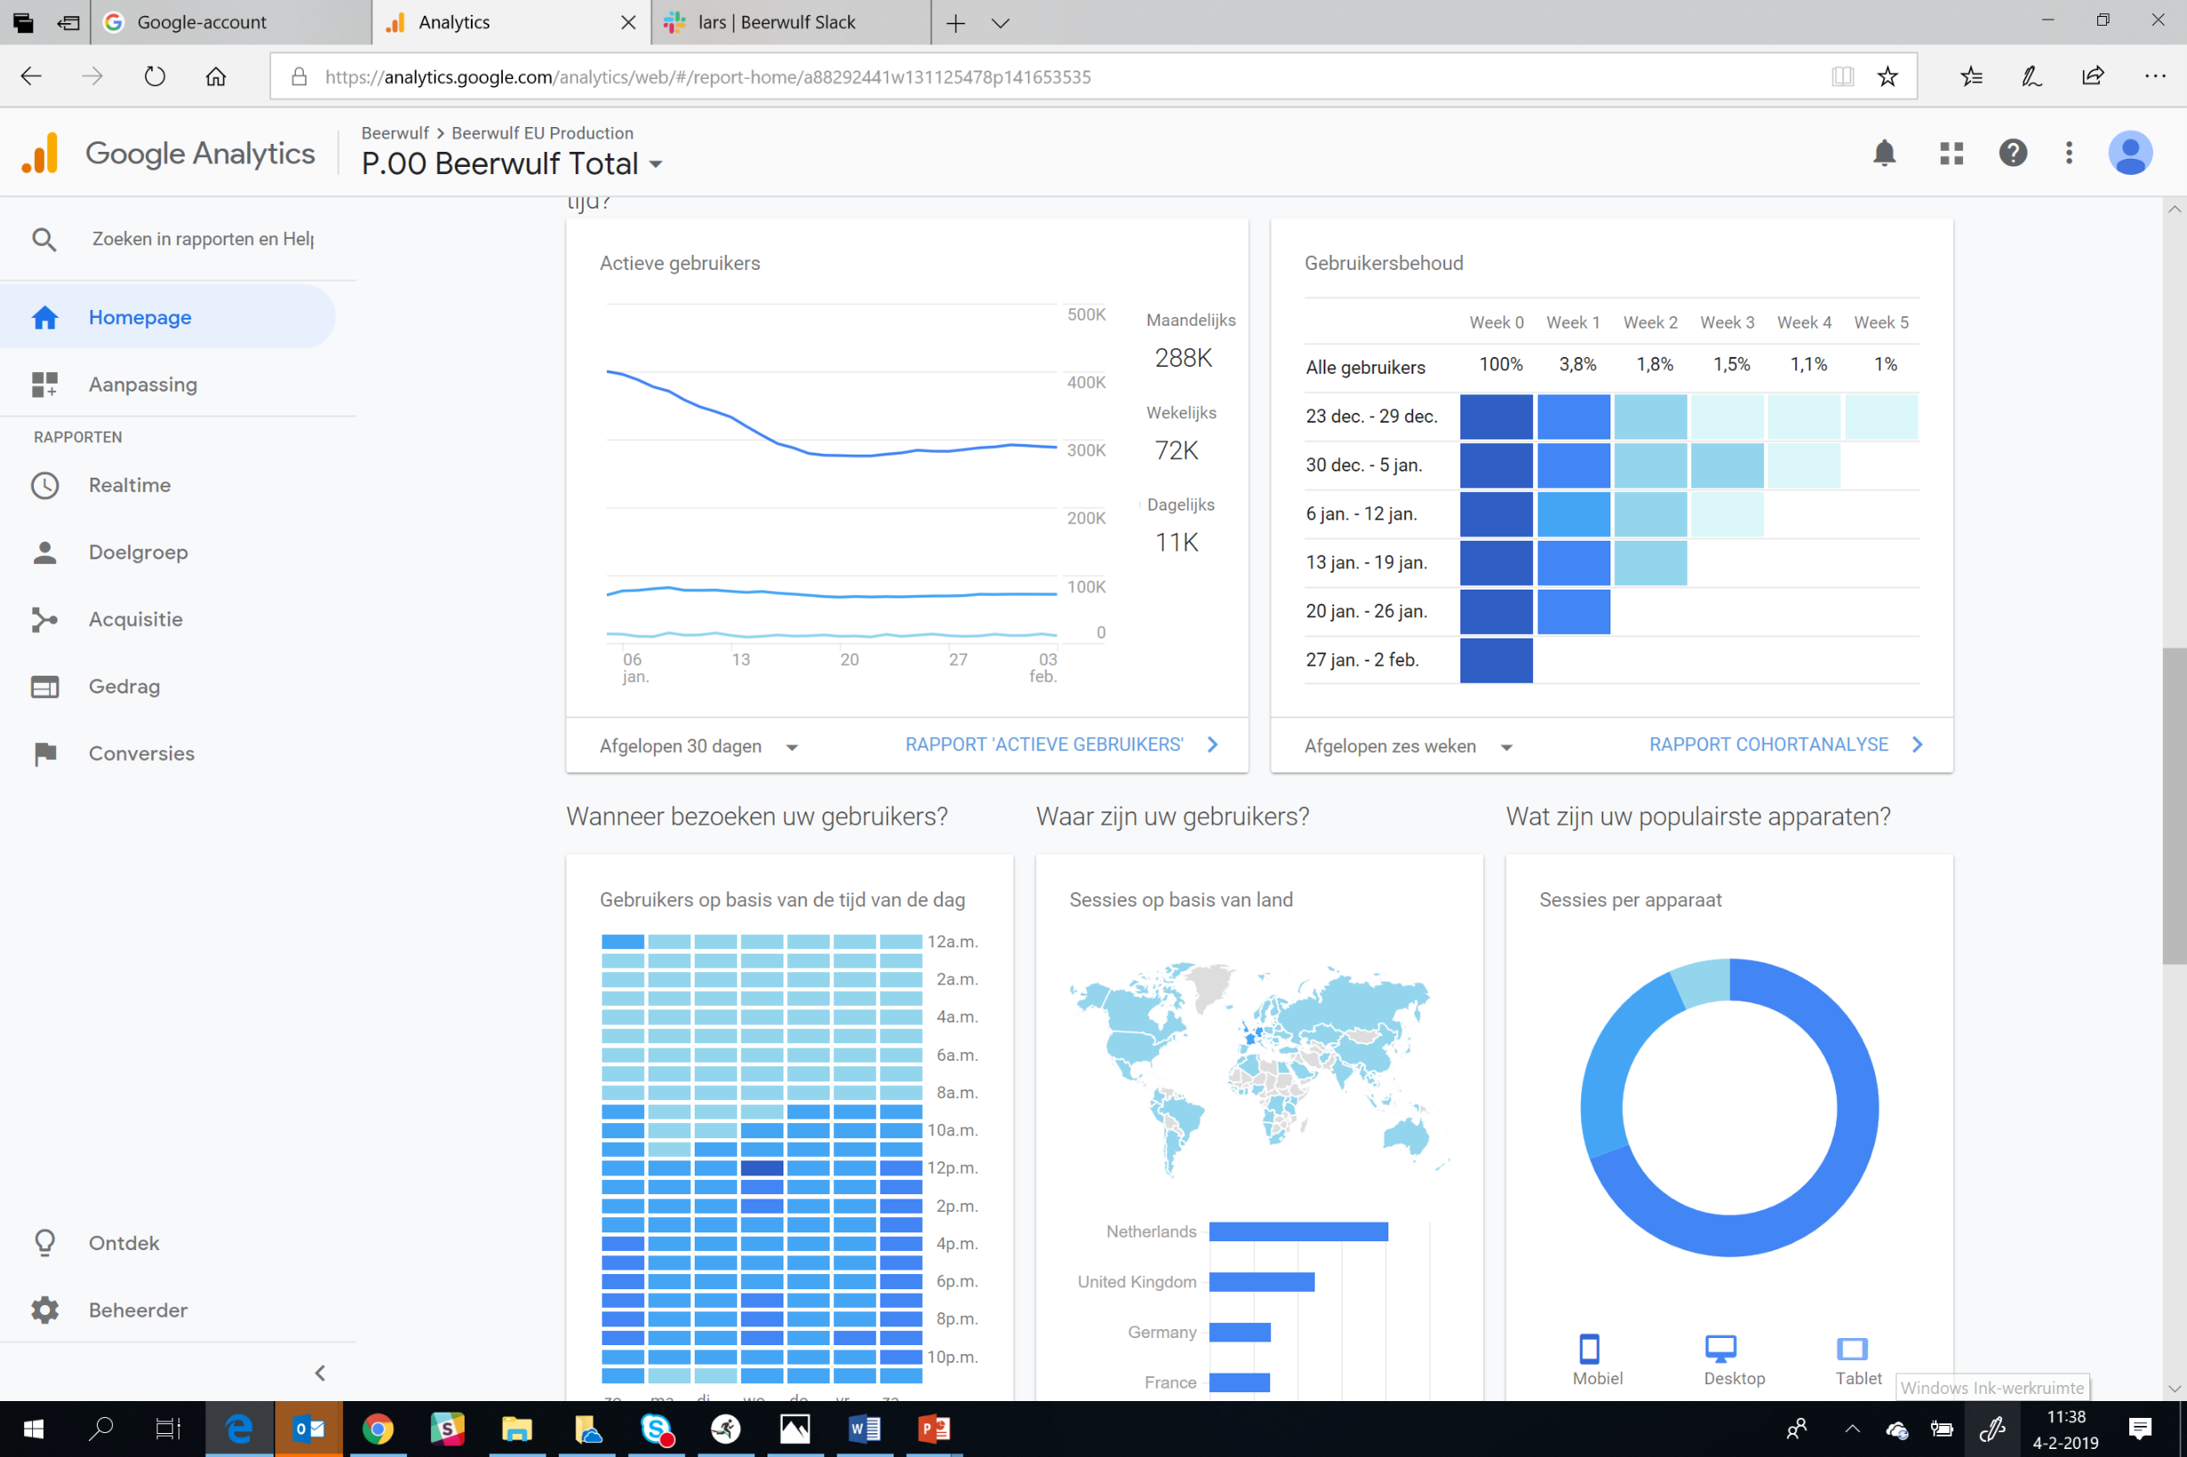
Almost married with GA

Slide 29
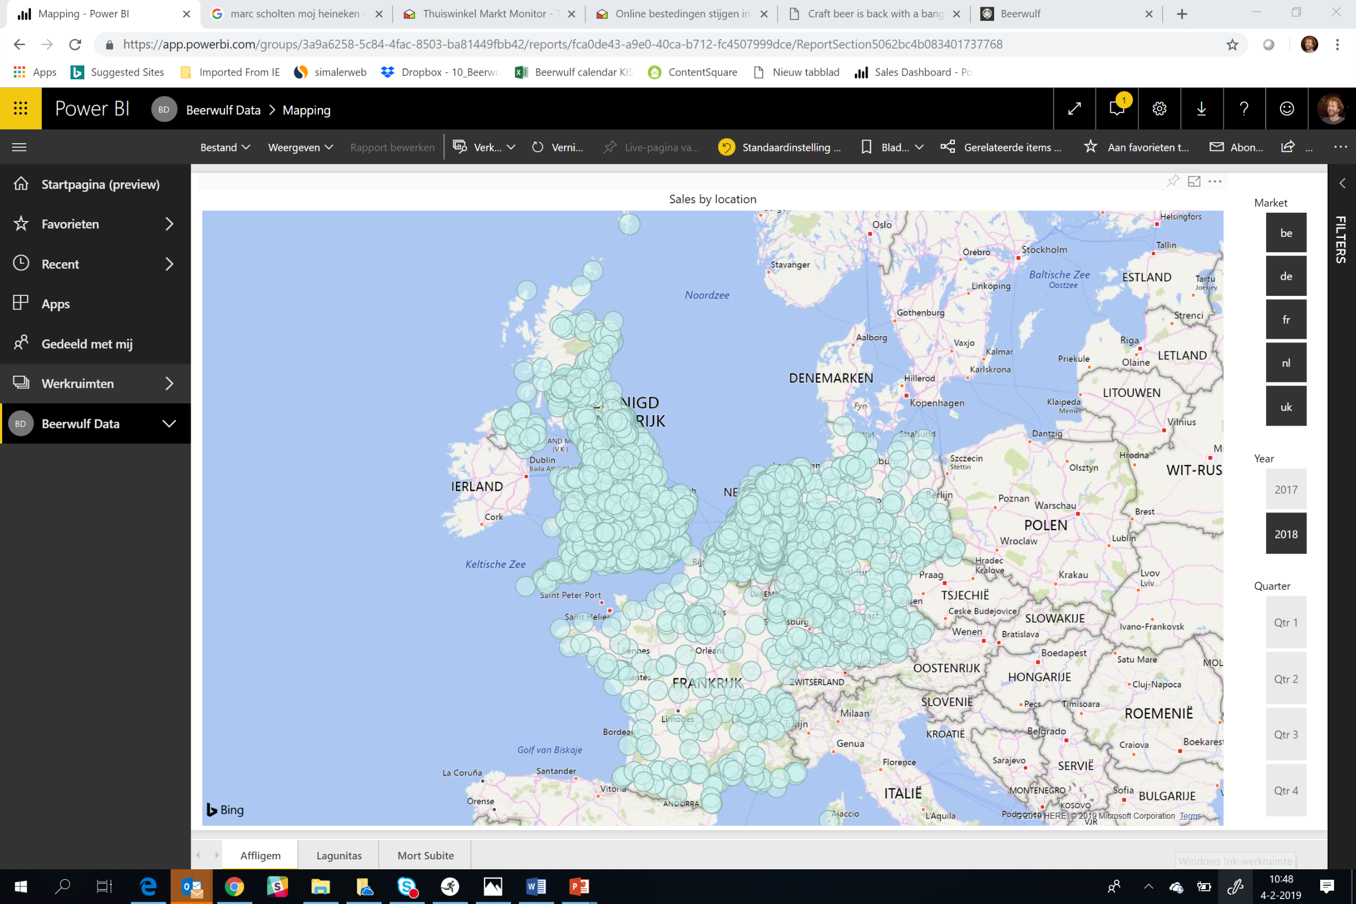
Power BI: Where did we sell what?

Slide 30
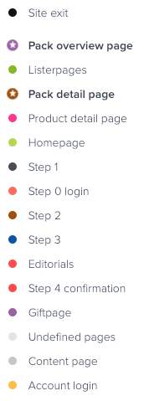
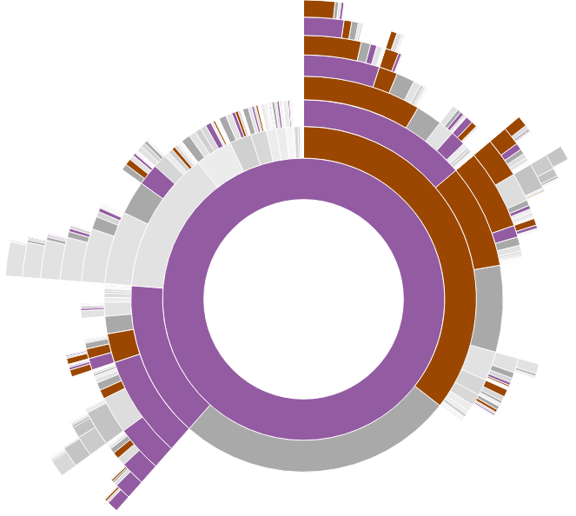
ContentSquare: How do people behave on the ‘all packs’ page?
Landing

Slide 31

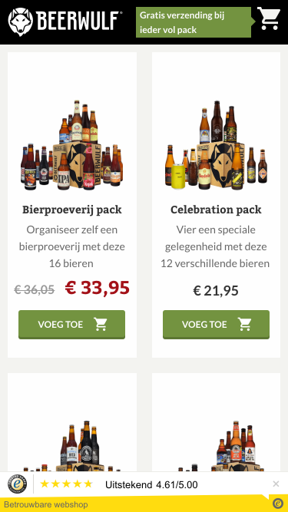
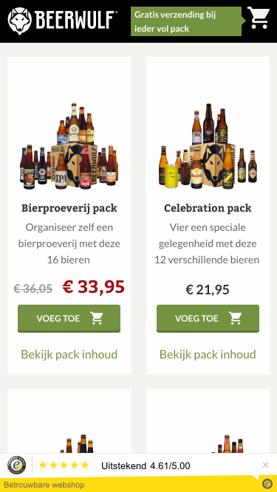
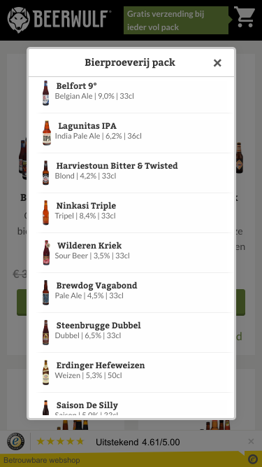
Let’s do a test to –we assume- make it easier
Control
Experiment

Slide 32
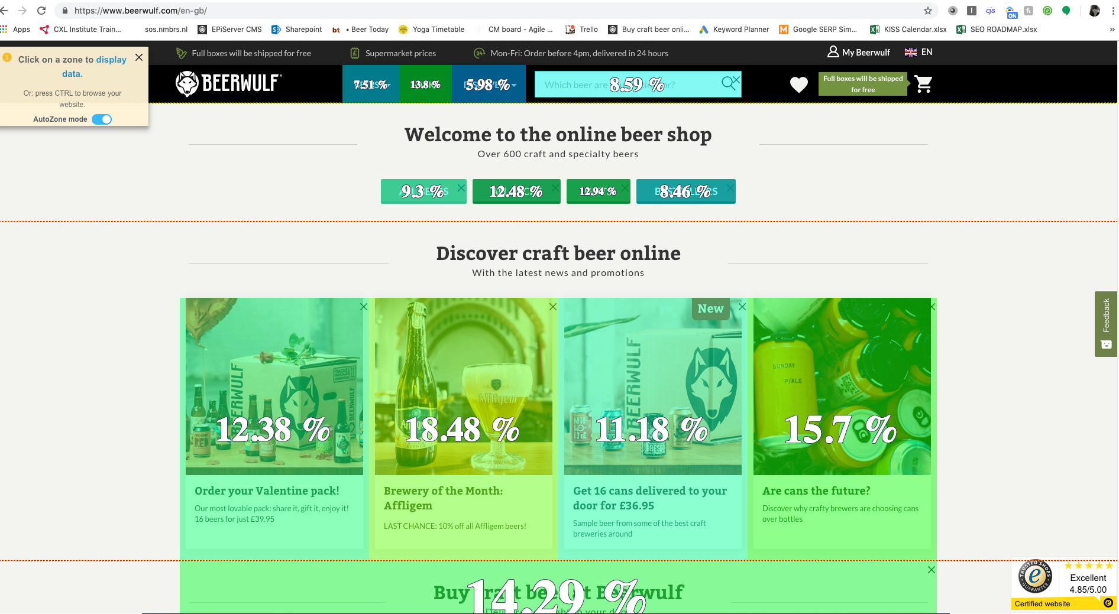
Conversion % per click

Slide 33
HOW?

Slide 34
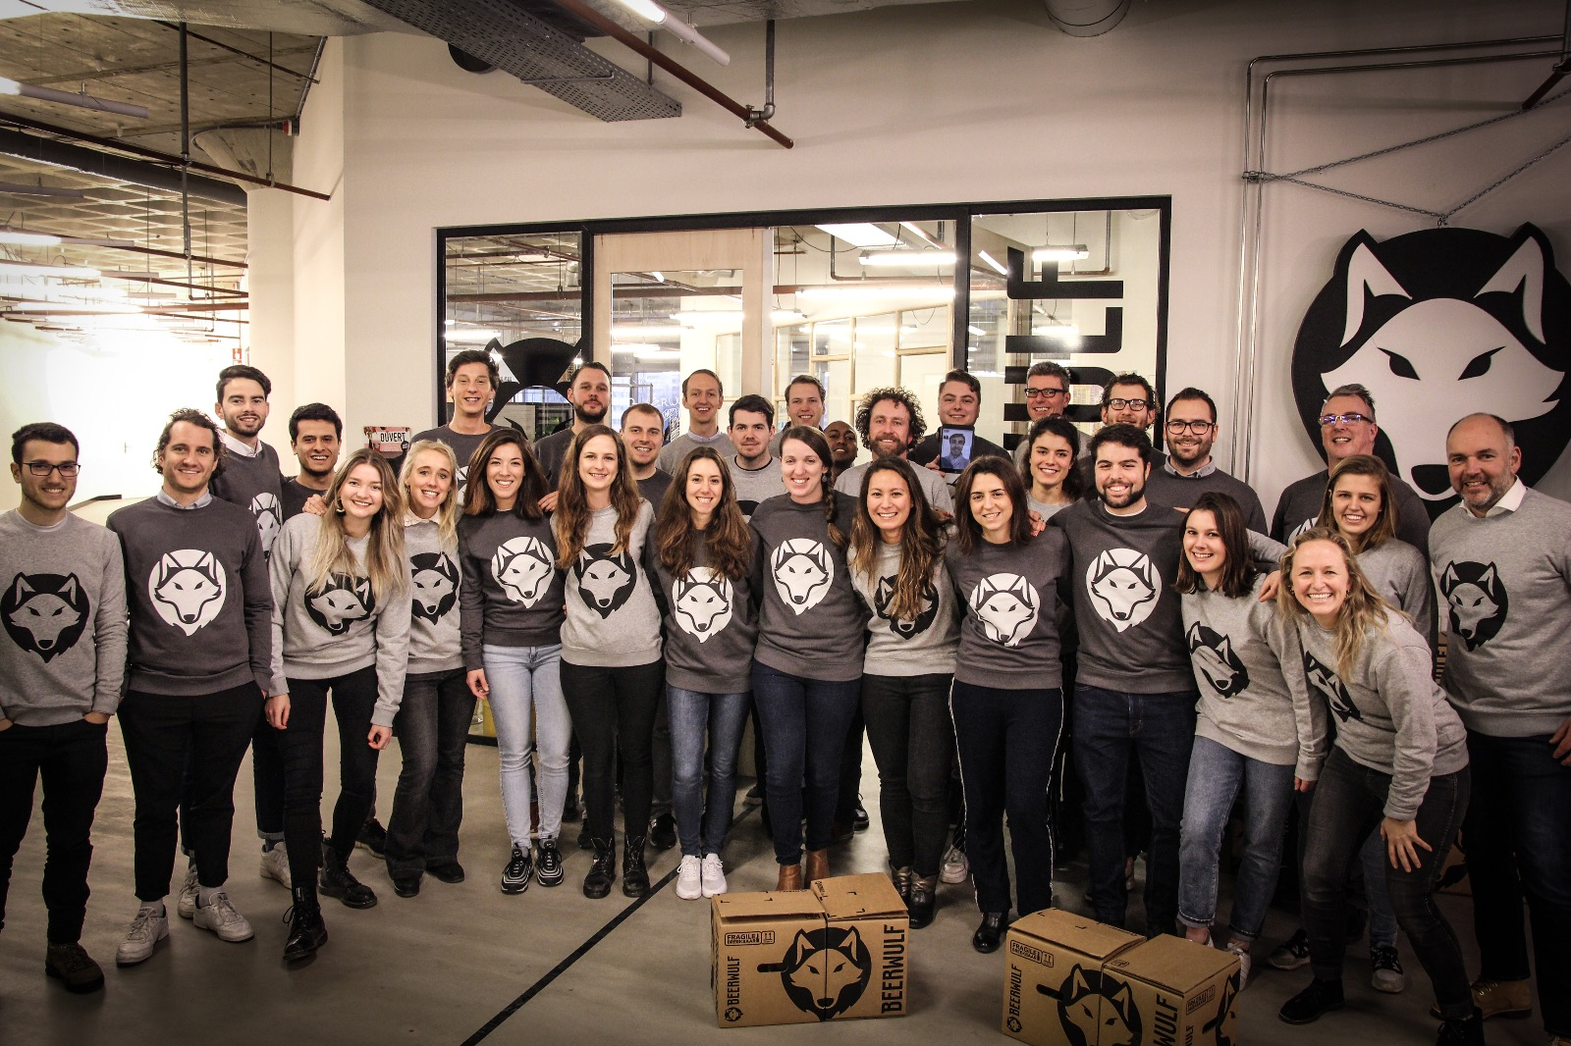
> 75 Wulfies from 26 countries

Slide 35
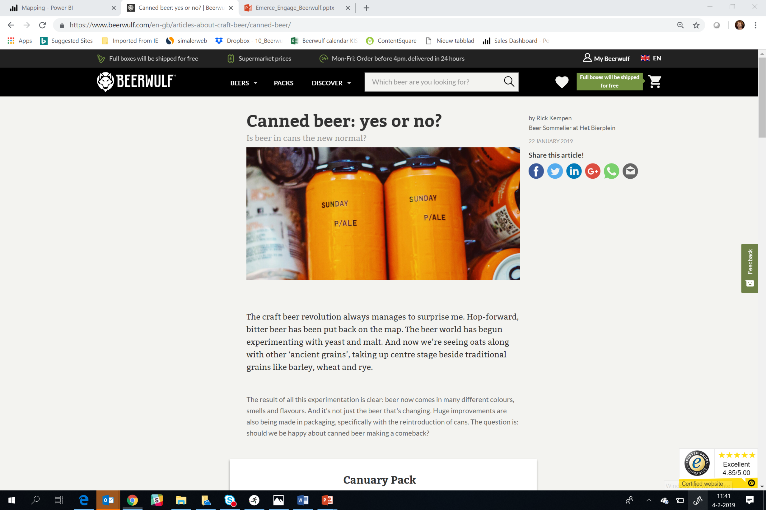
Telling

Slide 36
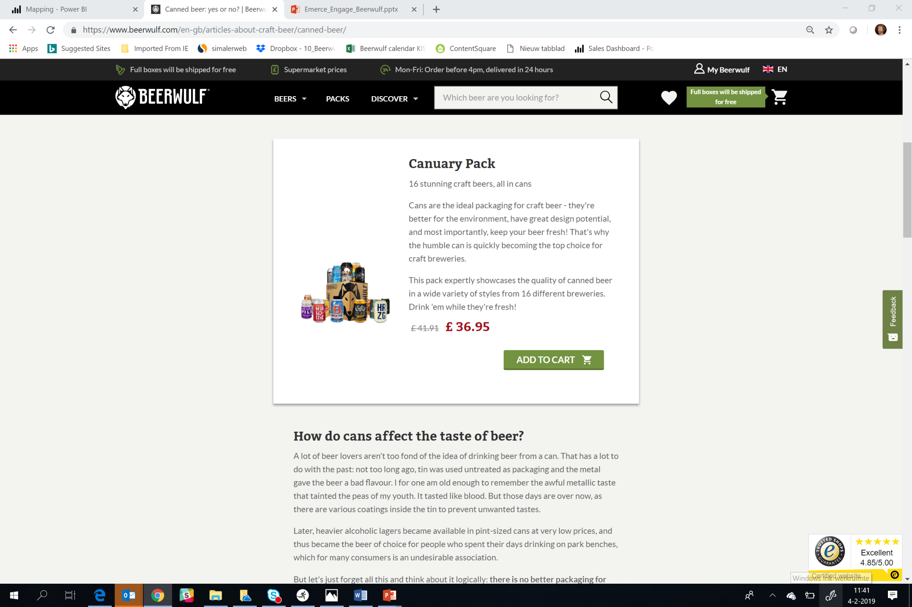
Selling

Slide 37
WHY DON’T PEOPLE BUY THEIR BEERS ONLINE?

Slide 38
Bottles will break?

Slide 39
Uncertainty about delivery?

Slide 40
Expensive beers?

Slide 41
High delivery fees?

Slide 42
An uhhh what’s wrong with the current situation?

Slide 43
SO INDEED, WHY SHOULD THEY?

Slide 44
Relevant assortment.

Slide 45
More time to discover.

Slide 46
Delivered at your doorstep.

Slide 47
Fair prices.

Slide 48
Broader range of recommandations.

Slide 49
We give some help!

Slide 50
WHAT DO THEY BUY?

Slide 51
Prepacked Packs
Fathersday Pack
Advent Pack
Belgian Beer Pack
Trappist Pack
Christmas Pack
Populair Beers Pack
Discovery Pack
Alcohol Free Pack
IPA Pack
World of Beers Pack

Slide 52
The bigger brands
Duvel
Karmeliet
Affligem
Westmalle
Erdinger
Paulaner
La Chouffe
Palm
Brewdog
Leffe

Slide 53
And a lot of local heroes!

Slide 54
WHO ARE THEY?

Slide 55
Who are they?
Very normal people ☺
Beer Likers and Beer Explorers
Relatively more rural then top 10 citys
Almost 35% of the transactions is female
Skewed to age of 35 and above

Slide 56
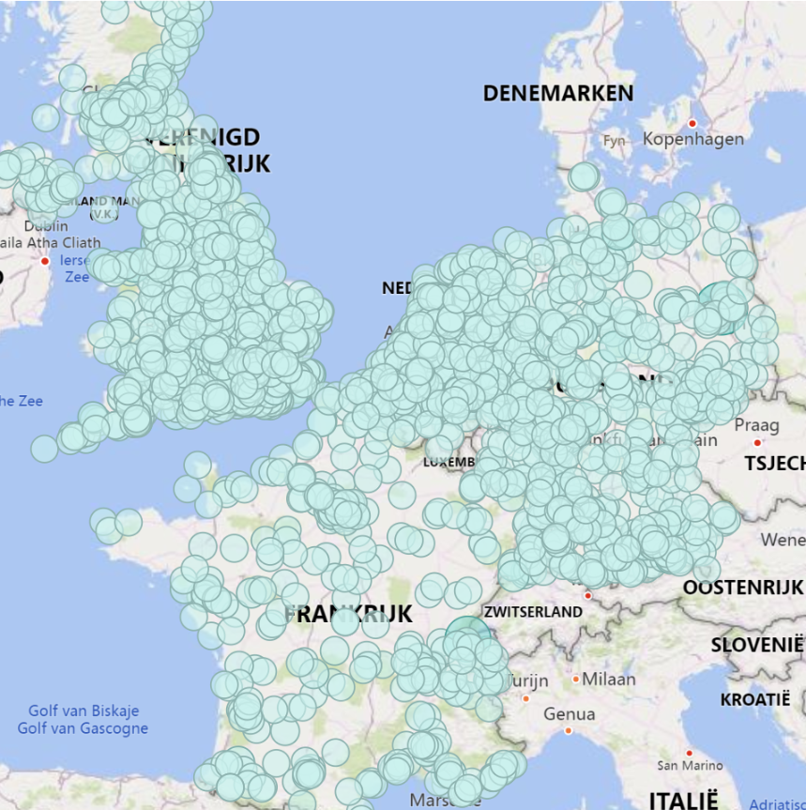

Slide 57
PEOPLE LIKE CHOICE.
BUT DON’T LIKE TO CHOOSE

Slide 58
So we have to help…
Predefined & Mystery Packs
Limit the amount of options
Short and accesible descriptions and explanations
Show also brands people recognize
Easy flow and check-out
Trust

Slide 59
CREATING AMBASSADORS.

Slide 60
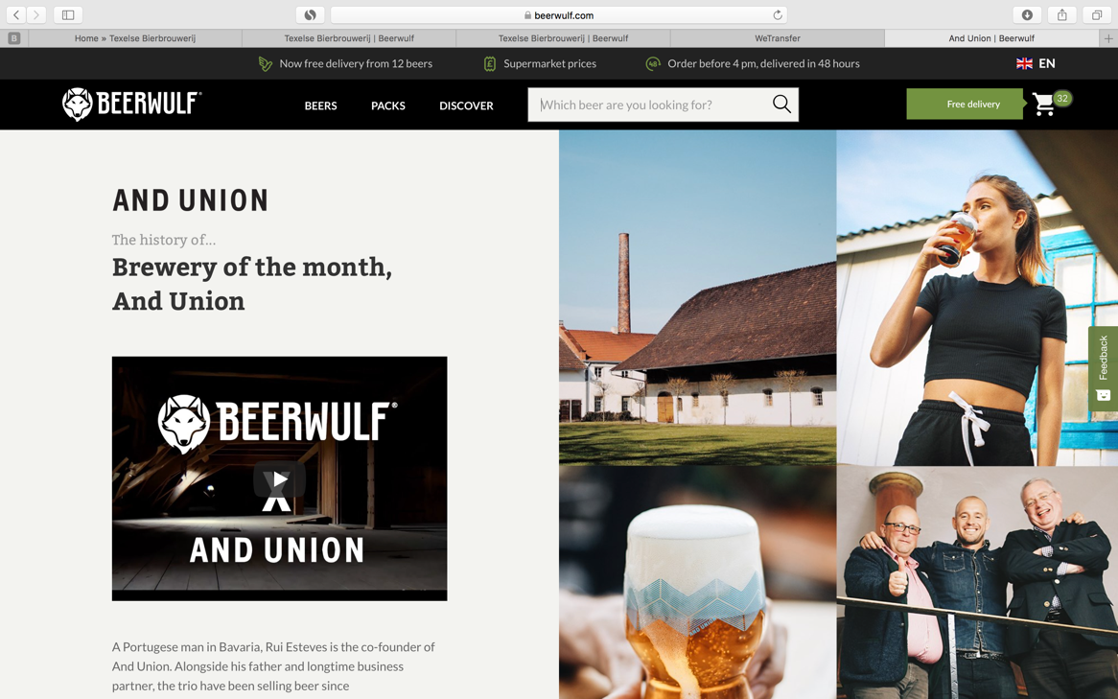
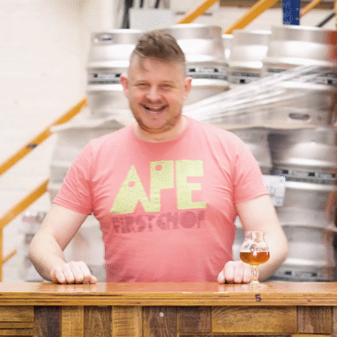
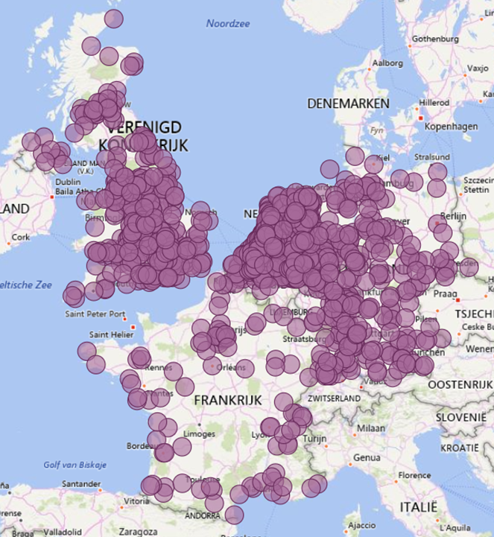
Beerwulf promotes the brewers

Slide 61
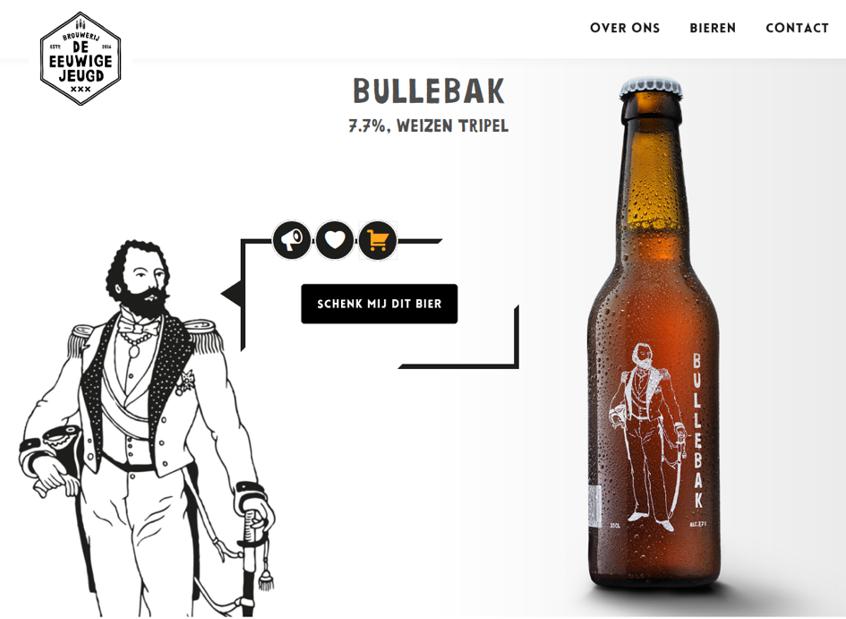
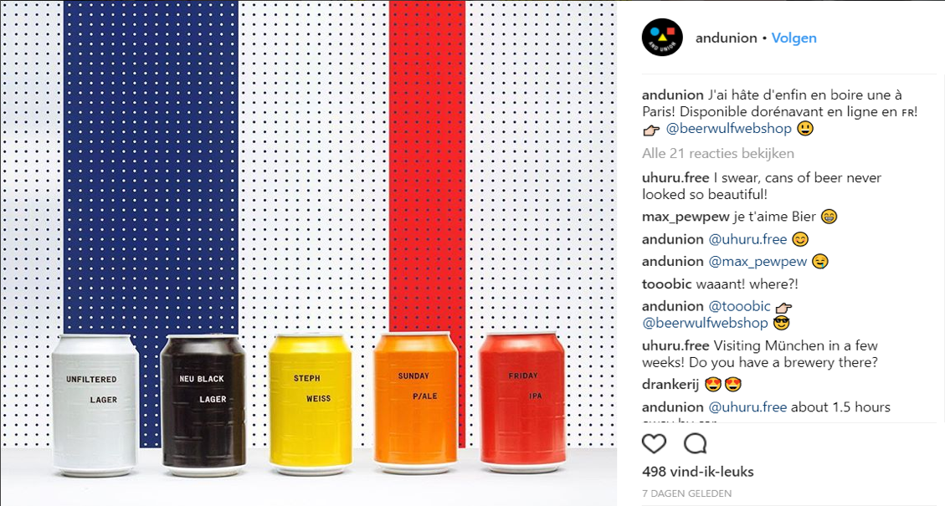
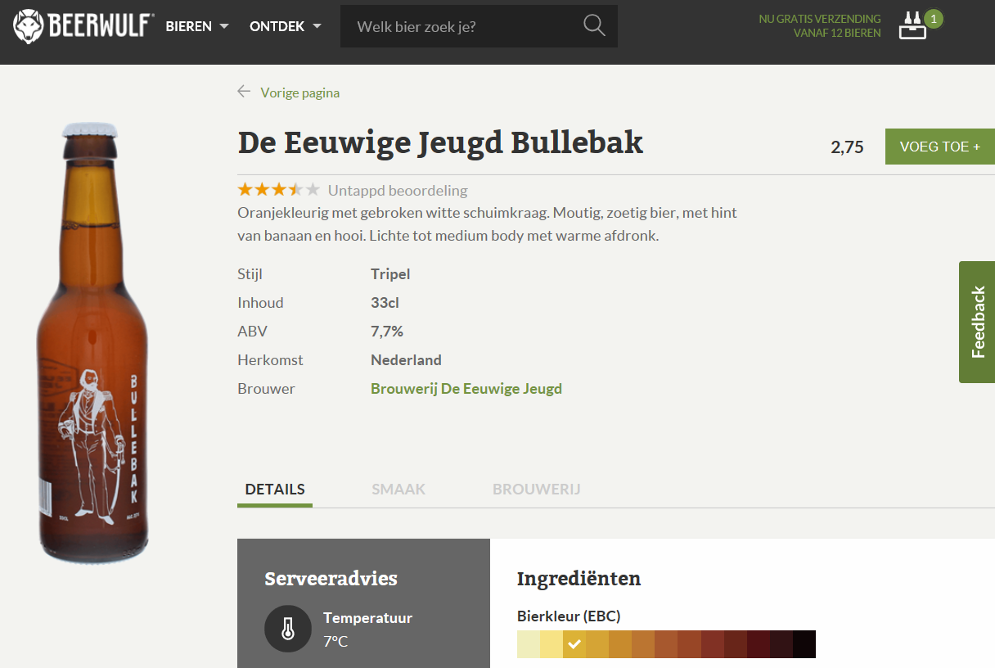
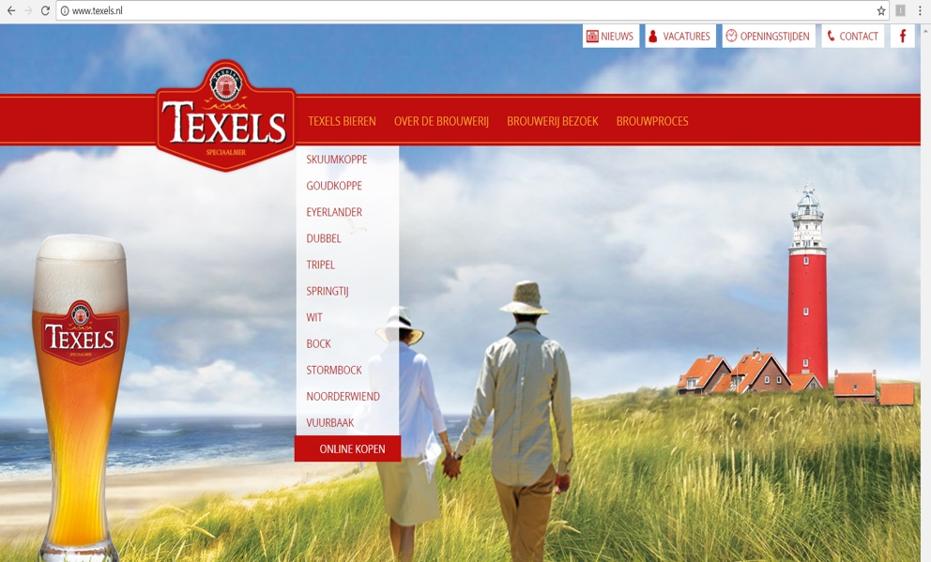
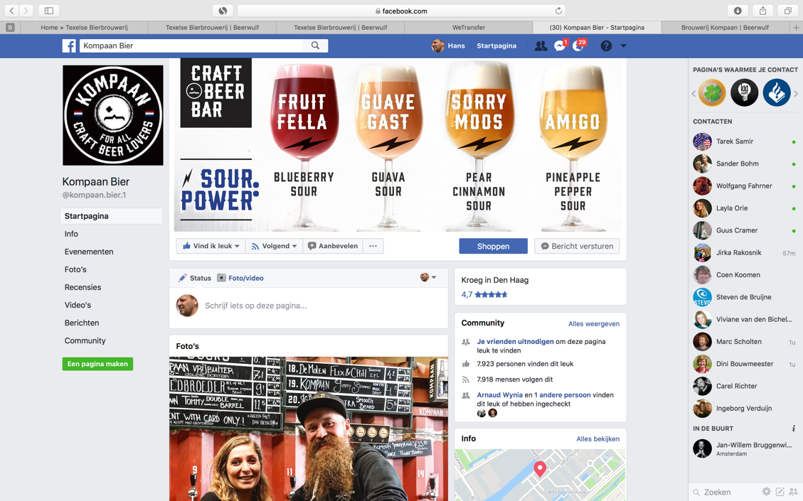
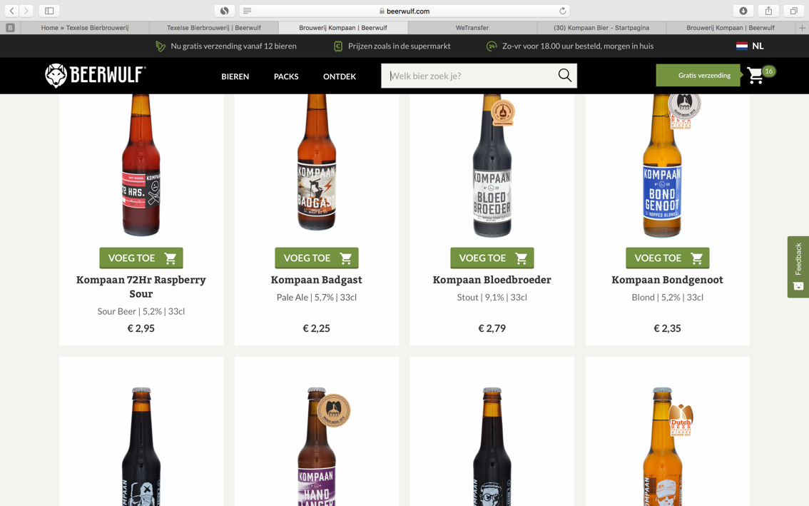
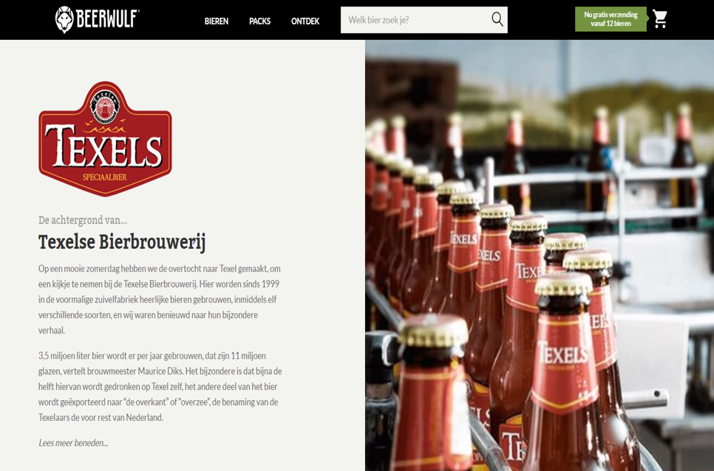
And the brewers, they promote us
Notes:
PERSOONLIJK CONTACT; BROUWER & BIER ZIJN HERO, GEMAK EN ONTZORGEN; MARKETING EN SALES; FAIR PRICES; DIGITALISEREN VOOR SCHAAL
Van ‘mogen wij je bieren verkopen’ naar marketing&sales partner tot brewers portal
Bouwen van netwerk van kwalitatieve craft brouwers.
Data delen
Festivals
Echte bierkennis
Brewer of the Month
Partnership, fair prices / data sharing
Performance = sales

Slide 62
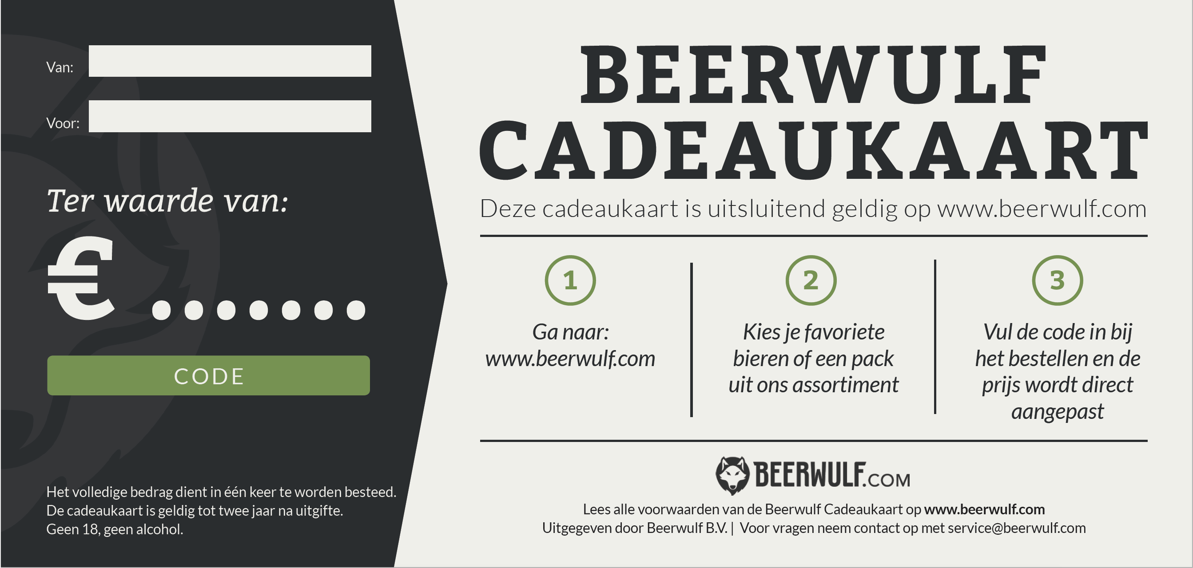
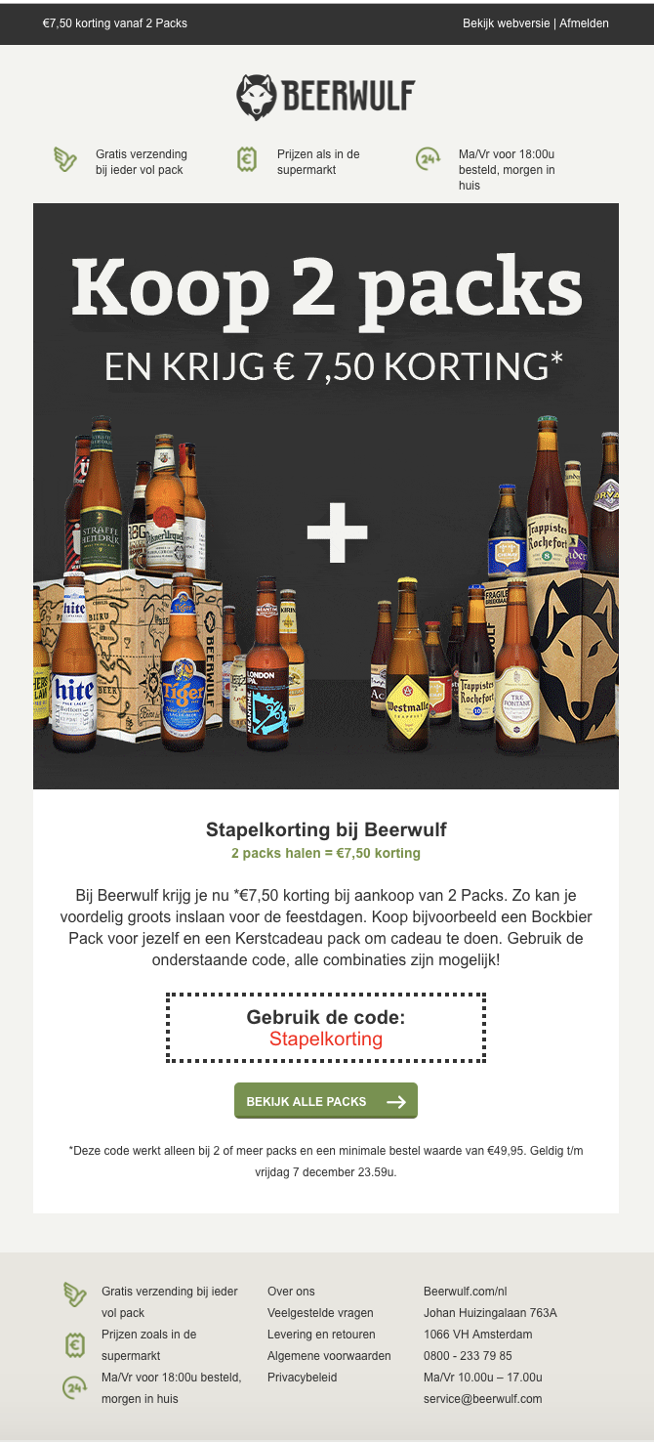
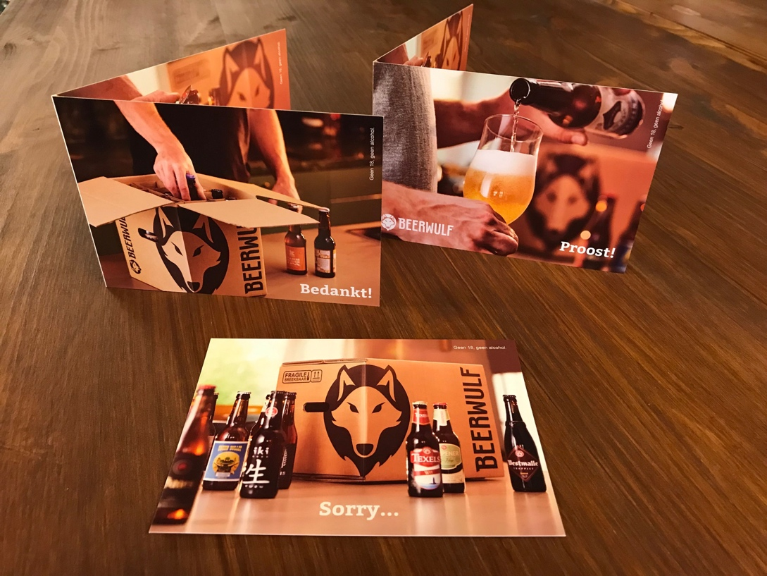
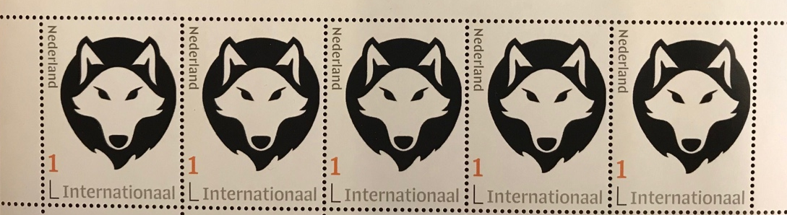
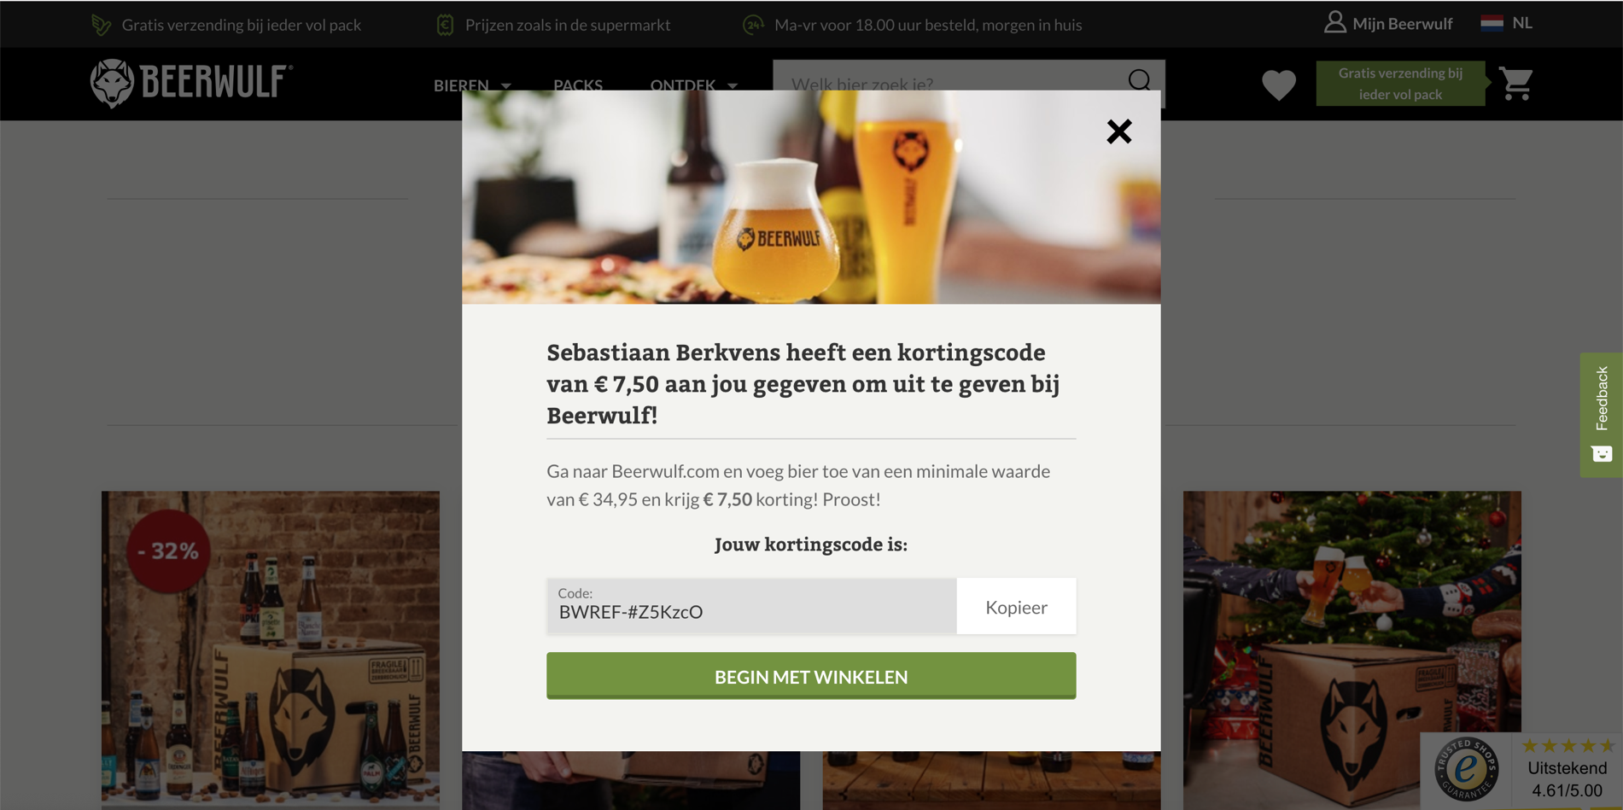
We put a lot of effort in retention…..
Notes:
Personalisatie
Retentie tools (refer a friend / giftcard / subscription /

Slide 63
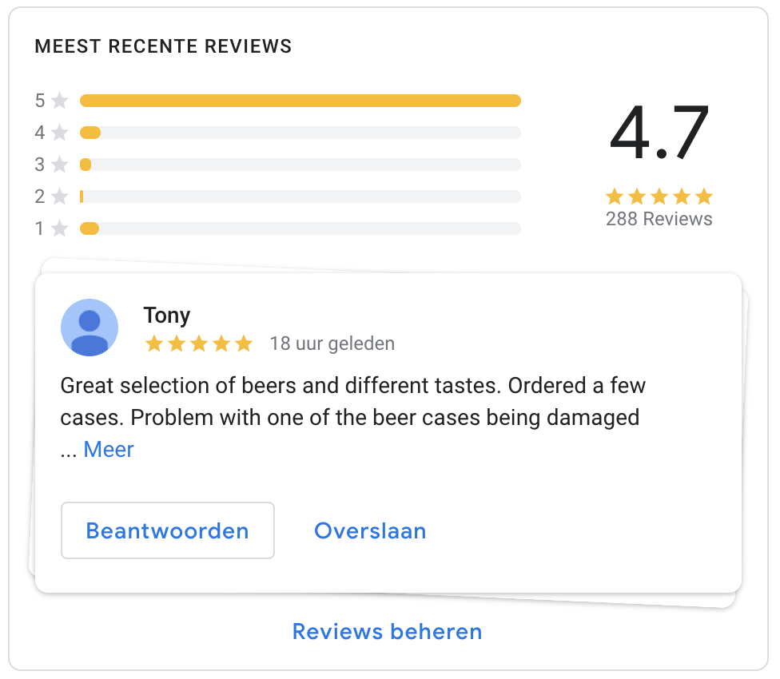
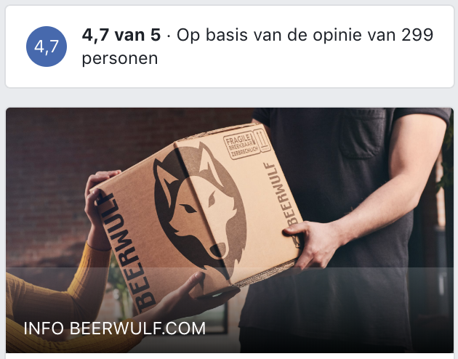
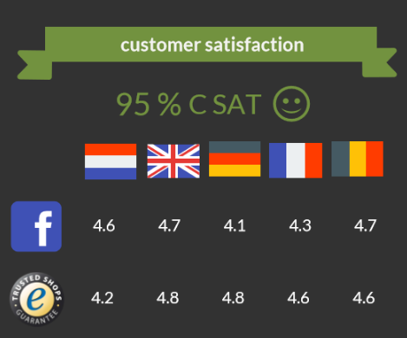
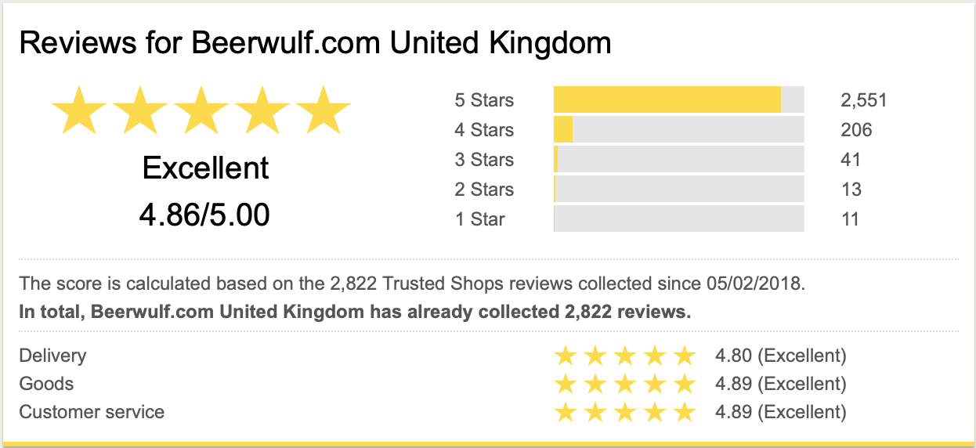
To create a lot of customer ambassadors as well.

Slide 64
Thank you.
Enjoy the Forum!

Slide 66
Results….

Slide 67
Performance 2017-2018
Europe development
Revenue development from the start

