Slide 1
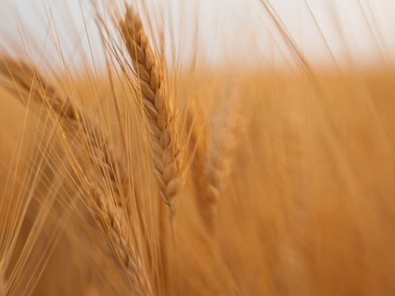
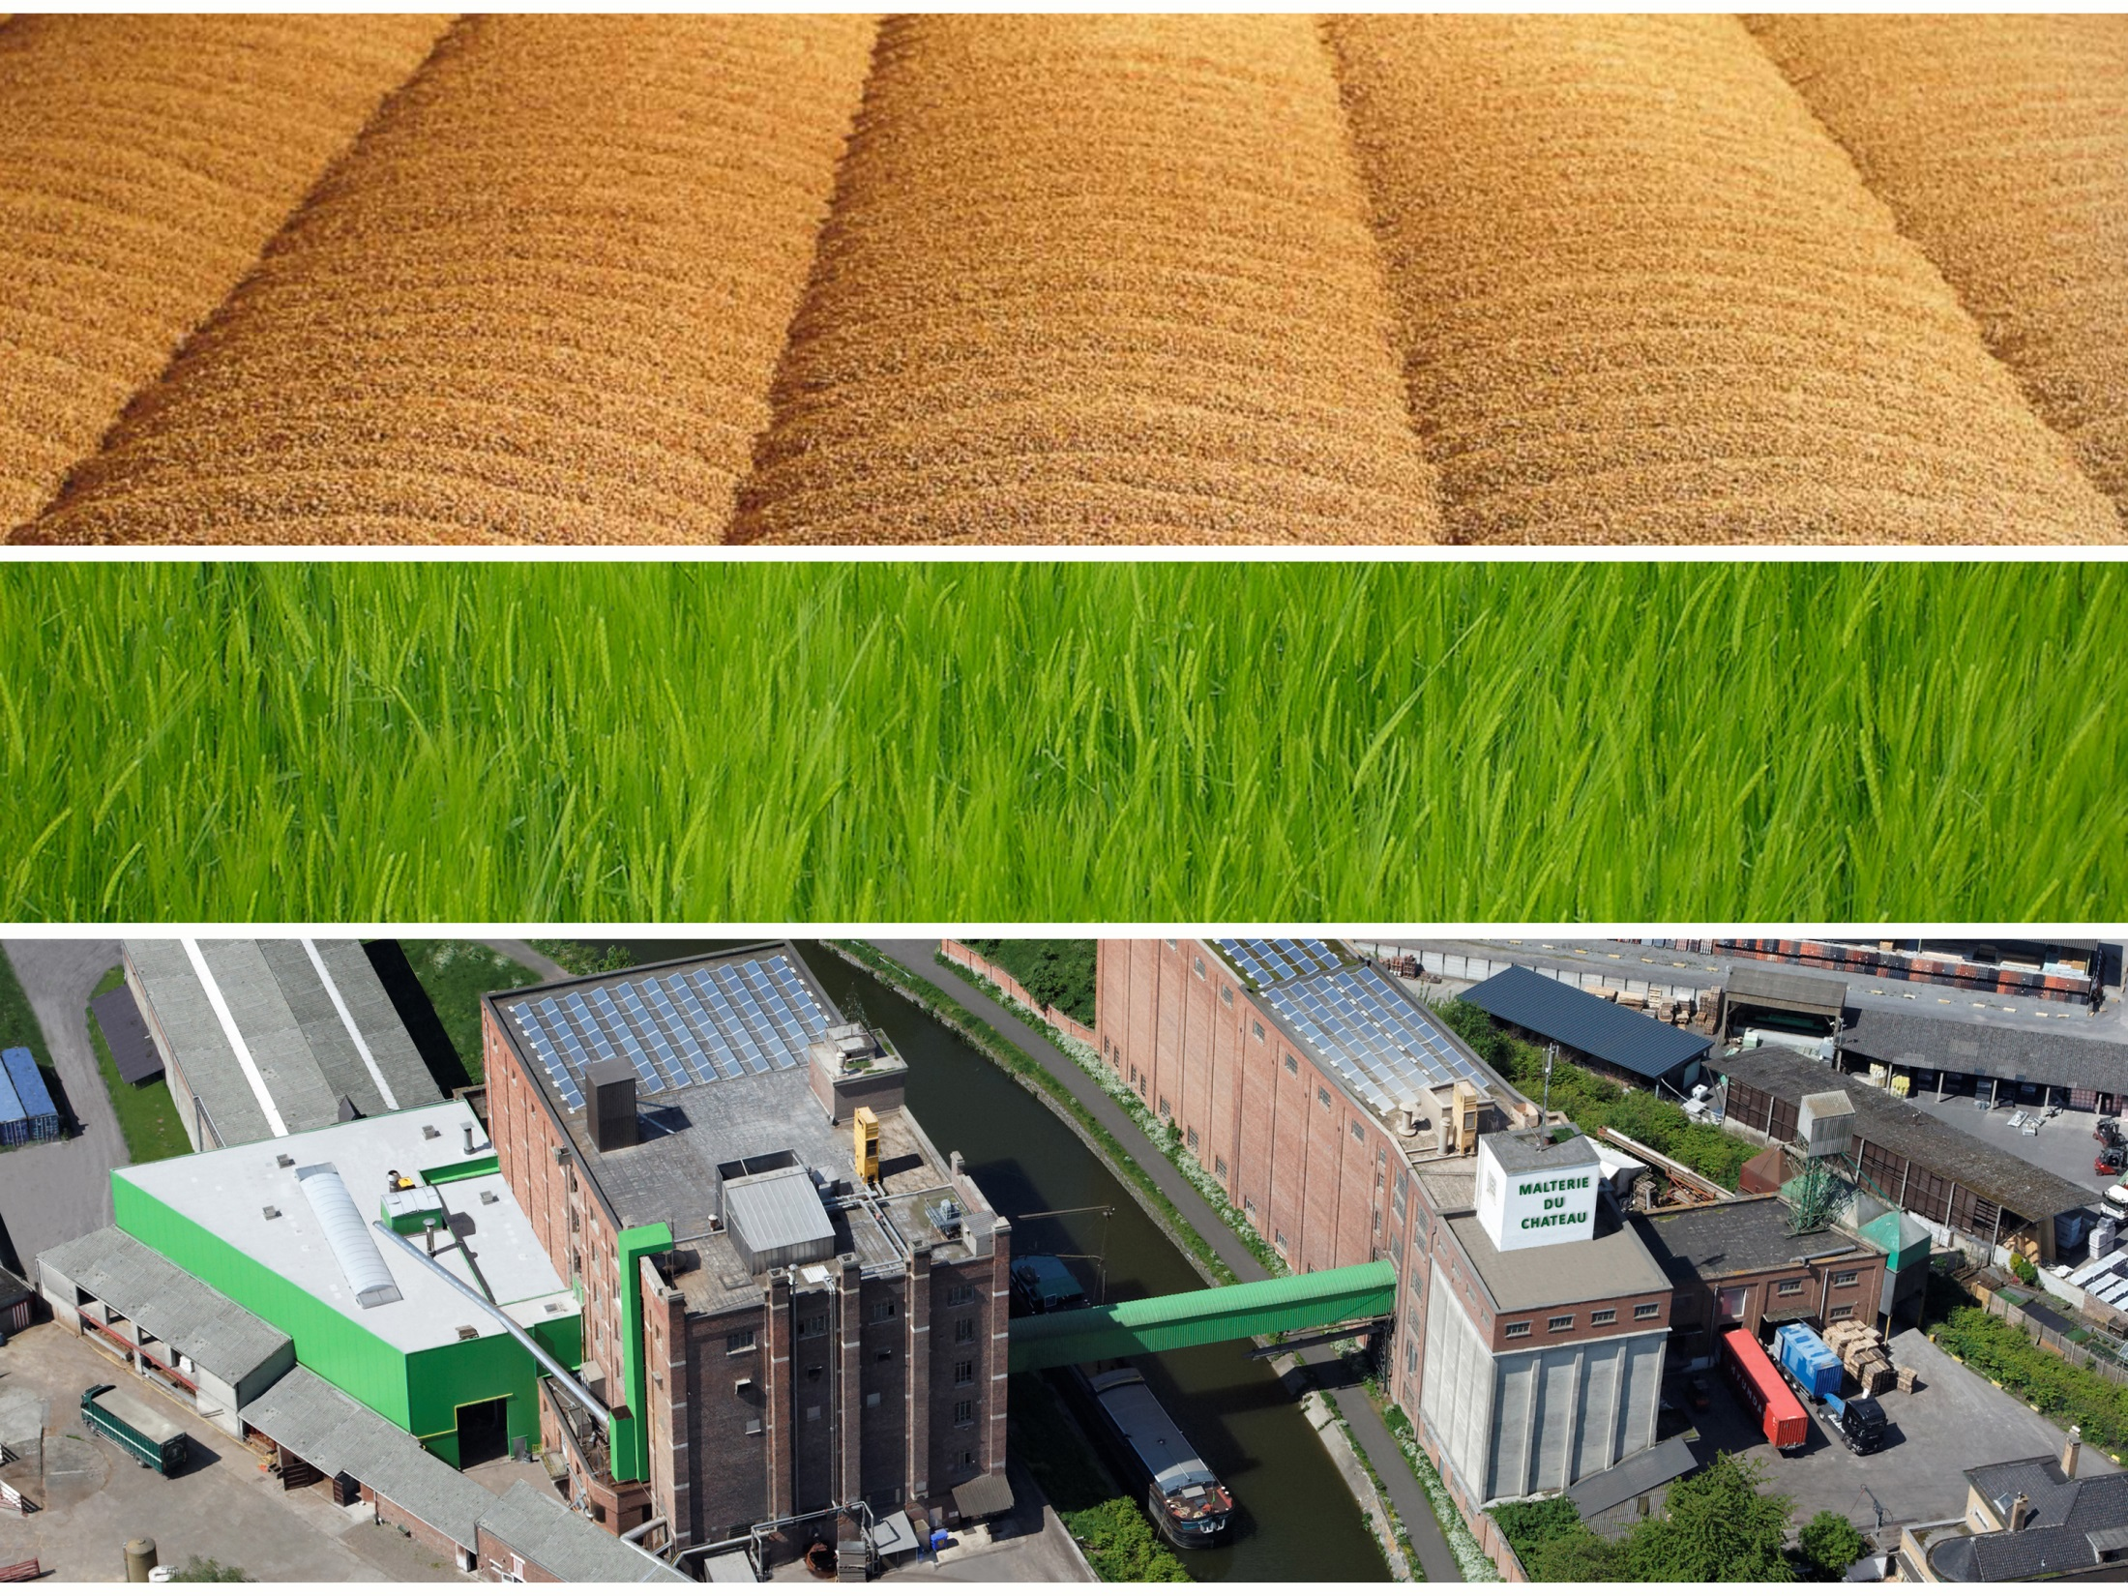
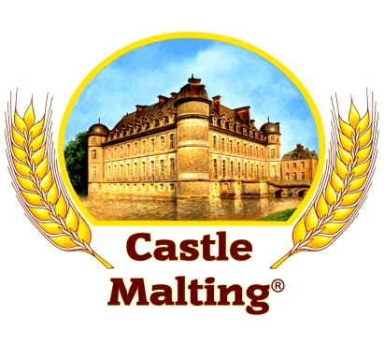

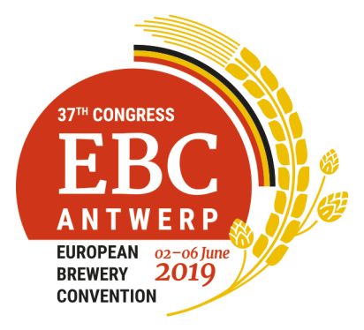
Terroir and heirloom barley varieties:
upcoming challenges in general and in a Belgian context
Gil Leclercq

Slide 2


What are we talking about?
Barley varieties characterized as:
Terroir ? → “natural environment” (soil, climate) → location
→ “locally grown” (region, country) → location
Heirloom ? → “heritage/tradition” (from… to…) → time
Ancient ? → “from the past” (date) → time
Craft ? → “individual or small company” → scale/who
Barley varieties characterized as:
Terroir ?
Local ?
Heirloom ?
Ancient/old ?
Craft ?
DEFINITION: NOT clear and NOT widely accepted for these varieties…
BREWERS want UNIQUE RAW material to create UNIQUE beers !

Slide 3
What are we talking about?
For example, what does “ancient/old” mean exactly?
Before 1948? Based on historical facts? Arbitrary.
Based on the genetic makeup? Example for wheat :
+
→
WILD wheat | GOAT grass | BREAD wheat
(T. turgidum) | (Aegilops tauschii) | (T. aestivum aestivum)
AABB | DD | AABBDD
If DD missing = “ancient” ? (einkorn AA, emmer AABB; not spelt AABBDD)
For barley, H. vulgare → H. vulgare : need to look deeper into genome.
Definition depends on the objective and the story…
Example : no D genome also means less gluten = better digestibility

Slide 4
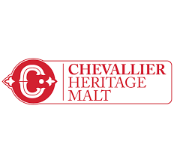
What do brewers and consumers expect?
1st CHALLENGE ! → Understanding what they want.
BREWERS :
Unique flavors and sensory attributes
Marketing : story-telling
CONSUMERS :
New drinking experience ? Curiosity ?
Locally grown ?
Conservation of Biodiversity ?
Medieval look…
Brewers’ challenge is to understand what consumers want/like.
It will depend on region/market → surveys needed !

Slide 5
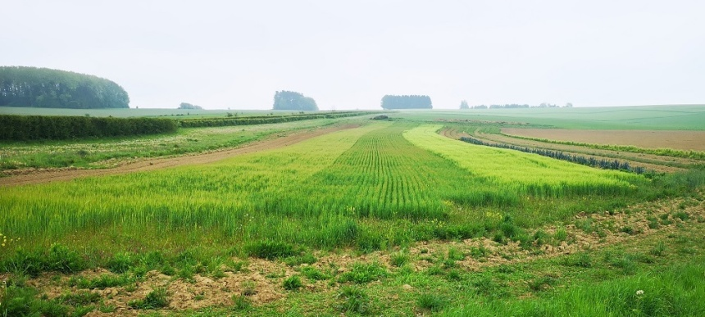
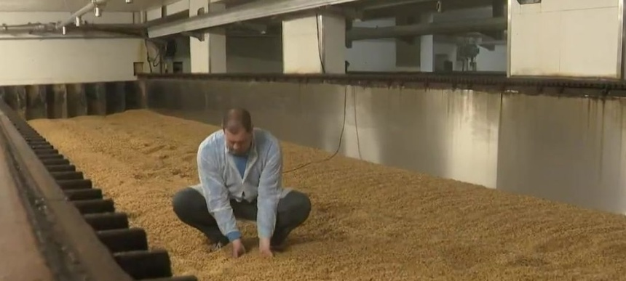
Challenges for farmers and maltsters
Going “BACK” has a price!
Lower yield (3 vs 9 t/ha)
Higher harvest lost in the field (10 vs 1-2%)
Longer process (germination)
Small batches (?)
Less eco-friendly ?
Meaning : there must be benefits → unique flavors !
Notes:
Producers (farmers and maltsters) face more challenges than users

Slide 6

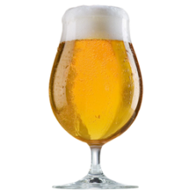
Belgian context: now
Belgium : famous for its beers! Not for its malting barley.
Why?
→ Almost NO malting barley is grown in Belgium (<1%).
Farmers
Maltsters
Higher income for feed
barley (VS malting barley)
Lower prices for imported
malting barley (VS local)
Brewers
Don’t care too much about the origin
Notes:
3000 ha in the year 2000.

Slide 7
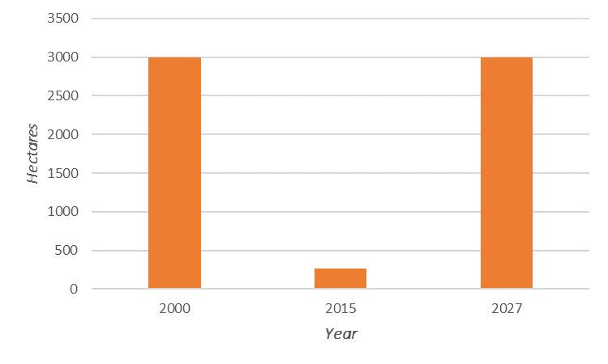

Belgian context: going for LOCAL
Breaking the LOOP : need to involve ALL stakeholders
PUBLIC sector
PRIVATE sector
Period of incentives
2017-2027
Farmers (+ Storekeepers)
Maltsters
Brewers
Such initiative only makes sense IF:
local environmental conditions are ideal for growing malting barley.
Notes:
LOCAL vs TERROIR

Slide 8
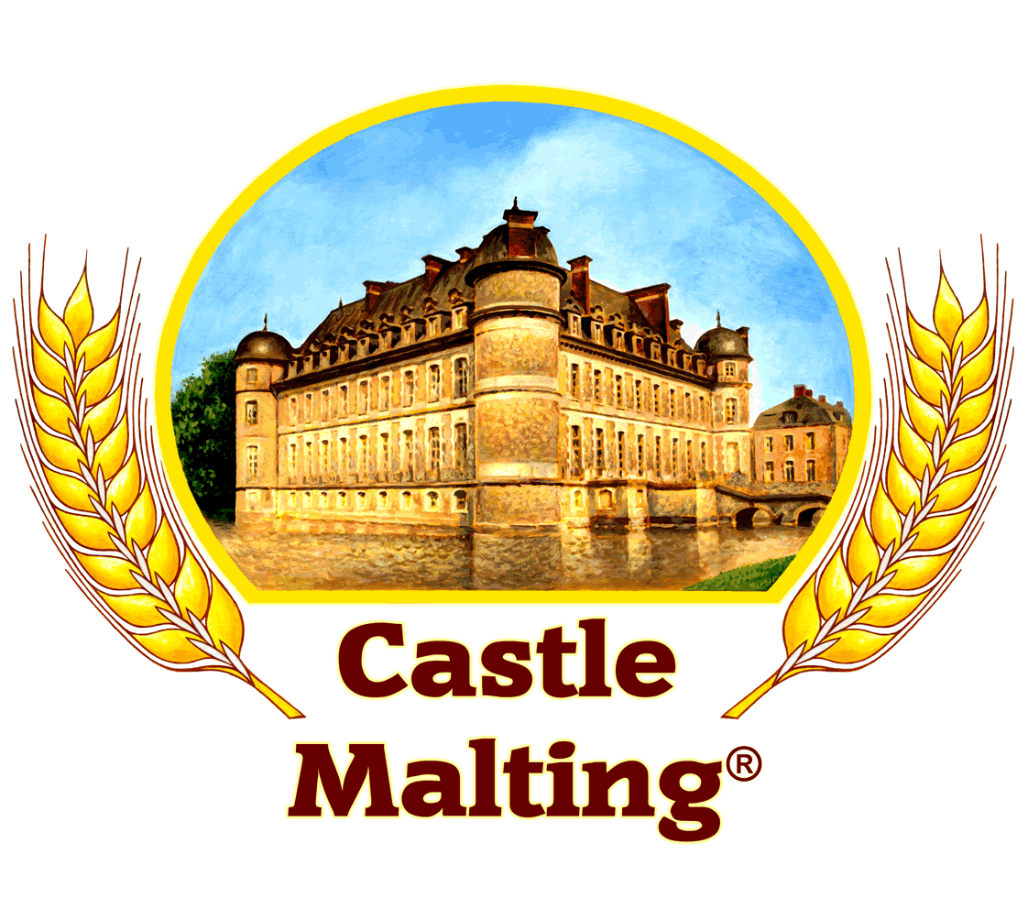
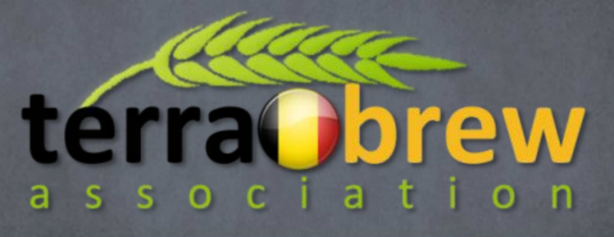

Belgian context: going for LOCAL
Castle Malting as a driver for a LOCAL industry
created :
+ POB
A new label for a LOCAL industry, with multiple GUARANTEES:
Fair price for malting barley – no speculation
Price stability for barley and malt for a period of 3 years
Traceability from field to breweries
No financial penalty for quality downgrade (due to climatic conditions)
Free labeling system for brewers using these malts
→ Consumers pay a few more cent€ / bottle (33cl) to support the local industry !
Notes:
Short supply chain

Slide 9
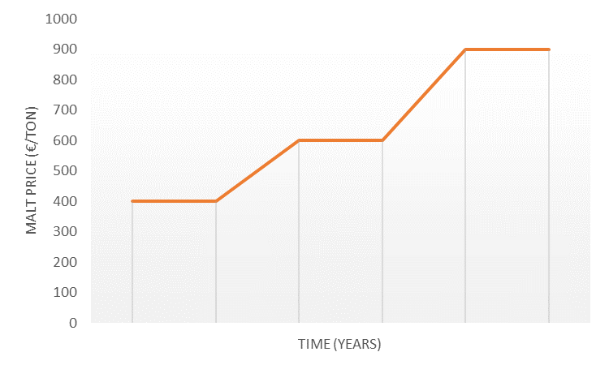
Belgian context: from LOCAL to Terroir/Heirloom?
Each transition requires time and efforts
→ that has to be compensated by benefits (price, flavors, ecology, etc.)
→ to ensure the sustainability of the stakeholders and the product.
Heirloom
ancient
barley
+ terroir
LOCAL
country’s
barley
+ terroir ?
NOW
imported
barley
R&D
transition
transition

Slide 10
Conclusions & future prospects
The “unknown”
NO clear definition: everything else that is not a current “modern” variety?
What are consumers and brewers expecting? → surveys needed!
Going “back” is challenging
Ancient/old varieties: BENEFITS should overcome the high COSTS
Beyond marketing: flavors and disease resistance
Belgian context
Current challenge: redeveloping the local malting barley industry
Future challenge: heirloom? Maybe.
Next challenge for breeders: ancient x modern varieties?
Are Terroir and Heirloom Barley varieties the NEW LEAP?
Notes:
Redeveloping (or “resurrecting”) ancient/old varieties has a high COST (for farmers and maltsters)
Meaning that the BENEFITS should go beyond story-telling: flavors, diseases resistance, etc.

Slide 11
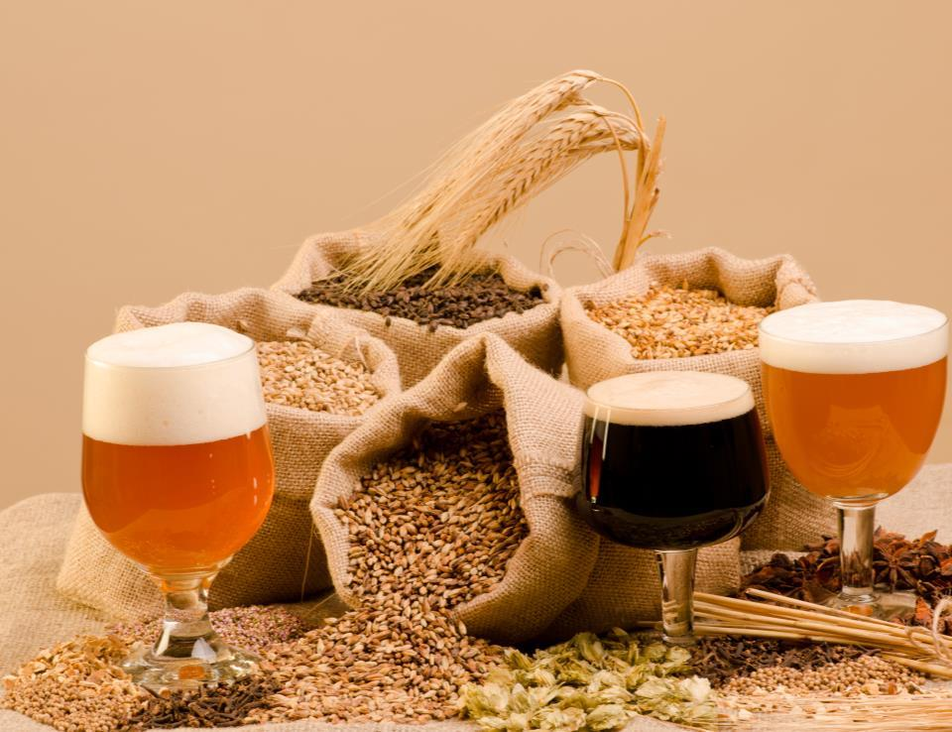
Thank you !

