Slide 1
Good education is indispensible
for a strong beer culture
Henri Reuchlin
Cordinator StiBON

Slide 2
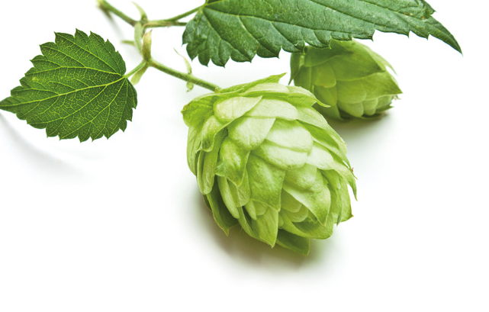
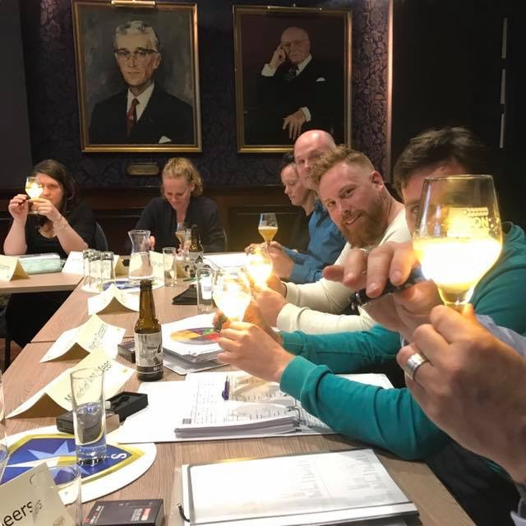
StiBON Beer Education
Founded in 2009
The Netherlands
Started with 15 participants
In 2018 over 400 participants
Brewers of Europe Forum
Antwerp

Slide 3
What makes a strong beer culture?
Revenue
Diversity
Quality
Brewers of Europe Forum
Pride
In order to boost revenue, people need to value the experience
In order to improve quality, people need to appreciate it
In order to grow diversity, people have to understand the difference
Antwerp

Slide 4
Beer landscape NL 2009
no generic beer education
lack of understanding on trade, off trade and at general public
120 breweries (most < 10 years old)
few hundred different beers
hardly any words to describe beer flavour
beer is just synonymous to lager
Brewers of Europe Forum
Antwerp
Notes:
All volunteer project

Slide 5
Our aim in 2009
create ambassadors for beer at all levels
create a common language to describe beer
create a professional network of beer enthusiasts
improve quality consciousness
instill a sense of pride
Brewers of Europe Forum
Antwerp
Notes:
All volunteer project

Slide 6
Beer landscape NL 2009
no generic beer education
lack of understanding on trade, off trade and at general public
Brewers of Europe Forum
Beer sommelier
Antwerp
Beer ambassador
Notes:
All volunteer project

Slide 7
Educational pyramid
Brewers of Europe Forum
International Diplom Beer Sommelier
2. StiBON Beer Ambassador
1. StiBON Beer Ambassador
Antwerp

Slide 8
Educational pyramid
Brewers of Europe Forum
International Diplom Beer Sommelier
Masterclasses
2. StiBON Beer Ambassador
Brewer
1. StiBON Beer Ambassador
Antwerp

Slide 9
Common language
Brewers of Europe Forum
Antwerp

Slide 10
Common language
Brewers of Europe Forum
“The extraordinary progress of Dutch brewing in the past decade is a helpful case study in how to improve a country’s beer culture.”
Tim Webb, World Atlas to Beer
Antwerp

Slide 11
Common language
Brewers of Europe Forum
“The key has been the bringing together of minds… The superiority of a broadly collaborative approach over competitive animosity is a lesson others might do well to learn.”
Tim Webb, World Atlas to Beer
Antwerp

Slide 12
StiBON Beer Education
Go to Beer education
on trade
off trade
interested consumers
brewers’ account managers
All over the country
Brewers of Europe Forum
Antwerp

Slide 13
Reasons to participate
Increase knowledge
Improve self confidence
Develop tasting skills
Fun
Network
Brewers of Europe Forum
Antwerp

Slide 14
Level 1
Max 25 people
Pub setting
Six evenings four hours
Curriculum:
Tasting, Raw materials & regulation, History & health, Brewing, Serving, Beer and food
Brewers of Europe Forum
Antwerp

Slide 15
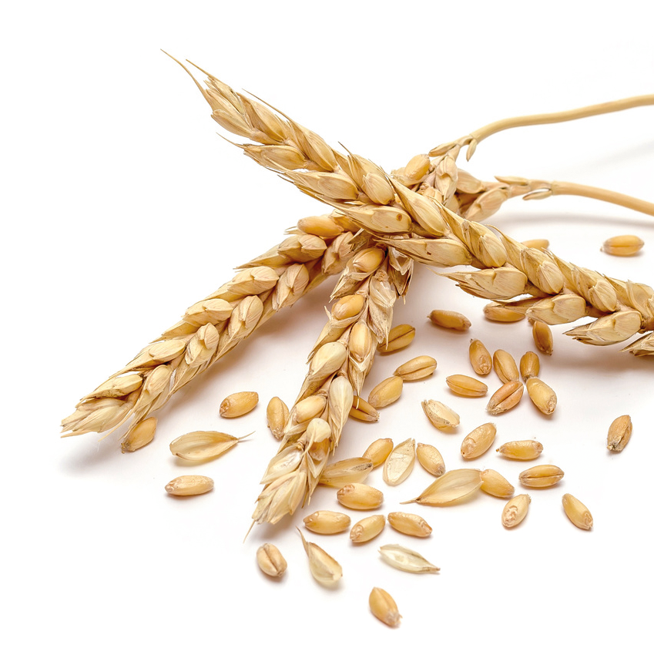
Level 2
Max 20 people
More formal setting
Twelve evenings four hours
Develop and brew your own beer
Curriculum:
Off flavours, Grains & malt, Trends, Hops, Serving & hospitality, Assortiment, Beer & cheese, Beer & Food, Yeast, Presentation, Judging, Brew your own beer, Beer cocktails
Brewers of Europe Forum
Antwerp

Slide 16
Level 3
Max 17 people
Obertrum, Austria
Two days
German and Austrian beers, Wood, Food, Glass, Mystery Guest
“You might know a lot, but there is still swath of unchartered territory out there”
Brewers of Europe Forum
Antwerp

Slide 17
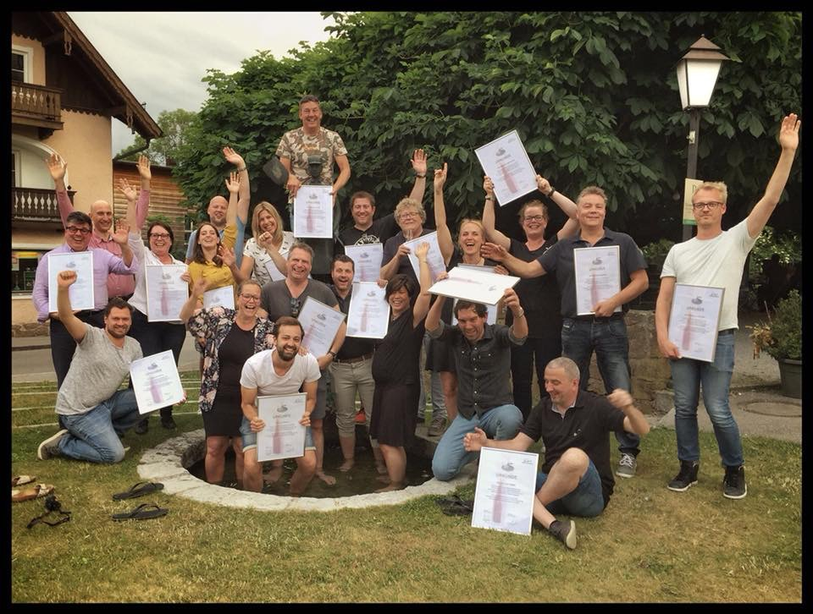
Level 3
Brewers of Europe Forum
Antwerp

Slide 18
Beer landscape NL 2019
680 breweries
few thousand different beers
trend of decrease in beer consumption has been reversed
beer revolution is mainstream
established beer education
Brewers of Europe Forum
Antwerp

Slide 19
Spin off 2019
1.400 beer ambassadors and 200 beer sommeliers
common language to describe beer
quality consciousness is improving
several breweries and companies started
strong network supporting brewers
Brewers of Europe Forum
Antwerp
Notes:
All volunteer project

Slide 20
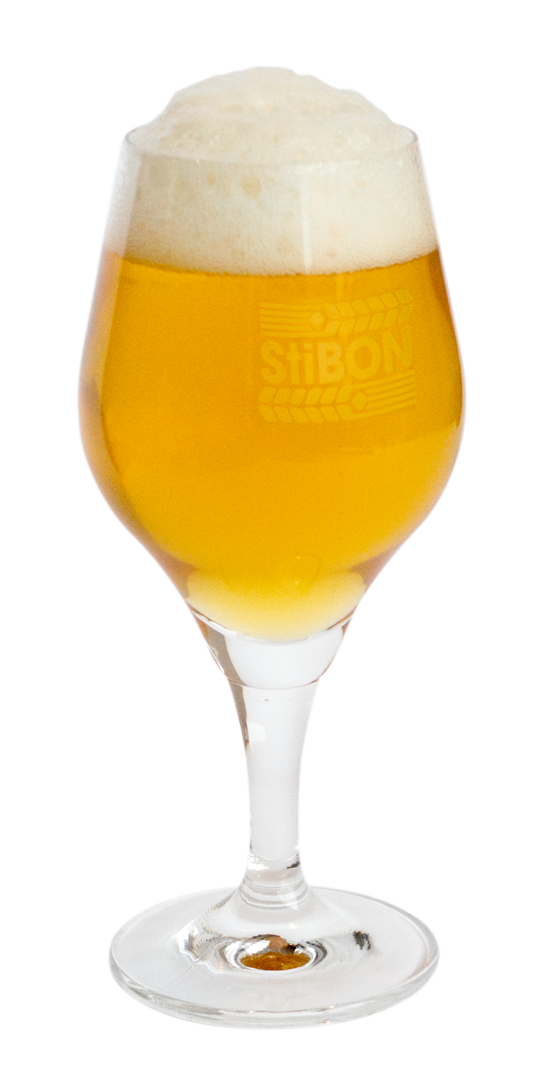
Education grows your market
Questions?
Notes:
?

Slide 21
Thank you!
Notes:
?

