Slide 1
Horeca going digital
Brewers of Europe forum Antwerp, June 4th 2019
Hugo Hanselmann
HuHeha – advisory services

Slide 2
For Food & Beverage Companies, Horeca used to be a Black Box, BUT…

Slide 3
… horeca is now opening up, digitalizing, therewith delivering lots of data

Slide 4
And some players in the market are tapping in

Slide 5
Also a tech start-up scene has been established around HORECa over the past years…

Slide 6
… Attracting investments from amongst others the Food & Beverage industry players

Slide 7
Digital Needs of horeca - why
Why digitalization is necessary in HoReCa

Slide 8
“WHY” in digital should start with the consumer

Slide 9
Digitalization is needed, in order to provide High-quality Services to New-Age customers
Experience is vital in the HoReCa industry. Digitalization is enabling the industry firms to deliver high-quality services to guests.
More and more “digital native” guests and employees are entering in the HoReCa industry who have a different set of expectations for the internet-related amenities.
Millennials/Gen Z want to self-serve more than the previous generations.
These connected consumers don’t hesitate to publish poor reviews online publicly if their expectation from the product and services are not met, thus, destroying the brand image in a few seconds.
Consumers are seeking personalization, which is not possible if the backend and frontend are not connected and interact with each other in real time.
Notes:
https://betterspace360.com/en/betterspace-en/digitization-of-the-hotel-industry-part-1-2142/

Slide 10
Analytics and AI tools are helping Businesses to personalize products as per Consumers’ needs
Digital tools are enabling businesses to capture data in real-time data for analytics.
Data analytics has become a critical tool in spotting business trends and understand customer sentiments to align operational efficiencies.
Analytics is also being used to push customer engagement and loyalty, thus, to establish a strong brand reputation.
The beverage industry is already taking a direct approach to customers, especially with the marketing potential of mobile & IoT.
Digital concepts enable beverages and services to be individually tailored to customer preferences.
Notes:
https://blog.drinktec.com/beverage-marketing/digitalization-opportunities-for-marketing-in-the-beverage-industry/

Slide 11
Digitalization in operations is bringing Efficiency and Lowering total Cost of ownership
E.g. IoT systems are helping companies in a range of tasks such as controlling the temperature of facilities, optimizing the speed of serving consumers, tracking bottles being opened or delivering food to the tables.
Notes:
https://cbcommunity.comcast.com/browse-all/details/the-next-phase-of-digital-transformation-in-hospitality

Slide 12
WHY is this important for beer brewers?
Attracting consumers to places where there is an experience to make
Healthier HoReCa businesses = healthier beer business
Supply chain & distribution optimisations
Insights for better products, services & marketing

Slide 13
Status of Digital in horeca
Status of digitalization in HoReCa, what happened in the past few years

Slide 14
services are provided to establish the basics, e.g. by METRO’s Hospitality.digital

Slide 15
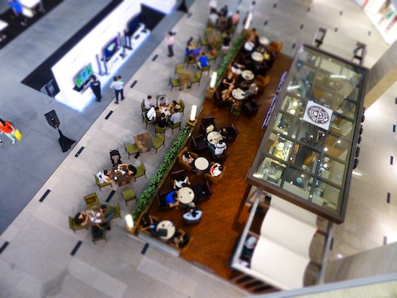
some hospitality industry players are already using a number of Advanced frontend & Backend Digital tools
Cloud, mobile, big data analytics, IoT and social are key for digital transformation.
Currently-deployed digital tools include mobile apps, comprehensive on-premises connectivity solutions, connected machine solutions, payment processing tools, and back-office data analytics platforms.
The hospitality firms have integrated their analytics platforms with social and other online sites to gauge customer sentiment and determine their strengths and weaknesses based on guest reviews and social media comments.
Notes:
https://goies.com/index.php/blog/64-siemens/439-brewery-automation

Slide 16
Digitalization in HORECA - how
How digitalization is taking place in the HoReCa industry today & tomorrow

Slide 17
Digitalization is improving engagement with consumers at multiple communication channels
In the era of social media and connected devices, digital technologies are improving customer experience by providing better engagement on multiple communication channels. BE ONLINE.
The collaboration between HoReCa companies and technologies firms are maturing where features such as mobile ordering and personalization create a frictionless consumer journeys. COLLABORATE
Today, the CRM systems in the HoReCa industry have sophisticated, newer features and integration with other systems. CONNECT
The industry players are recording guests’ experience to personalize experience during their next visits.

Slide 18
Digitalization has become a key success Factor for a Customer-centric horeca Business Model
The first wave of digital transformation enabled restaurants to utilize technology to work smarter and more efficiently.
Next: Firms such as McDonald’s are leveraging technologies to eliminate mundane tasks, such as taking simple food orders to free humans to develop meaningful customer service interactions and tackling more complex issues for guests.
Voice Assistants: Many firms are preparing for the voice assistants. The voice assistants are already available through some apps; they will become ubiquitous in the coming years.

Slide 19
AR apps are becoming Great Promotional tools
Restaurants are taking advantage of Augmented Reality promotions.
Restaurant chain Bareburger ran a Snapchat contest, offering free food to people who scanned Snapcodes from their takeout bags.
To redeem prizes, customers posted Snapchat stories featuring Bareburger AR images and then brought the Snapcode to the nearest Bareburger
The restaurant also ran an AR filter that allowed customers to access menu items in detail, effectively previewing their customized food order before placing it.
Notes:
https://www.forbes.com/sites/forbestechcouncil/2018/06/28/new-technologies-will-revolutionize-the-hospitality-industry/#29b9e12573c3

Slide 20
biometric authentication on the way to become an essential Tool to provide seamless customer transactions
Biometrics: In the future, the biometric authentication will become a go-to tool for providing seamless customer transactions that enable users to leave right after a restaurant meal with the confidence that their bill was paid automatically without the need for waitstaff or pay terminal interaction.
Hospitality is getting closer to seamless processes where consumers can authenticate a purchase without a phone or wallet, digital or otherwise.
Amazon’s physical store, Amazon Go, in Seattle has already run proof-of-concept trials that eliminate the need for waitstaff or pay terminal interaction.
Notes:
https://www.forbes.com/sites/forbestechcouncil/2018/06/28/new-technologies-will-revolutionize-the-hospitality-industry/#29b9e12573c3

Slide 21
Benefits of Digitalization - What
What are the ultimate benefits for all players involved, particularly beer brewers?

Slide 22
Digital Transformation can increase Top and bottom lines for all the ecosystem players
Digital Transformation
More Revenue
Better, Personalized Services
Efficient Operation
Sustainability
Lower Costs
Speedier Delivery
Greater Profitability
Online Booking and reservation
Realtime Insights
Frictionless Payments
The Business Operation
The Customer Experience
Notes:
https://www.forbes.com/sites/forbestechcouncil/2018/06/28/new-technologies-will-revolutionize-the-hospitality-industry/#29b9e12573c3

Slide 23
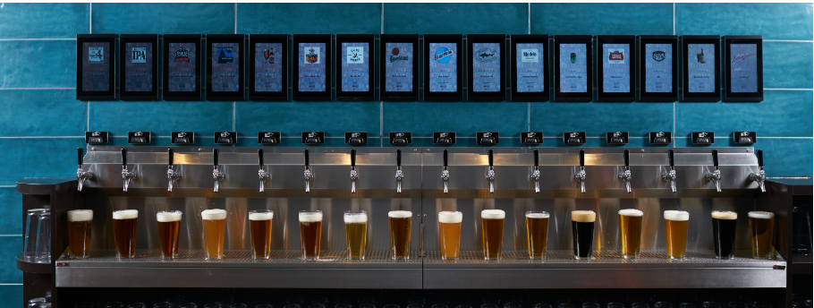
The Digitalization of the Hospitality Industry benefits all suppliers, particularly Beer Brewers
Digitalization generates data that can be used for Insights and New Services
Insights into e.g.:
Consumer behavior – time, place, combinations, group-size,
On-Trade Marketing and Promotion engagement
Price elasticity, dynamic pricing
Location specifics
New Services:
Just-in-time delivery / B.A.A.S.
Self-serve, personalization
Automated, precise and correct kick-backs
Mobility services offerings

Slide 24
Thank You & Cheers
Hugo Hanselmann
HuHeHa – Advisory Services

