Slide 1
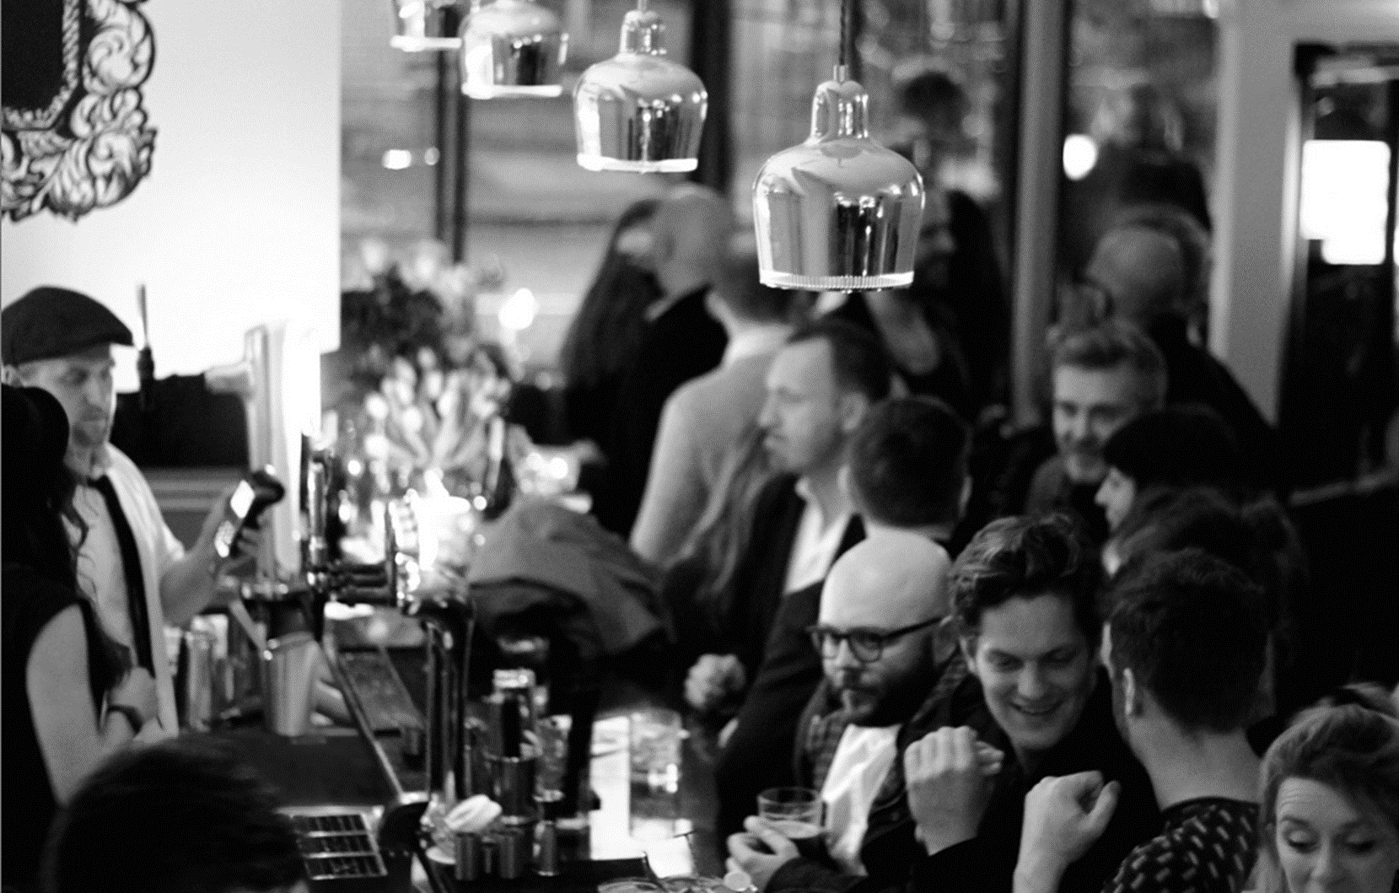
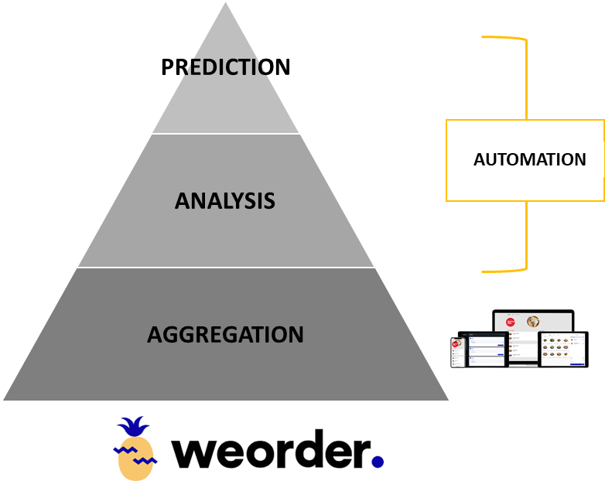
DIGITAL COMMERCE &
THE €3 TRILLION DISRUPTION
ANDY CHEN
CEO, WEORDER HOSPITALITY TECHNOLOGIES

Slide 2
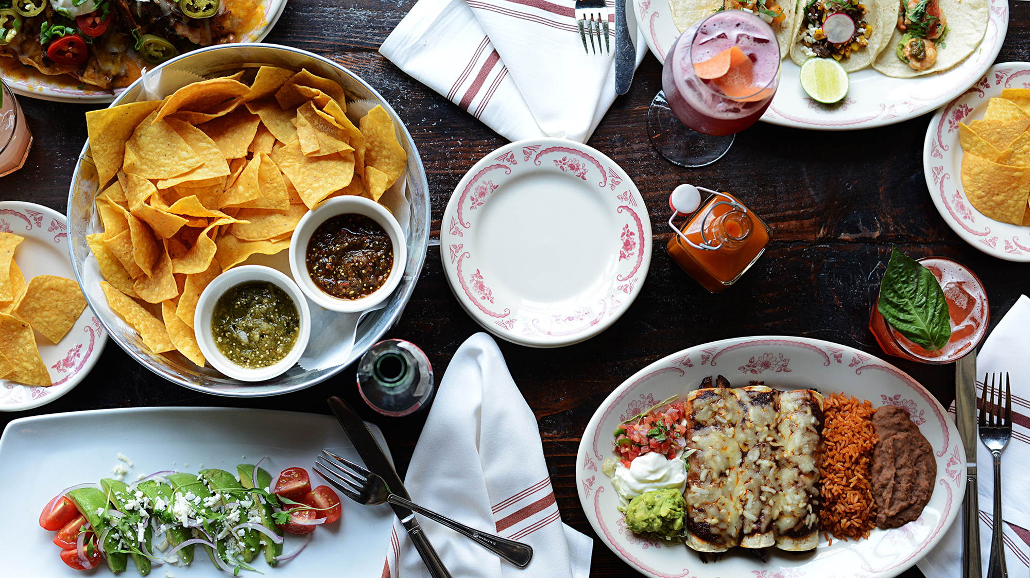
RECABA, NOT HORECA

Slide 3
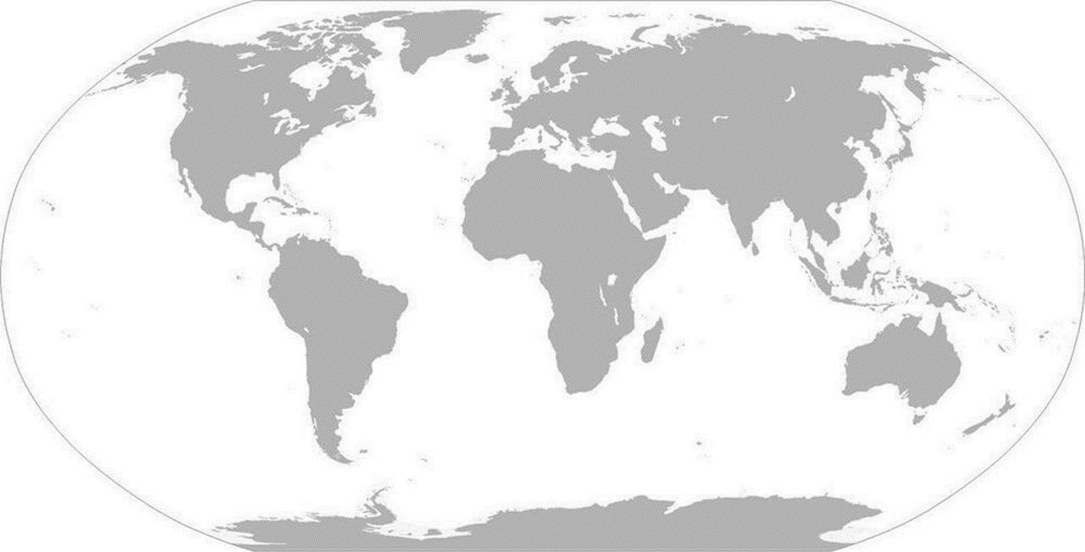
NORDICS
€30 BILLION EUROS
U.S.A
€900 BILLION EUROS
€3 TRILLION EUROS ANNUALLY IN F&B SALES

Slide 4
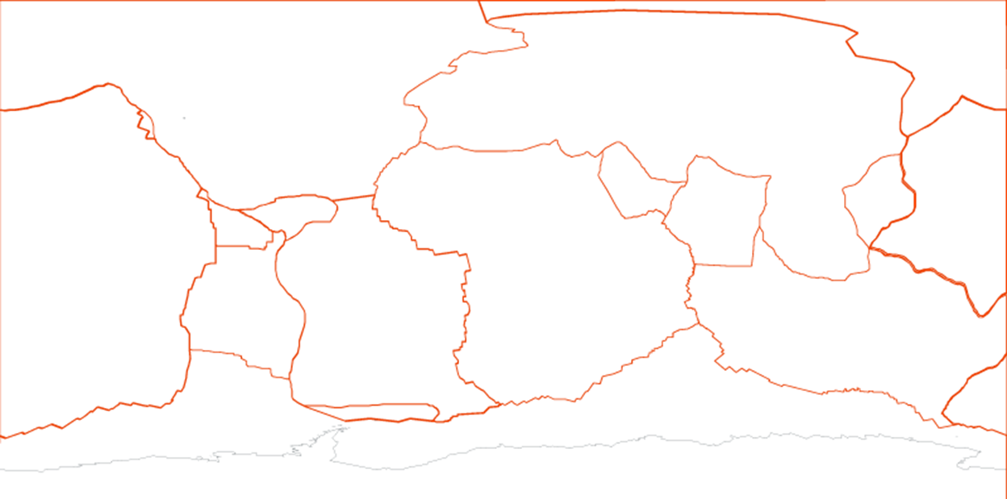
TECTONIC CHANGES
OMNI-CHANNEL SALES
(Mobile-first)
PERSONALIZATION
(Customer data)
SOFTWARE AUTOMATION (Cloud-based)
CUSTOMER BEHAVIOR
OPERATIONAL PRACTICE
SYSTEM ADVANCEMENT
Notes:
We estimate conservatively that digital ordering and mobile payment will become the norm for the majority of F&B businesses by the end of 2021, where 50% of the total €30 billion in sales will be digitally processed from mobile devices.
Mobile ordering creates unprecedented opportunities to capture customer order data and establish a new PAYMENT and LOYALTY channel that did not exist previously.

Slide 5
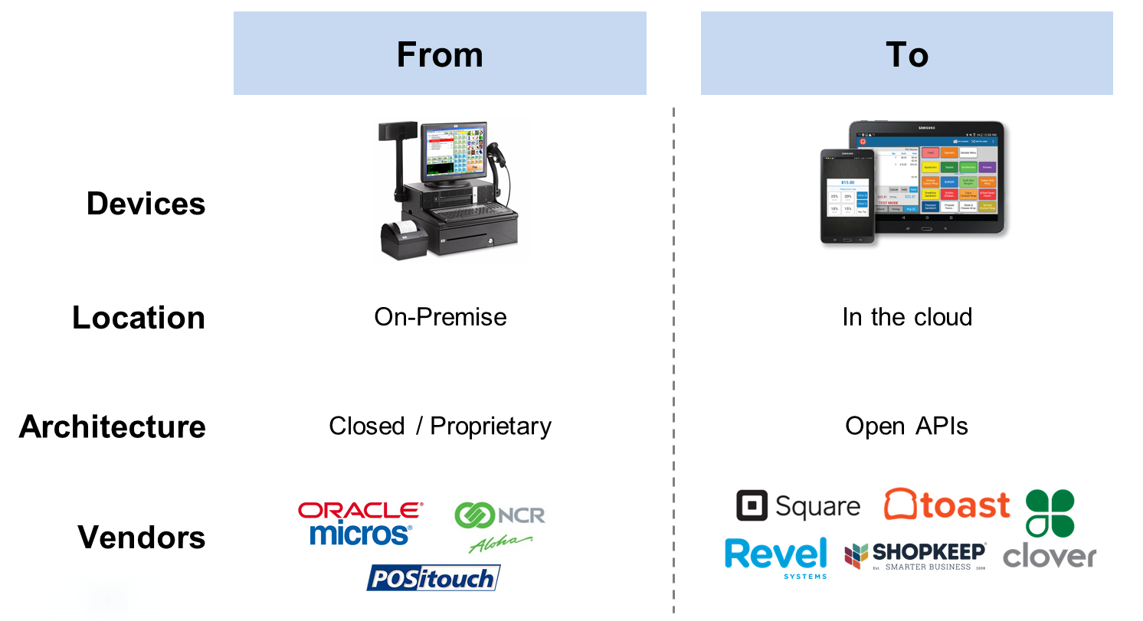
SOFTWARE IS CHANGING EVERYTHING
eCOMMERCE
CRM
Mobile payment

Slide 6
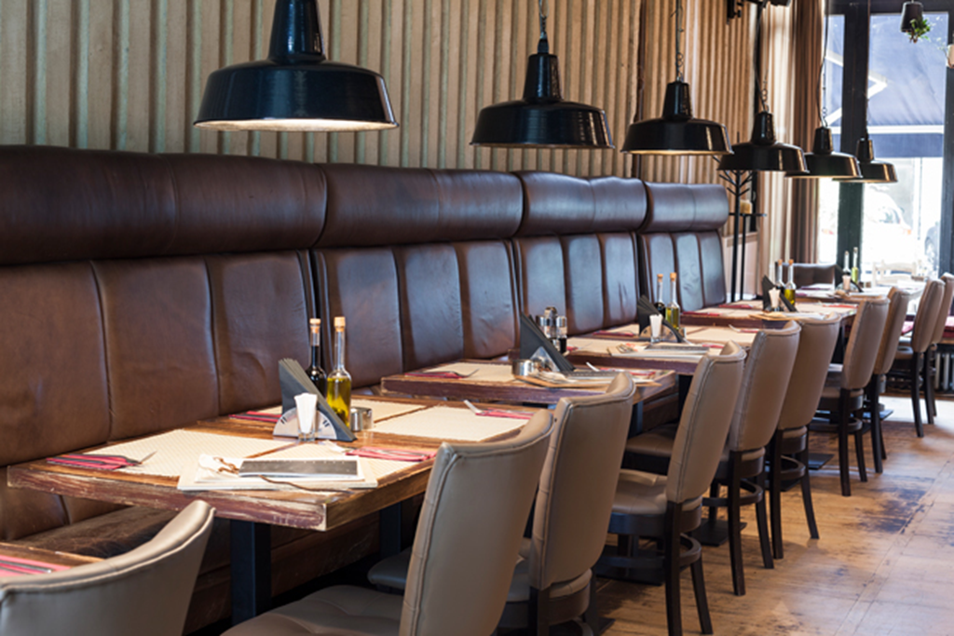



F&B IS THE LEAST DIGITALIZED HOSPITALITY INDUSTRY
Lack of sales digitalization
Lack of customer data & CRM
Lack of order process automation
Lack of intelligent business
No global industry-level standardized platform eg Amadeus, Sabre, etc
No omni-channel sales management

Slide 7

BUSINESS NEEDS HAVE GONE BEYOND HUMAN CAPABILITY
Weorder Addresses the Top Tech Priorities for Restaurants
77%
Consumers use their smart phones in restaurants
(Mindberry Report)
20%
Uplift in customer spend when ordering via mobile
(Business Insider)
% who responded “Must Have” in the survey of most important POS functionality*
78%
Consumers would use mobile app if offered in-app discouns
(IAB)
60%
Consumers are willing to share personal info for more targeted offers
(Boxever Report)
72%
Millennials want to purchase products or services via a company’s app
(Oracle Global Research)
65%
Millennials want to flag issues or raise complaints via a company’s app
(Oracle Global Research)
67%
Millennials want to receive regular usage updates via a company’s app
(Oracle Global Research)
62%
Millennials want to receive advanced notice of upcoming offers via a company’s app
(Oracle Global Research)
*Source: Restaurant Technology Study 2017

Slide 8



MODERN ORDERING REQUIRES ON-DEMAND TECHNOLOGY
Customer data is a requirement.
WEB
APP
KIOSK

Slide 9
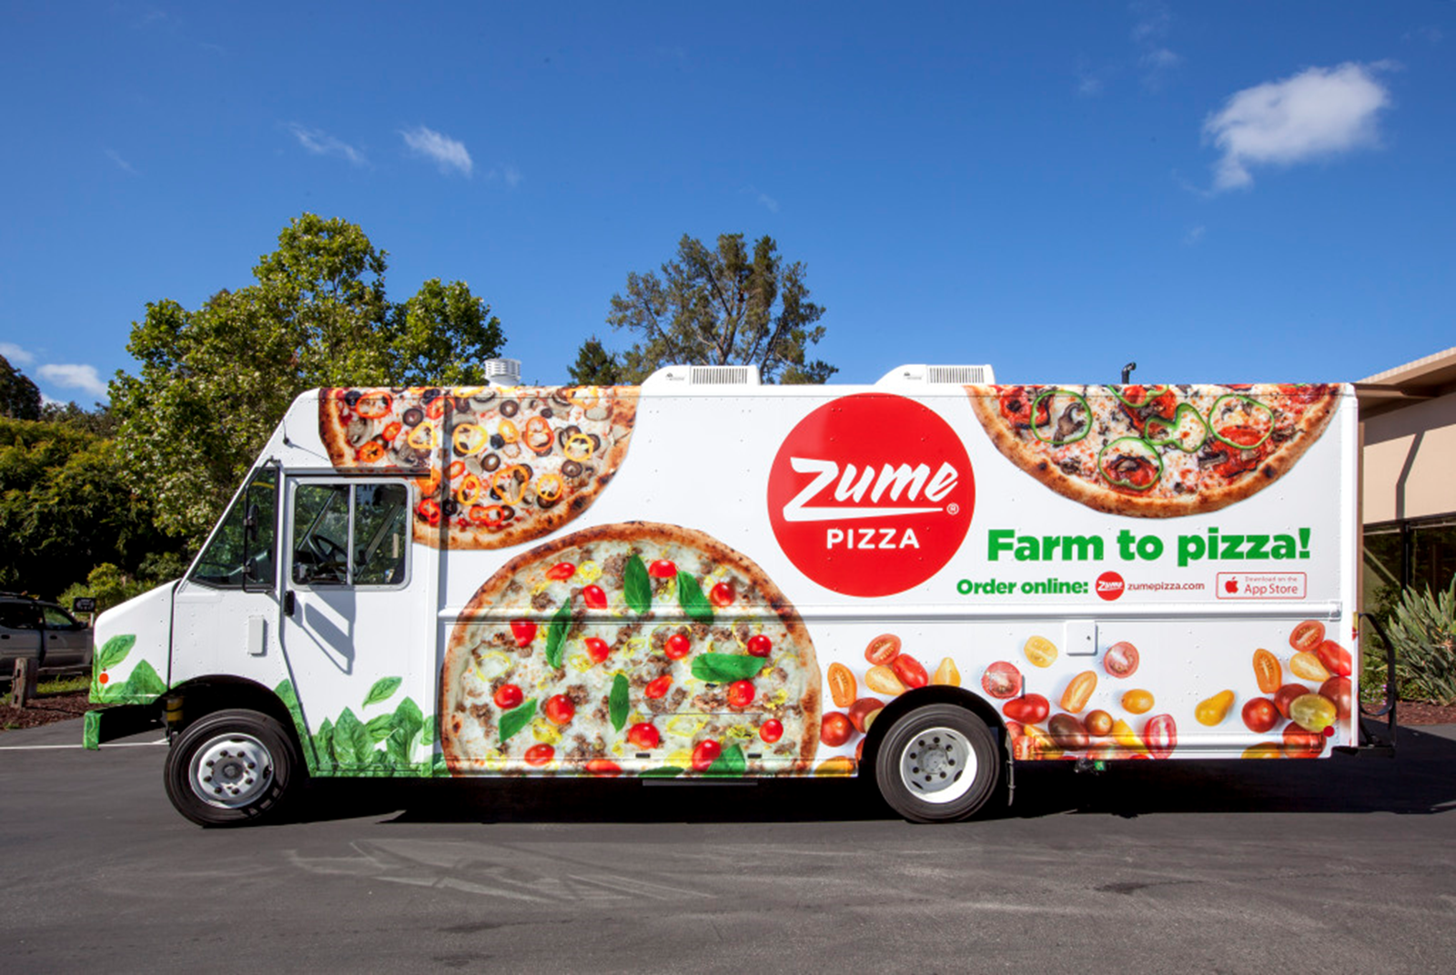
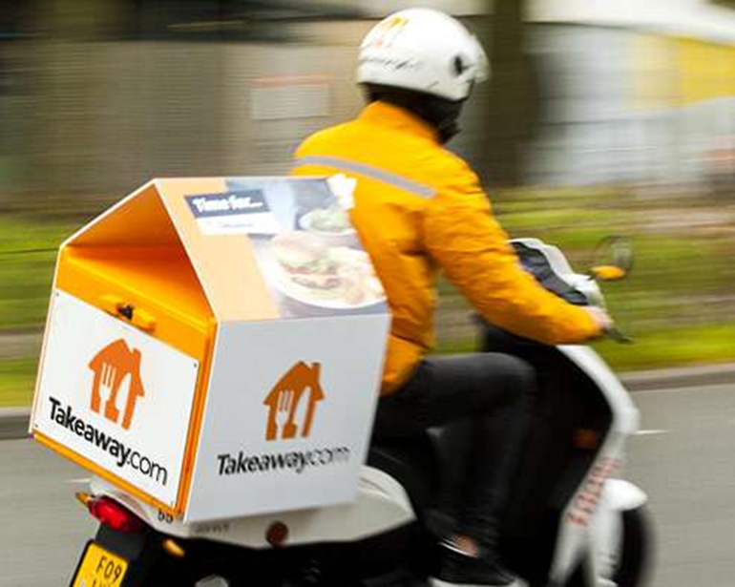
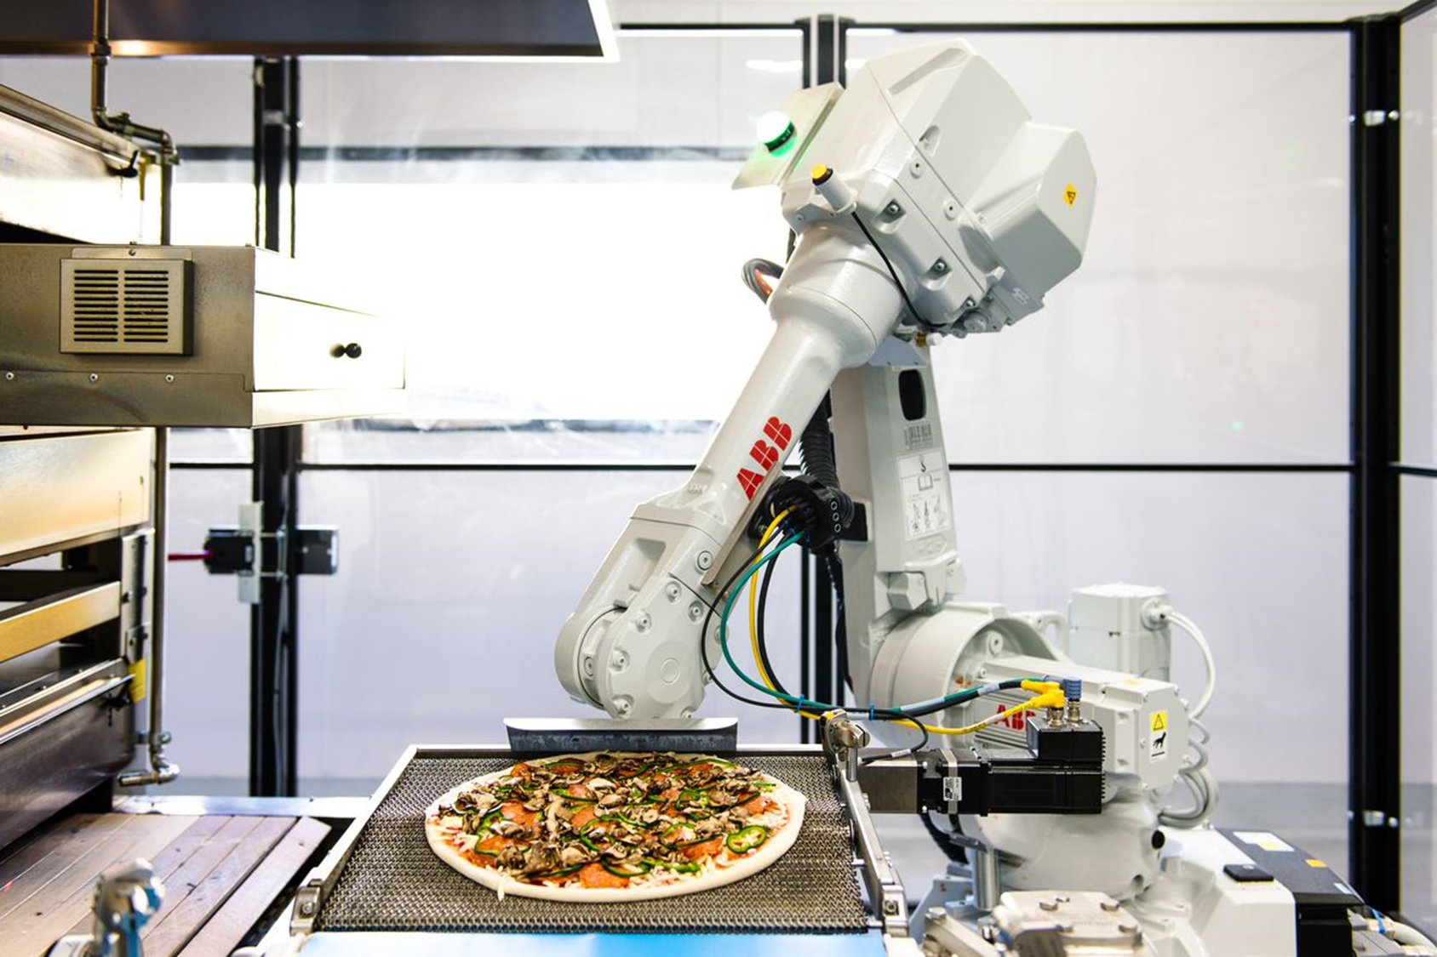
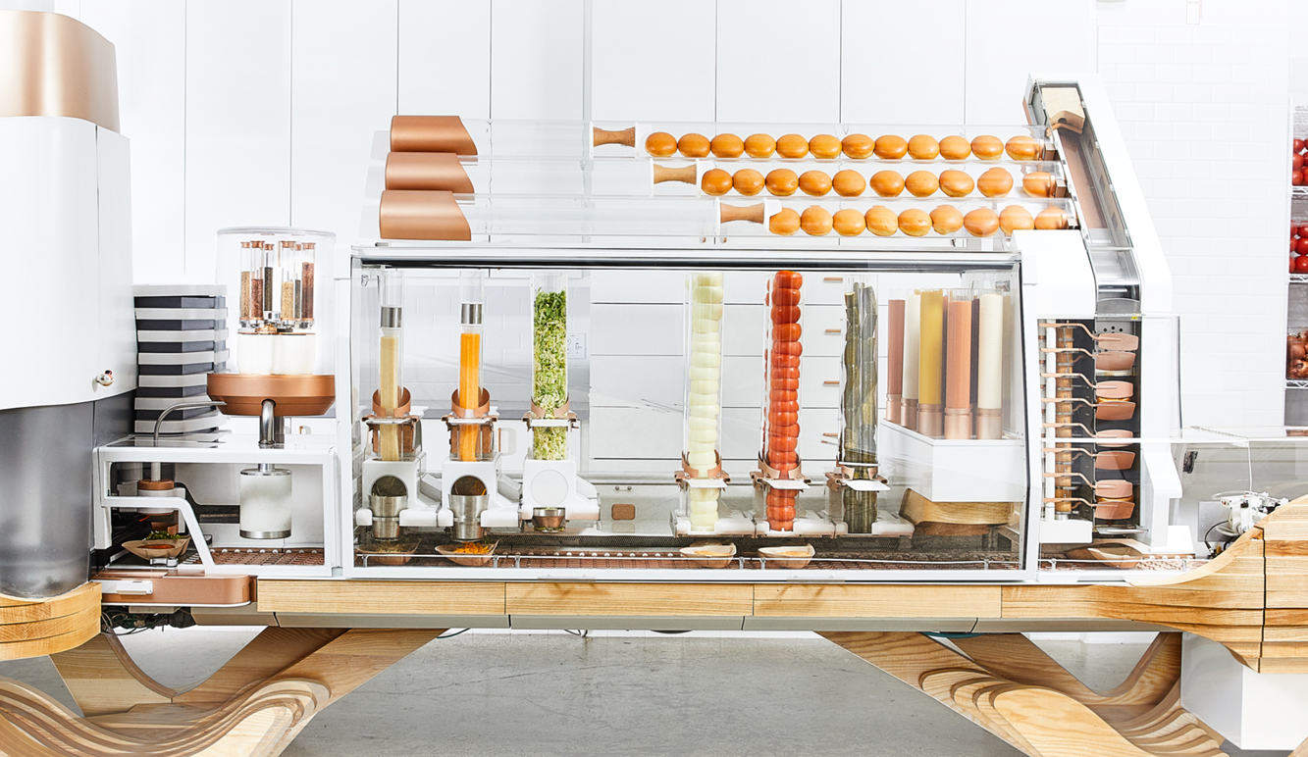
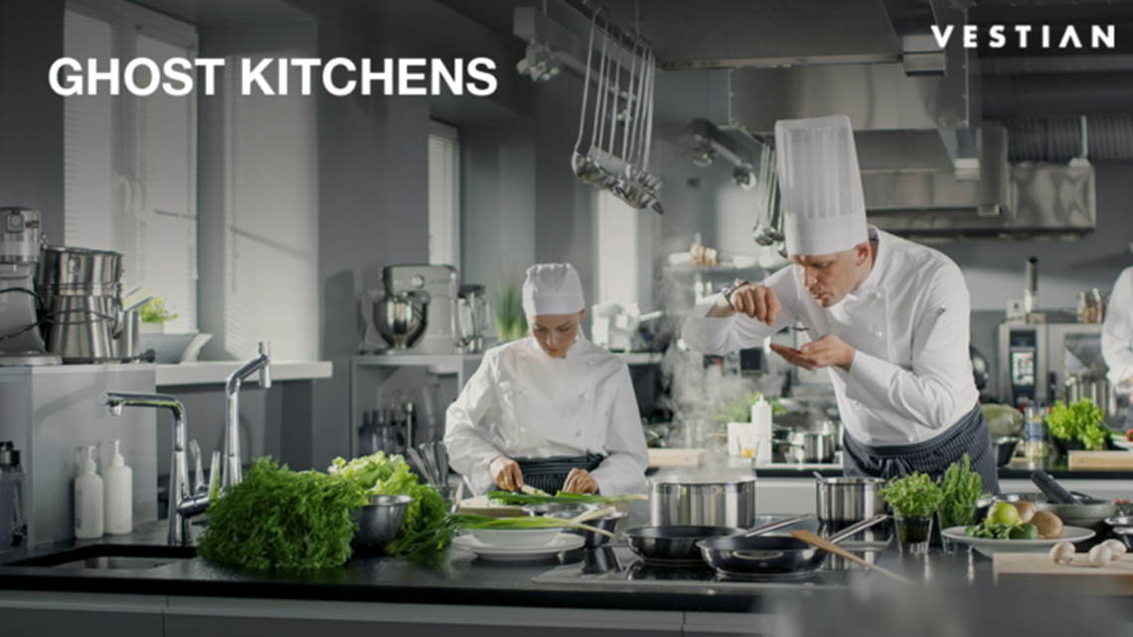
DELIVERY HAS REDEFINED RESTAURANTS WITH OFF-PREMISE CONSUMPTION
ROBOTIC MOBILE KITCHEN

Slide 10
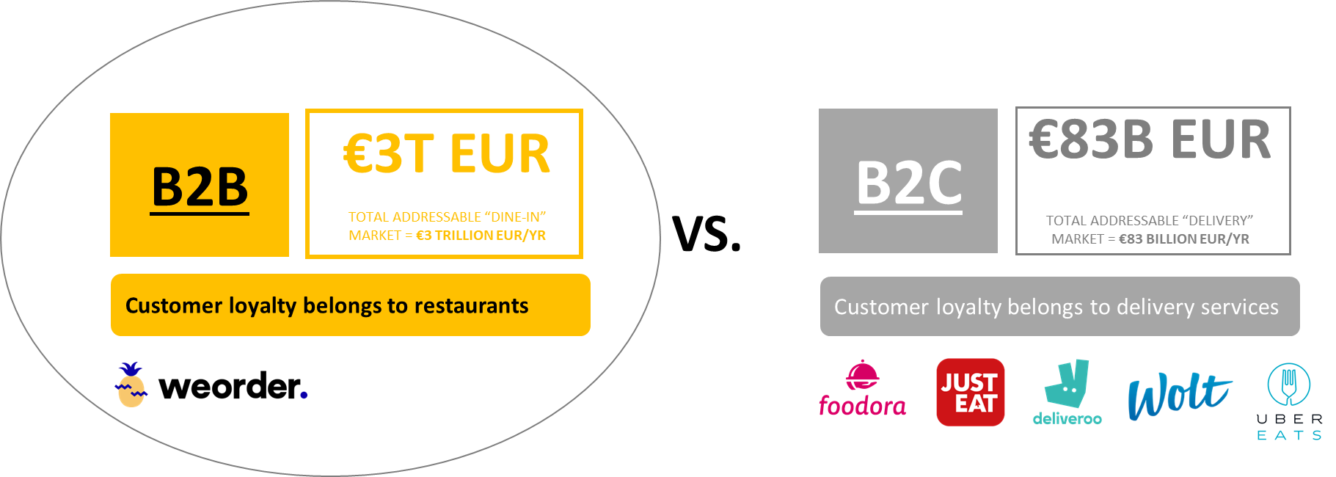
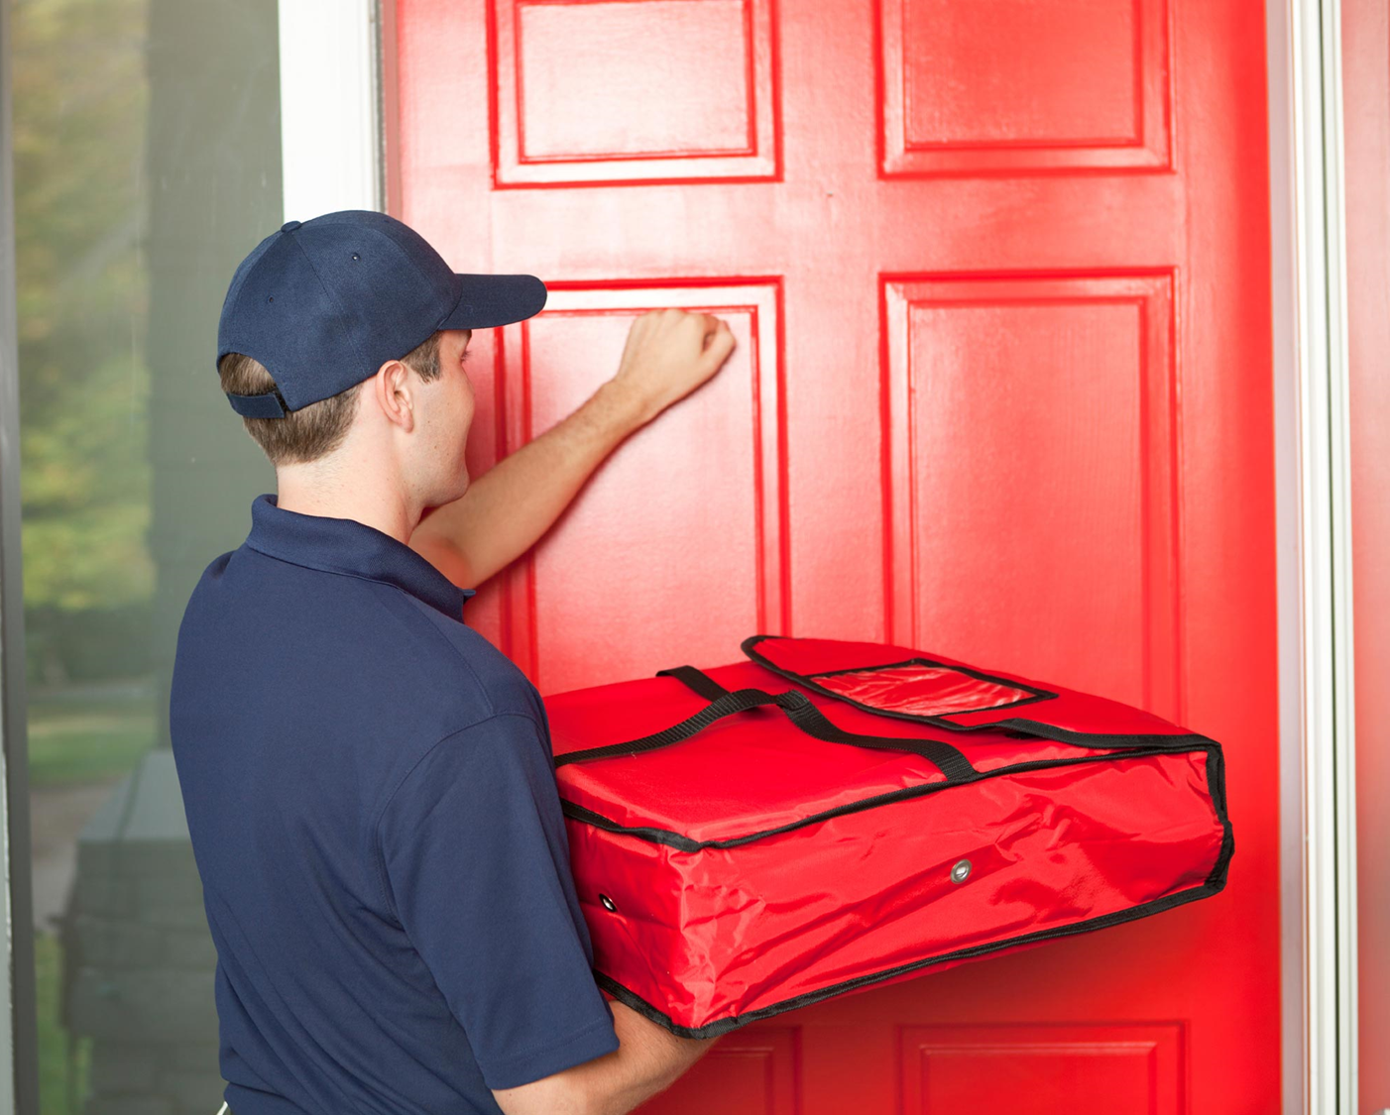
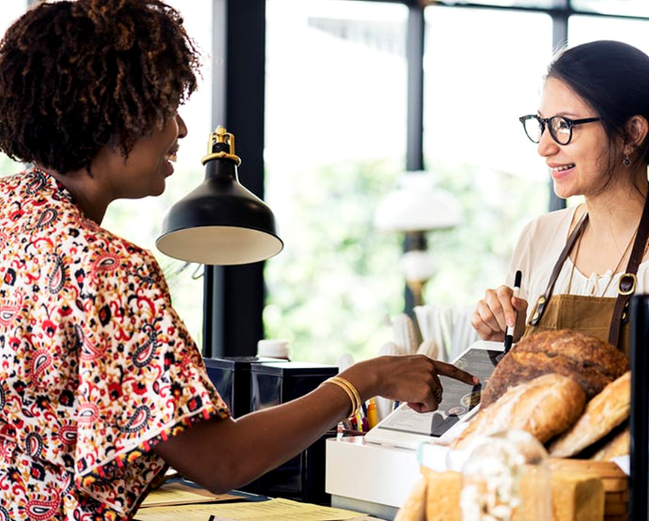
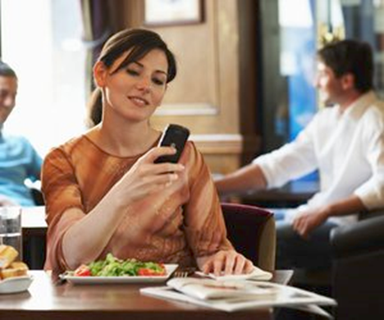
DELIVERY IS JUST THE BEGINNING...
DELIVERY
PREORDER/PICKUP
IN-SEAT

Slide 11
eCommerce refers to the buying and selling of goods or services using the internet, and the transfer of money and data to execute these transactions.

Slide 12


Slide 13
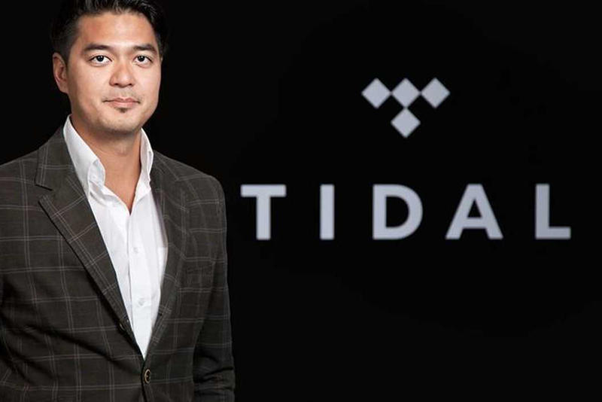
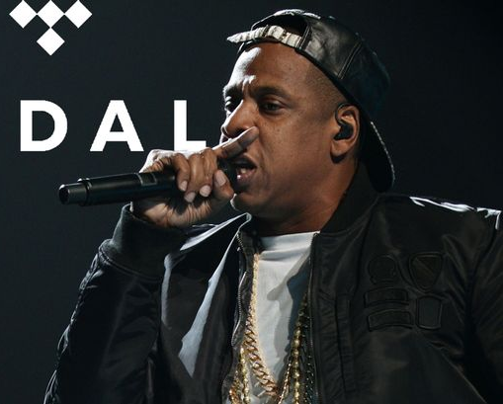
2015

Slide 14
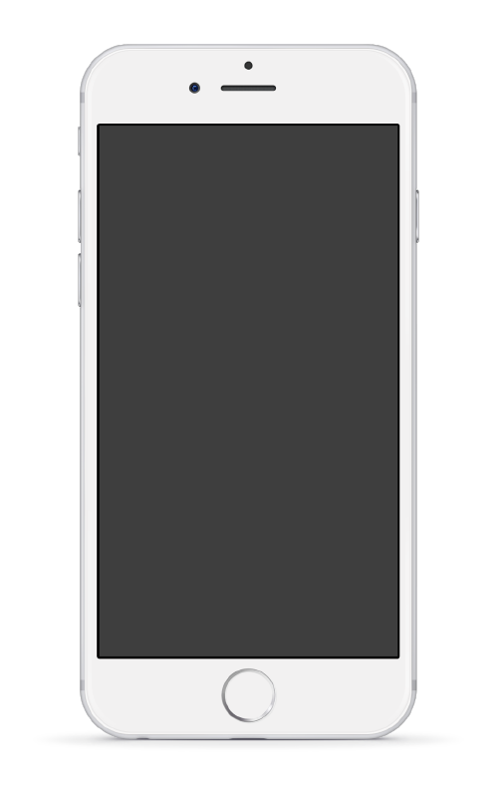
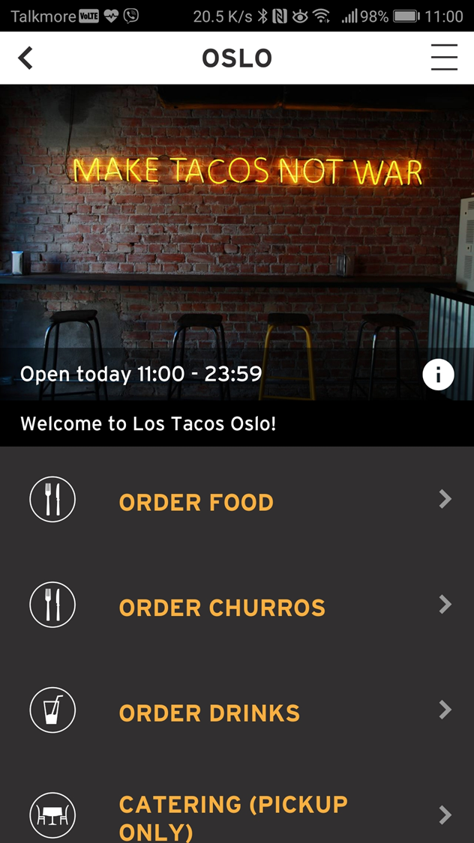
eCOMMERCE IS KEY TO ACQUIRE & RETAIN CUSTOMERS
01
1-CLICK ORDERING
FAST ORDERING CONVENIENCE
Mobile ordering can reduce traditional waiter-based ordering time by 90%. Every order has a digital receipt, which allows 1-click re-ordering to increase convenience.
80% of the customers order similar or identical items as previous visits. Since every order is digitalized with a receipt that is clickable to repeat, customer can place a repeat order in our system in less than 3 seconds.
02
TAKEAWAY & IN-SEAT ORDERING
Customer can order anytime and set their own pick-up time up to 48 hours in advance. We also offer waiter-less in-seat ordering to reduce amount of staff needed to service all the customers in the restaurant.
DIGITALIZE EVERY ORDER & CUSTOMER
Restaurants cannot improve sales if they do not know who their customers. Our digital ordering system tracks every order to an identifiable customer so they can manage and grow their customer database.
03
LOYALTY PROGRAM
We offer a variety of loyalty modules to increase customer purchase frequency, including pioneering CashPoints for F&B.
TURNING VISITORS INTO CUSTOMERS
Restaurant growth is anchored by loyal customers who regularly purchase and consume. Our system delivers integrated loyalty schemes and CRM to enable restaurants to identify repeat customers and send out personalized offers to increase visits and sales.

Slide 15
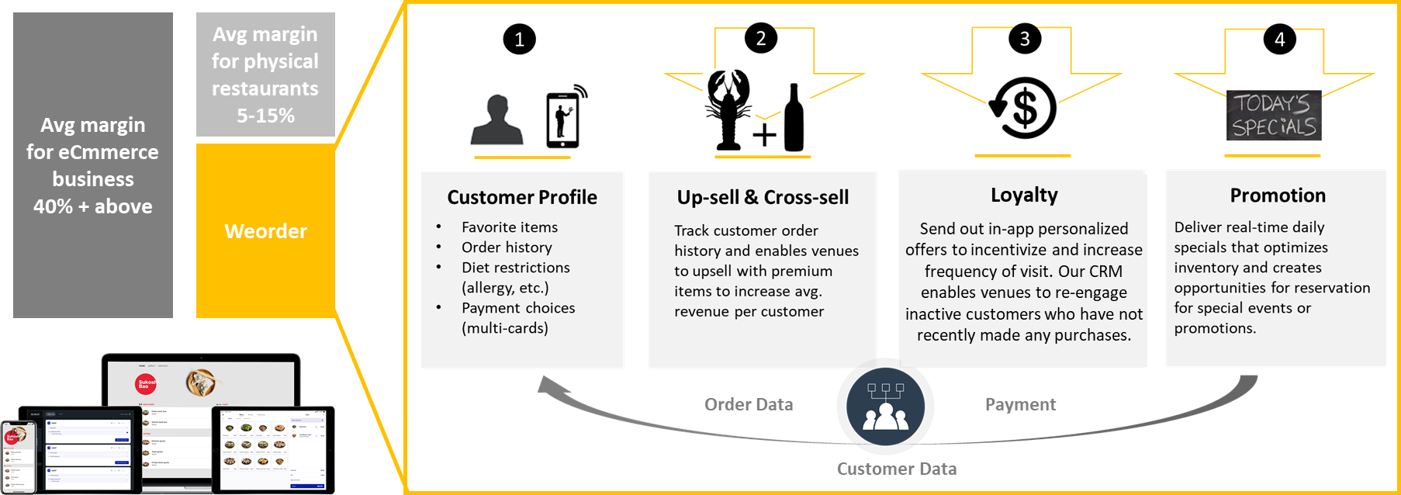
DIGITAL EXPONENTIALLY IMPROVES RESTAURANT ECONOMICS

Slide 16
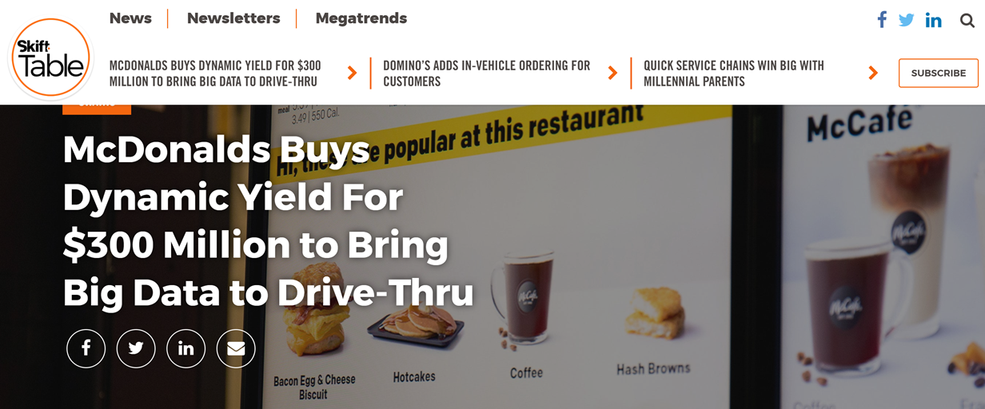
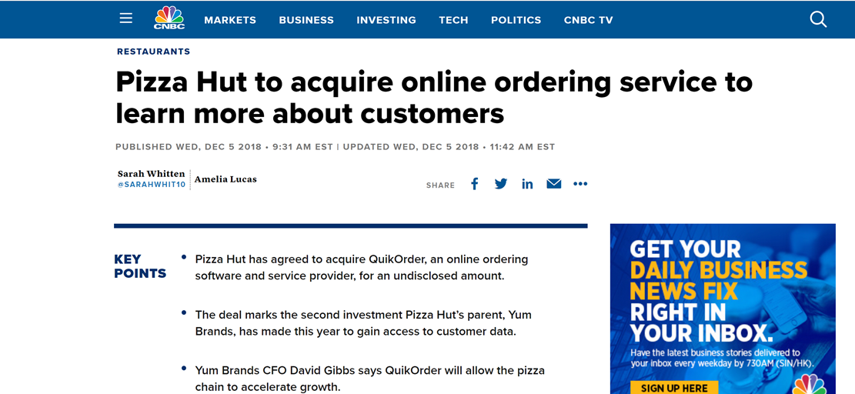
LARGE GLOBAL PLAYERS HAVE UNFAIR ADVANTAGES WITH TECHNOLOGY INVESTMENTS & UTILIZATION

Slide 17
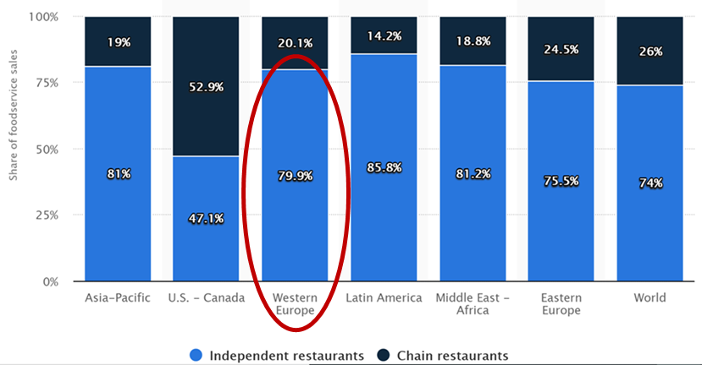
INDEPENDENT RESTAURANTS REPRESENT 80% OF THE F&B MARKET

Slide 18
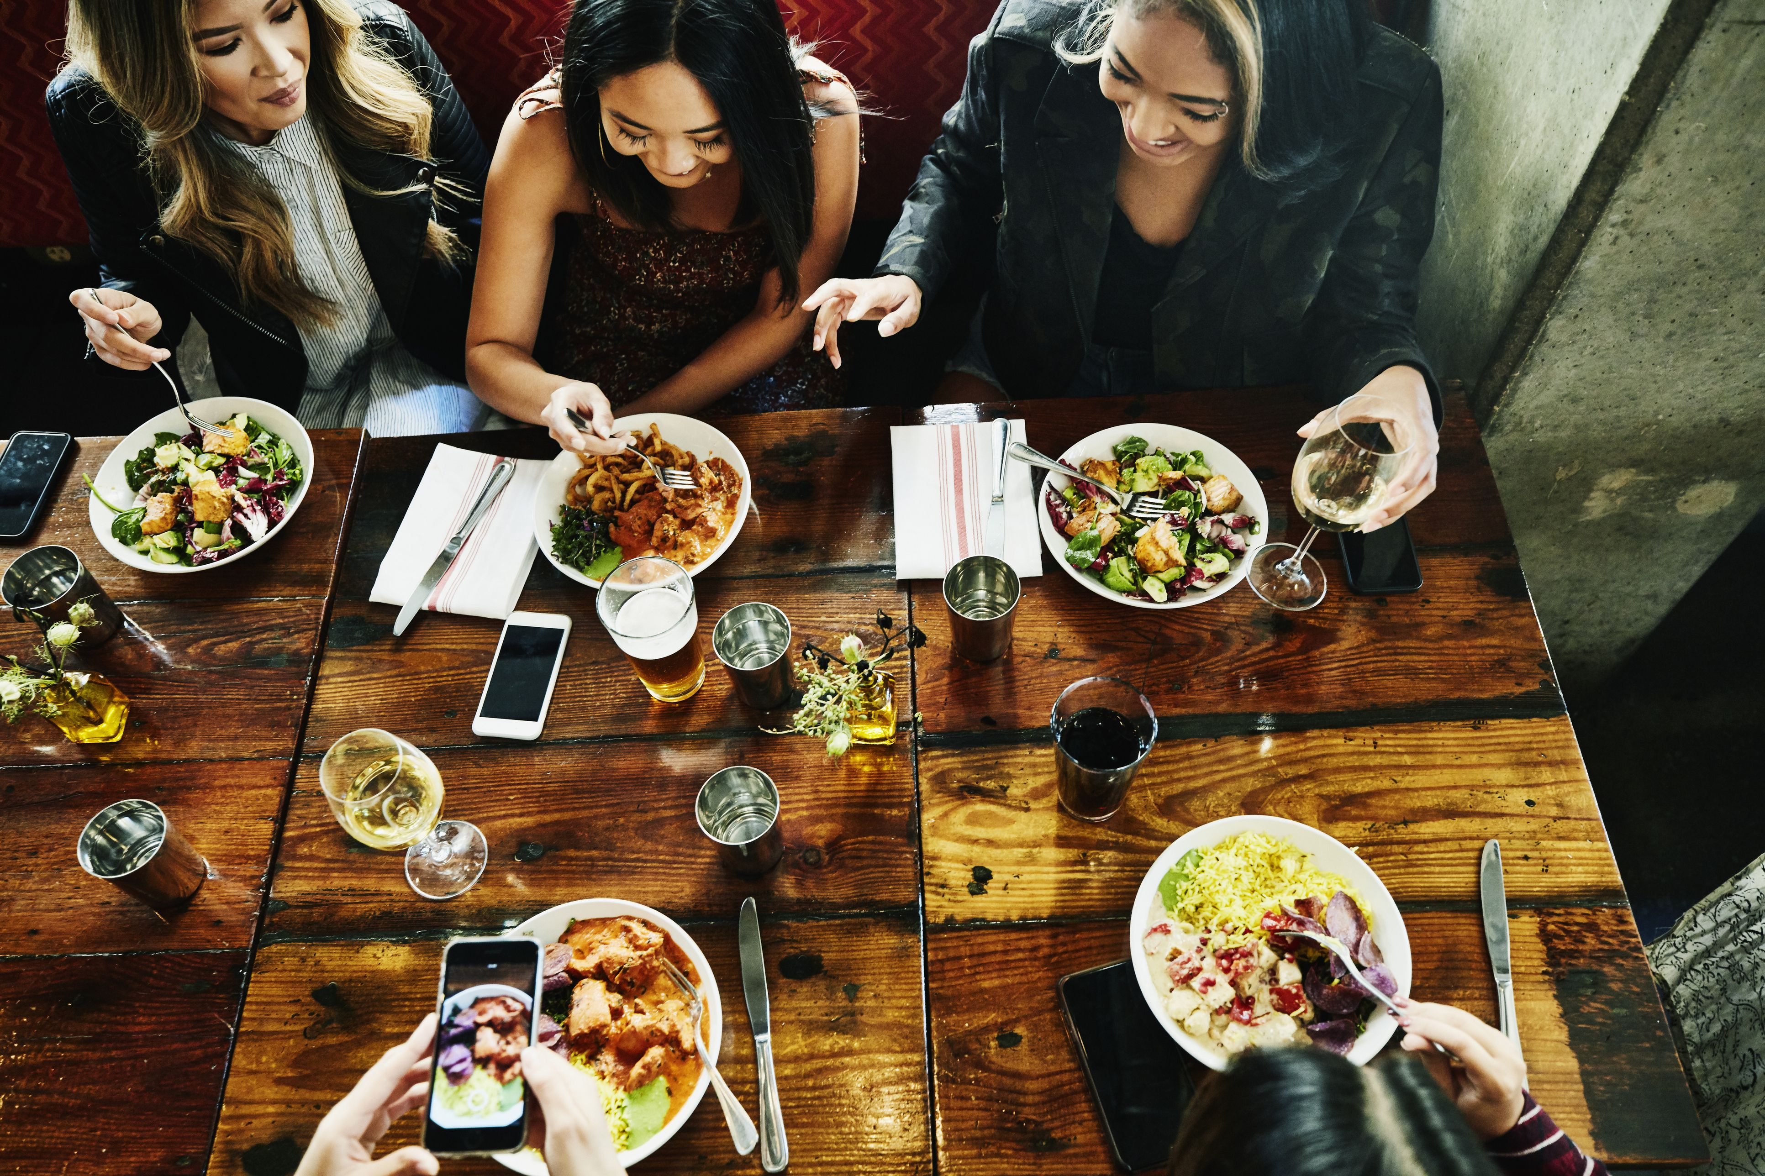
WE TURN RESTAURANTS INTO DATA-CENTRIC ENTERPRISES
DIGITAL ORDERING
(DINE-IN, TAKEAWAY, DELIVERY)
AUTOMATION
(MARKETING, LOYLATY)

Slide 19
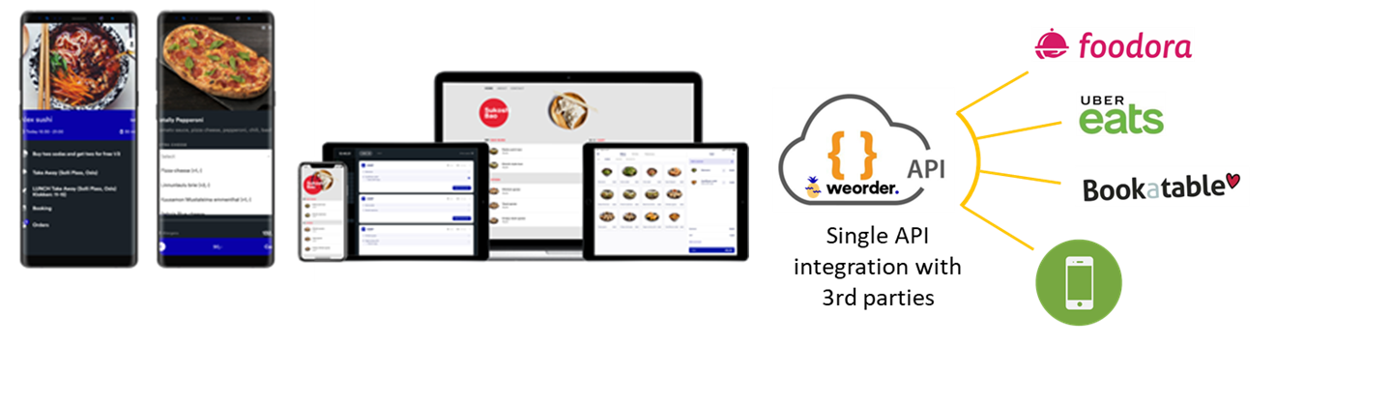
3 LEVELS OF BECOMING A DATA CENTRIC ENTERPRISE

Slide 20
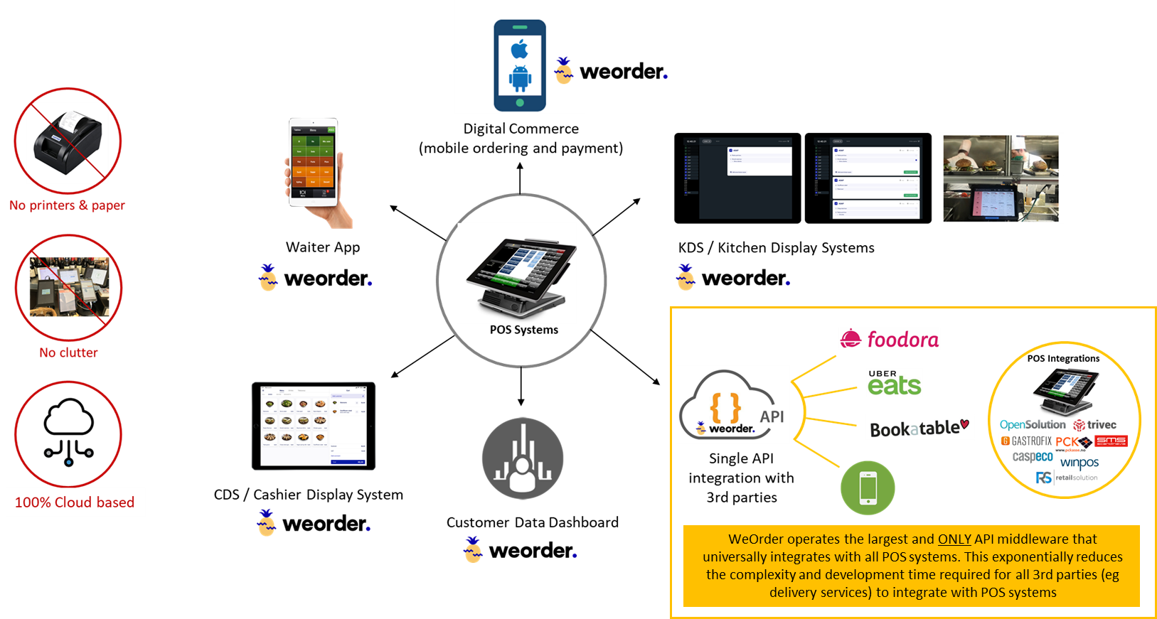
OUR PRODUCTS MAKE POS SYSTEMS SMARTER

Slide 21
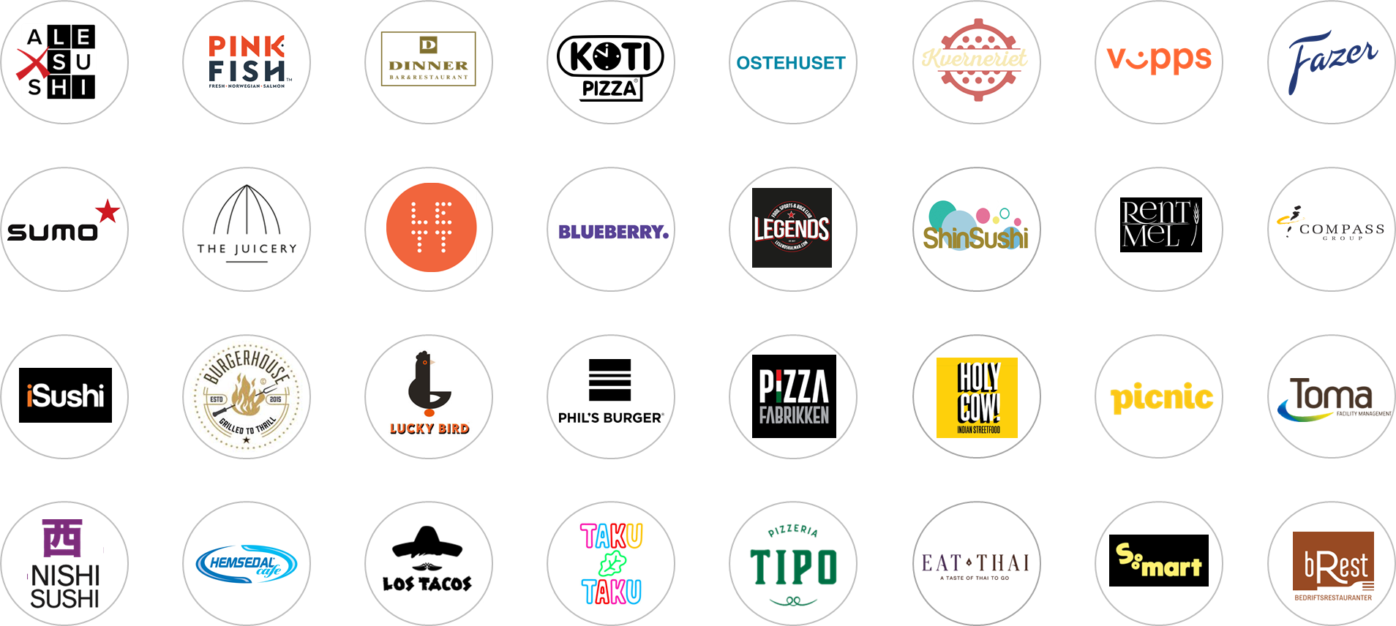
PROCESSING €100 MILLION EUROS WORTH OF DIGITAL ORDERS

Slide 22

Andy Chen
CEO
andy@weorder.com
+47 94831783

