Slide 1
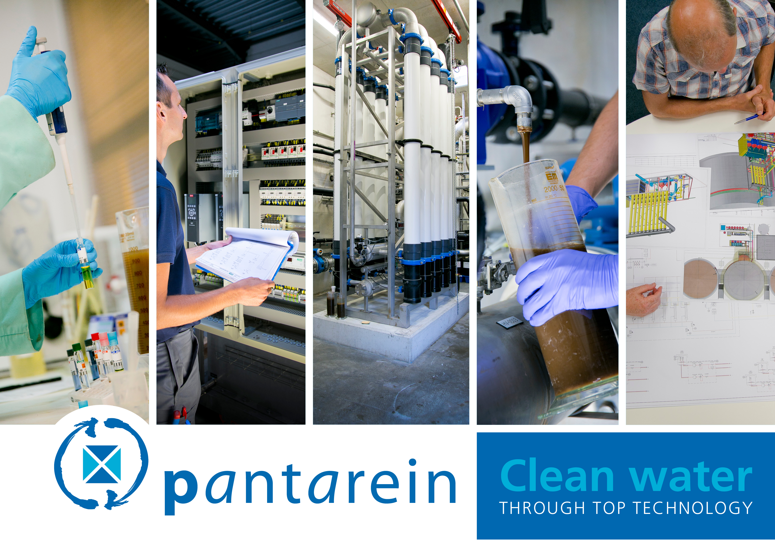

Slide 2
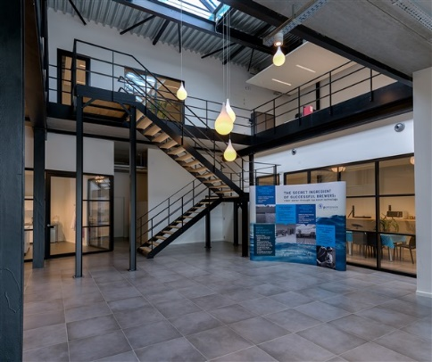
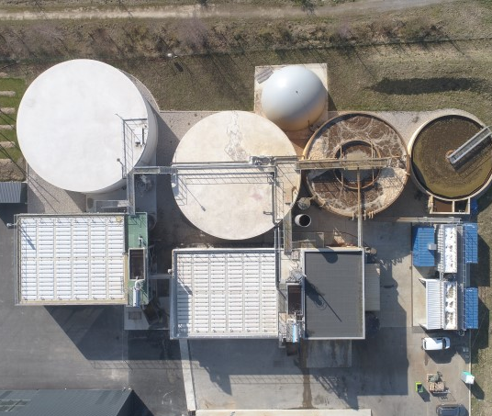
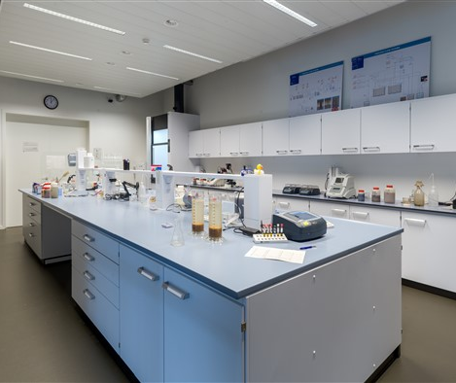
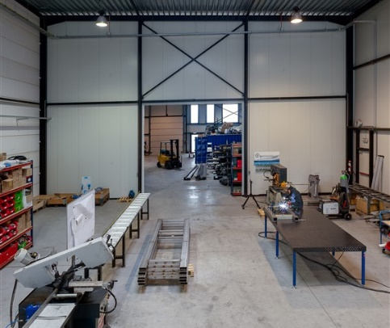
FACTS & FIGURES
BELGIUM - MECHELEN
100 INDUSTRIAL CLIENTS
Mission:
Clean industrial wastewater through top notch technology
35
ENTHUSIASTIC EMPLOYEES
LABORATORY & PILOT HALL
IN HOUSE WORKSHOP
€8
million annual turnover
35
WASTE WATER TREATMENT PLANTS UNDER CONTROL

Slide 3




















References Breweries/Malt house setor

Slide 4
OUR SERVICES
Design &
Optimisation
Engineering & Construction
Operation and
After-care
Innovation
Financing

Slide 5
DESIGN & OPTIMISATION
The best available technology.
Selected by the best available partner in water treatment.

Slide 6
CONSTRUCTION
An efficient construction process, from engineering to start-up.

Slide 7
OPERATION & AFTER-CARE
A water treatment with a long service life due to high quality maintenance.

Slide 8
INNOVATION: RESEARCH & DEVELOPMENT
Developing solutions today for the challenges of tomorrow.

Slide 9
FINANCING
A clear view on financing.

Slide 10
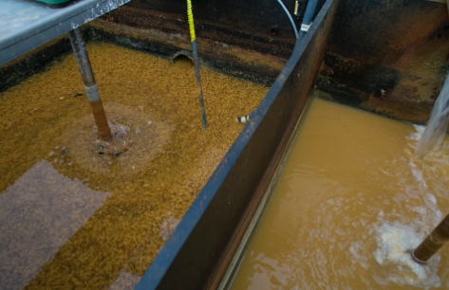
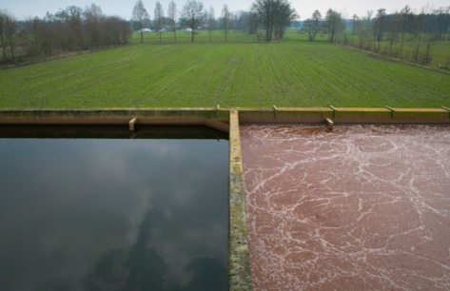
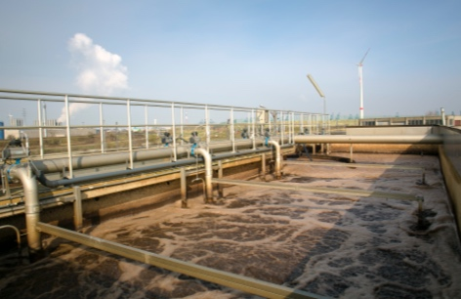
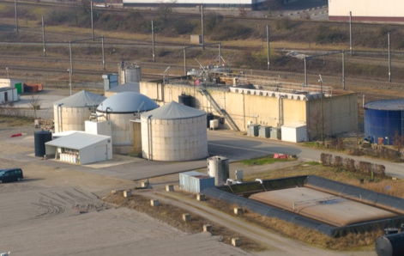
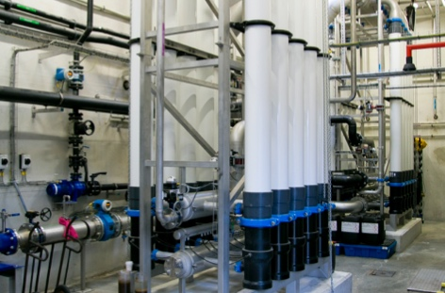
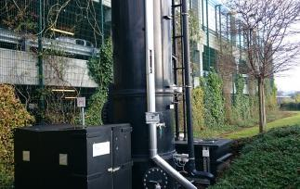
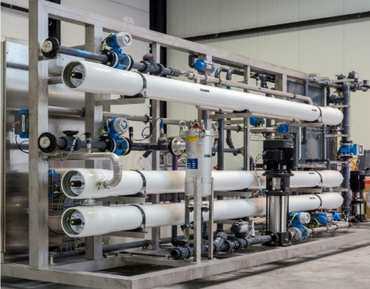
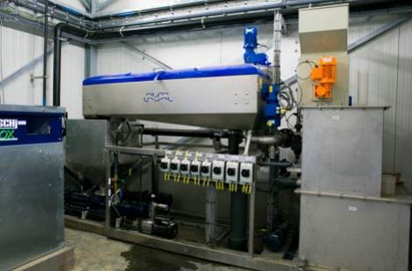
TECHNOLOGIES
PRETREATMENT
AEROBIC TREATMENT
NUTRIENT REMOVAL
ANAEROBIC TREATMENT
MEMBRANE BIOREACTOR
POST TREATMENT
WATER REUSE
SLUDGE PROCESSING

Slide 11
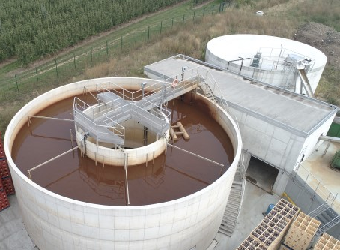
SMALL – MEDIUM BREWERIES
COMPACT GRANULAR SLUDGE AEROBIC BATCH REACTOR
Simple – cost-effective – reliable

Slide 12
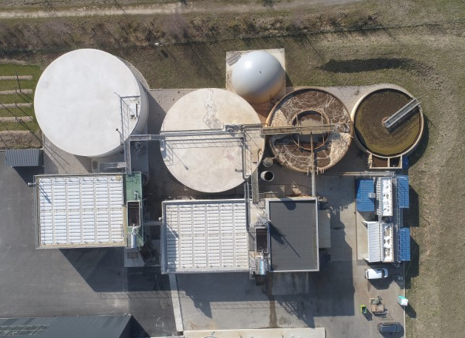
MEDIUM – LARGE BREWERIES
ANAEROBIC – AEROBIC TECHNOLOGIES
Sustainable – low sludge and energy cost – biogas valorisation

Slide 13
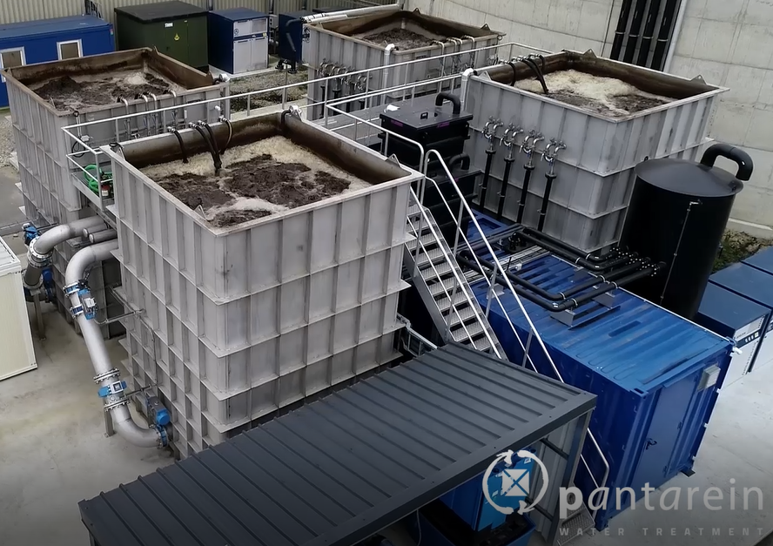
DOUBLING THE CAPACITY OF EXISTING PLANT
MEMBRANE BIOREACTOR
Pre-assembled and containerised – Compact – Excellent effluent quality

Slide 14
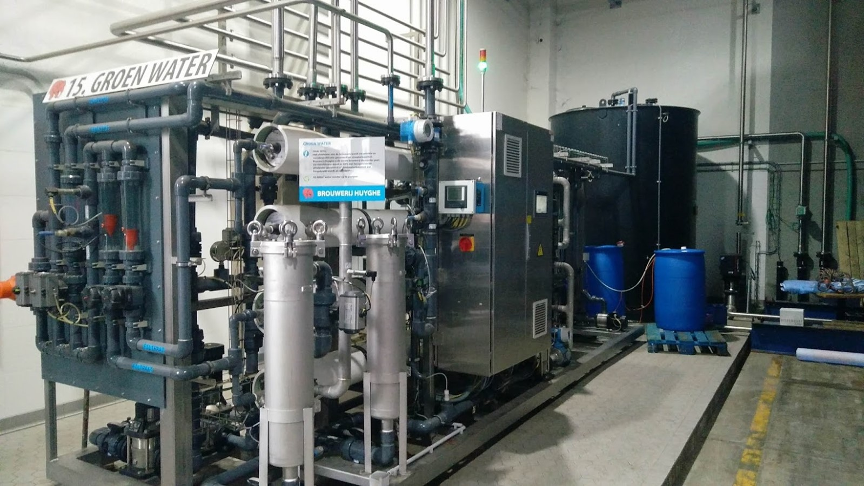
CLOSING THE WATER CYCLE
REVERSE OSMOSIS
Pre-assembled and containerised – waste water reuse

Slide 15
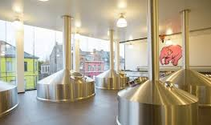
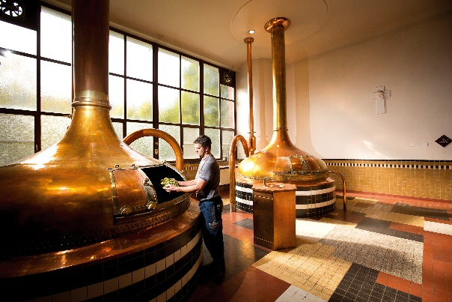
WATER MANAGEMENT IN BREWERIES
Fresh water resources becoming increasingly vulnerable
Breweries consume 4-12L_{water}/L_{beer} depending on:
  Beer production volume
  Beer type (low vs high fermentation)
  Number of different beers
  Tank volume
  Best practices
  Process water production
Optimisation water management =
  Water savings at the source
  Waste water reuse
  ➔ reduce water consumption 50-65%
Notes:
Water resources:
Climate change
Overuse
Pollution
Growing demand

Slide 16
WHY WATER REUSE?
Changing environmental conditions:
  Water scarcity
  Climate change
Sustainable development goals
Legal constraints
Financial drive
Excellent water quality

Slide 17
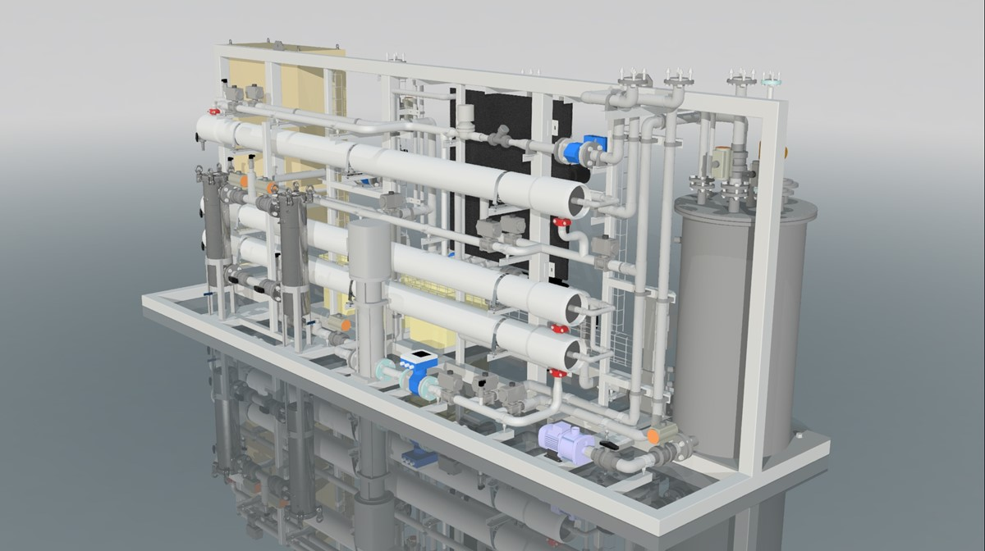
WASTEWATER REUSE IN BREWERIES
POINTS OF ATTENTION
Technology
Operation, Production & Reuse
Quality control
Legal framework
Operational cost

Slide 18
TECHNOLOGY?
Drinking water production:
  Removal of salts and COD from the effluent of the biological treatment with REVERSE OSMOSIS (RO)
RO membranes are very sensitive to SS
Choice of RO membranes based on ion balance (pilot testing?)
Buffer
CAS
SF
UF
RO
Buffer
MBR
RO

Slide 19
OPERATION, PRODUCTION & REUSE
Conditions in
the brewing process
(i.e. wastewater
composition)
Operation of the
biological treatment
Maximize water reuse:
  Fine tune wastewater production, drinking water production and water consumption in the production process
  AN RO UNIT IS NOT A STANDALONE UNIT AND ITS EFFICIENT OPERATION IS DEPENDENT ON THE PERFORMANCE OF THE ENTIRE INSTALLATION
Affect the operation of the RO unit
  Important to fine tune
  the operation of the bioreactor
  prevention of fouling
  conditioning of RO feed
  the RO CIP products and frequency

Slide 20
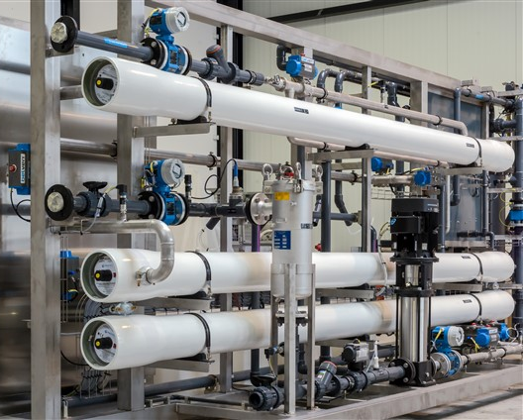
QUALITY CONTROL
Monitoring of membrane fouling:
  Flow and pressure measurements
Monitoring of permeate:
  Conductivity measurement
Monitoring of desinfection:
  Online measurement of active chlorine

Slide 21
LEGAL FRAMEWORK
Legal framework water reuse:
  Confirm possible reuse application within production environment with FASFC (Belgium)
  Legal framework: demands concerning quality, monitoring, risk analysis, …
  Practical and administrative affairs
Legal framework: discharge of concentrate
  Load principle
  Effect of ‘salt discharge’ on receiving medium (sewer or surface water) needs to be examined → impact study
  Which discharge limits are to be used
  Directive 2000/60/EC (Framework for community action in the field of water policy)
Notes:
Federal Agency for the Safety of the Food Chain

Slide 22
Operational costs
Chemicals:
  Antiscalant (conditioning of feed)
  Cleaning (acid & caustic cleaning, biocide)
  Desinfection (also on fresh water)
Energy
Maintenance & Membrane replacement
Follow up
Savings (lowered fresh water intake, chemicals for conditioning (e.g. brine), lowered discharge, …)
OPEX dependent on fresh water source, conditioning of fresh water, type of wastewater, reuse amount, design of RO unit, …
Reduction of consumption through
technological advancements

Slide 23
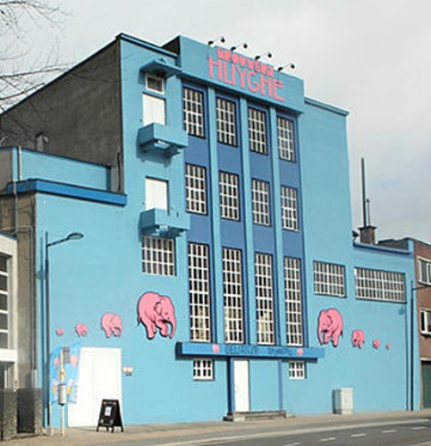
BREWERY HUYGHE
KEY VALUES
Quality
Respect for family traditions and future generations
Sustainability
Flexibility (export)
Innovation

Slide 24
INSTALLATION
Buffer
UASB
Bioreactor
MBR
RO
Water reuse
WHY WATER REUSE?
Improved sustainability
Prepare the brewery for the next generation(s)
Reduction of costs in the long run

Slide 25
IMPACT OF WATER REUSE
Water reuse applications:
  Reuse water is used throughout the entire brewery but not as ingredient for beer:
  Cleaning of floors
  Suppletion water for steam boiler
  Replenishing of caustic baths
  Final rinsing water for bottling and keg lines
  CIP
  …

Slide 26
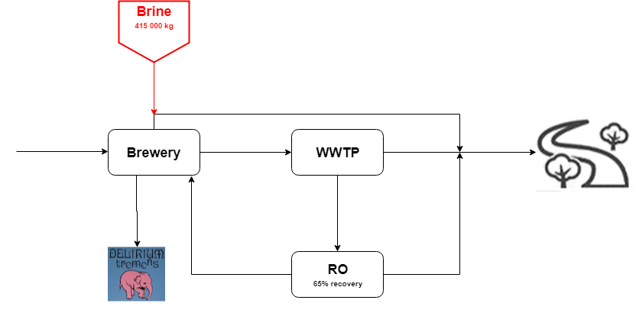
IMPACT OF WATER REUSE
2018: 200 000 hl – No water reuse
Fresh water intake 88 700 m³/y
Brine consumption 415 000 kg/y
Water reuse 0 m³/y – 0 %
Fresh water consumption 4,4 l/l

Slide 27

IMPACT OF WATER REUSE
2018: 200 000 hl – Actual water reuse
Fresh water intake 75 700 m³/y
Brine consumption 354 000 kg/y
Water reuse 13 000 m³/y – 20%
Fresh water consumption 3,8 l/l

Slide 28

IMPACT OF WATER REUSE
2018: 200 000 hl – Max water reuse
Fresh water intake 63 000 m³/y
Brine consumption 295 000 kg/y
Water reuse 24 700 m³/y – 40%
Fresh water consumption 3,2 l/l

Slide 29

IMPACT OF WATER REUSE
Future: 270 000 hl – Max water reuse (2 RO units)
Fresh water intake 54 300 m³/y
Brine consumption 254 000 kg/y
Water reuse 69 000 m³/y – 75%
Fresh water consumption 2,0 l/l

Slide 30
IMPACT OF WATER REUSE
Specific water consumption
Bottle washer
Tunnelpasteur &
Cooling tower
Rincer
Automatic CIP’s
Water reuse

Slide 31
IMPACT OF WATER REUSE
Operational cost (Max water reuse: 24 700 m³/y)
Not included in operational cost:
  Green image
  Despite the growth of the brewery, the impact on the receiving surface water remains unaffected. Easier permitting process.
  Expansion of production capacity is no longer relying on the ground water permit.
  Savings on taxes for discharge of water and ground water abstraction
Monitoring
Membrane
replacement
Chemicals
Maintenance
Energy
Including savings on de-ironing and brine total cost amounts to 0,63 €/m³

Slide 32
WATER QUALITY MONITORING
Annual analyses:
  Reuse water is subjected to the same analyses (parameters and frequency)
Weekly measurements of chlorine dioxide and microbiological parameters
Measurements by FASFC in 2018 revealed no problems

Slide 33
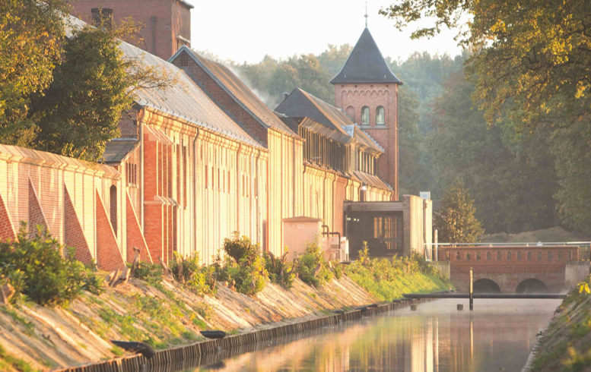
BREWERY WESTMALLE
KEY VALUES
The vision of the monks
Small scale approach with long term vision
Focus on the quality of the product and sustainability
Profits are used to invest in the brewery, livelihood of the monks and charitable projects

Slide 34
INSTALLATION
Buffer
Bioreactor
MBR
RO
Water reuse
WHY WATER REUSE?
Reduction of the use of ground water
Reducing the water consumption to below 6 l/l
More sustainable production process

Slide 35
IMPACT OF WATER REUSE
Water reuse applications:
  The water is not used as brew water or for the final rinsing step (tanks, piping, bottles)
  Reuse water is transported via a separate system to approved consumers:
  Sanitary system
  Lubrication of lines
  External cleaning
  Suppletion water for steam boiler
  Replenishing of caustic baths
  Rinsing of sand filters
  …

Slide 36
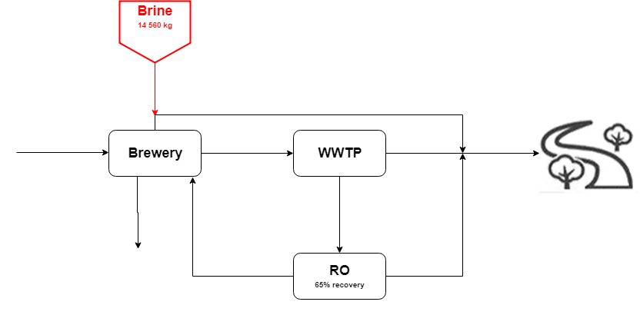

IMPACT OF WATER REUSE
2016: 131 600 hl/y – No water reuse
Fresh water intake 108 420 m³/y
Brine consumption 14 560 kg/y
Water reuse 0 m³/y – 0%
Fresh water consumption 8,2 l/l

Slide 37
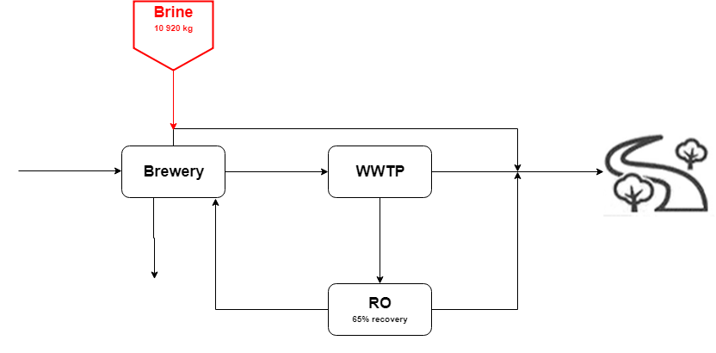
IMPACT OF WATER REUSE
2018: 134 500 hl/y – Water reuse
Fresh water intake 81 420 m³/y
Brine consumption 10 920 kg/y
Water reuse 16 700 m³/y – 20%
Fresh water consumption 6,1 l/l

Slide 38
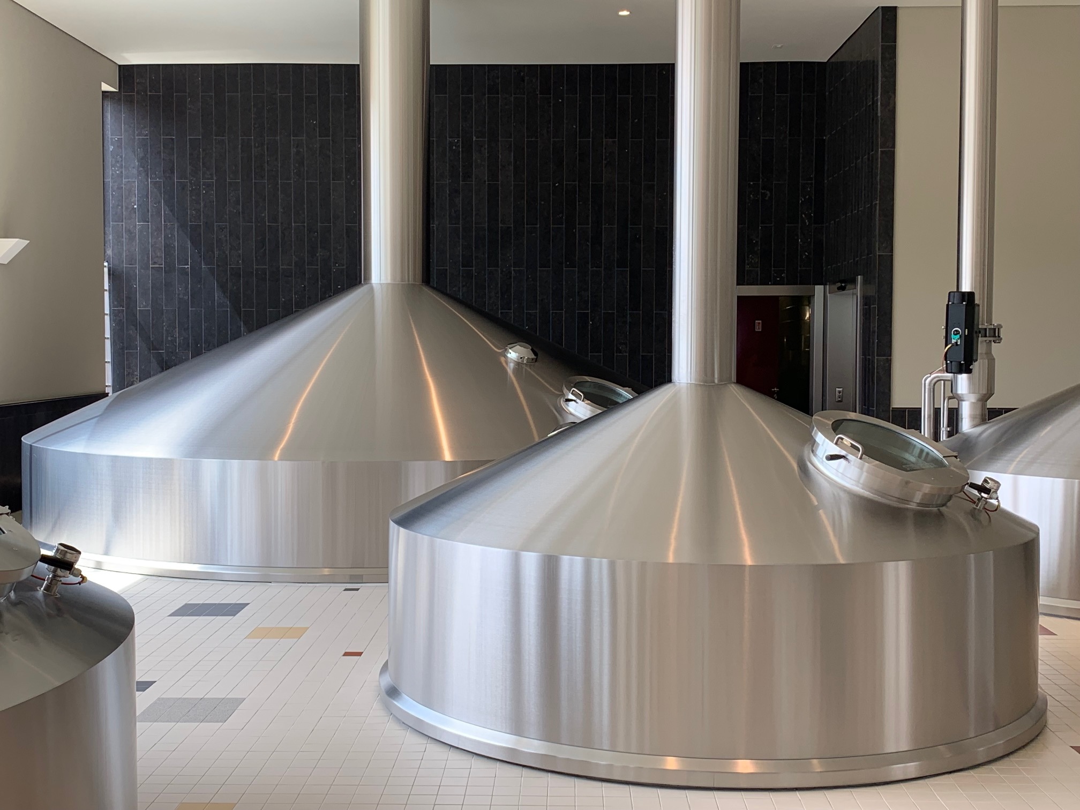
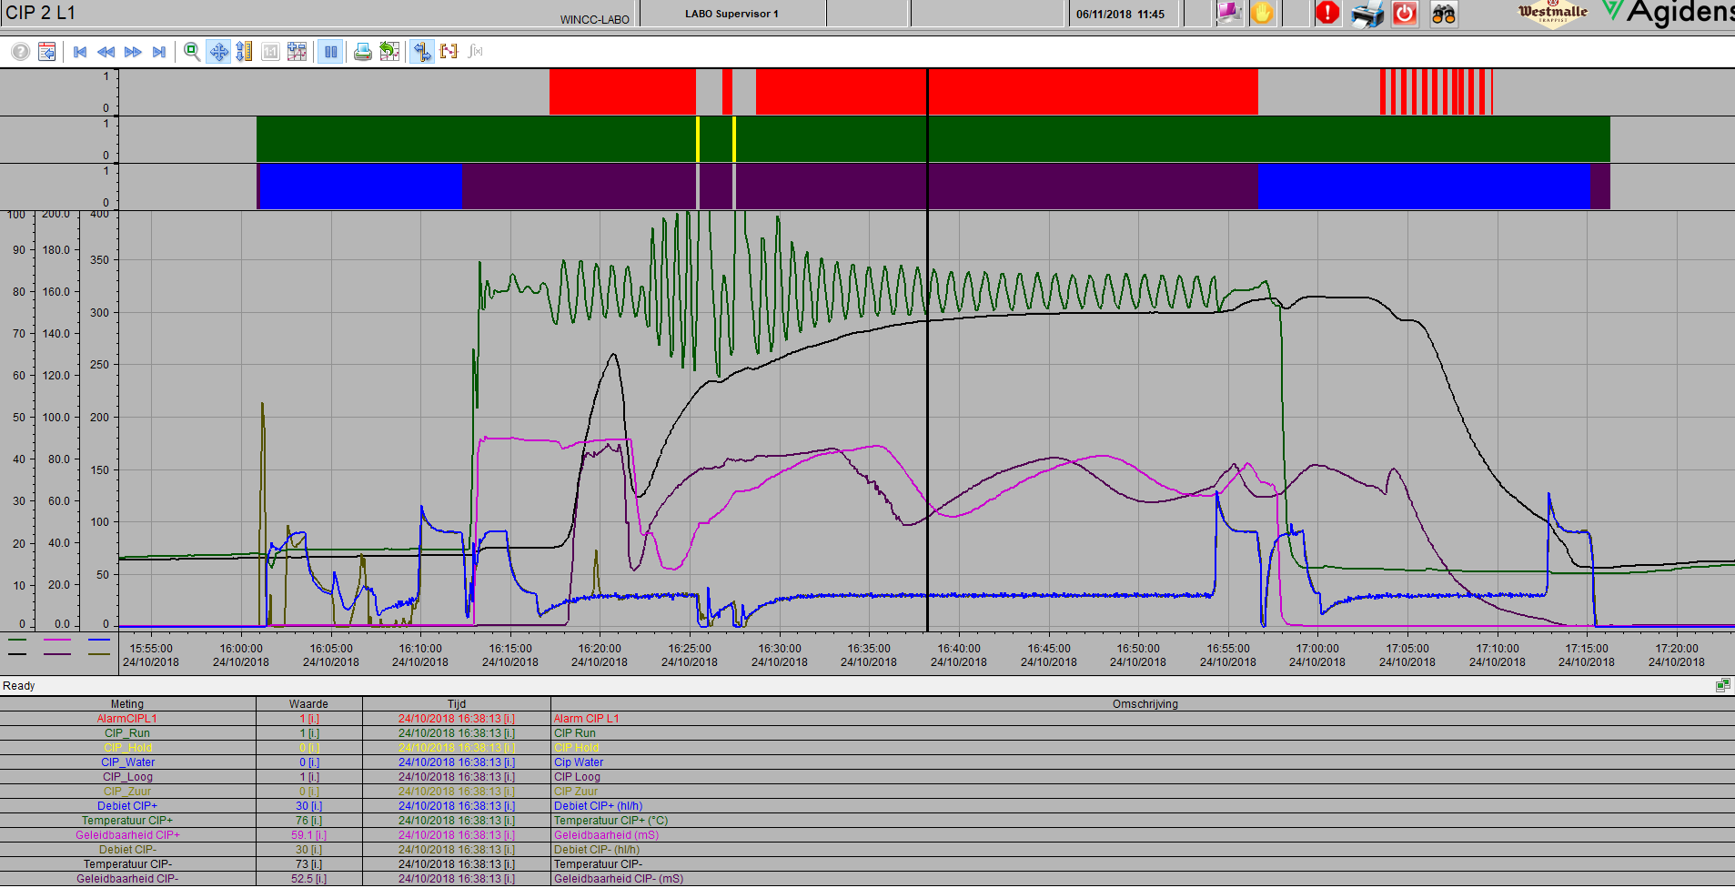
IMPACT OF WATER REUSE
Specific water consumption
Implementation of RO water reuse
Star-up of new installation
CIP optimisation

Slide 39
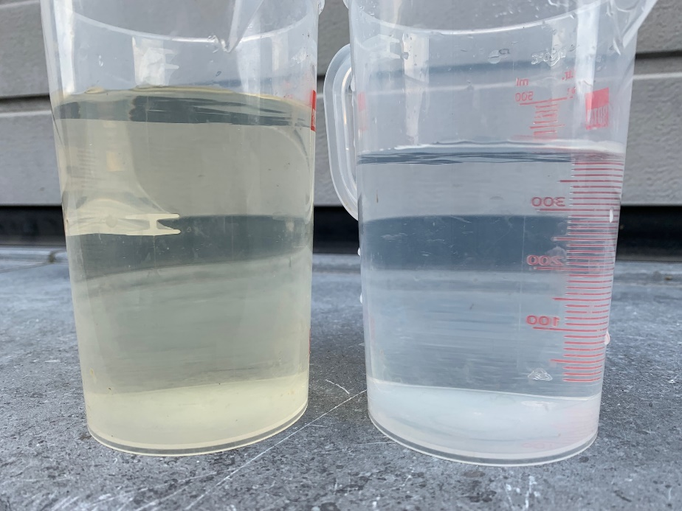
IMPACT OF WATER REUSE
Operational cost
Chemicals
Monitoring
Energy
Membrane
replacement
Maintenance
Permeate MBR
Permeate RO
Including savings on brine total cost amounts to 0,29 €/m³

Slide 40
GENERAL CONCLUSION
Stable process
Excellent water quality
Increased water robustness
Continuous improvement of OPEX
  CIP procedure
  Ultrasonic waves for reduction of chemicals consumption

Slide 41
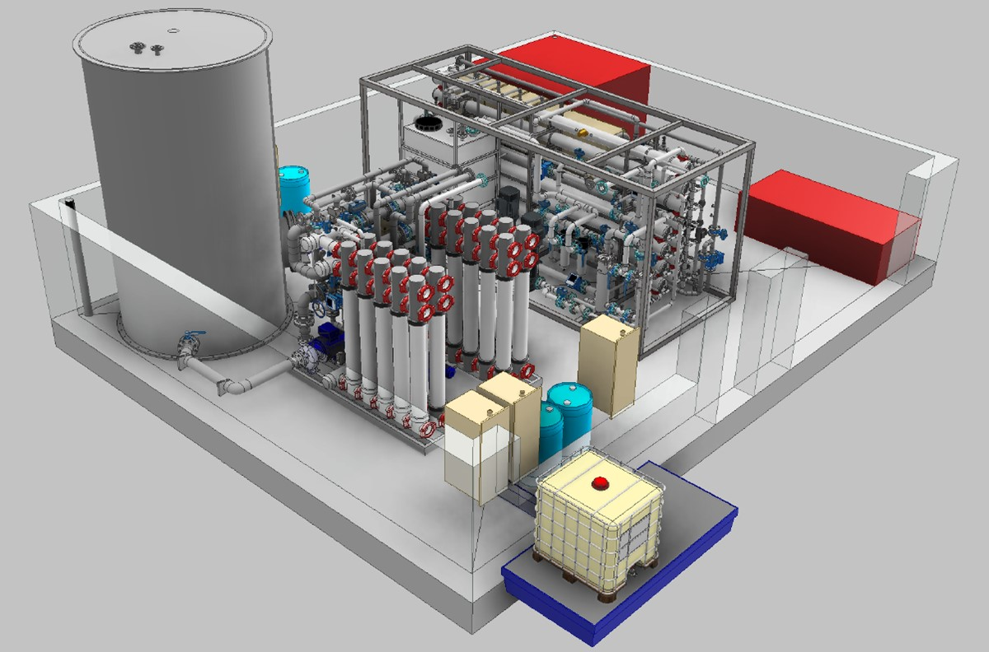
THANK YOU FOR YOUR ATTENTION
QUESTIONS?
Currently under construction
Water reuse project at Brewery Duvel Moortgat
UF-RO installation
30 m³/h water reuse
Pantarein Water
piet.delanghe@pantarein.be

