Slide 1
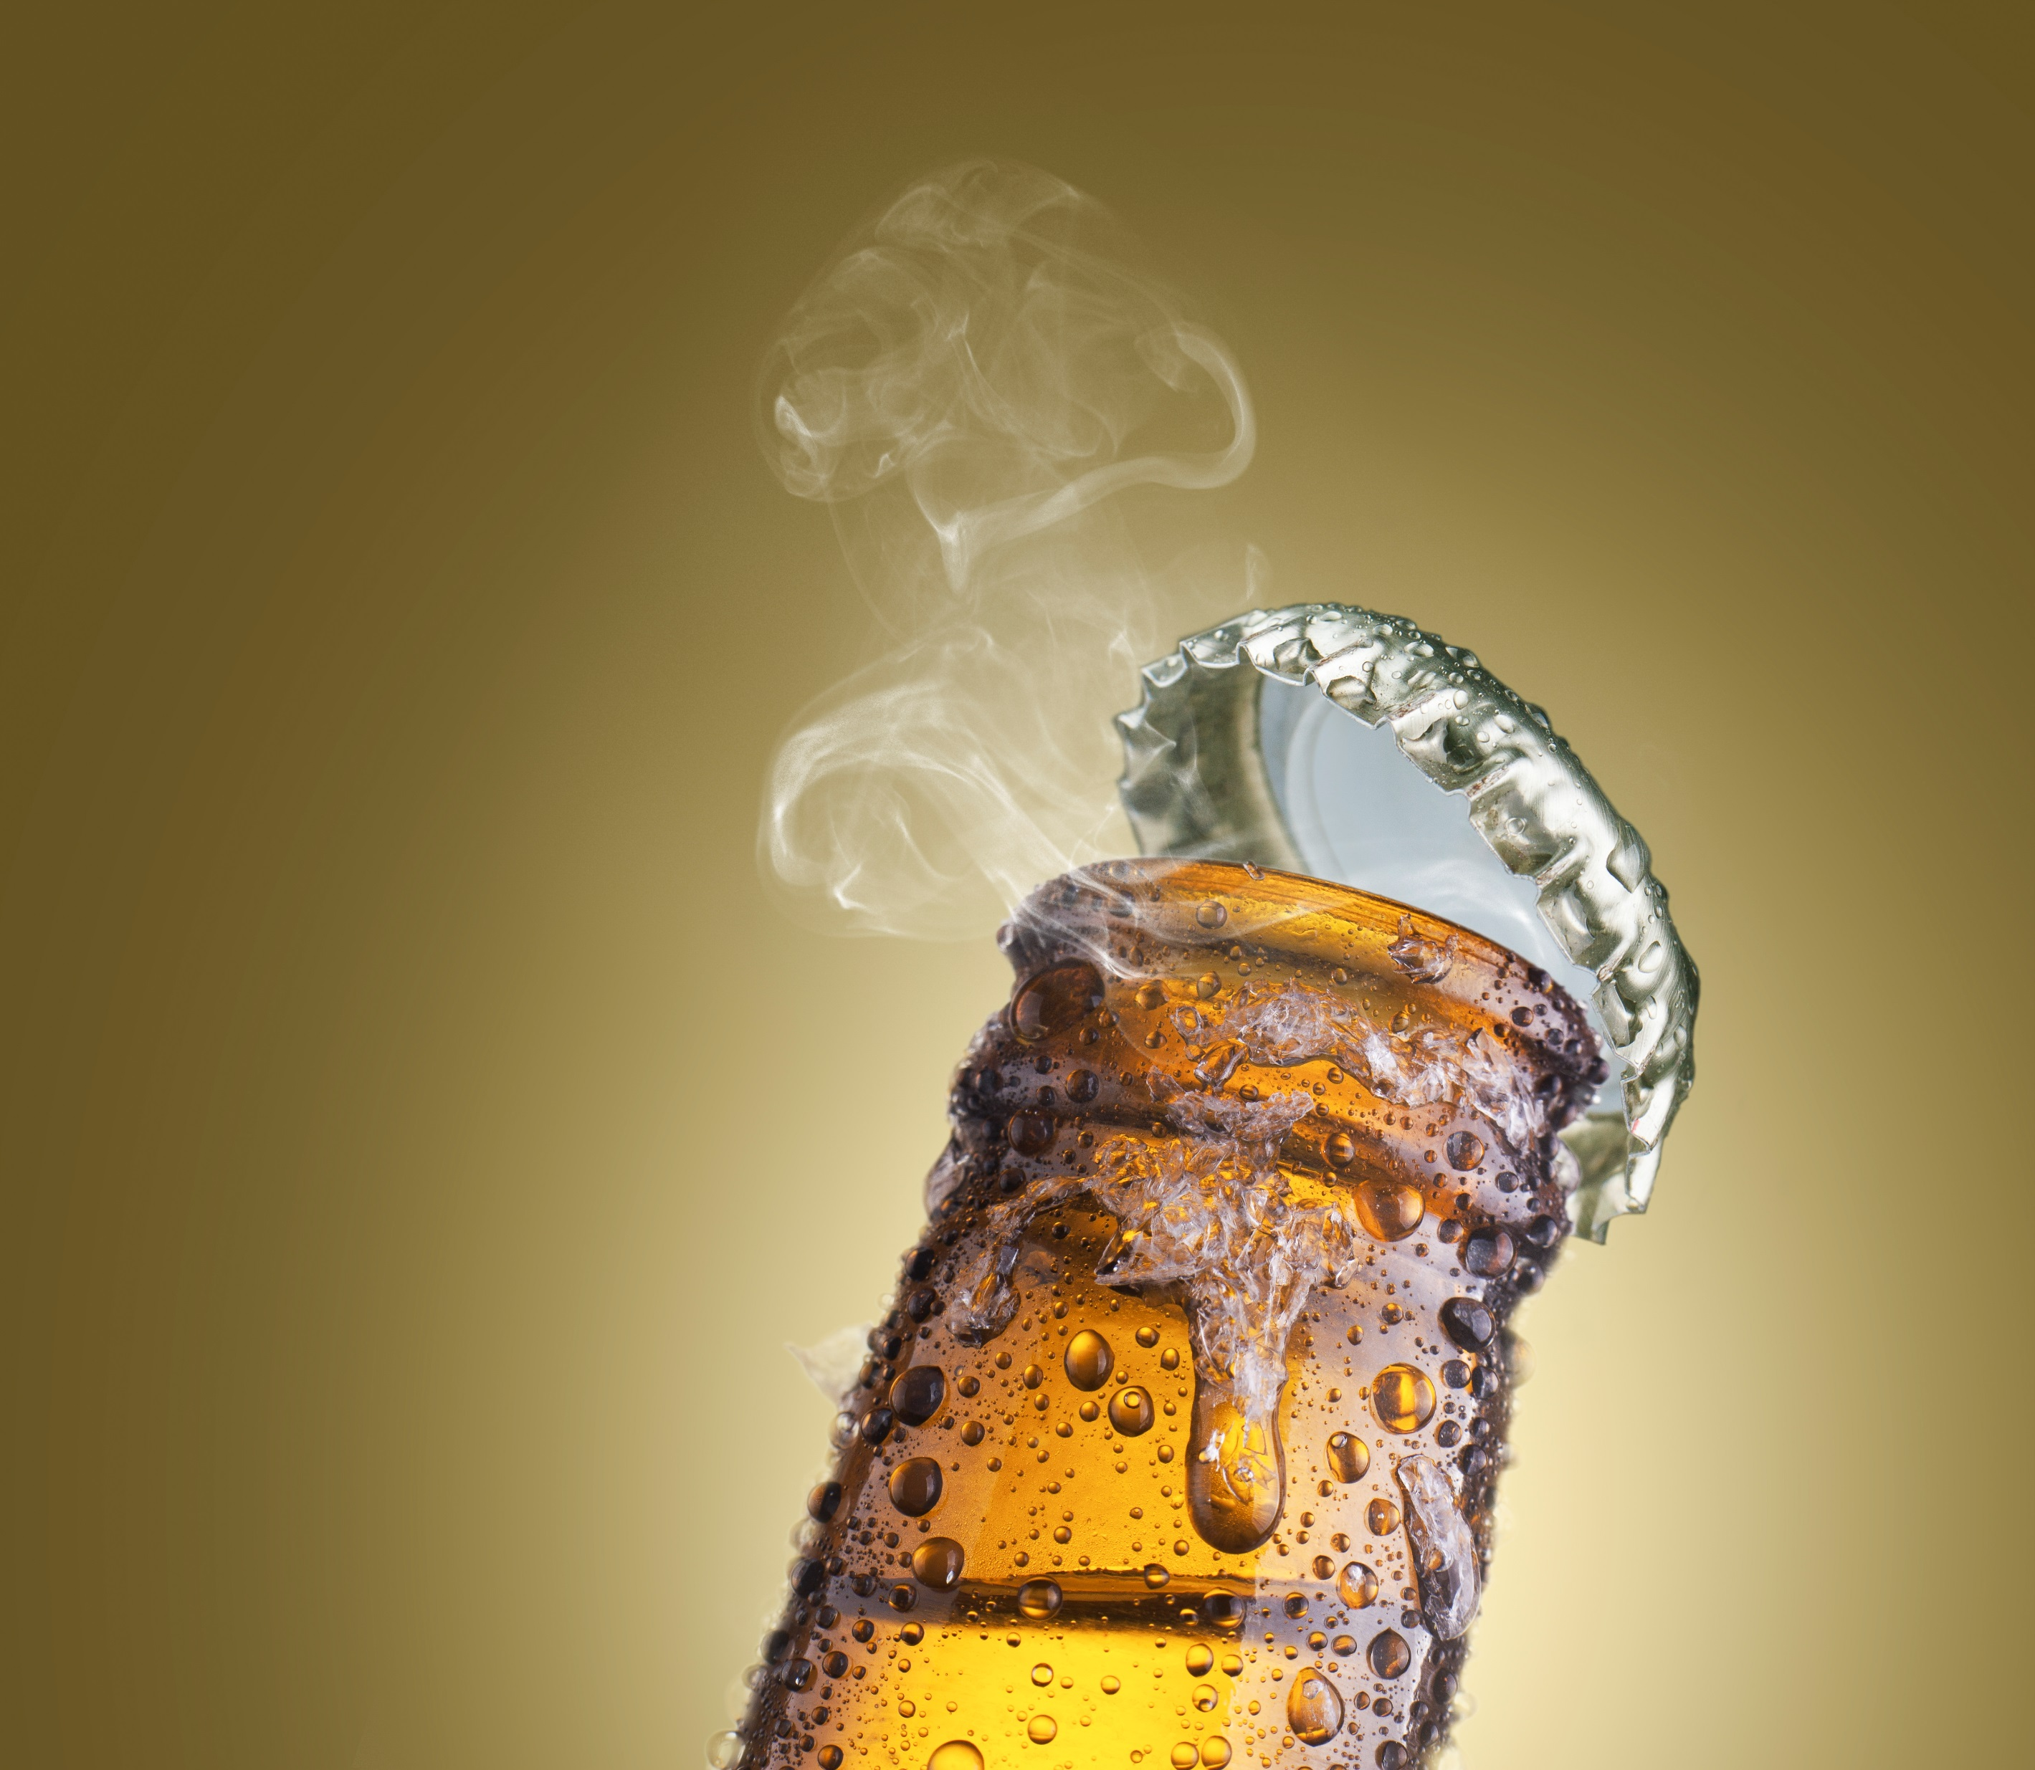
Notes:
The primary role of packaging is to bring:
the product on the table of consumers as it has been originally conceived and produced.
- not only to preserve, but also to enhance the quality and characteristics of the product (think about drinks like beer (but also wine, champaign, food!) that need to complete their fermentation process into the packaging)
- enhance consumer experience.

Slide 2
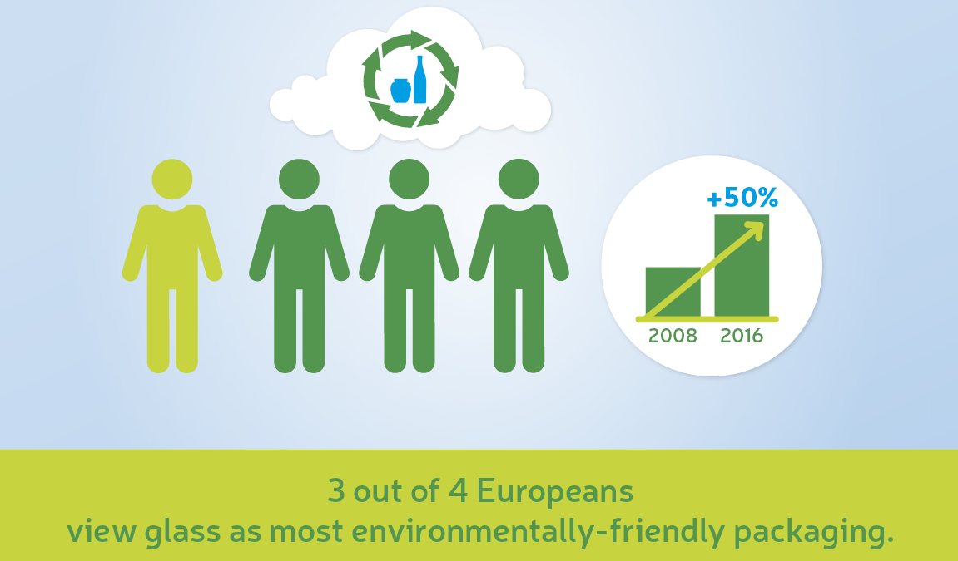
Notes:
According to a 2018 survey carried out by the Friends of Glass community, three out of four Europeans rate glass as the most ocean-friendly packaging choice. 72%now consider their impact on the ocean as a lifestyle priority, starting with the products they buy and how they are packaged.
Since the release of BBC’s Blue Planet II in 2017, concern over the state of our oceans has exponentially grown, and public attention has increasingly focused on the need to make more sustainable choices in everyday life. Reassuringly, 78% of Europeans have reported a change in their behaviour and are now paying more attention to the environmental impact of their everyday decisions. A further 78% of Europeans would rate glass among their top choices for food and drink packaging.

Slide 3
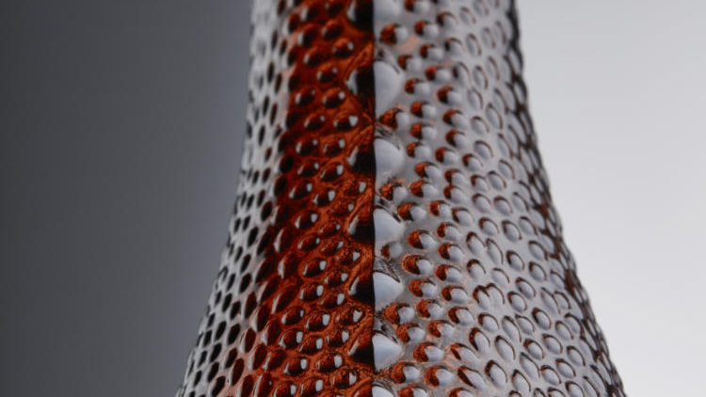
Notes:
Innovation of the packaging solution, innovation of the production technology

Slide 4

DOLIUM
ONE-WAY KEG
THERE IS ONLY ONE WAY
A presentation by Matt Panucci (CEO)

Slide 5
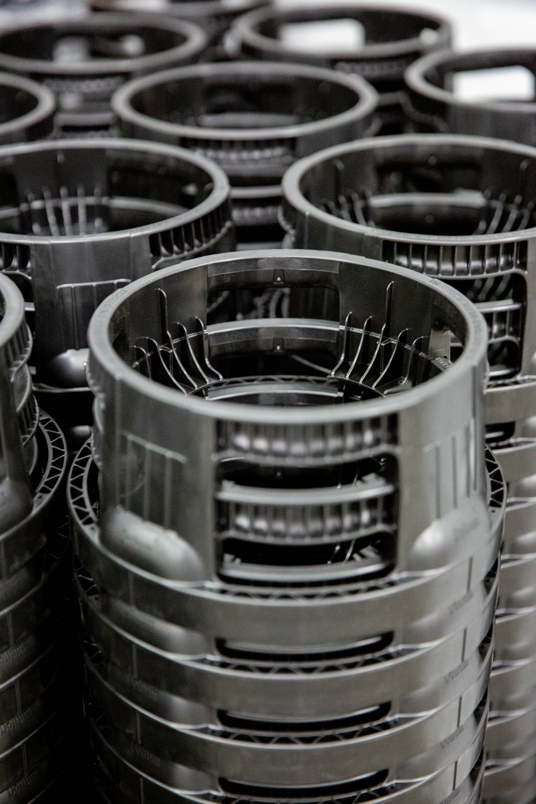
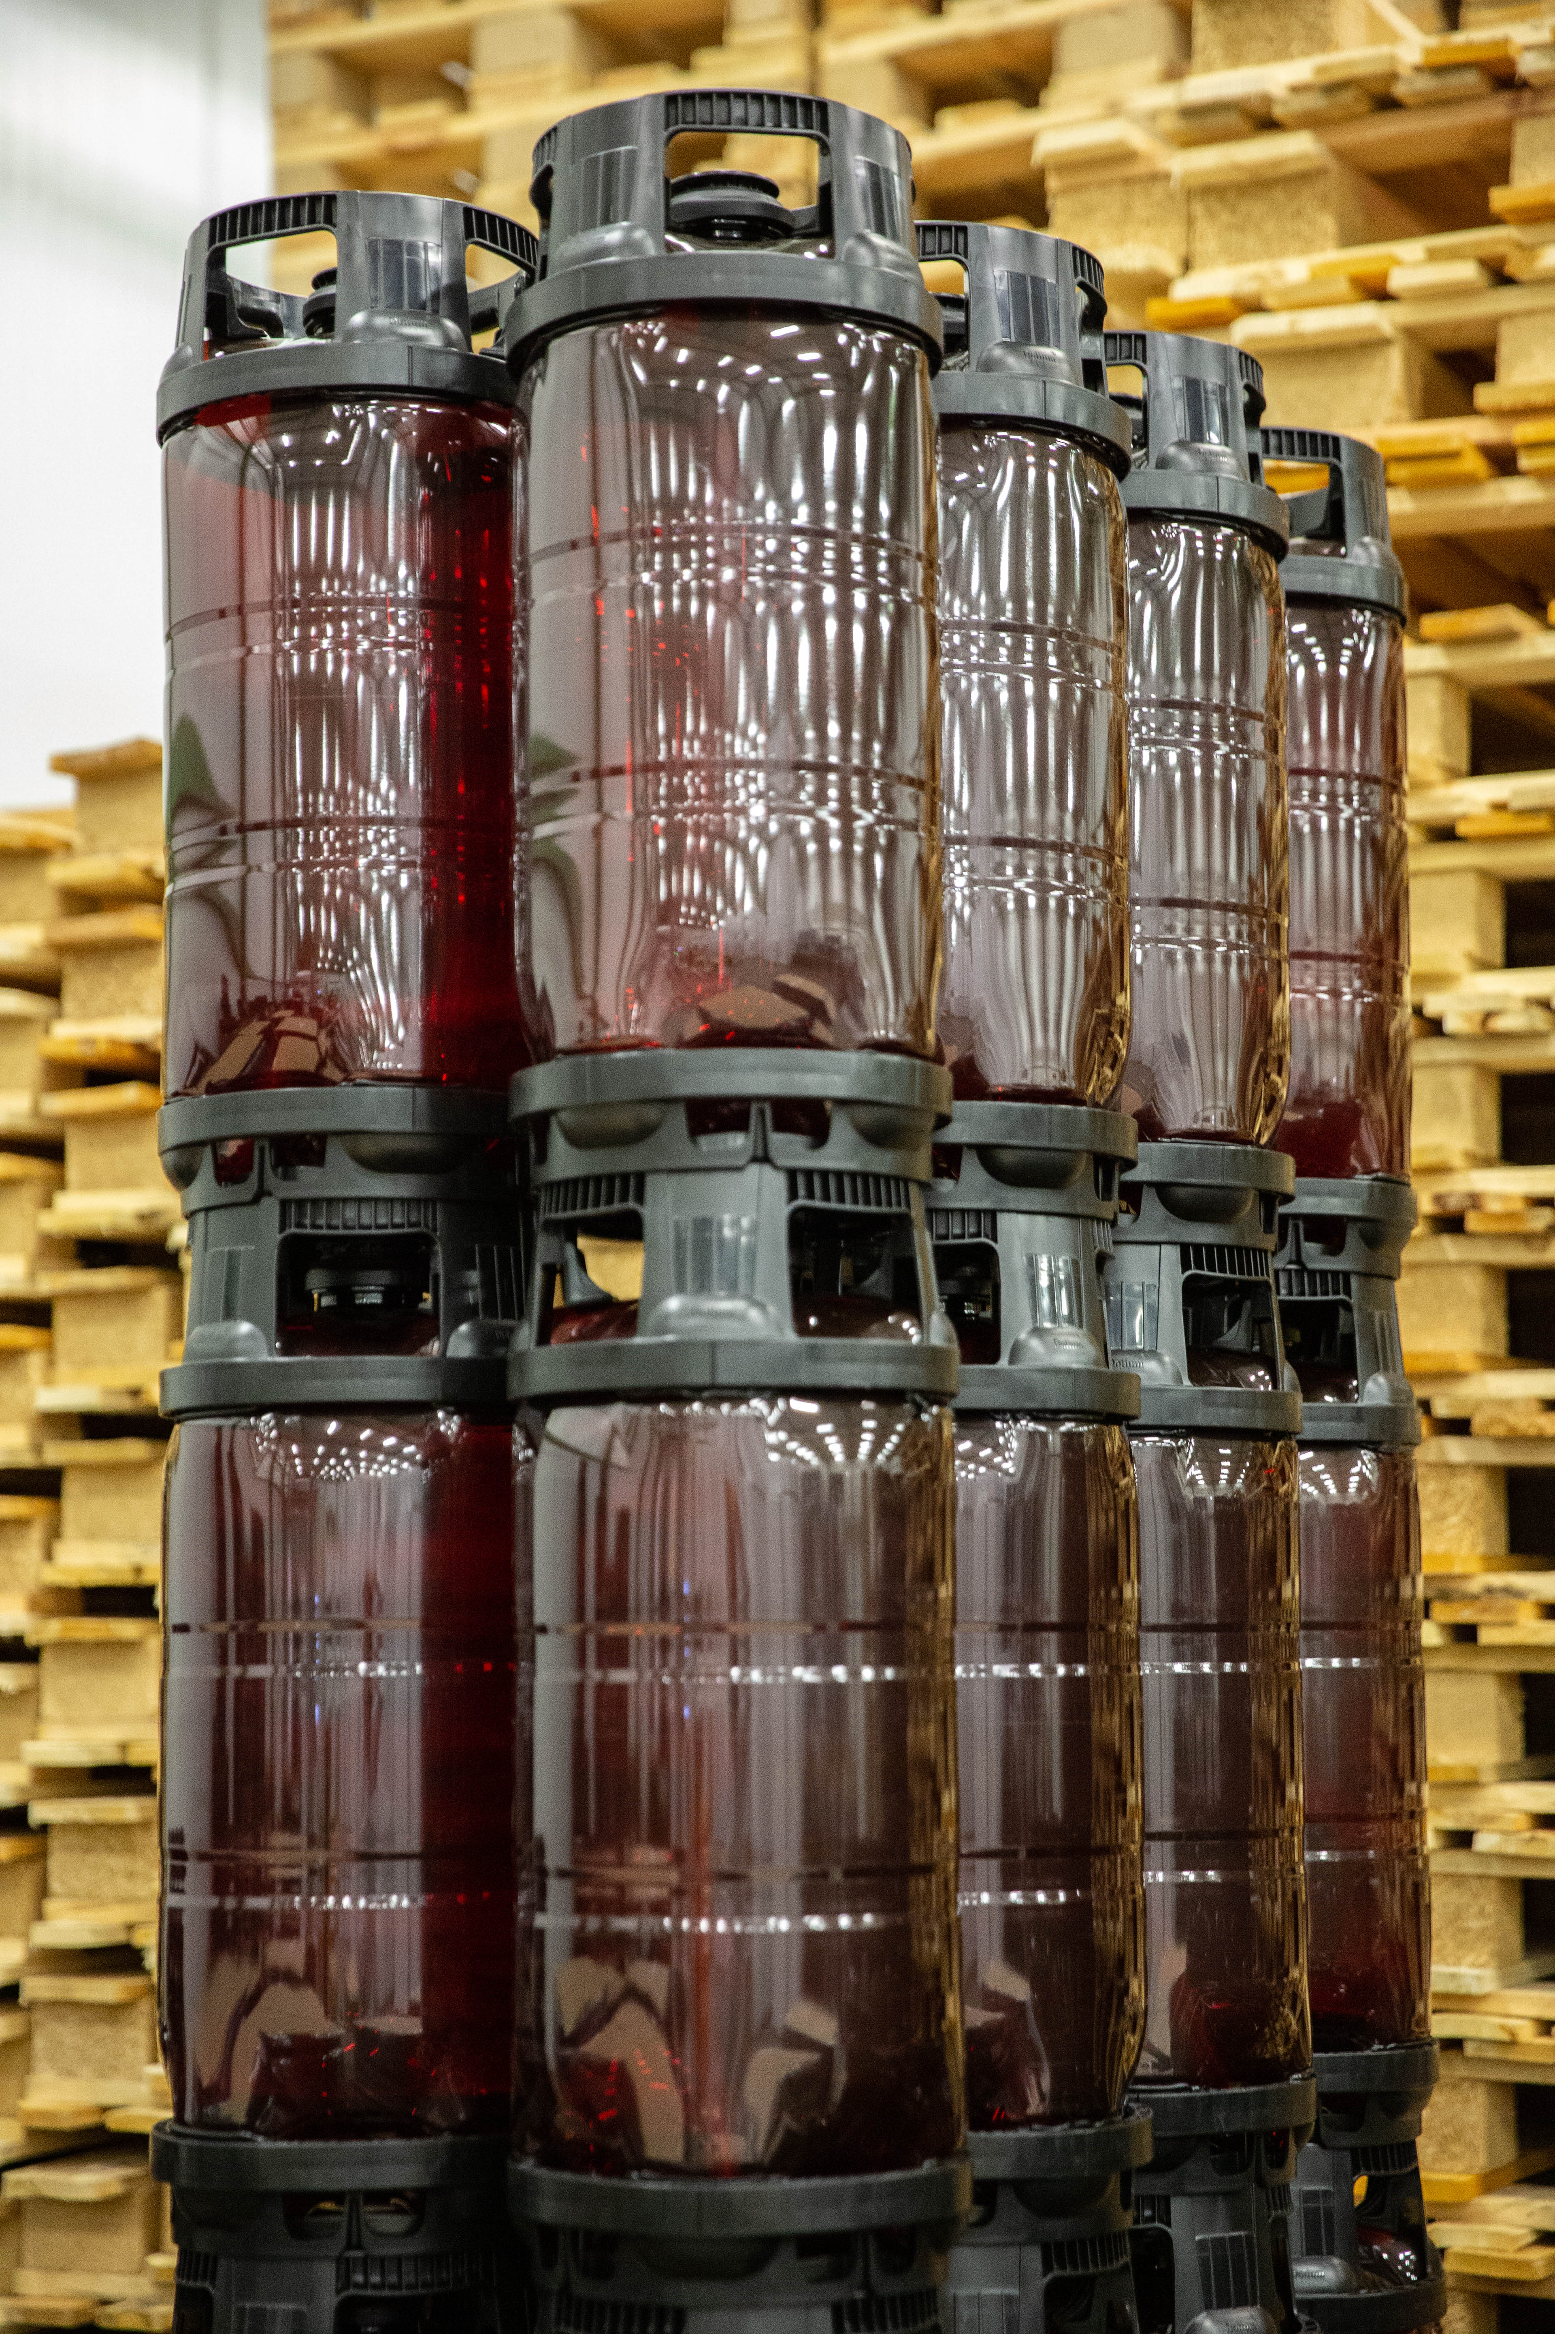
Who We Are:
Antwerp-based since 2013
  Disruptive actor in the c800-millon (fills annually) stainless steel keg market
    Offer the most innovative One-Way Keg solution on the market
      Complement → full replacement of stainless steel
        Innovation partners

Slide 6
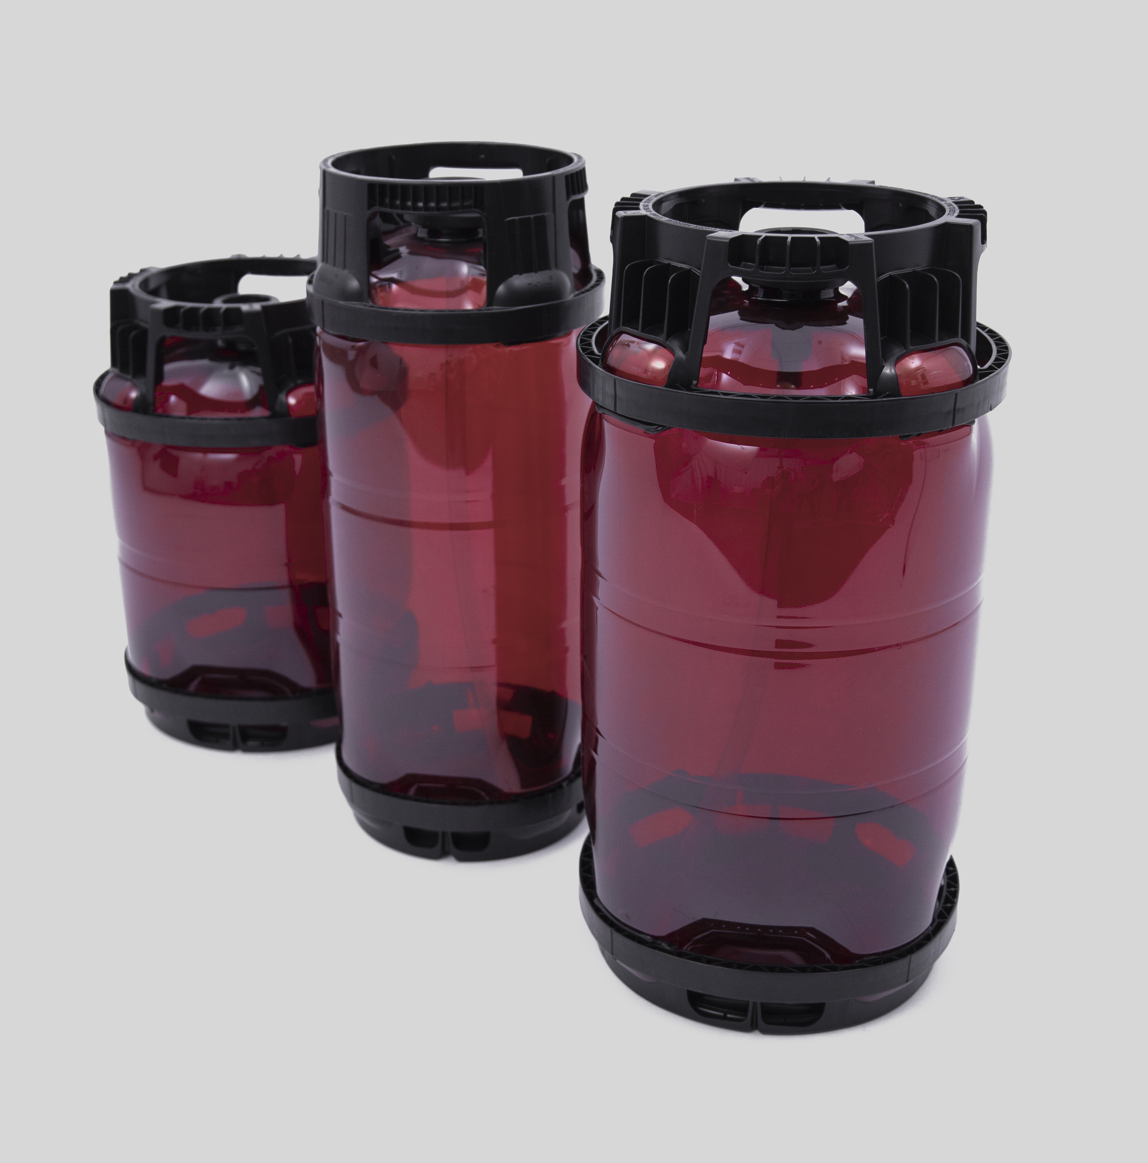
What Problems Are We Solving?
Sustain-ability:
LCA validated, fact-based, transparent
Financial Benefits:
Substantial savings in Capex & Opex
Operational
Efficiency:
Seamless integration into supply chain
Customer
Experience
“Power of Draught”
A very small target with huge potential benefits for clients

Slide 7





Sustainability: Our Position
Plastics: Facts - EU
DOLIUM LCA
Critical Variables
Synthesis
Our Roadmap
Jobs: 1.5m
Companies: 60k; many SMEs
Finances: €32.5-billion in contribution in 2017
Recycling: 8.4m tonnes collected for recycling
Flemmish Institute for Technological Research (VITO)
Cradle to grave vs. Stainless steel
18 environmental impact categories assessed
Shipping distance
Rotations
End of Life (recycled or not recycled)
Best case : 1x, 0 miles; recycled DOLIUM > SS in 18 of 18 impact categories
Worst case: 3x, 0 miles; not recycled DOLIUM > SS in 11 of 18 impact categories
Recyclibility: 100% from day 1
Recycled Content: target to exceed 25% by 2025
Re-collaction: Pilots launcing in France (2) and NL this summer

Slide 8
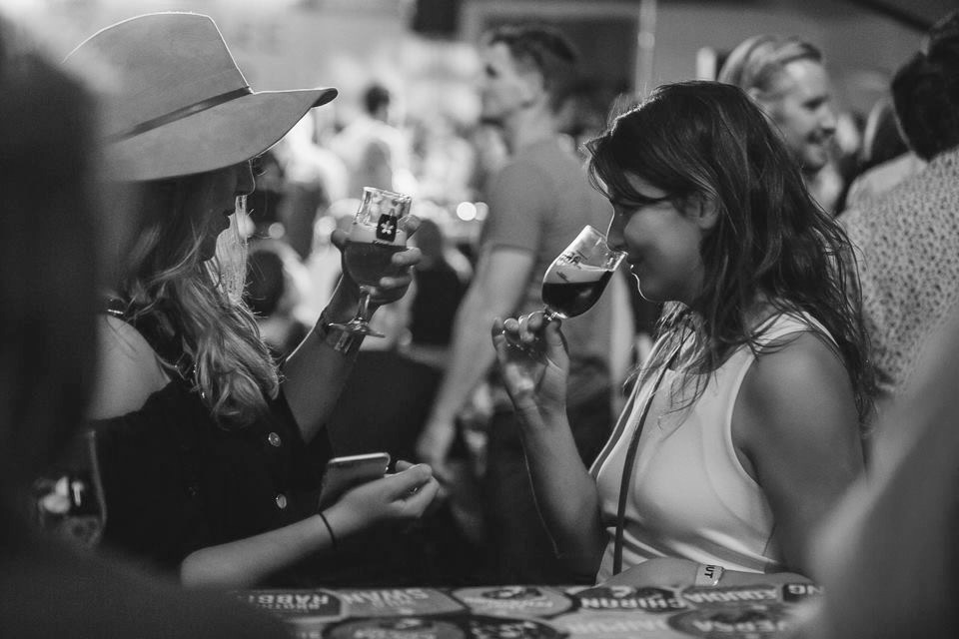
smart kegs + great beers = happy drinkers!

Slide 9
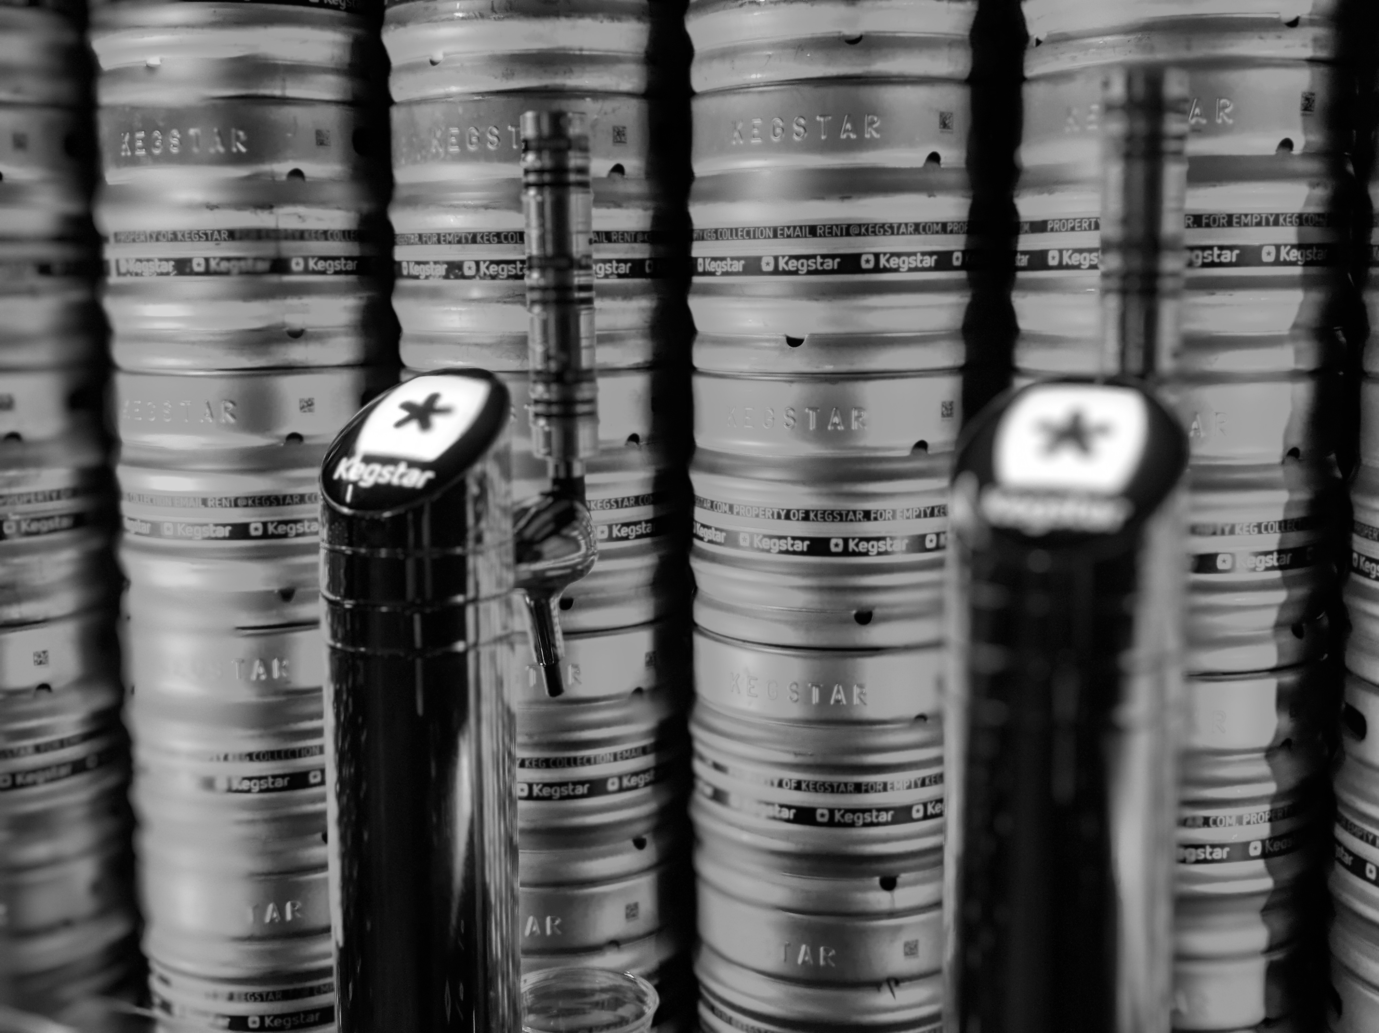
we own the kegs
…collect
…repair
…clean
…track so you can brew bigger!

Slide 10
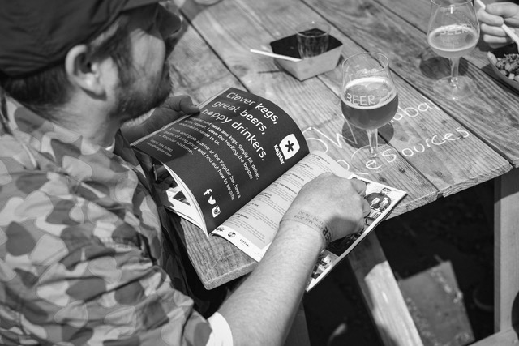

we provide the software so you can
...order
…scan
…track
…analyse so you can grow faster!

